Slide 1

Cervical Cancer Risk Factors for Biopsy
Estela Perez, Angie Bolden, Ramiro Cervantes, Paola Moreno

Slide 2

Cervical Cancer
The cervix is in the uterus
Most common detected through HPV and PAP smear test.

Slide 3
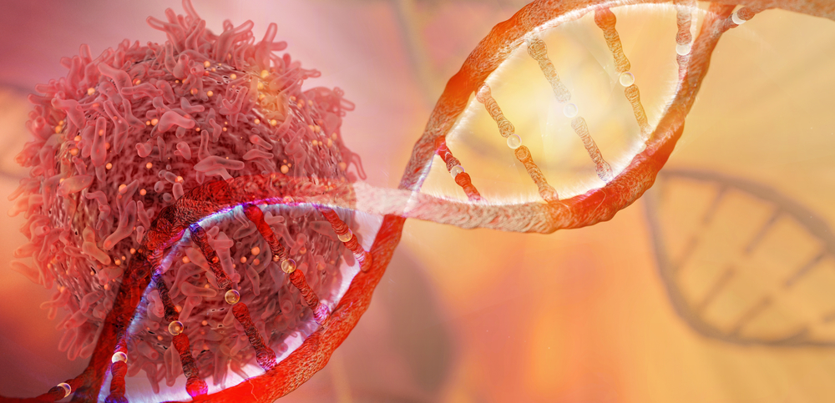
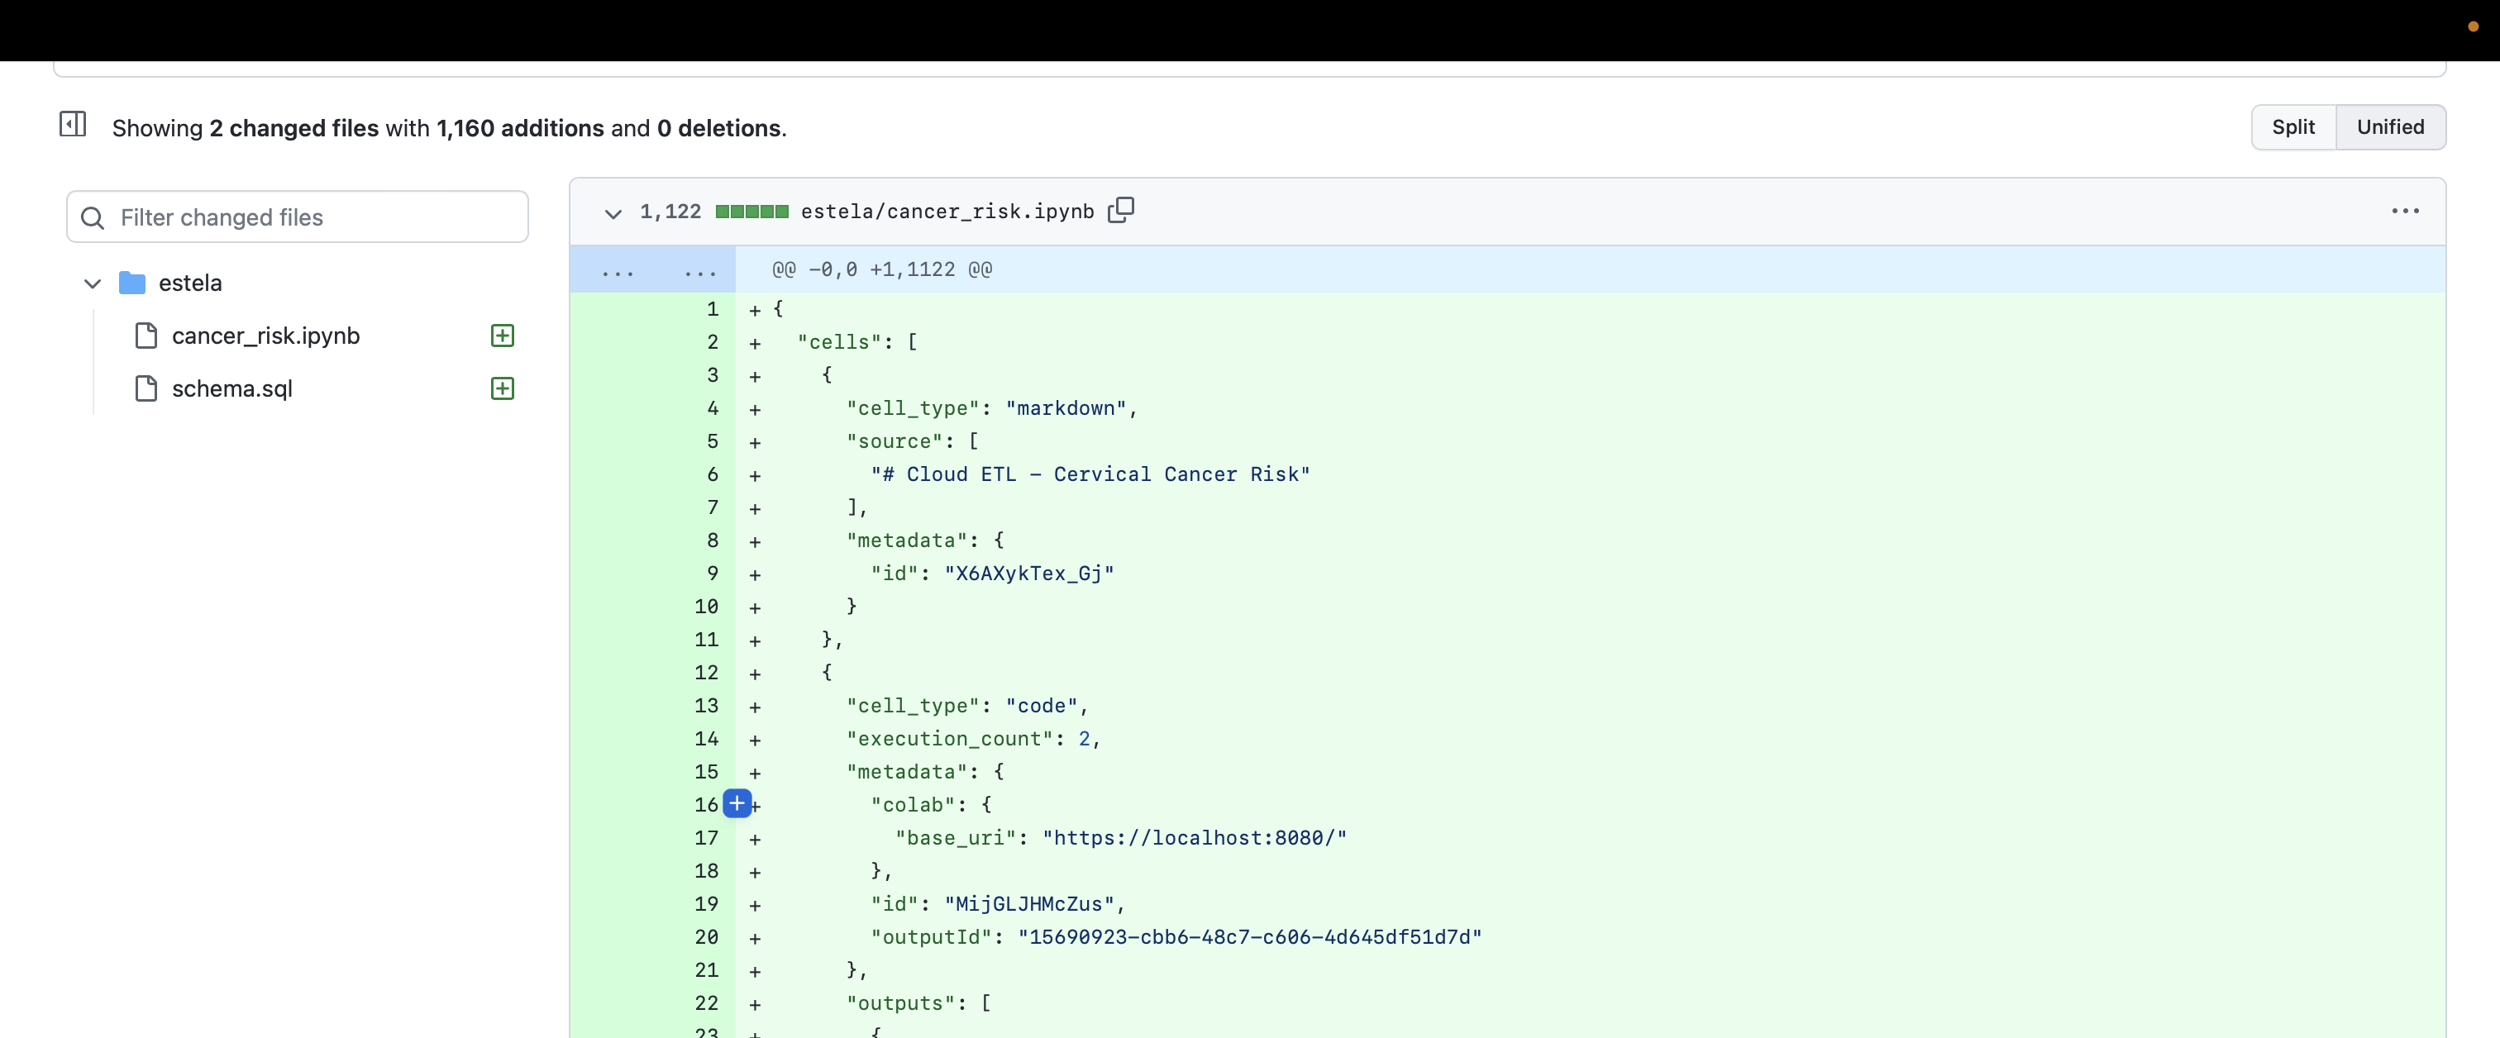
Back End

Slide 4
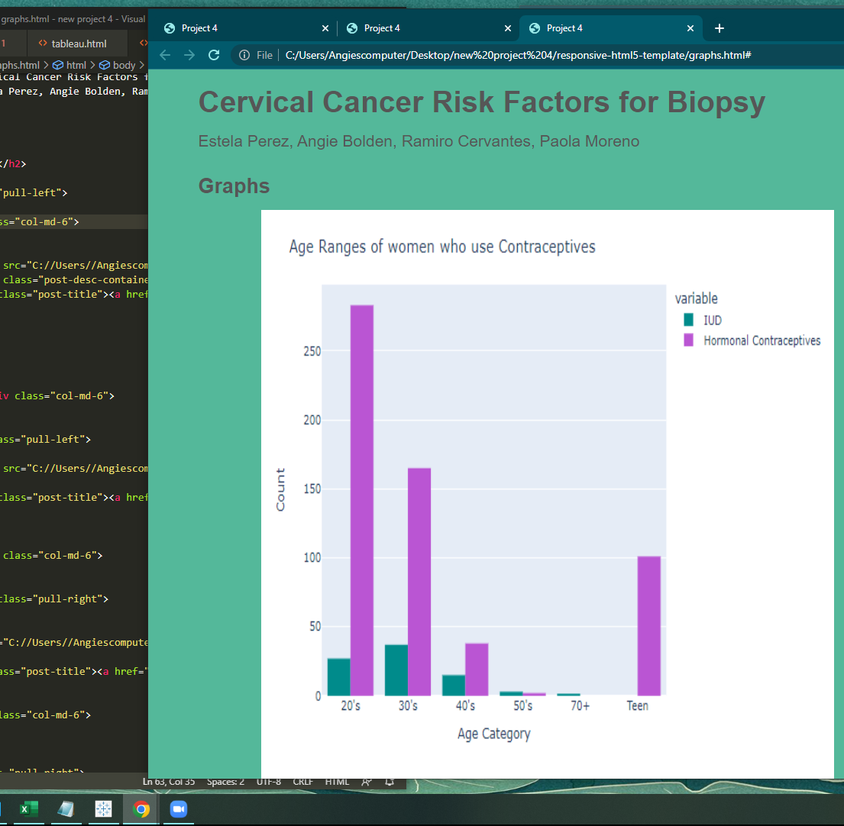
Front end walk through
www.google.com

Slide 5

Conclusion

Slide 6


Cervical Cancer Fighter/Survivors
We would like to honor anyone them for fighting the good fight against cervical cancer
Patients
Doctors
Nurses
Supportive Family Members
Along with with survivors

Slide 7

Limitations
Data Source
Clean up
Missing data
Spark
AWS
Serious topic
Images

Slide 8

Questions/Concerns
For health concerns please contact your local health care provider

