Slide 1

Cervical Cancer Risk Factors for Biopsy
Estela Perez, Angie Bolden, Ramiro Cervantes, Paola Moreno

Slide 2

Cervical Cancer
The cervix is in the uterus
Most common detected through HPV and PAP smear test.

Slide 3
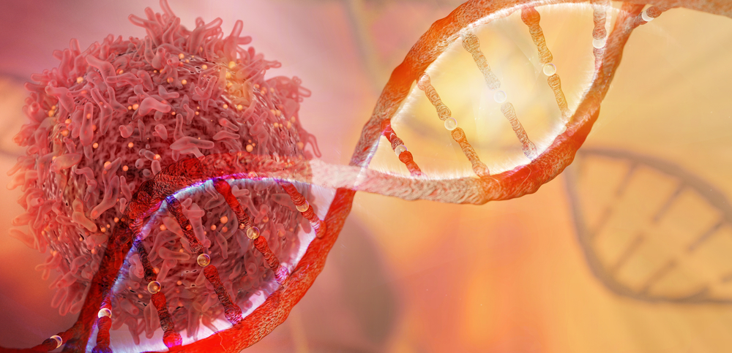
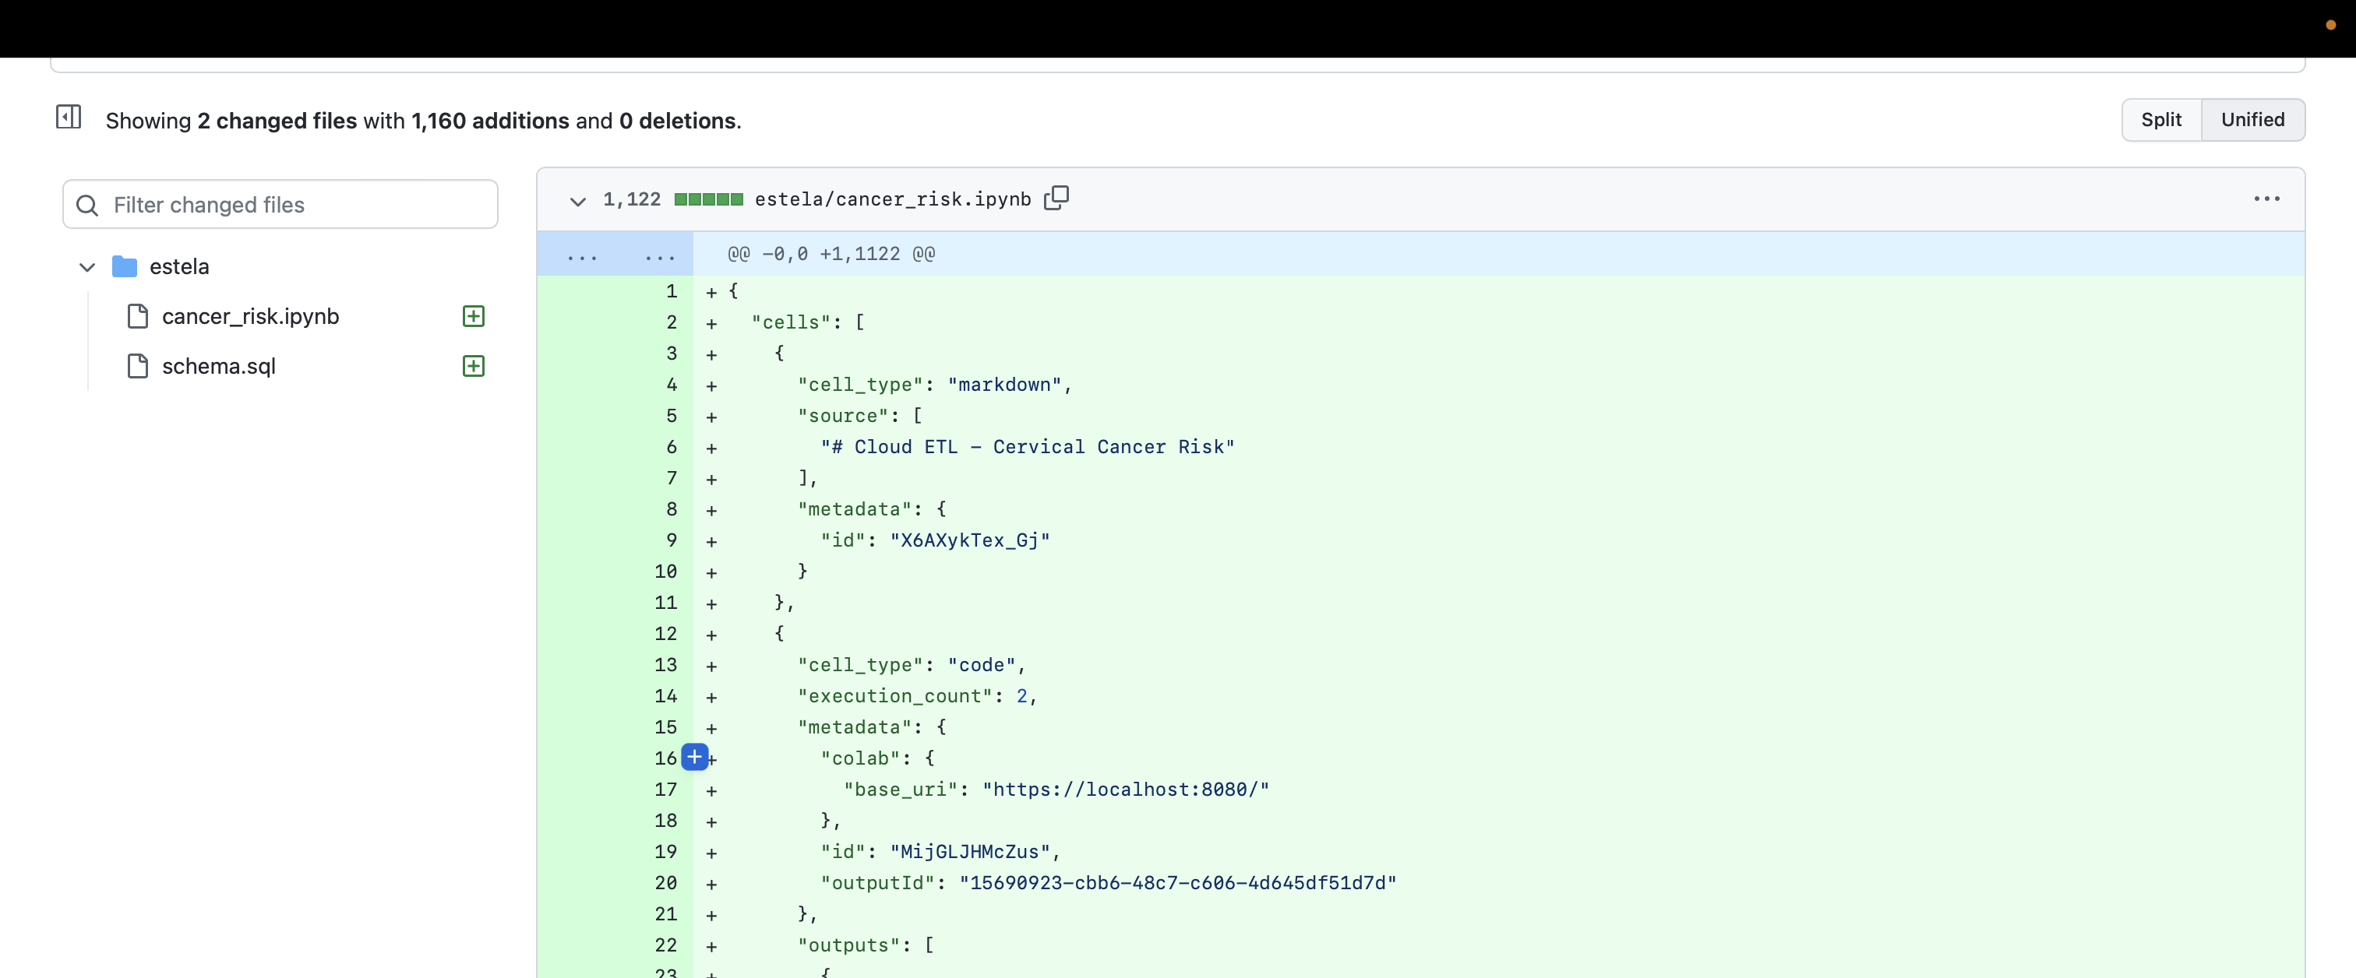
Back End
Spark
Postgres
Amazon AWS- RDS
Google Colab

Slide 4
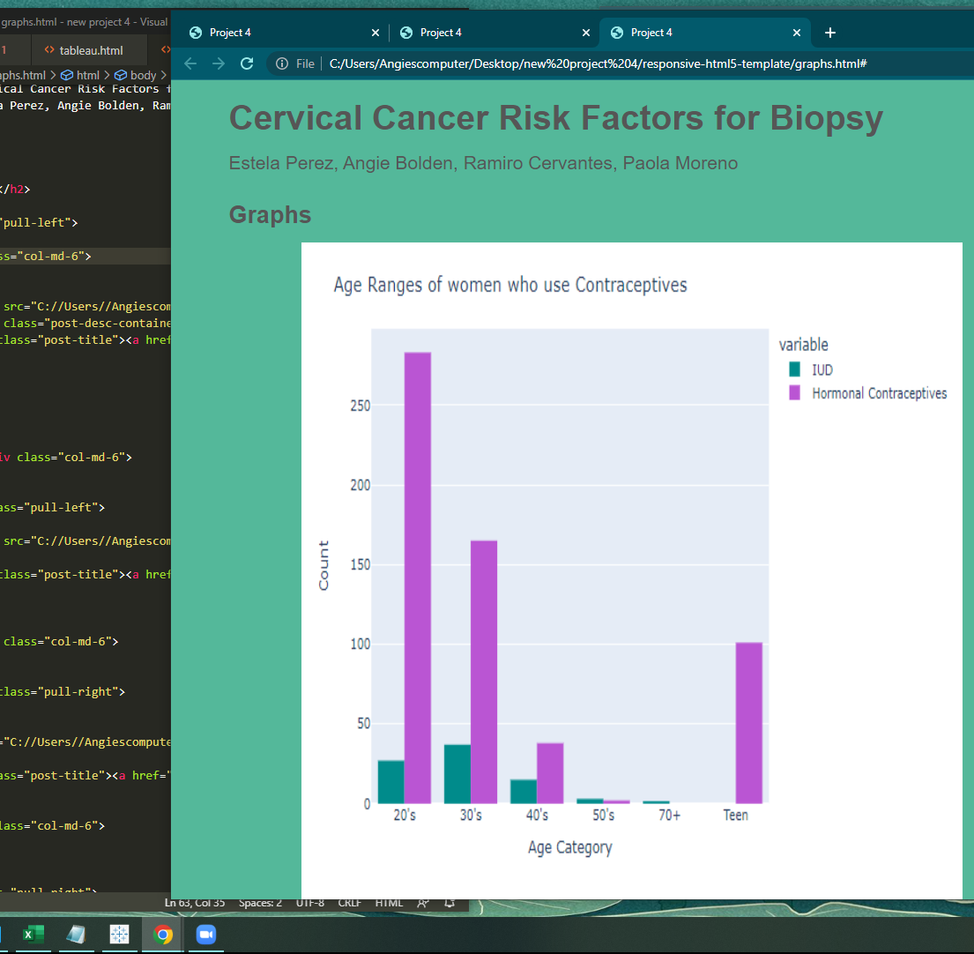
Front end walk through
https://cervaramigomez.github.io/Project_4.io/

Slide 5

Conclusion
With a Training Score of 0.93820 and a Testing Score: 0.98315, our model demonstrates meaningful predictive power in the cervical cancer screening process.

Slide 6


Cervical Cancer Fighter/Survivors
We would like to honor anyone who is fighting the good fight against cervical cancer
Patients
Doctors
Nurses
Supportive Family Members
Along with with survivors
Remember those who lost the fight to cervical cancer

Slide 7

Limitations
Data Source
Clean up
Missing data
Spark
AWS
Serious topic
Images

Slide 8

Questions/Concerns
For health concerns please contact your local health care provider

