Slide 1
The 2014 Seattle Seahawks
Did they call the right play in Super Bowl XLIX?

Slide 2
Introduction
An American football game consists of a series of ‘plays’
Each play, the offense team tries to get as far down the field as possible, or at least to the next checkpoint (first-down line or touchdown). The other team tries to stop them.
The offense team has four tries(downs) to get to the next checkpoint, where the counter resents.
Points are scored either when one team takes the ball to the endzone for a touchdown (6 pts + a chance for a field goal for 1 pt) or to kick a field goal (3 pts)
The offensive team is said to be ‘in possession’ of the ball. Possession is given to the other team if a point is scored, if the other team fails their 4th down, or if they intercept the ball.

Slide 3
Super Bowl XLIX, the controversy
Score was Seahawks 24 to Patriots 28. 26 seconds on the clock.
Seahawks were in possession of the ball. They were on 2nd down on the Patriot’s 1 yd line.
SEA quarterback Russell Wilson attempts pass to WR Ricardo Lockette rather than handing the ball to RB Marshawn ‘Beast Mode’ Lynch.
Pass is intercepted by Malcolm Butler of NEP
Interception lost the game for the Seahawks.
Did they call the right play?

Slide 4
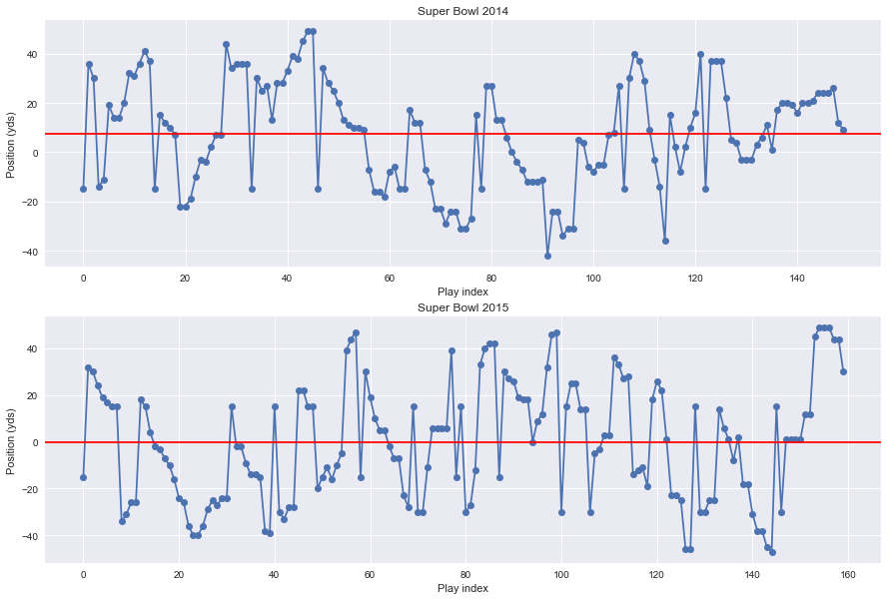
Dive into the Data
To the right is where every play started for the 2014 and 2015 superbowl mapped as distance from the Seahawks endzone. The zero line is set as the middle of the field (50 yard line).
Seahawks won the 2014 Super Bowl 43 to 8 against the Denver Broncos, and lost the 2015 Super Bowl 24-28 against the New England Patriots.

Slide 5
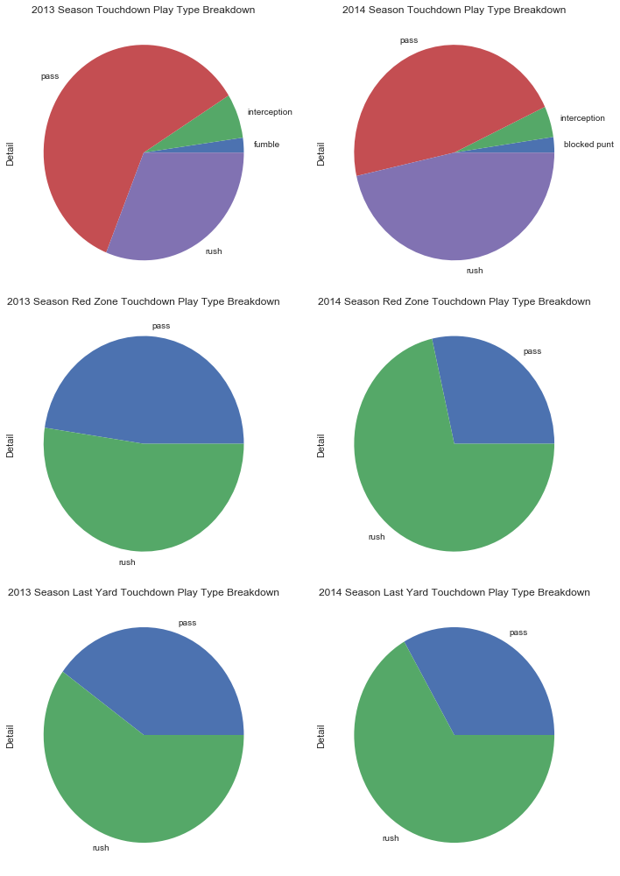
What Plays Make Touchdowns?
Right we have the breakdown of the demographic of all touchdown plays made by the seahawks.
For the 2014 season, pass and rush plays make up roughly the same proportion of scoring plays.
Demographics change as we observe scoring plays closer and closer to the endzone, generally favoring rush plays.

Slide 6
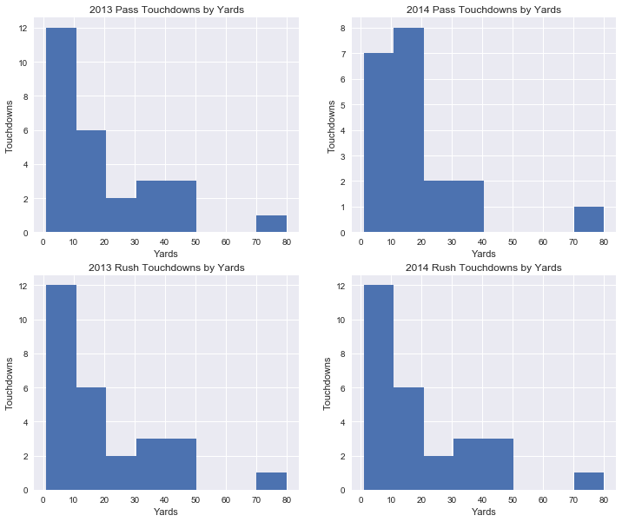
Where are these plays coming from?

Slide 7
What About Success Rate?
While it is interesting to observe the scoring play demographics are, it doesn’t provide a lot of information regarding expected success rates for any given play.
We need to compare the number of attempts by play type in this circumstance to how many of these plays were successful.
The question: How many rush or pass plays were attempted by the seahawks on their opponent’s 1 yard line, and how many were successful.

Slide 8
D’OH Insufficient Sample Size
To gain a sufficient sample size, I stitched together the play-by-play data for 9 games: the 8 games leading up to the 2015 Super Bowl and the Super Bowl itself.
Small problem, the circumstance doesn’t occur very often:
Out:
Our mega game has 1506 plays. 6 of the plays start at the opponent's 1 yard line. 54 of the plays start within the opponent's 10 yard line.

Slide 9
Details From The 1 Yard Plays:
Marshawn Lynch up the middle for no gain (tackle by Eric Reid)
Russell Wilson sacked by Ahmad Brooks for -1 yards
Russell Wilson left tackle for 1 yard touchdown
Russell Wilson pass incomplete short right intended for Ricardo Lockette is intercepted by Malcolm Butler at NWE--1 and returned for 3 yards. Penalty on NWE: Unsportsmanlike Conduct 1 yards
Timeout #2 by New England Patriots
Penalty on Michael Bennett: Encroachment 5 yards (no play)

Slide 10
What Now? Expand Circumstances.
Not enough data exists regarding the play types used by the 2014 Seahawks on the opponent’s 1 yard line to come to any meaningful conclusion.
We expand our analysis to include all red zone plays made by the seahawks over the course of the 9 sample games.
Comes with some caveats:
1. Added distance would change the success rate of passing plays, as opponent has more ground to cover. 2. Our data does not distinguish who is in possession of the ball. While rare, the other team may have the ball in their red zone, polluting our data.

Slide 11
Conclusion
Successful Passes Count: 2 Total Pass Count: 16
Red Zone Pass Success Rate: 0.125%
Successful RushesCount: 6 Total RushCount: 36
Red Zone Rush Success Rate: 0.1667%

Slide 12
Proposed Further Study
Increasing our sample size increases the power of analysis. Rather than focusing on one team, we could study the league averages for a given season.
Hypothesis: Rush plays have a higher chance of scoring then pass plays when starting on the opponent’s 1 yard line.
Rollout: Automate the collection method for play by play data for every game in any arbitrary season, and filter by plays that start on defense’s 1 yd line. We must also collect data from a sampling of seasons to gain a better understanding the strengths and weaknesses of individual teams on the 1 yd line.
Evaluation: What teams get on their opponent’s 1 yard line more often? Do teams exhibit affinity for either passing or rushing before getting to the 1 yd line? Are these strengths reflected in what happens in the one yard line? Our ability to answer these questions our degree of confidence when comparing avgs.

