Slide 1
United States Drug Prices
Analysis and Forecasting

Slide 2
Abstract
We want to analyze the medical drug market in the United States between the dates 12/11/2013 to 12/30/2015
Create a metric for and analyze market volatility based on the drug price change log
Analyze how drug rate change characteristics impact prices and change rates
We want to forecast market trends and individual drug prices
Correlation analysis of market volatility
Time series analysis of individual drugs

Slide 3
Data Collection
We have a log of price changes submitted to the National Average Drug Acquisition Cost (NADAC) database.
Database updated on a weekly basis
Dates range from 12/11/2013 to 12/30/2015
We will access the data using the medicaid API
https://data.medicaid.gov/resource/a4y5-998d.csv
API accepts SoQL queries within the URL
NADAC Database Metadata

Slide 4
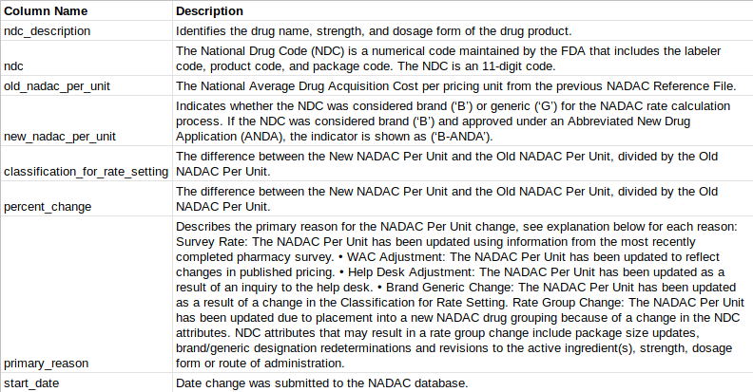
Metadata

Slide 5
Breaking Apart ndc_description
Drug name, dosage, units of measurement, and drug form are encapsulated in the ndc description.
We needed to extract these features to scale drug prices by dosage.
Correlates amount of active ingredient
METFORMIN HCL 500 MG TABLET
Drug Name | Dosage | Unit of Measurement | Drug Form
Notes:
ADD EXAMPLE

Slide 6
Exploratory Data Analysis: At a Glance
Number observations per ndc number is tiny
Over the entire ~7 years of data, no ndc number has more than 64 observations
NDC number encapsulates labeler, product code and package code, information too specific to be useful
Better to use drug name extracted from ndc description
~13% data loss from dropping missing values
Entirely through ndc description fall through.

Slide 7
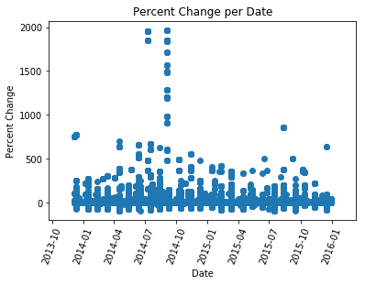
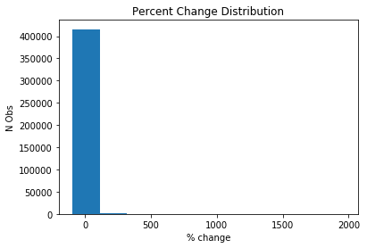
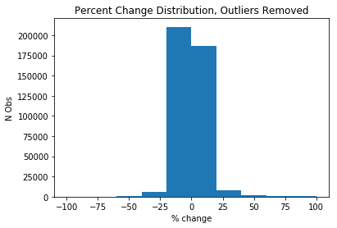
Exploratory Data Analysis: Percent Change
Initial Assessment:
Several Outliers, wide range
Outliers Removed:
Slight negative tilt, as expected
Notes:
Every point represents a change to every unique NDC code, which contains batch.

Slide 8
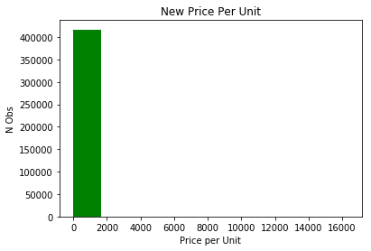
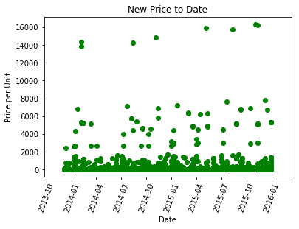
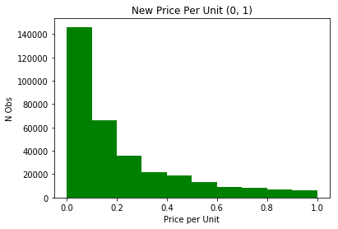
Exploratory Data Analysis: New Prices per Unit
Exponential Distribution
Significance testing should be done non-parametrically
Majority of Entries Within the Range 0 - 0.2
Scatterplot shows notable outliers
Stelara: treats Crohn’s disease
Neulasta: post-chemotherapy immune system stimulant
Notes:
The outliers here represent STELARA, a immune system suppressant used to treat Crohns Disease.
Neulasta: stimulates the growth of white blood cells

Slide 9
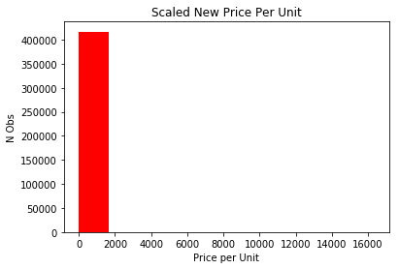
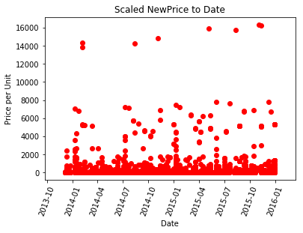
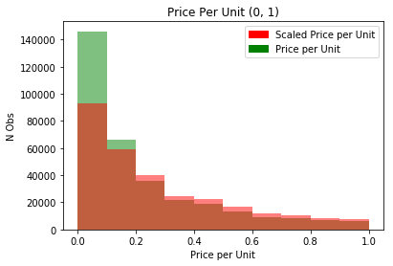
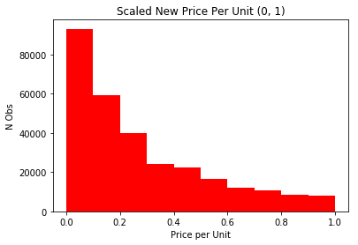
Exploratory Data Analysis: Scaled Price
We scaled price to dosage
Same issue with outliers
Normal slope less aggressive in the 0 to 1 range.

Slide 10
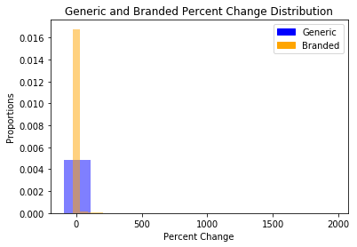
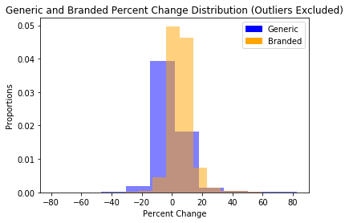
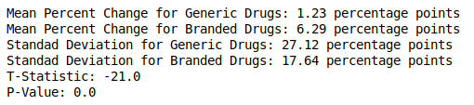
Generic vs Branded Drugs: Percent Change
Percent Change:
We have run a T-test comparing the percent change between generic and branded drugs and found a significant difference
Notes:
ADD LABELS

Slide 11
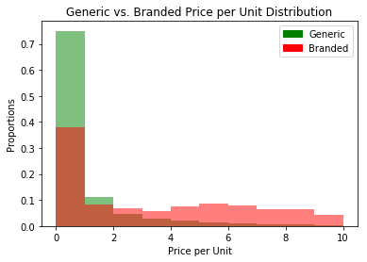
Generic vs Branded Drugs: Price per Unit
This is not a normal distribution
We used the Mann-Whitney U test to determine significance

Slide 12
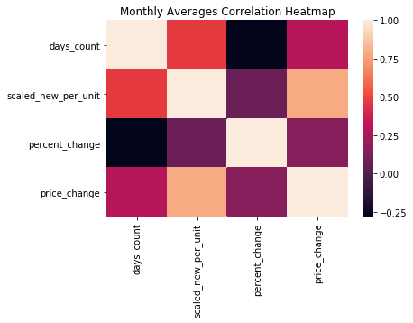
Correlation Testing: Inferring Relationships
Price per unit increasing every month
Percent change decreasing every month
PPU as an approximate function of day count:
Notes:
We use days count here for the relationship, as opposed to months count to account for

Slide 13
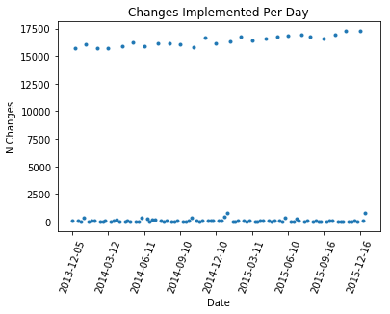
Metrics For Market Volatility: Changes per Day
Lows and Highs:
Most medicines appear to be updated on a monthly basis
Grouping by Month:
More directly related to our business goals
Notes:
There may be some interesting information we could pull out of this when comparing low and high volume days, but for our purposes, we will proceed to group by month

Slide 14
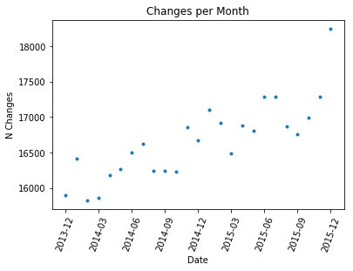
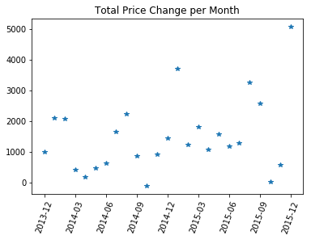
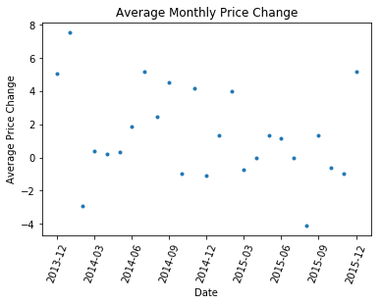
Metrics For Market Volatility: Monthly Analysis
At a Glance
Changes per Month: strongest correlation with date
Total Price Change per Month: loose correlation
Average Monthly Price Change: slight negative correlation, as expected with negative percent change to days count
Notes:
ADD ACTUAL NUMBERS TO ILLUSTRATE CORRELATION

Slide 15

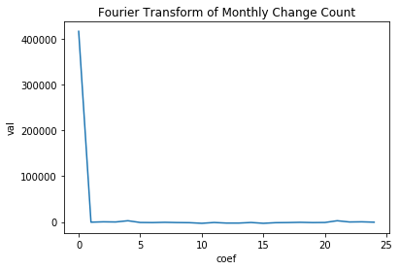
Understanding Periodicity: Fourier Transform
Hard to pick up periodicity at such low resolutions
We can attempt to formalize periodicity using the fourier transform
I don’t know what is going on here!

Slide 16
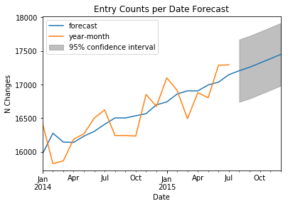
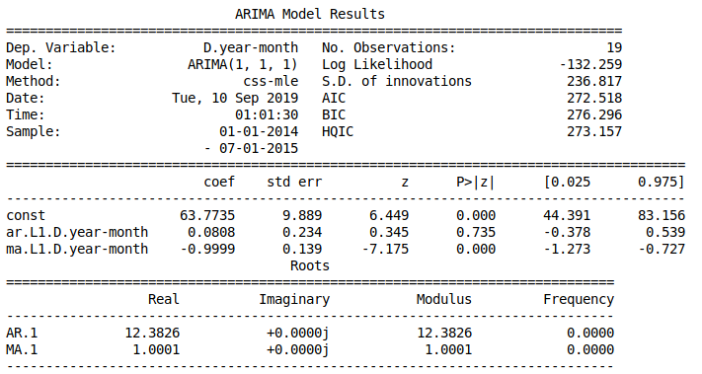
Forecasting Volatility
Notes:
We decided to use the straight changes per month, as it showed the strongest linear trend.

Slide 17
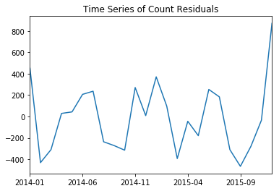
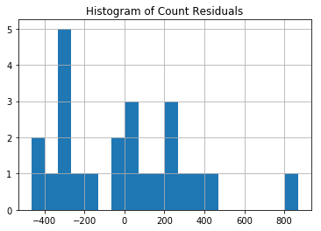
Model Performance
Low resolution
It may be difficult to come to any real conclusion given the low resolution
Count of residuals has seasonality, histogram of residuals has negative tilt.
Notes:
Here I wish we could have higher resolution data.

Slide 18
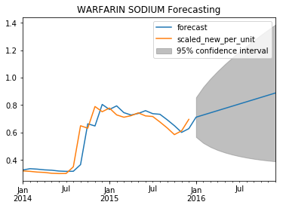
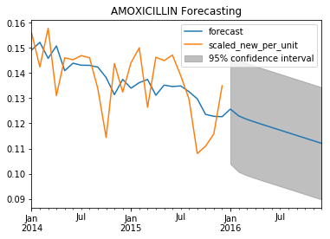
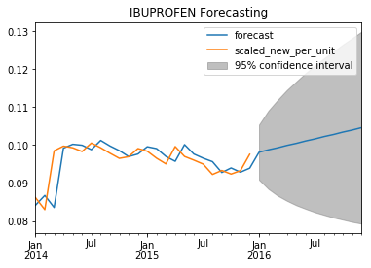
Individual Drugs: ARIMA Modelling
We used the top 25 most mentioned drugs in the database.
We see varying degrees of success in the models.

Slide 19
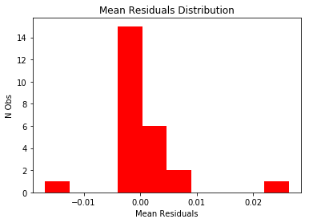
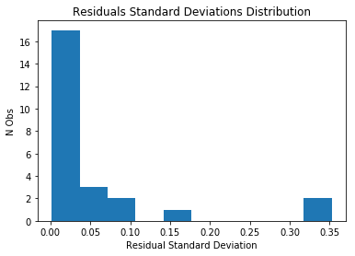
Individual Drugs: Validation
Mean: Majority lay between 0.00 and 0.01.
Standard Deviation: Majority between 0 and 0.1
Overall, decent.

Slide 20
Conclusion
We Created a Pipeline:
Transformed price changelog into drug information.
Data can be expanded to current week.
We Explored Trends in the Market:
Explored relationship between time, change count, percent change, price.
We Created a Model for Volatility:
Time series analysis of predictors of change
We Created a Model to Predict Individual Drugs:
Dictionary of models that can easily be expanded to include other drugs of interest.
Notes:
Add in description of general trend
Add numbers (percent increase, infer parametric expression of market change (P(m)= percent(m) * (P(m - 1))
Add more takeaways.

Slide 21
Further Work
Roll out model to include up to date data
Database has ~1.4 million entries and is growing
Distributed computing solutions such as spark are imperative
Analyse production and consumption data to complete supply and demand curve
Useful for producing more tangible results regarding the current state of the drug market
Integrate A/B testing of public policies regarding drugs and drug marketing
We will fit our analysis to a ‘public health’ metric

