Slide 1
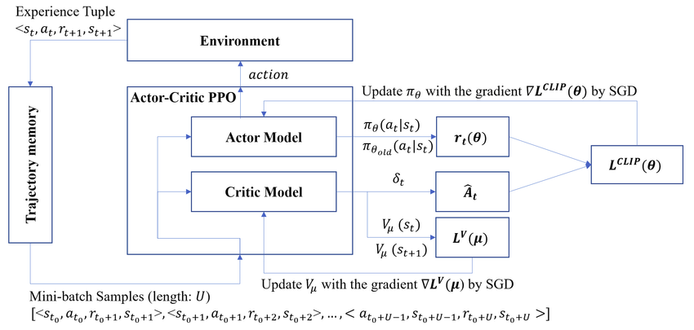
PPO Actor Critic

Slide 2
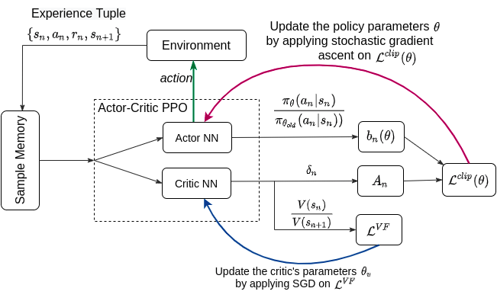

Slide 3
Sheeps-Head
Actor
Possible actions(42)
Actions (42x1)
SOFTMAX
Input
(161x1)
128+42
42
PRELU
PRELU
PRELU
161
128
128
Q-value (1x1)
PRELU
128
128
Critic

