Slide 1
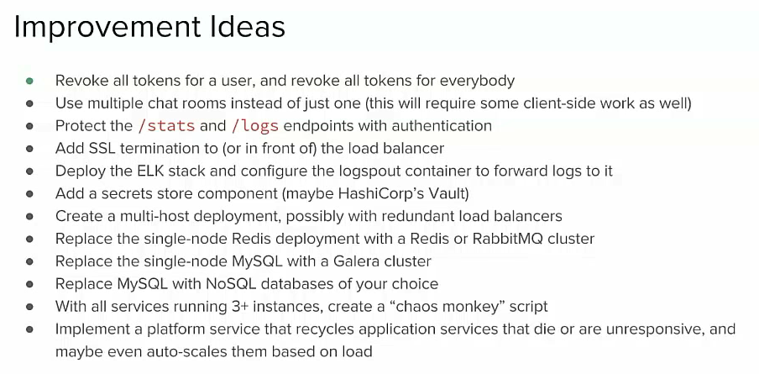

Slide 2
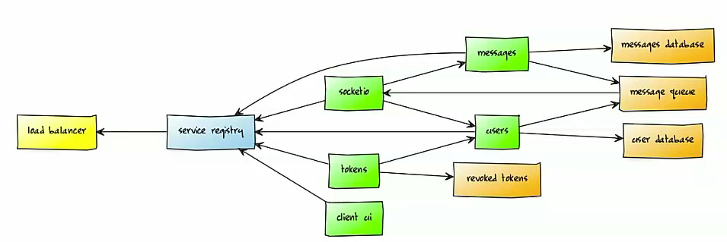
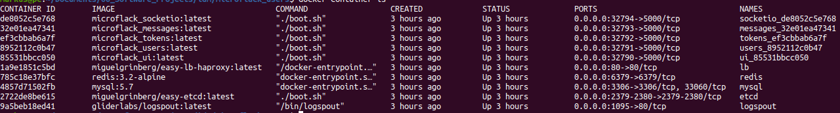
Runs in docker image
messages db
messages
socketio
messages queue
redis
load balancer (lb)
haproxy
service registry
etcd
users
tokens
user db
ui
revoked tokens
TODO CLIENT
TODO gunicorn server
Logging docker output
logspout
mysql

Slide 3
Workflow login / register a user
If user not in userList
→ create User
requestToken(nickname, pw)
→ api/tokens
Submit Btn
Views→login_form.js
→ sumit()
new_token
Generate_token(jwt)
For userid and expires...
users service
tokens service
nickname
get_me_user()
verify_password
password

Slide 4
Workflow login / register a user
Register/Sign In
Register (User is new:)
1. POST api/users
2. POST api/tokens
Sign In (user is known)
1. (in users verify_password) name and pw
2. GET api/users/me → causes Tokens UNAUTHORIZED ERROR.

Slide 5
Database Migrations
Workflow to change a database e.g. add a new column in users.db
With deleting all old databases:
- ./startDEVService users → with flask db init, migrate, upgrade
- then the service runs locally with high weight and can be tested there
- next use ./mfupgrade try users → an extra docker container runs (logs are printed!)
- next use ./mfupgrade roll users → is installed (other docker service is deleted?)

Slide 6
Running a service locally
Its only possible to run one service locally (cause of networking)
./createTestService.sh ui -u -env
It is possible to kill the service on production mode or to let it run with less weight
Ubuntu PC
Production WebSite
inside Docker Containers
(socketio, ui, etcd, etc.)
tokens (weight=1)
Testing a local service
(inside venv)
e.g. tokens (weight=100)

