Slide 1
Schafkopf 2.0
Much better documented
Uses more tests
Only schafkopf no witches etc. support!
Examines different learning algorithms

Slide 2
Class diagramm here

Slide 3
State diagramm here

Slide 4
Create Gymnasium:
https://gymnasium.farama.org/tutorials/gymnasium_basics/environment_creation/#sphx-glr-tutorials-gymnasium-basics-environment-creation-py

Slide 5
Check algos for imperfect decision games as:
A3C
DDGP?
Suphx: https://arxiv.org/abs/2003.13590

Slide 6
Create Gymnasium:
https://gymnasium.farama.org/tutorials/gymnasium_basics/environment_creation/#sphx-glr-tutorials-gymnasium-basics-environment-creation-py

Slide 7
Old version from here on:

Slide 8
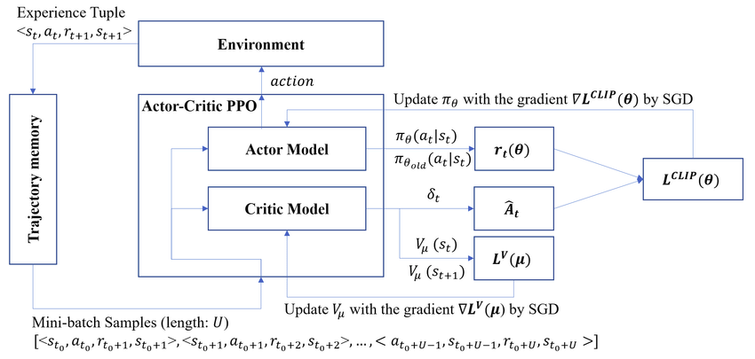
PPO Actor Critic

Slide 9
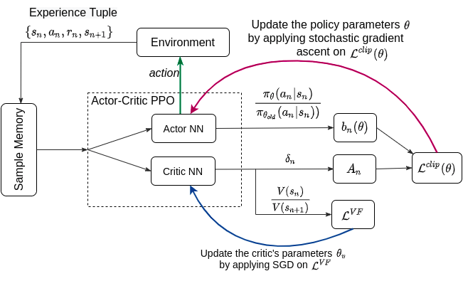

Slide 10
Sheeps-Head
Actor
Possible actions(42)
Actions (42x1)
SOFTMAX
Input
(161x1)
128+42
42
PRELU
PRELU
PRELU
161
128
128
Q-value (1x1)
PRELU
128
128
Critic

Slide 11
PPO as Estimator
Actor
Possible actions(42)
Actions (42x1)
SOFTMAX
Input
(161x1)
128+42
42
PRELU
PRELU
PRELU
161
128
128
Q-value (1x1)
PRELU
128
128
Critic

Slide 12
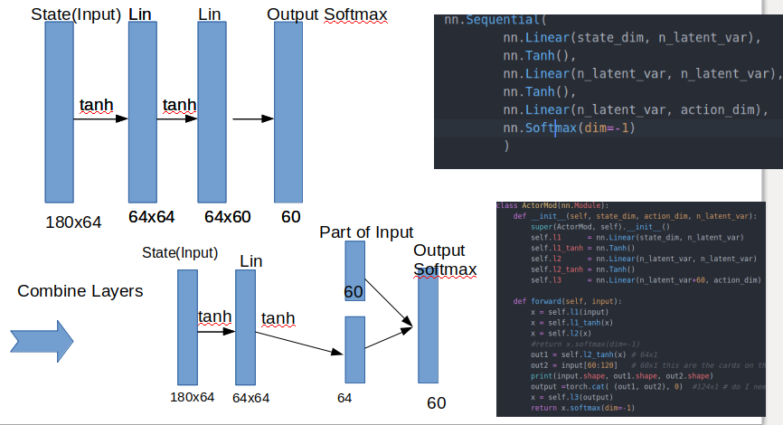

Slide 13
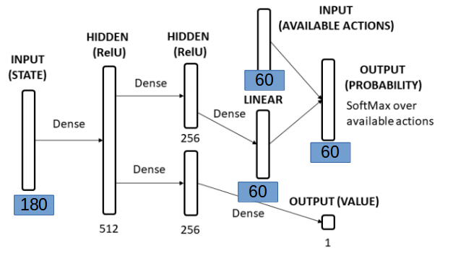
See this question at:
https://discuss.pytorch.org/t/training-a-card-game-classifier/70625/8

Slide 14
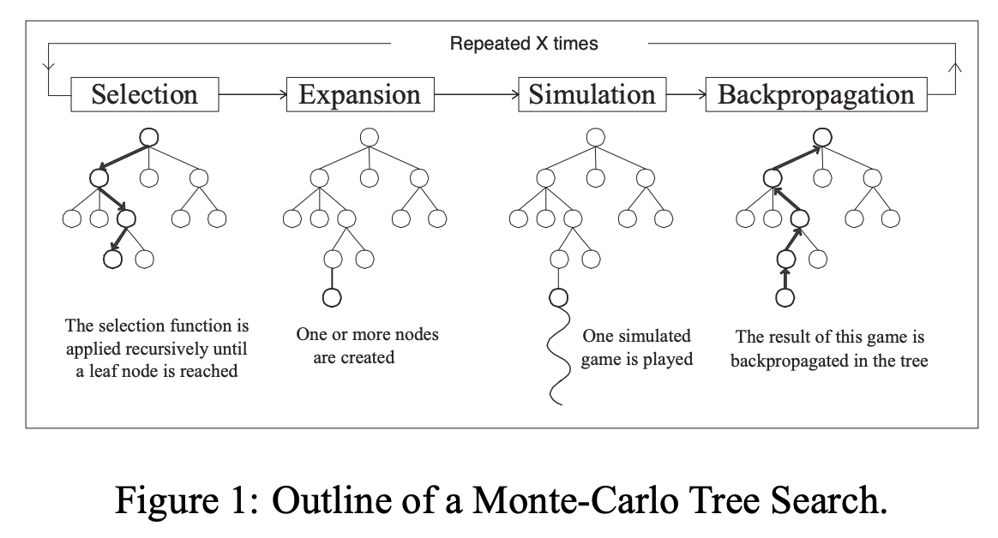

Slide 15
X=number Playouts
Each Node has:
self.cumulative_rewards = [0, 0, 0, 0]
self.visits = 0
If fully expanded select best node! By calculating a
ucb_value= average_reward + ucb_const * np.sqrt(2 * np.log(self.parent.visits) / self.visits)
For each child
Select this child and expand it again!

Slide 16
Improve with MonteCarlo
MCTS
Game_State
Subsampled Enemys
allowed_actions
https://github.com/Taschee/schafkopf

Slide 17
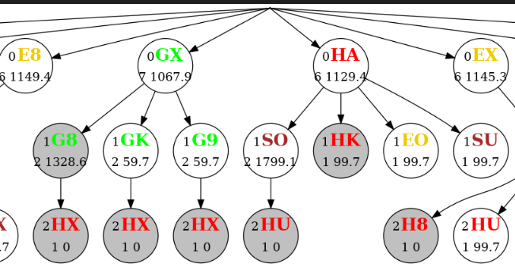
Root Node
Card Options for player 0
Number of visits
Back-propagated value
Best nodes (the one with the highest number of visits is marked gray)

