Slide 1
Conditionals

Slide 2
if/else Statements
Printing the player’s health condition
fun main(args: Array<String>) {
val name = "Madrigal"
var healthPoints = 100
var healthPoints = 89
if (healthPoints == 100) {
println(name + " is in excellent condition!")
} else {
println(name + " is in awful condition!")
}
}
operator (==)structural equality operator
operator (+) string concatenation

Slide 3
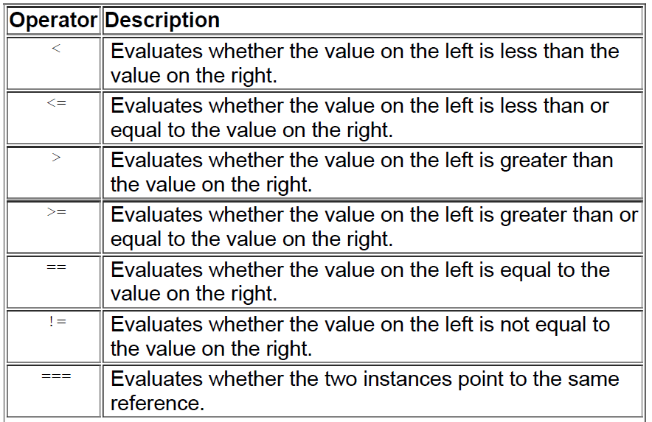
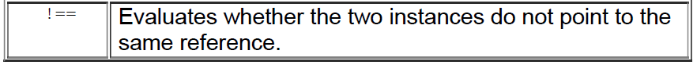

Slide 4
fun main(args: Array<String>) {
val name = "Madrigal"
var healthPoints = 89
if (healthPoints == 100) {
println(name + " is in excellent condition!")
} else if (healthPoints >= 90) {
println(name + " has a few scratches.")
} else if (healthPoints >= 75) {
println(name + " has some minor wounds.")
} else if (healthPoints >= 15) {
println(name + " looks pretty hurt.")
} else {
println(name + " is in awful condition!")
}
}
first else if will evaluate as true.

Slide 5
fun main(args: Array<String>) {
val name = "Madrigal"
var healthPoints = 89
val isBlessed = true
if (healthPoints == 100) {
println(name + "is in excellent condition!")
} else if (healthPoints >= 90) {
println(name + " has a few scratches.")
} else if (healthPoints >= 75) {
if (isBlessed) {
println(name + " has some minor wounds but is healing quite quickly!")
} else {
println(name + " has some minor wounds.")
}
} else if (healthPoints >= 15) {
println(name + " looks pretty hurt.")
} else {
println(name + " is in awful condition!")
}
}

Slide 6
fun main(args: Array<String>) {
val name = "Madrigal"
var healthPoints = 89
val isBlessed = true
val isImmortal = false
// Aura
if (isBlessed && healthPoints > 50 || isImmortal) {
println("GREEN")
} else {
println("NONE")
}
if (healthPoints == 100) {
...
}
code comment, indicated by //- Anything to the right of // is included in the comment and is ignored by the compiler, so you can use any syntax you want there.

Slide 7
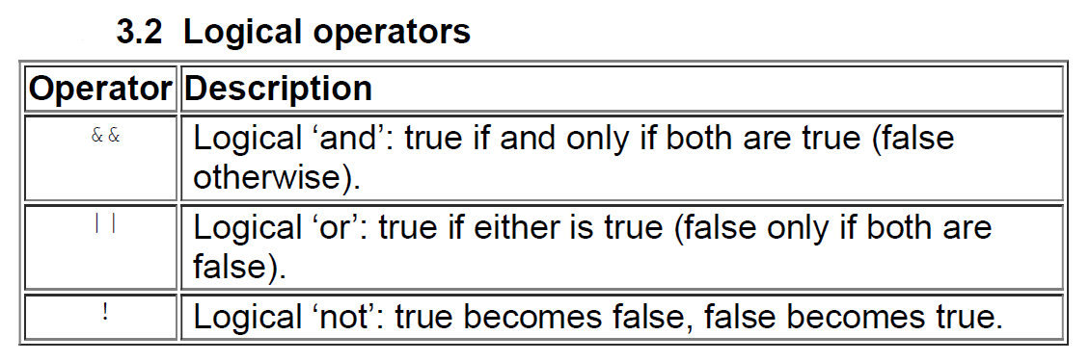
< (less than), <= (less than or equal to), > (greater than), >= (greater than or equal to)
== (structural equality), != (non-equality)
&& (logical ‘and’)
|| (logical ‘or’)
! (logical ‘not’)

Slide 8
// Aura
if (isBlessed && healthPoints > 50 || isImmortal) {
val auraVisible = isBlessed && healthPoints > 50 || isImmortal
if (auraVisible) {
println("GREEN")
} else {
println("NONE")
}

Slide 9
Conditional expressions
A conditional expression is like a conditional statement, except that you assign the if/else to a value that you can use later. Update the health status display code to see what this looks like.

Slide 10
fun main(args: Array<String>) {
...
if (healthPoints == 100) {
val healthStatus = if (healthPoints == 100) {
println(name + "is in excellent condition!")
"is in excellent condition!"
} else if (healthPoints >= 90) {
println(name + " has a few scratches.")
"has a few scratches."
} else if (healthPoints >= 75) {
if (isBlessed) {
println(name + " has some minor wounds but is healing quite quickly!")
"has some minor wounds but is healing quite quickly!"
} else {
println(name + " has some minor wounds.")
"has some minor wounds."
}
} else if (healthPoints >= 15) {
println(name + " looks pretty hurt.")
"looks pretty hurt."
} else {
println(name + " is in awful condition!")
"is in awful condition!"
}
// Player status
println(name + " " + healthStatus)
}

Slide 11
val auraVisible = isBlessed && healthPoints > 50 || isImmortal
if (auraVisible) {
println("GREEN")
} else {
println("NONE")
}
val auraColor = if (auraVisible) "GREEN" else "NONE"
println(auraColor)

Slide 12
Ranges AND IN
The .. operator, as in in 1..5, signals a range. A range includes all values from the value on the left of the .. operator to the value on the right, so 1..5 includes 1, 2, 3, 4, and 5. Ranges can also be a sequence of characters.
And the until function creates a range that excludes the upper bound of the range specified.

Slide 13
fun main(args: Array<String>) {
...
val healthStatus = if (healthPoints == 100) {
"is in excellent condition!"
} else if (healthPoints >= 90) {
} else if (healthPoints in 90..99) {
"has a few scratches."
} else if (healthPoints >= 75) {
} else if (healthPoints in 75..89) {
if (isBlessed) {
"has some minor wounds but is healing quite quickly!"
} else {
"has some minor wounds."
}
} else if (healthPoints >= 15) {
} else if (healthPoints in 15..74) {
"looks pretty hurt."
} else {
"is in awful condition!"
}
}

Slide 14
when Expressions
The when expression is another control flow mechanism available in Kotlin. Like if/else, the when expression allows you to write conditions to check for and will execute corresponding code when the condition evaluates as true. when provides a more concise syntax and is an especially good fit for conditionals with three or more branches.
val race = "gnome"
val faction = when (race) {
"dwarf" -> "Keepers of the Mines"
"gnome" -> "Keepers of the Mines"
"orc" -> "Free People of the Rolling Hills"
"human" -> "Free People of the Rolling Hills"
}

Slide 15
fun main(args: Array<String>) {
...
val healthStatus = if (healthPoints == 100) {
"is in excellent condition!"
} else if (healthPoints in 90..99) {
"has a few scratches."
} else if (healthPoints in 75..89) {
if (isBlessed) {
"has some minor wounds but is healing quite quickly!"
} else {
"has some minor wounds."
}
} else if (healthPoints in 15..74) {
"looks pretty hurt."
} else {
"is in awful condition!"
}

Slide 16
val healthStatus = when (healthPoints) {
100 -> "is in excellent condition!"
in 90..99 -> "has a few scratches."
in 75..89 -> if (isBlessed) {
"has some minor wounds but is healing quite quickly!"
} else {
"has some minor wounds."
}
in 15..74 -> "looks pretty hurt."
else -> "is in awful condition!"
}
}
You have seen how to use the in keyword to check whether a value is within a range

Slide 17
String Templates
// Player status
println(name + " " + healthStatus)
println("$name $healthStatus")
You added the values of name and healthStatus to the player status display string by prefixing each with $. This special symbol indicates to Kotlin that you would like to template a val or var within a string you define, and it is provided as a convenience. Note that these templated values appear inside the quotation marks that define the string.

Slide 18
fun main(args: Array<String>) {
...
// Aura
val auraVisible = isBlessed && healthPoints > 50 || isImmortal
val auraColor = if (auraVisible) "GREEN" else "NONE"
print(auraColor)
...
// Player status
println("(Aura: $auraColor) (Blessed: ${if (isBlessed) "YES" else "NO"})")
println("$name $healthStatus")
}

