Slide 1
Variables, Constants, and Types

Slide 2
Types
Variables and constants have a data type that you specify. The type describes the data that is held by a variable or constant and tells the compiler how type checking will be handled, a feature in Kotlin that prevents the assignment of the wrong kind of data to a variable or constant.

Slide 3
Imagine you are writing an adventure game that allows a player to explore an interactive world. You may want a variable for keeping track of the player’s score.
fun main(args: Array<String>) {
var experiencePoints: Int = 5
println(experiencePoints)
}

Slide 4
fun main(args: Array<String>) {
var experiencePoints: Int = 5
var experiencePoints: Int = "thirty-two"
println(experiencePoints)
}
Kotlin uses a static type system – meaning the compiler labels the source code you define with types so that it can ensure the code you wrote is valid. IntelliJ also checks code as you type it and notices when an instance of a particular type is incorrectly assigned to a variable of a different type. This feature is called static type checking, and it tells you about programming mistakes before you evencompile the program.
reassigned
fun main(args: Array<String>) {
var experiencePoints: Int = 5
experiencePoints += 5
println(experiencePoints)
}

Slide 5
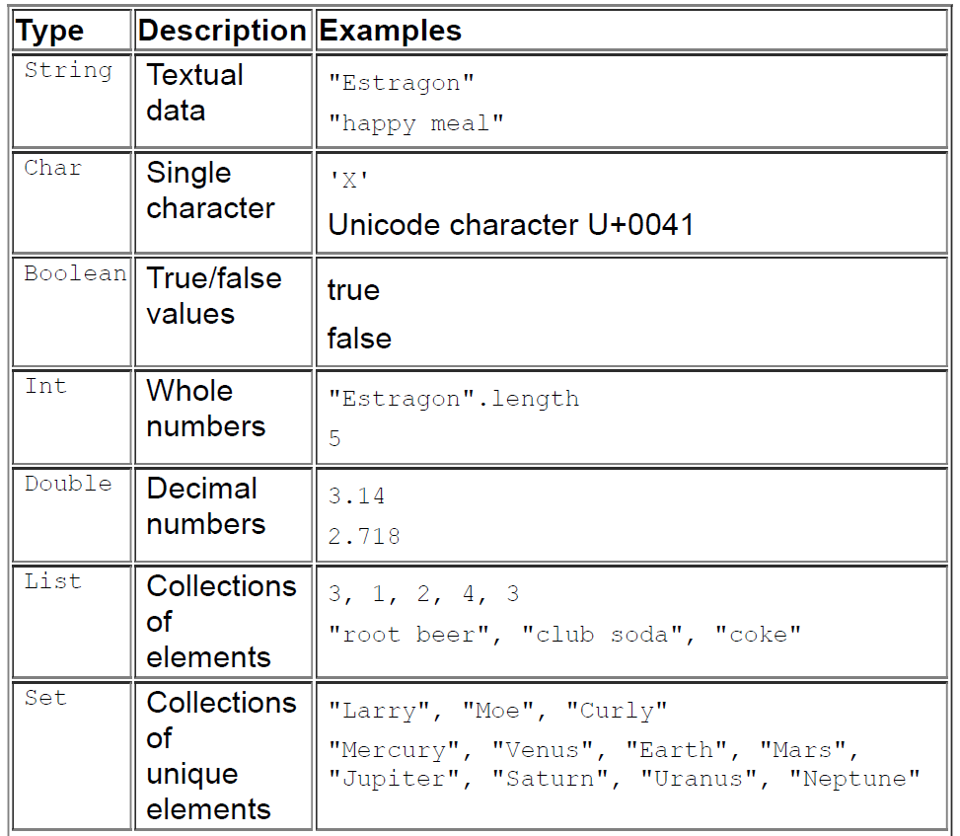
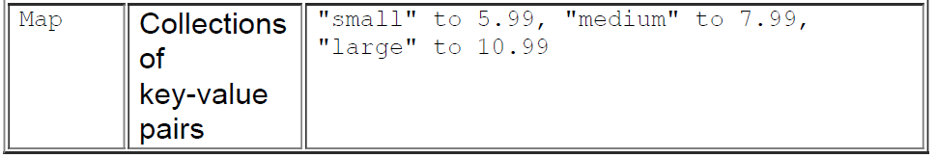

Slide 6
Read-Only Variables
So far, you have seen variables whose values can be reassigned. But often, you will want to use variables whose values should not change in your program. For example, in the text adventure game, the player’s name will not change after it has been initially assigned.
Kotlin provides a different syntax for declaring read-only variables – variables that cannot be modified once they are assigned.
You declare a variable that can be modified using the var keyword. To declare a read-only variable, you use the val keyword.

Slide 7
fun main(args: Array<String>) {
val playerName: String = "Estragon"
var experiencePoints: Int = 5
experiencePoints += 5
println(experiencePoints)
println(playerName)
}
fun main(args: Array<String>) {
val playerName: String = "Estragon"
playerName = "Madrigal"
var experiencePoints: Int = 5
experiencePoints += 5
println(experiencePoints)
println(playerName)
}

Slide 8
Type Inference
Notice that the type definitions you specified for the playerName and experiencePoints variables are grayed out in IntelliJ. Grayed-out text indicates an element that is not required. Mouse over the String type definition, and IntelliJ will provide an explanation about why the element is not required
Kotlin includes a feature called type inference that allows you to omit the type definition for variables that are assigned a value when they are declared. Because you assign data of the String type to playerName and of the Int type to experiencePoints when you declare them, the Kotlin compiler infers the appropriate type information for both variables.

Slide 9
Compile-Time Constants
A compile-time constant must be defined outside of any function, including main, because its value must be assigned at compile time (that is, when the program compiles) – hence the name. main and your other functions are called during runtime (when the program is executed), and the variables within them are assigned their values then. A compile-time constant exists before any of these assignments take place.
Compile-time constants also must be of one of the following basic types, because use of more complex types for a constant could jeopardize the compile-time guarantee.
String
Int
Double
Float
Long
Short
Byte
Char
Boolean

Slide 10
const val MAX_EXPERIENCE: Int = 5000
fun main(args: Array<String>) {
...
}
Prepending a val with the const modifier tells the compiler that it can be sure that this val will never change. In this case, MAX_EXPERIENCE is guaranteed to have the integer value 5000, no matter what. This gives the compiler the flexibility to perform optimization behind the scenes.

