Slide 1

FIFA 18 stats vs. English Premium League ’17/’18 Stats
Evan, Cesar and Charlotte

Slide 2
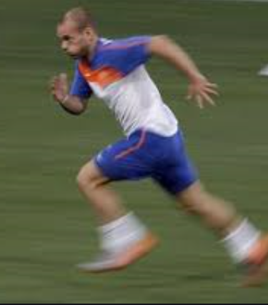
Finding the Data
Kaggle
CSV for FIFA
JSON for EPL
CSV all the data was extractable
Acceleration
Agility
Balance
Ball Control
JSON was nested

Slide 3

Extracting Data
CSV File and Json extracting with Pandas
Web Scrapping from Wikipedia
Extracting nested info Json was a challenging
Due to time constraints we agreed that Name, Club, Individual Rating would the info we extracted
Looping - 4 loop
Accuracy – unique / overwriting

Slide 4

Joining the Data / Database
Created a SQL Database
Fun with matching the player from two different sets of data
Naming convention mismatch
i.e. Charlotte Cabrera vs. C. Cabrera
Charlotte De La Cabrera vs. DeLaCabrera
Bringing in club name
Not number … not in Json

Slide 5
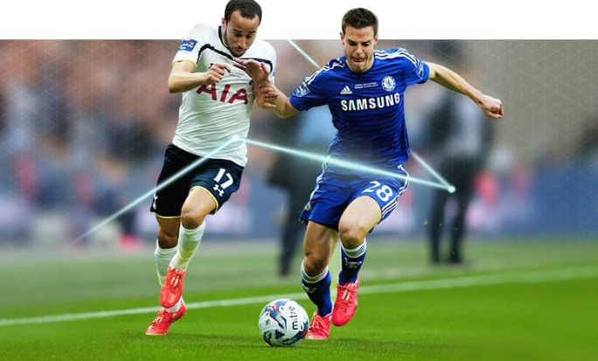
Conclusion
Plan
Map things out
Information good for end user in mind
The more data the better
Question: Given the time frame how are we going to accurately put this data into use
How to join all tables together
Ex: Name - analyze them
Plan, Analyze, Divide and Conquer

