Slide 1
Digital Twin-Based Wind Load Assessment of a GDR Heritage Building under Climate Change
Cesar Fernando Gamba Tiusaba¹, Itzel Sandoval Maldonado¹, Keangsinh Taing ¹, Eva
Griebl ¹ and Anastasia Athanasiou ¹
¹Bauhaus-Universität Weimar, Germany

Slide 2
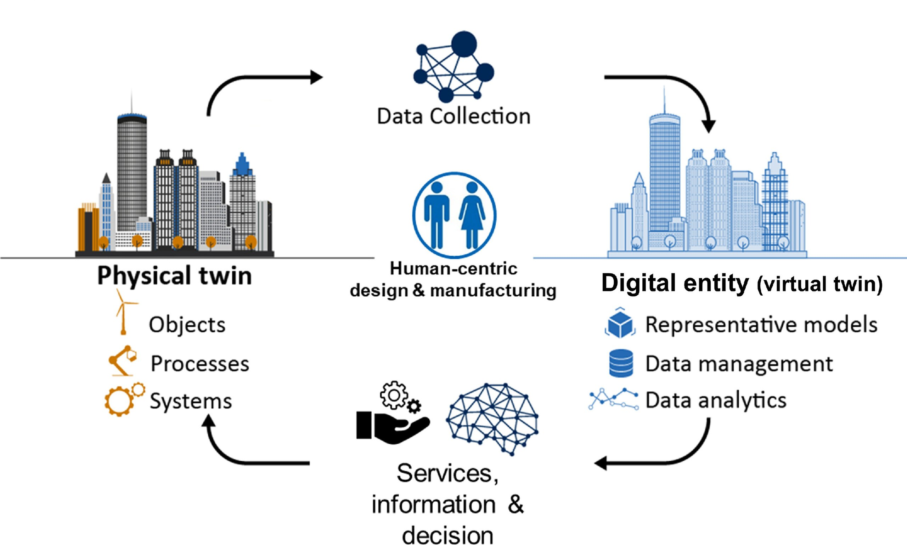

Wikipedia: Digital twin.

Slide 3
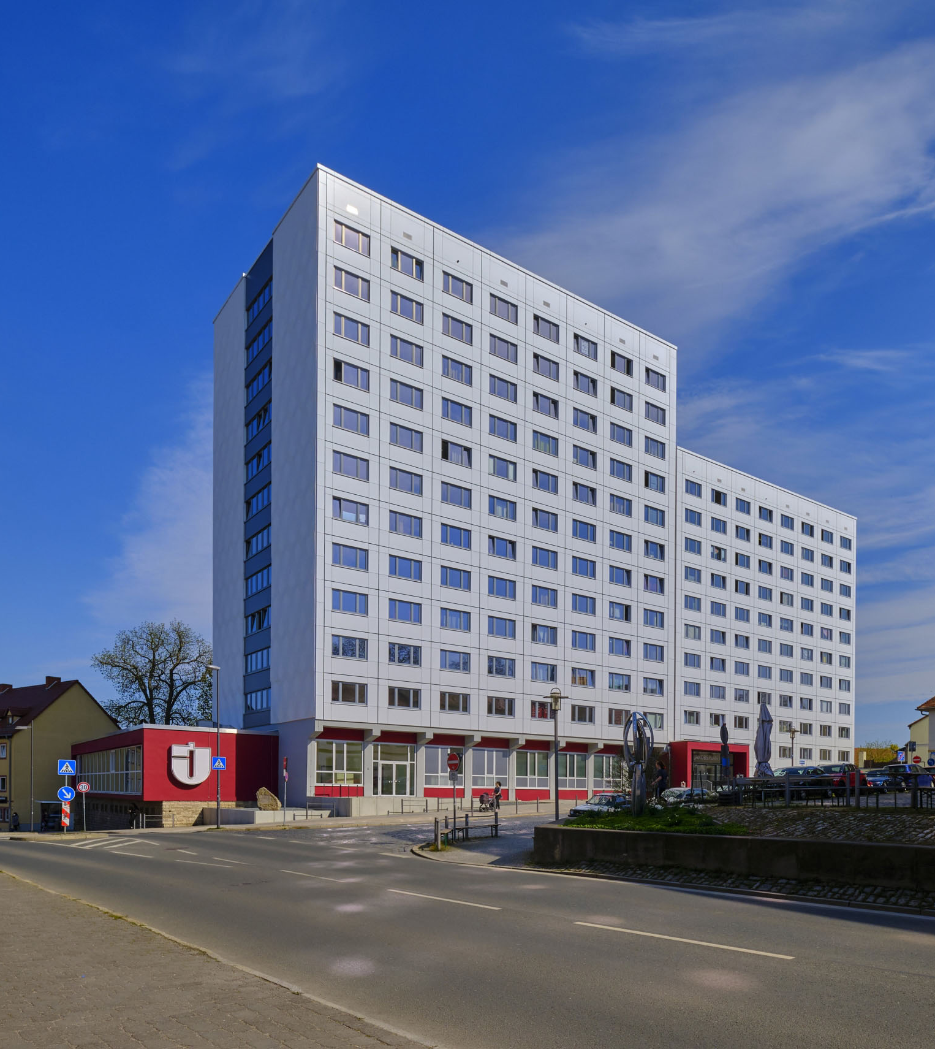
Problem
Climate change is intensifying extreme events.
Many existing buildings — especially those built during the DDR period — are approaching or exceeding their service life.
There is an urgent need for monitoring, model calibration and forecasting.
Research Aim
Real-time Structural Health Monitoring (SHM) using a Digital Twin approach.
Most SHM commercial systems:
  are expensive
  use proprietary SaaS platforms
  operate as black-box solutions

Slide 4
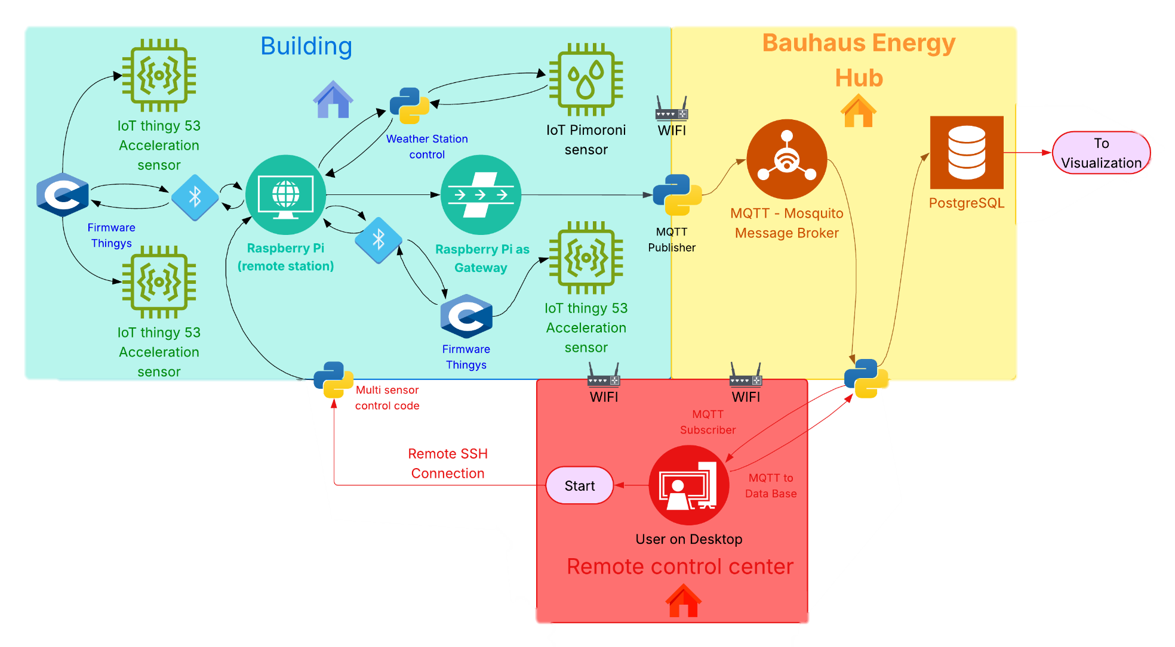
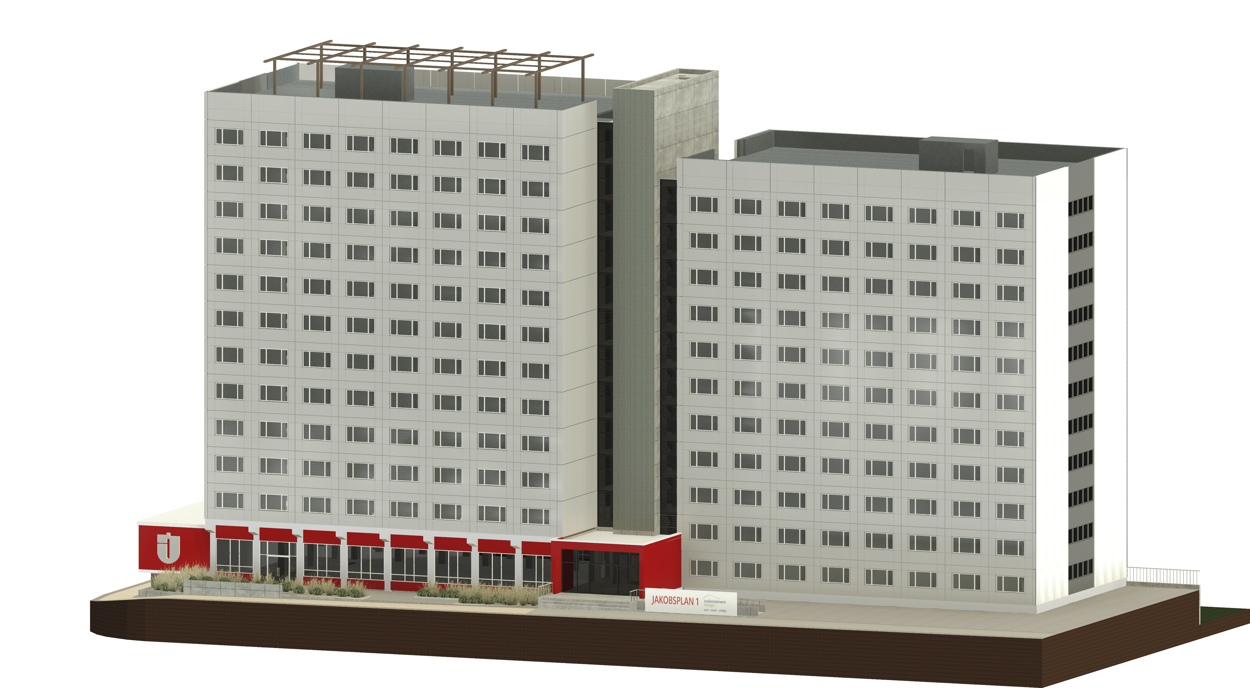


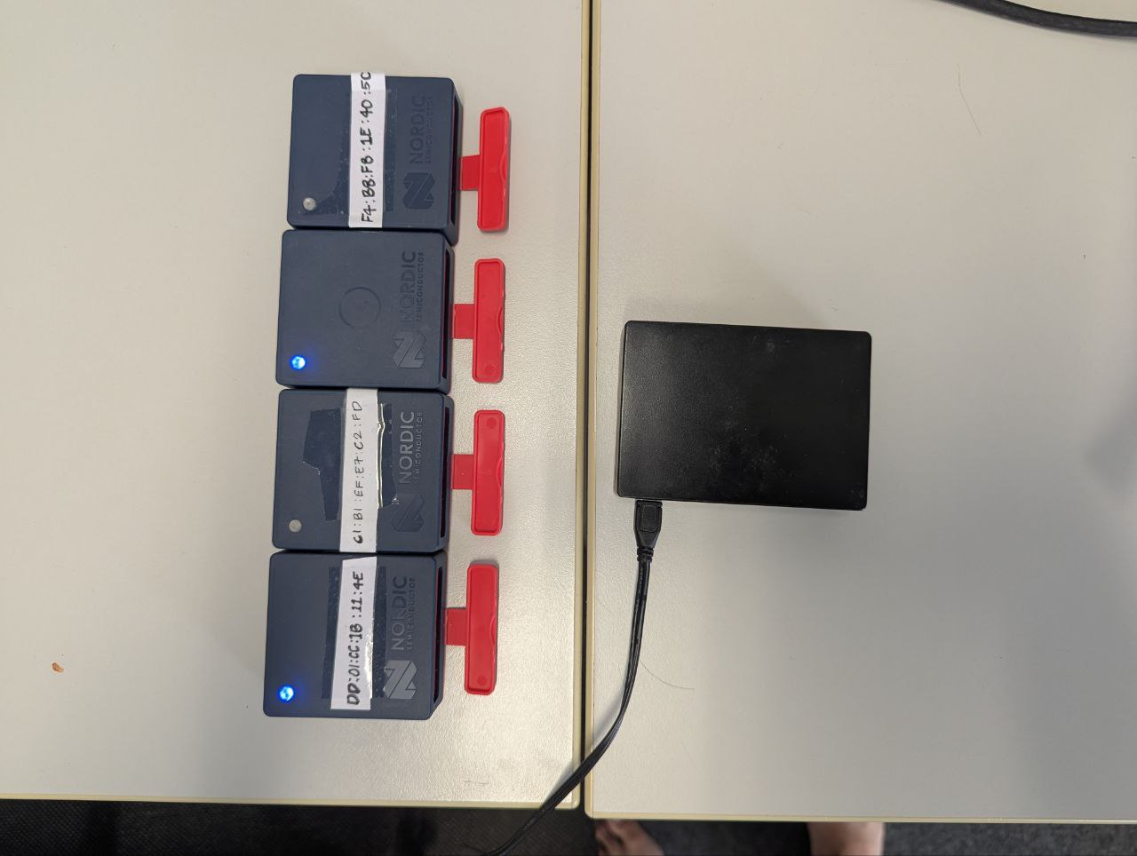

© Associated Press

Slide 5
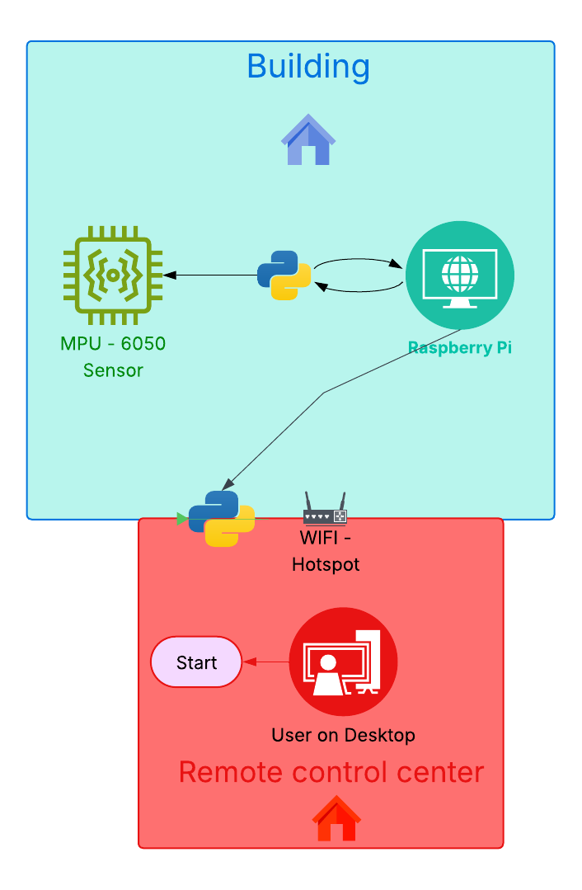
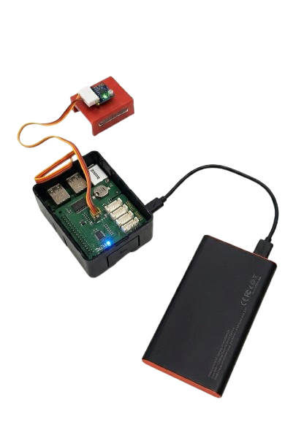
© Associated Press

Slide 6
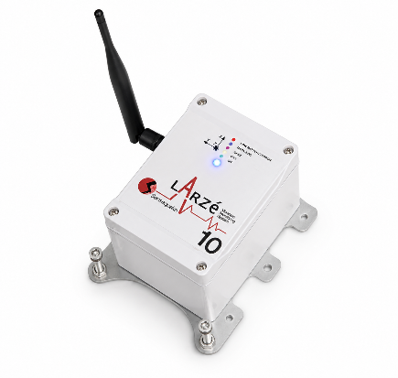
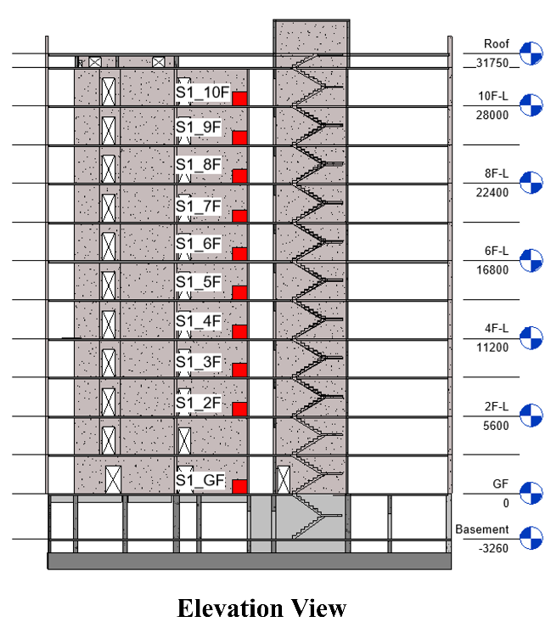

Instrument
Experimental Plan
Measurement Information
Sampling: 400 Hz
Duration: 30 min
Range Used: ±2g
Measurement Date: 12 Aug 2026
Sensequake Larzé
Specification
Triaxial accelerometer triaxial velocity sensor
24-bit ADC
Acceleration range: ±2g / ±4g / ±8g
Sampling frequency: 10 –4800 Hz
Built-in analogue & digital anti-aliasing filters
Synchronisation: 2.4 GHz radio or GPS
Self-noise density: 25 µg/√Hz
Elevation View
Layout Plan

Slide 7
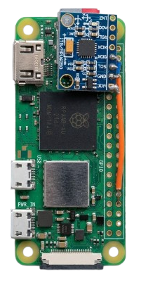
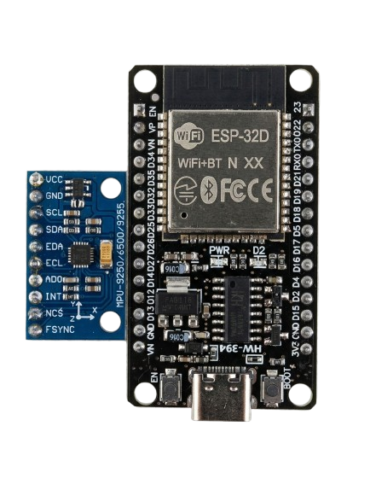
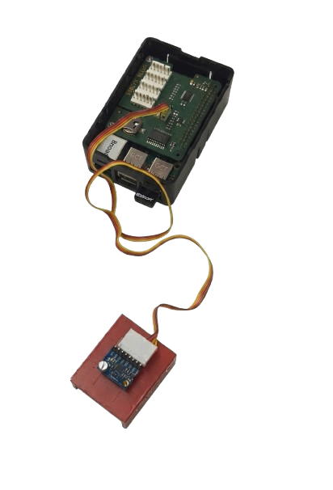
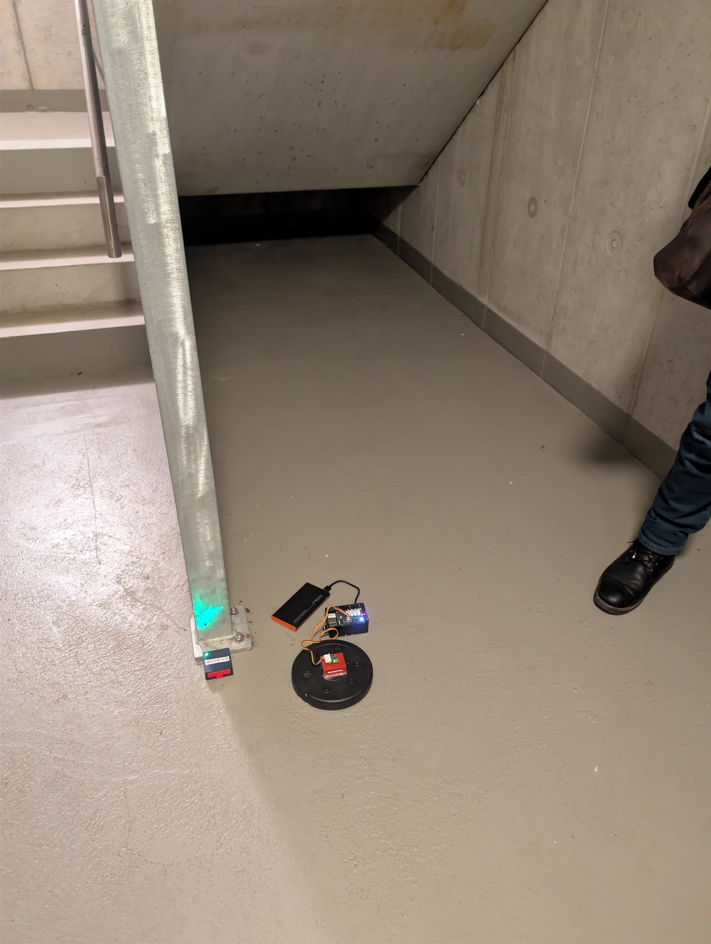
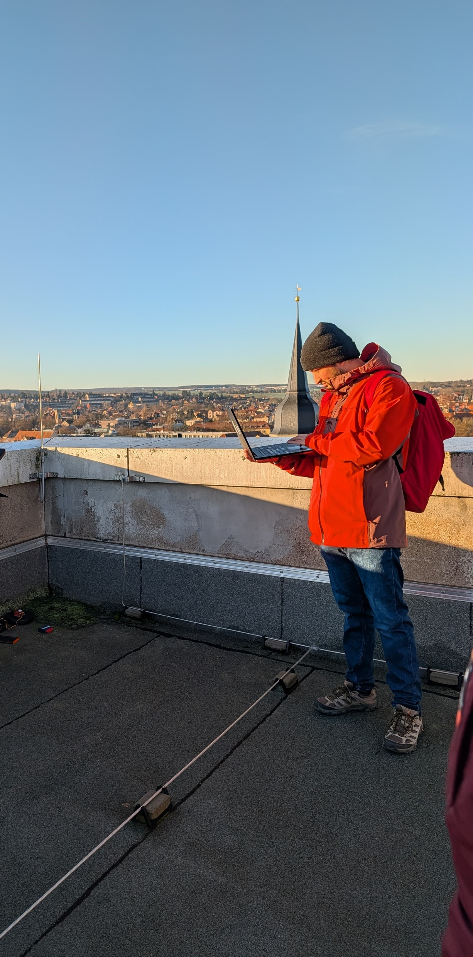
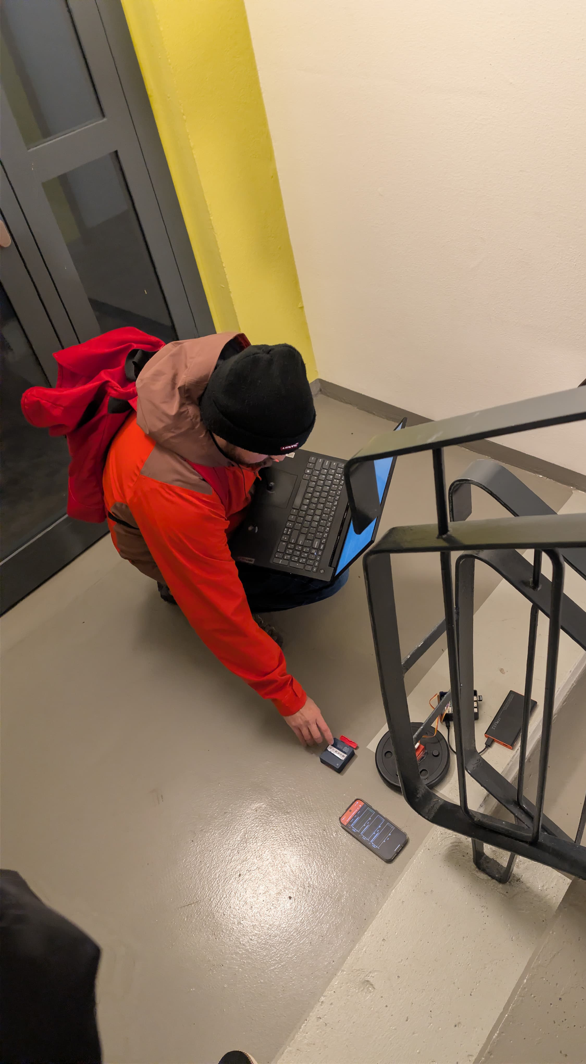
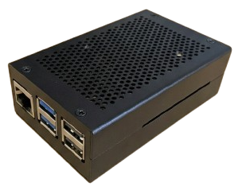

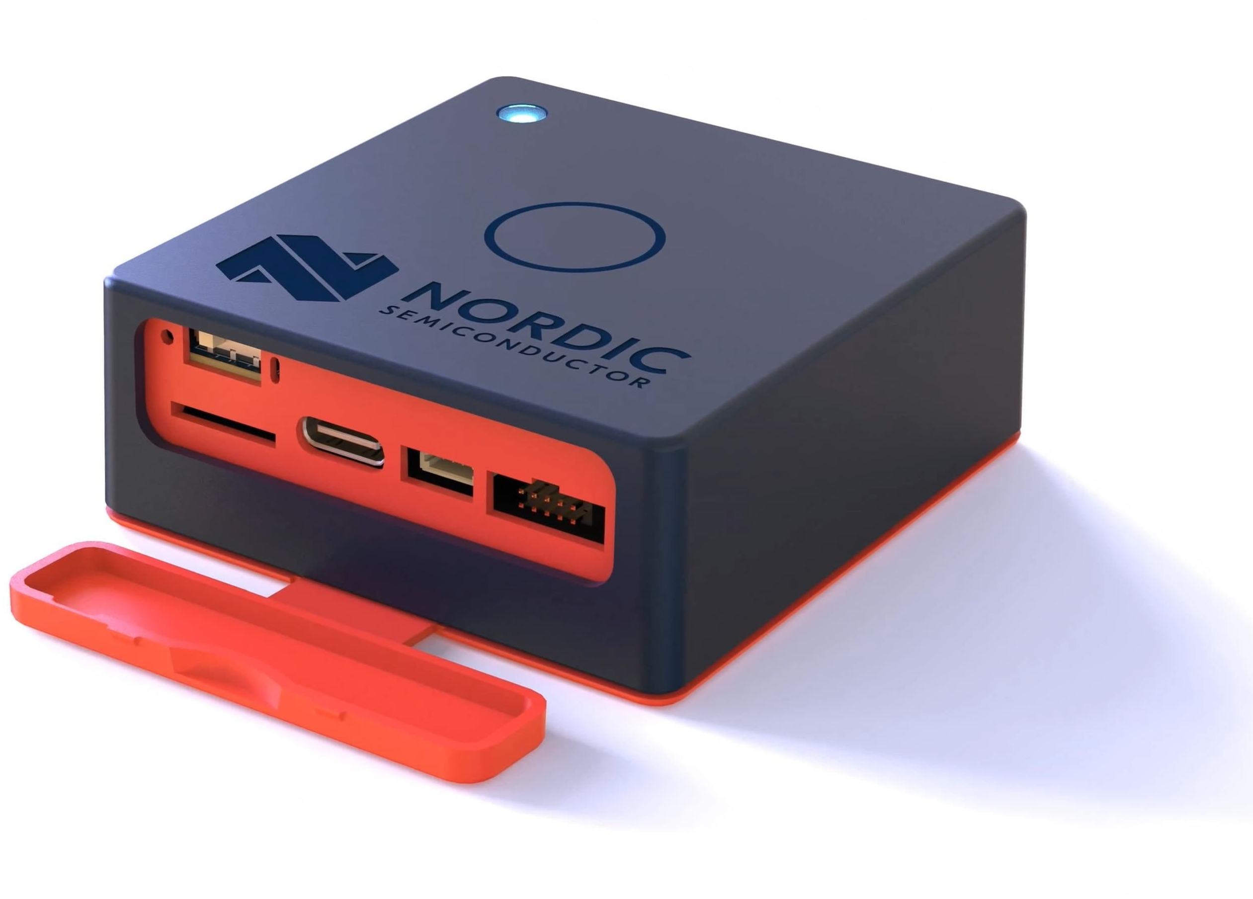

MPU 6050
Raspberry Pi Zero W
© Associated Press
© Associated Press
Sensitivity
Thingy:53
Raspberry Pi 3B
7

Slide 9
© Associated Press
9

Slide 10
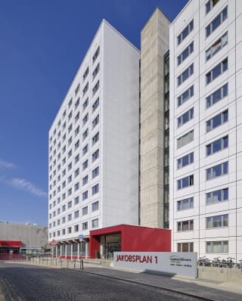
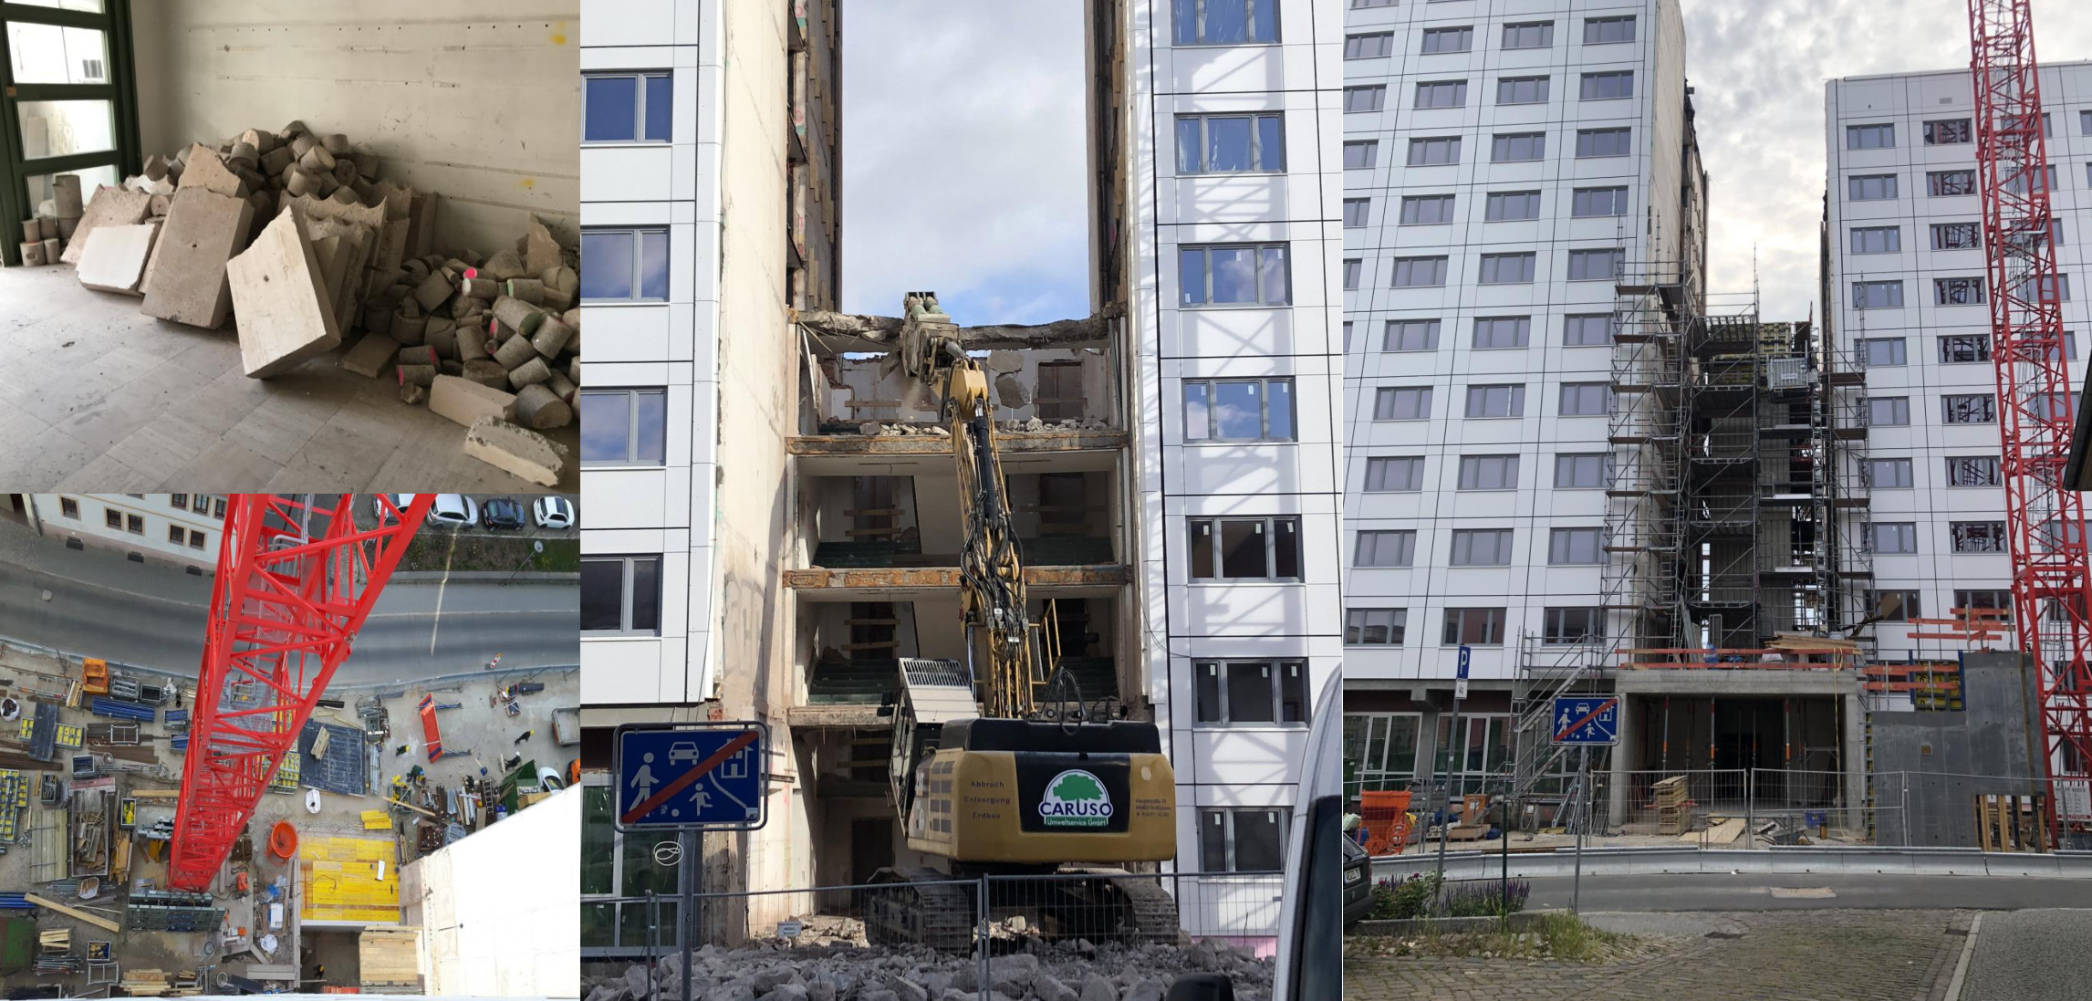
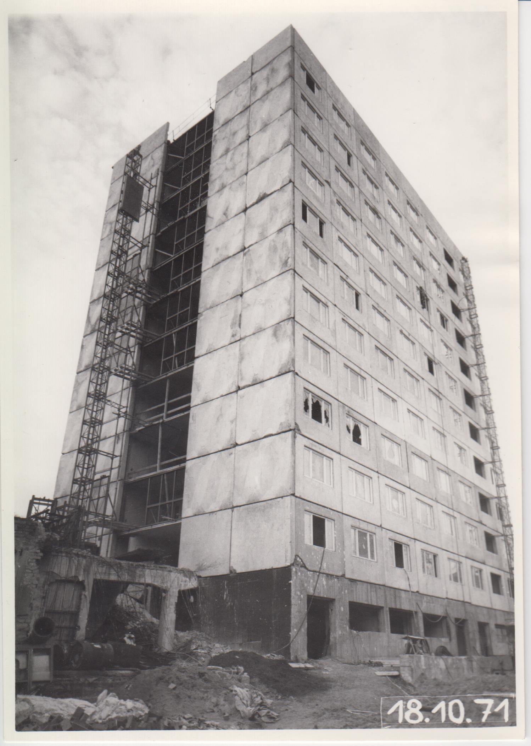
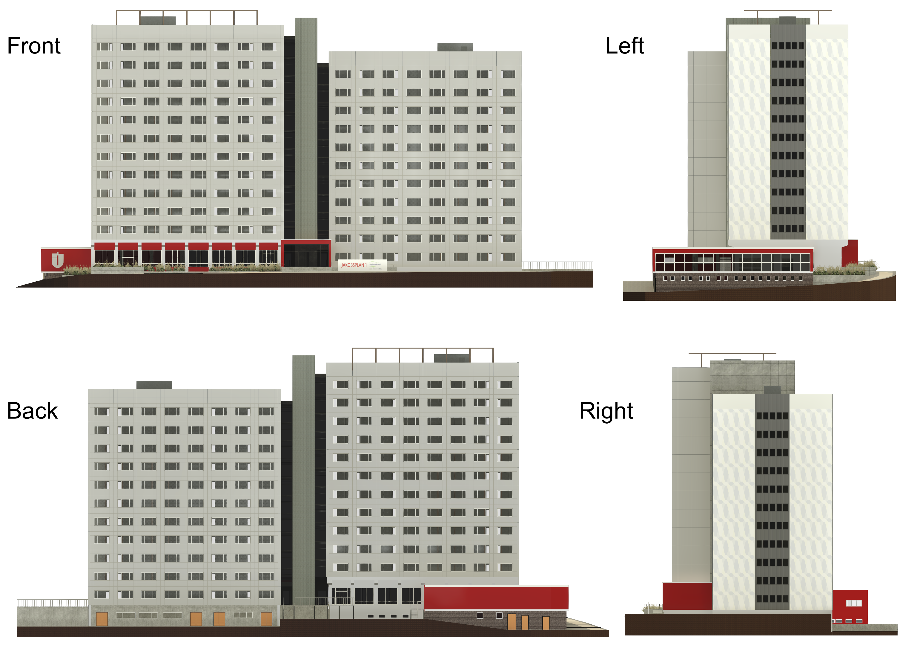
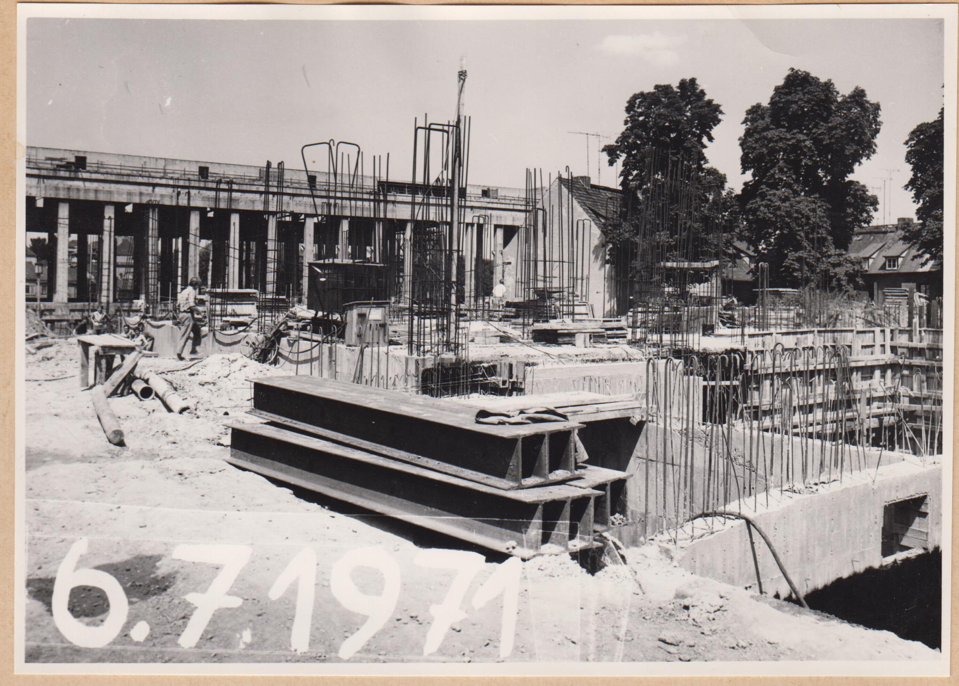
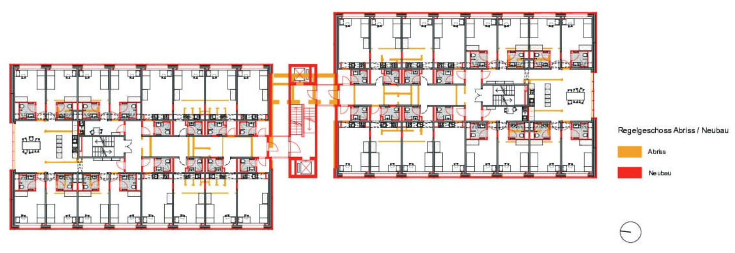
© Associated Press

