Slide 1

Your own personal cloud
Zsolt Sztupak

Slide 2
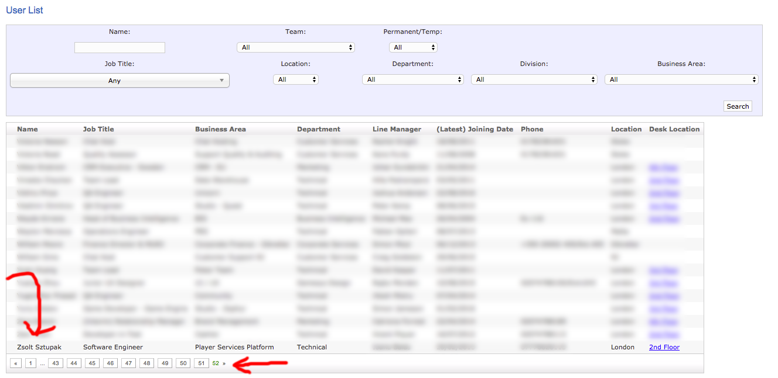

Slide 3
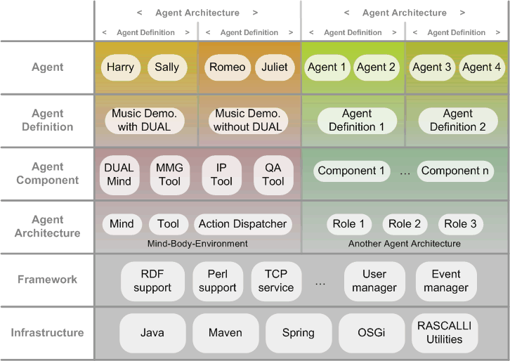

Slide 4
Prerequisites
git clone https://github.com/sztupy/doclusterdemo
Register on DO: https://m.do.co/c/5b7b04063796
You can find this URL in the git repo above
You‘ll need a debit card or PayPal account
Install terraform
OSX: brew install terraform
Windows: choco install terraform

Slide 5
Prerequisites
git clone https://github.com/sztupy/doclusterdemo
Register on DO: https://m.do.co/c/5b7b04063796
You can find this URL in the git repo above
You‘ll need a debit card or PayPal account
Install terraform
OSX: brew install terraform
Windows: choco install terraform
After completing steps of the guide 1-3 you can
WIN

Slide 6
Goals
Install a modified three-tiered version of TodoMVC
Make sure most components are HA / fail safe
Make sure we have logging and monitoring
Make sure we can push updates to the site in a rolling way
Make sure our cluster is secure

Slide 7
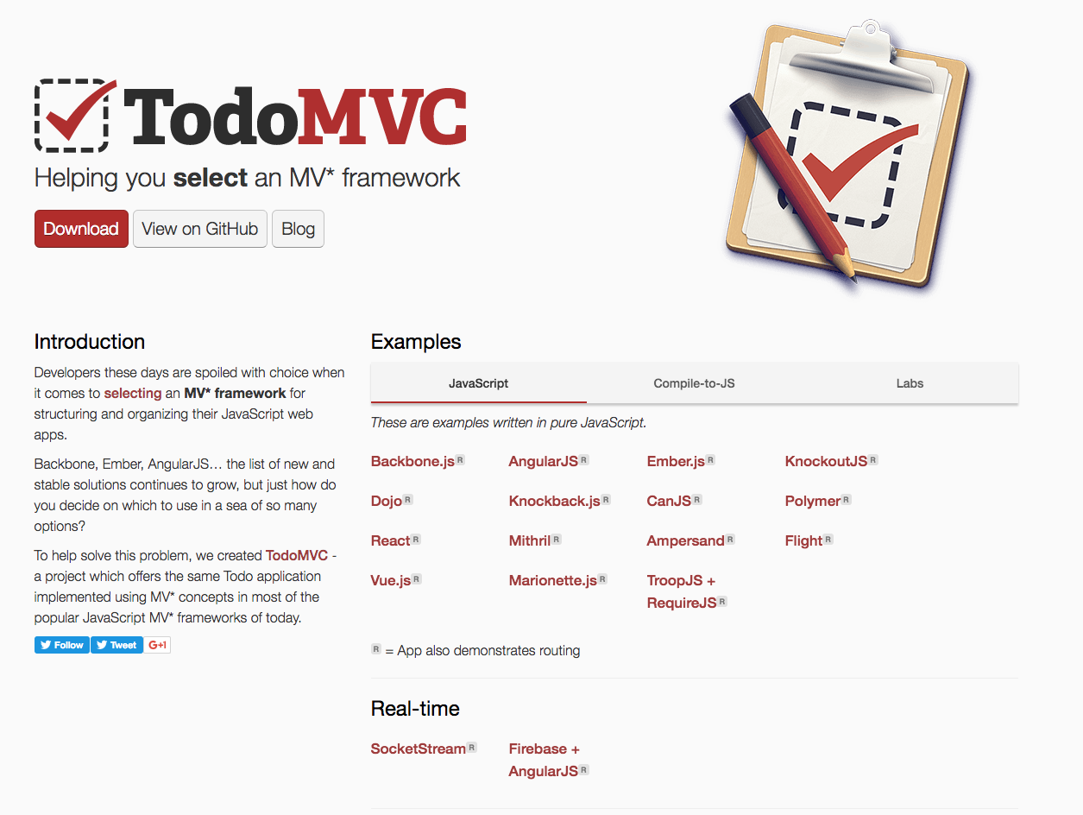
Todo MVC

Slide 8
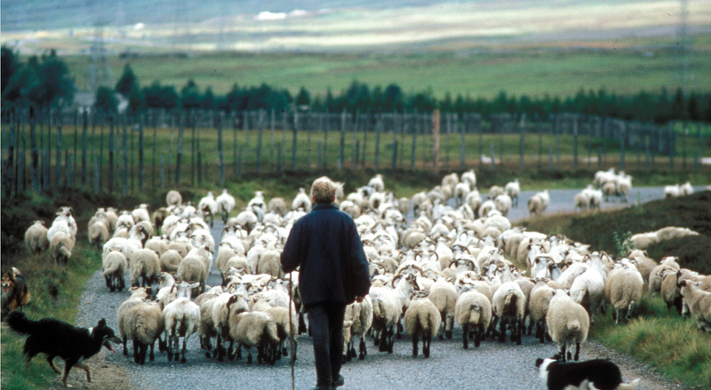
Todo MVC

Slide 9
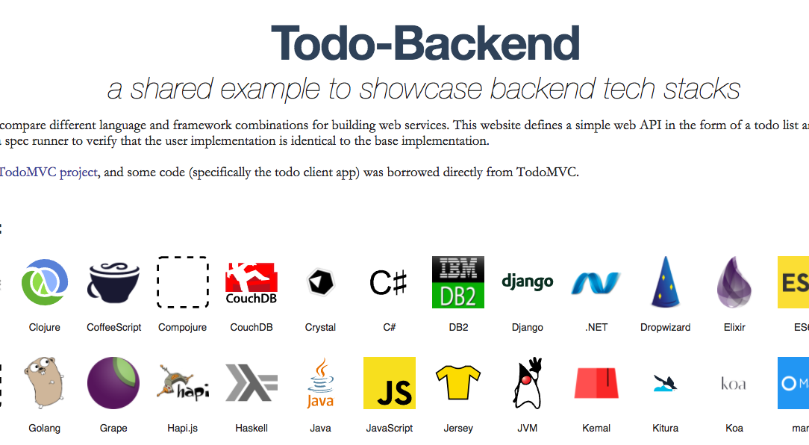
Todo MVC

Slide 10

Todo MVC

Slide 11
Digital Ocean
Cheap ($5+VAT/month for smallest box, $20+VAT/month for a usable one)
Fast
No support for advanced features:
Load balancing
Autoscaling
Virtual networks
Triggers
External volumes (available in some regions)

Slide 12
CoreOS
Minimal system
Supports running docker and rkt containers
Supports quick cluster setup
Updates itself automatically
Absolutely no package manager
Use docker or rkt instead

Slide 13
Terraform
Vagrant for cloud
Can set up an entire infrastructure including
hosts
volumes
domains
networking
etc.

Slide 14
Step 1
(Internet)
Web (FE, BE, DB)

Slide 15
Step 1
Obtain keys from DigitalOcean
https://cloud.digitalocean.com/settings/api/tokens
cd terraform/1
Create terraform.tfvars
access_key="aaaaaaa"
#local_bash_shell_location="C:\\stuff\\git\\git-bash.exe”
terraform plan
terraform apply
ssh core@<IP>
Test the site in a browser
terraform plan --destroy
terraform destroy
Check README.md if stuck

Slide 16
main.tf
resource "digitalocean_droplet" "web" {
image = "coreos-stable" # the image to use.
name = "web" # the name of the node to create.
region = "lon1" # the region to put this new node.
# lon1 is the main London datacenter
size = "2gb" # the amount of RAM you want to give
private_networking = true # whether we need internal IP or not.
ssh_keys = ["${digitalocean_ssh_key.dodemo.id}"] # The SSH key
# Here we just refer to the ID of the previously created resource.
# Note that CoreOS on DO always requires access by SSH keys,
# you cannot set up password auth for root at droplet creation.
user_data = "${file("web.conf")}"
# the cloud-config file to set up the node
}

Slide 17
web.conf
#cloud-config
# cloud config MUST start with the line above, otherwise provisioning will fail.
# If you use any kind of YAML editor make sure it keeps the above line inside the output file
coreos:
units: # here we can create new systemd compatible services. Some are already provided (like etcd2),
# and we just tell CoreOS to start them up, but some of them we create completely in this section
- name: "etcd2.service"
command: "start"
- name: "docker-frontend.service" # this is how you could start up a docker container using only systemd units
command: "start"
content: |
[Unit]
Description=Frontend Service
Author=Me
After=docker.service
[Service]
Restart=always
ExecStartPre=-/usr/bin/docker kill frontend # =- means we don't care if the command fails
ExecStartPre=-/usr/bin/docker rm frontend
ExecStartPre=/usr/bin/docker pull doclusterdemo/frontend
ExecStart=/usr/bin/docker run -p 80:80 -e API_ROOT_URL=http://$public_ipv4:8080/todo --name frontend doclusterdemo/frontend
# we could have used some other configuration mechanism here as well,
# but as this is a simple service providing everything on the command line should be enough
ExecStop=/usr/bin/docker stop frontend

Slide 18
Step 2
Web
API
Web
API
BE
DB
BE-2
DB-1
DB-2
(Internet)
Internet
BE-1

Slide 19
Step 2
cd terraform/2
copy over terraform.tfvars
terraform apply
Note how it deploys the site from bottom-up
test the site
Check logs on api proxy using journalctl –f
Try to stop a backend and/or database node
terraform destroy

Slide 20
Step 3
(Internet)

Slide 21
Step 3
cd terraform/3
copy over terraform.tfvars
./apply.sh
wait…
On master node check logs using journalctl –f
(if download is slow, try to destroy and recreate the boxes)
Once finished try
sudo /opt/bin/kubectl cluster-info

Slide 22
Security

Slide 23
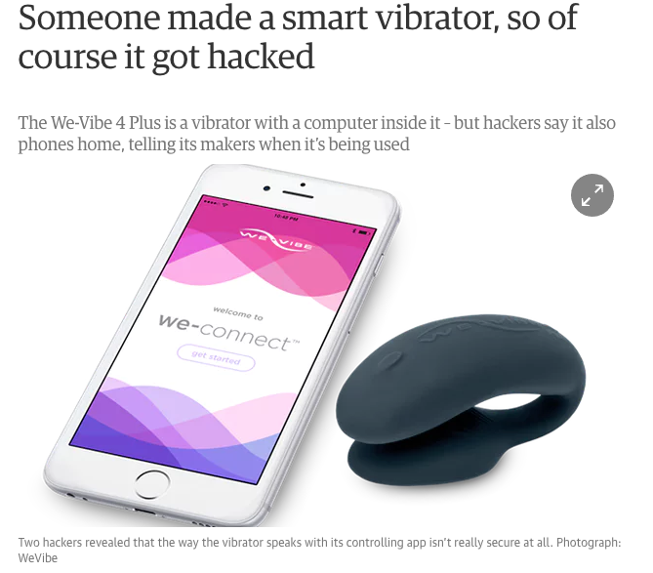
Security

Slide 24
Security
We’ll be using SSL keys to secure communication
The master node is our Certificate Authority
We have some scripts to generate certificates for the slaves
We’ll be securing etcd2 and kubernetes

Slide 25
etcd2
Distributed key-value store
Ideal for storing configs
Has an official service to help clusters find each other
curl -w "\n" "https://discovery.etcd.io/new?size=1"

Slide 26
flanneld
Virtual network layer
maps something like
46.101.82.81 master.local
138.68.146.15 node-0.local
138.68.159.48 node-1.local
138.68.146.38 node-2.local
into a flat structure: 10.2.0.0/16
actually runs inside a container

Slide 27
kubernetes
Container orchestration system
You just define the state you want, and it takes care of the rest

Slide 28
kubernetes
(Internet)
frontend
App
DB

Slide 29
kubernetes
Container orchestration system
You just define the state you want, and it takes care of the rest
Also runs as a container
Supporting infrastructure also runs in a container:
reflector.go:203] pkg/kubelet/config/apiserver.go:43: Failed to list *api.Pod Get http://127.0.0.1:8080/api/v1/pods?fieldSelector=spec.nodeName%3D10.131.35.90&resourceVersion=0

Slide 30
Step 4
(Internet)
frontend
App
DB

Slide 31
Step 4
cd terraform/4
./initializeCluster.sh
Will use terraform state from the 3rd directory to obtain the IPs
ssh core@<master_ip>
sudo su
# list all of the pods on the cluster
/opt/bin/kubectl get pods
# get some information about the pods
/opt/bin/kubectl describe pods
# get some information about the nodes
/opt/bin/kubectl describe nodes
# check logs from a pod
/opt/bin/kubectl logs <enter_pod_name>
# enter into a pod to play around
/opt/bin/kubectl exec -ti <enter_pod_name> bash

Slide 32
Pods
Abstraction around containers.
Usually one pod == one docker container
Can be more
Kubernetes will abstract the pod so all of it’s containers run in one IP, but separate ports
Separate pods will always have separate IPs

Slide 33
Deployment
An abstraction to get a number of the same pods onto your cluster
Also supports rolling updates.
Useful for stateless services that don’t depend on each other

Slide 34
Pets
An abstraction for pods, that are
More permanent in nature
Are not independent
Usually: databases

Slide 35
Ingress
So far our containers run in the internal kubernetes virtual network
To access anything from inside we need to
Either be in one of them (kubectl exec…)
Or expose them to the outside world
Ingress is a fairly new abstraction that is essentally an abstraction around virtualhost configs

Slide 36
backend.conf
Service:
creates a common interface for the pods
Ingress:
creates a virtualhost mapping for the outside world
Deployment:
Actually deploys the pods
Note how the links are set up:
env:
name: CASSANDRA_CONTACT_POINT
value: "cassandra-0.cassandra.default.svc.cluster.local"

Slide 37
Step 5
(Internet)
frontend
App
Logging
DB

Slide 38
Step 5
cd terraform/5
./initializeCluster.sh
Will use terraform state from the 3rd directory to obtain the IPs
./adminProxy.sh
Open up the sites locally
Play with the dashboard and kibana
Once finished:
cd terraform/3
terraform destroy
(enter any random value for the discovery_url)

Slide 39
What to do with the remaining $9.80?
Mine Bitcoins
Use it as a TOR proxy
VPN into the US to circumvent geoblock
Or do some of the homeworks

Slide 40
What to do with the remaining $9.80?
Mine Bitcoins
Use it as a TOR proxy
VPN into the US to circumvent geoblock

Slide 41
Homework (or part 2)
Add a full CI/CD environment
GitLab is a good candidate
Open Source
Can store git repositories
Can build docker images
Can store docker images

Slide 42

Homework (or part 2)
Add more monitoring
grafana, nagios, etc.

Slide 43

Homework (or part 2)
Monitor the monitors
(preferably from outside)

Slide 44
Homework (or part 2)
Security
Add calico plugin
Add support for IPSec
Secure communications between the apps
Separate CAs for etcd and kubernetes
Add users and roles for the nodes
Etc.

Slide 45
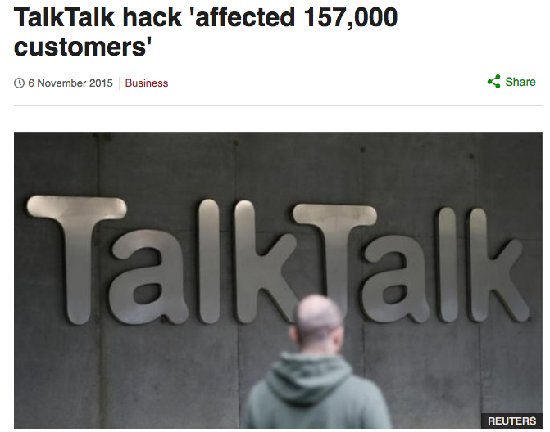
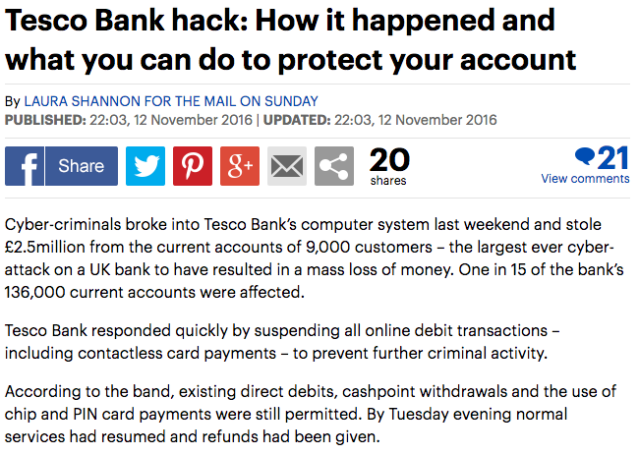
Homework (or part 2)

Slide 46
Homework (or part 2)
High availability
Add failover for the master nodes
Add more etcd2 masters
Failover for the load balancer
You can use Digital Ocean’s new Floating IP

Slide 47
Thanks!
Don’t forget to destroy your cloud!

