Slide 1
PULCRO
On-Demand Laundry & Home Cleaning App
Product Walkthrough • Architecture • Roadmap
Frontend Prototype — React Native (Expo) + TypeScript

Slide 2
OVERVIEW
Agenda
01 What is Pulcro?
02 Tech stack & architecture
03 Screen inventory & navigation map
04 User flow, end to end
05 Feature walkthrough (with screenshots)
06 Internationalization (ES / EN)
07 What's missing — this is frontend only
08 Roadmap & points to improve
PULCRO | Agenda
2

Slide 3
PRODUCT
What is Pulcro?
Pulcro is a mobile app concept for on-demand laundry and home-cleaning services in Mexico — request pickup, choose a service, schedule a time window, and track your order, all from your phone.
Laundry by kilo
Garment cleaning
House cleaning
Car cleaning
Positioning
• Same category as Cleano (Qatar), JustClean, Washho: on-demand home services
• Pricing in MXN — built for the Mexican market
• Single-vendor model today (Pulcro is the provider, not a marketplace yet)
+ Shop for cleaning products
PULCRO | Product
3

Slide 4
ARCHITECTURE
Tech Stack
Framework
Navigation
State & Data
UI & Platform
• Expo SDK 54
• React Native 0.81
• React 19
• TypeScript
• Expo Router 6
• File-based routing
• Typed routes
• Tab + Stack nav
• React Context API
• AsyncStorage
• Supabase JS SDK (installed, unused)
• No API layer yet
• lucide-react-native
• expo-linear-gradient
• react-native-maps
• expo-location
No custom native modules requiring an EAS dev build beyond Maps/Location — runs in Expo Go.
PULCRO | Architecture
4

Slide 5
ARCHITECTURE
App Layers
Screens (app/*)
Home · Orders · Shop · Profile · Laundry · Garments · House · Car · Cart
Shared Components (components/*)
ScreenHeader · PrimaryButton · CategoryCard · ServiceCard · LanguageToggle · LocationConfirmScreen
Global State (contexts/*)
LanguageContext (ES/EN) · LocationContext (confirmed address)
Foundations (constants/*)
theme.ts (colors, spacing, type scale) · translations.ts (i18n dictionary)
PULCRO | Architecture
5

Slide 6
NAVIGATION
Screen Inventory
Screen | Route | Purpose
Location Confirm | gate at launch | First-run only: confirm pickup/delivery address via map or manual entry
Home | / (tabs) | Greeting, search, hero banner, service categories, popular services
Orders | /orders | Active order tracker + order history
Shop | /shop | Browse & filter cleaning products, add to cart
Profile | /profile | Account info, addresses, payment methods, settings, language
Laundry by Kilo | /laundry | Weight stepper, tiered pricing, schedule pickup
Garment Cleaning | /garments | Per-item quantity picker (sneakers, boots, caps…)
House Cleaning | /house | Plan selector (Basic/Deep/Premium) + extra services
Car Cleaning | /car | Vehicle type + wash package selector
Cart / Checkout | /cart | Review items, address, schedule, payment, confirm order
PULCRO | Navigation
6

Slide 7
USER FLOW
End-to-End Journey
App Launch
Home
Browse & Configure
Cart & Checkout
Order Confirmed
Track in Orders
Confirm Location
(first launch only)
Loop: Orders and Profile are always reachable from the bottom tab bar, so users can start a new service, reorder, or edit account details at any point without leaving the main flow.
PULCRO | User Flow
7

Slide 8
03
Feature Walkthrough
A guided tour of every screen, with live screenshots from the app.
PULCRO | Section
8

Slide 9
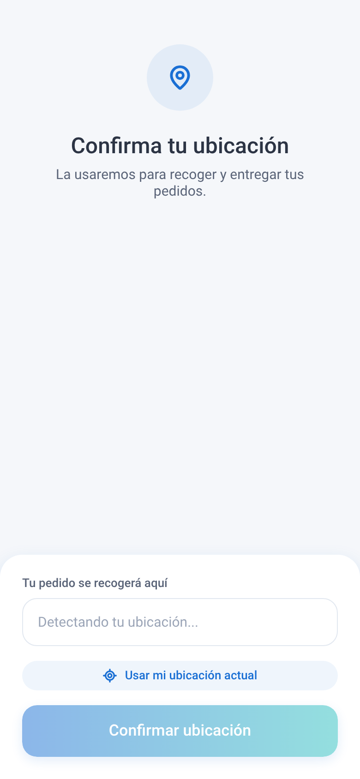
ONBOARDING
Confirm Your Location
• Shown once, before the very first Home screen — gates the whole app
• Native (iOS/Android): live MapView with a fixed center pin, drag to adjust
• GPS auto-detect via expo-location + reverse geocoding to a readable address
• Web fallback: manual address field (no native map module on web)
• Confirmed address is saved to AsyncStorage — never asked again
⚠ Address is currently stored locally only; it is not yet linked to a user account or backend.
PULCRO | Onboarding
9

Slide 10
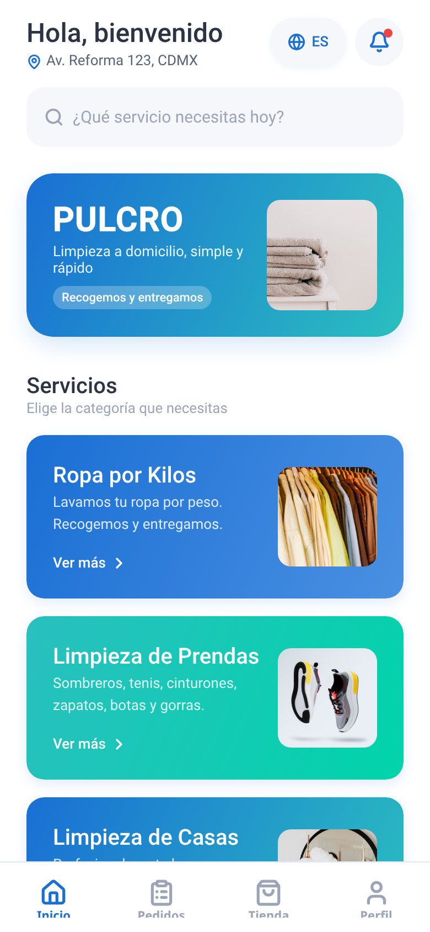
HOME
Discover Services
• Personalized greeting + detected address in the header
• Language toggle (ES/EN) and notification bell, always one tap away
• Search bar for services (UI only — not wired to real search yet)
• Hero banner reinforces the brand promise: pickup & delivery
• Service category cards route to each booking flow
• Horizontal "Popular" carousel highlights top services
PULCRO | Home
10

Slide 11
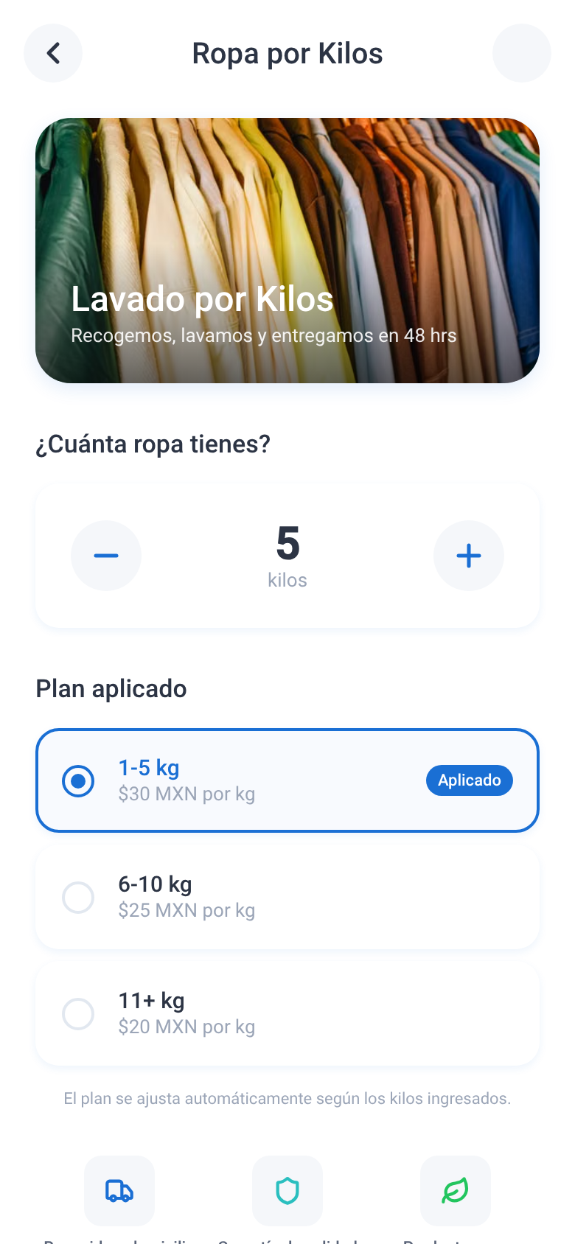
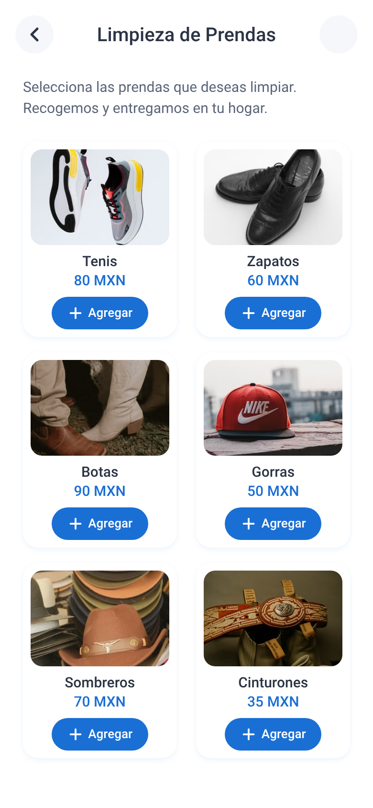
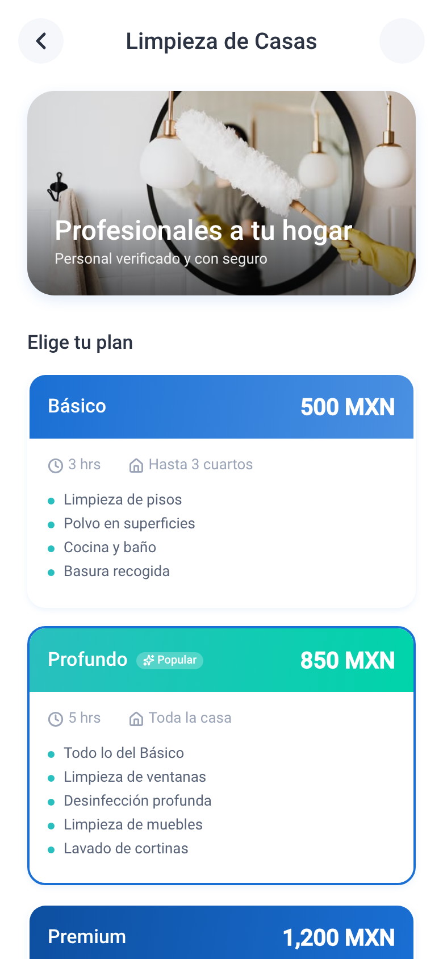
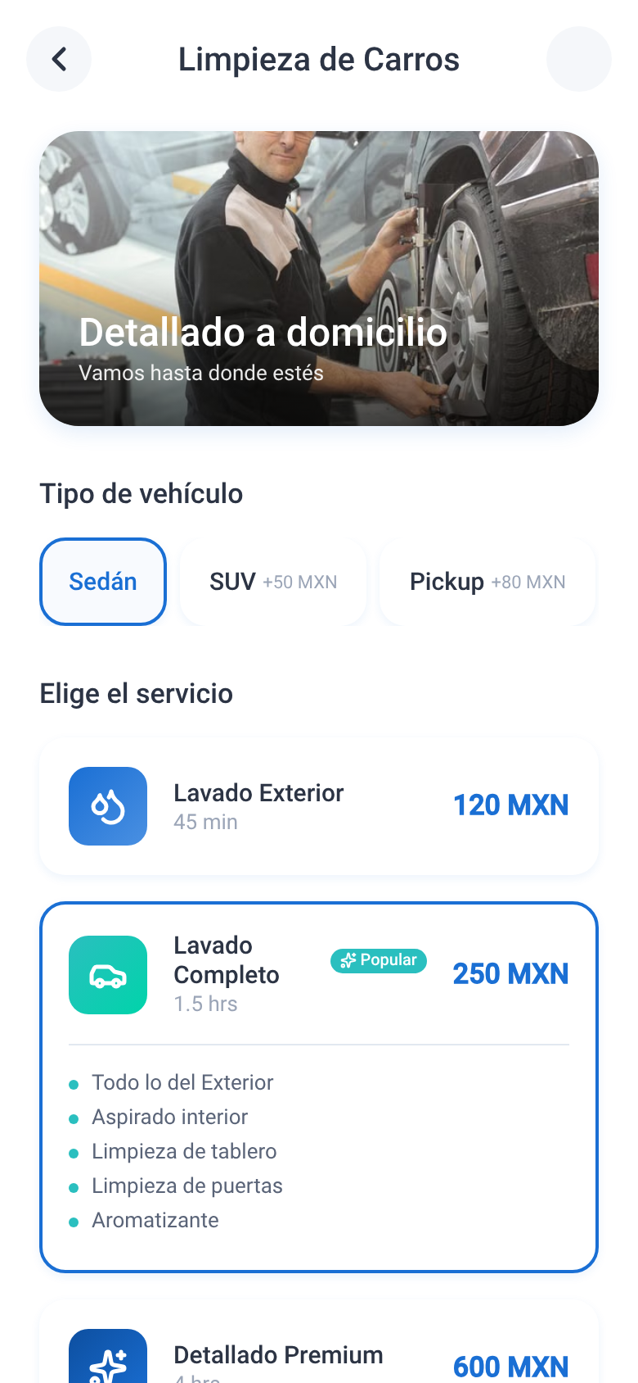
BOOKING FLOWS
Four Ways to Book a Service
All four flows share the same pattern: configure → live price updates → "Schedule" → Cart
Laundry by Kilo
Garment Cleaning
House Cleaning
Car Cleaning
Weight stepper + auto tier pricing
Per-item quantity picker
Plan tiers + optional extras
Vehicle type + wash package
PULCRO | Booking Flows
11

Slide 12
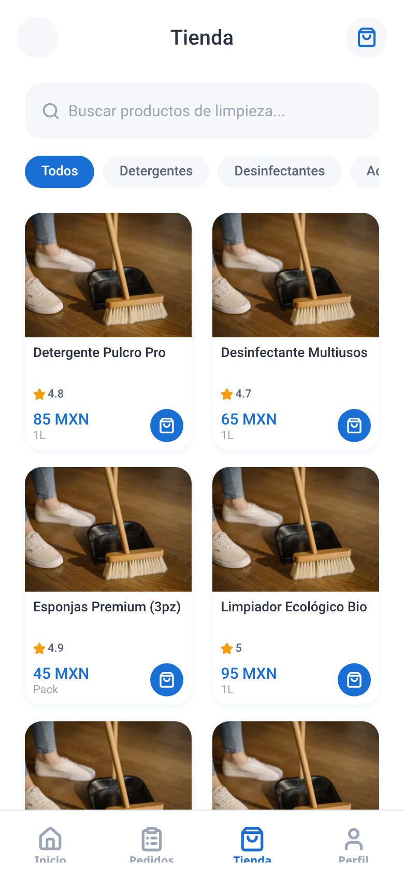
SHOP
Buy Cleaning Products
• Category filter chips (All, Detergents, Disinfectants, Accessories, Eco)
• Product grid with rating, price (MXN) and unit size
• Quick "add to cart" button per product
• Shared cart icon in the header badges into checkout
⚠ Catalog is a static in-memory array — no inventory, stock, or vendor backend.
PULCRO | Shop
12

Slide 13
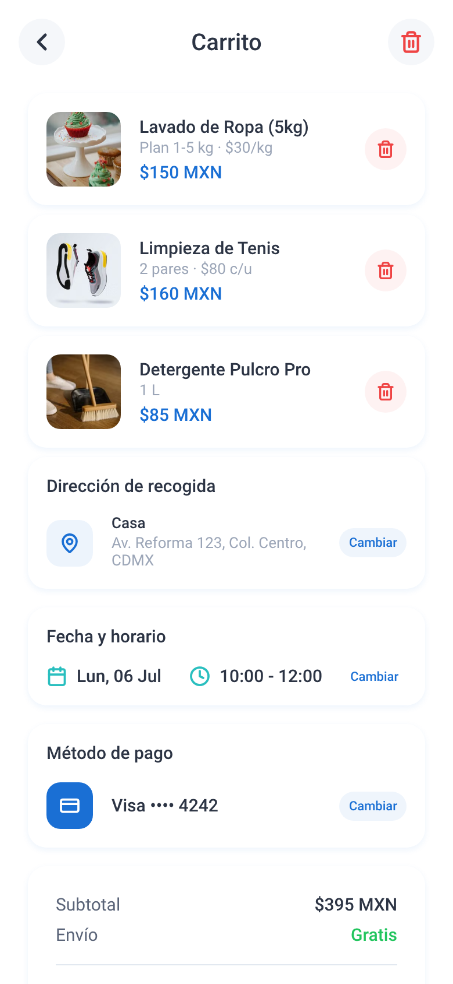
CHECKOUT
Cart & Checkout
• Line items pulled from every booking flow / shop add-to-cart
• Pickup address, date & time window, and payment method — each editable via a modal
• Calendar picker blocks past dates; time-slot grid for delivery window
• Live order summary with subtotal, free shipping, and total
• "Confirm order" pushes a new entry into the Orders tab
⚠ Checkout is fully mocked: no real payment gateway is called and totals aren't persisted server-side.
PULCRO | Checkout
13

Slide 14
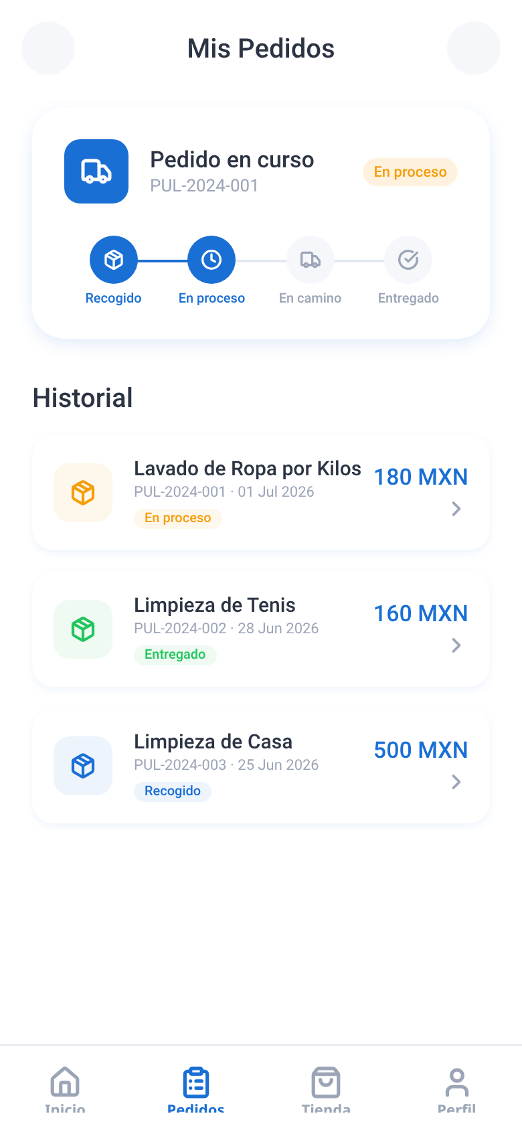
ORDERS
Track Your Orders
• Active order card with a 4-step progress tracker (Picked up → In progress → On the way → Delivered)
• Order history list with status badges, dates, and totals
• Tapping a past order does not yet open a detail view
⚠ Status is hard-coded demo data — there is no live courier/dispatch system behind it.
PULCRO | Orders
14

Slide 15
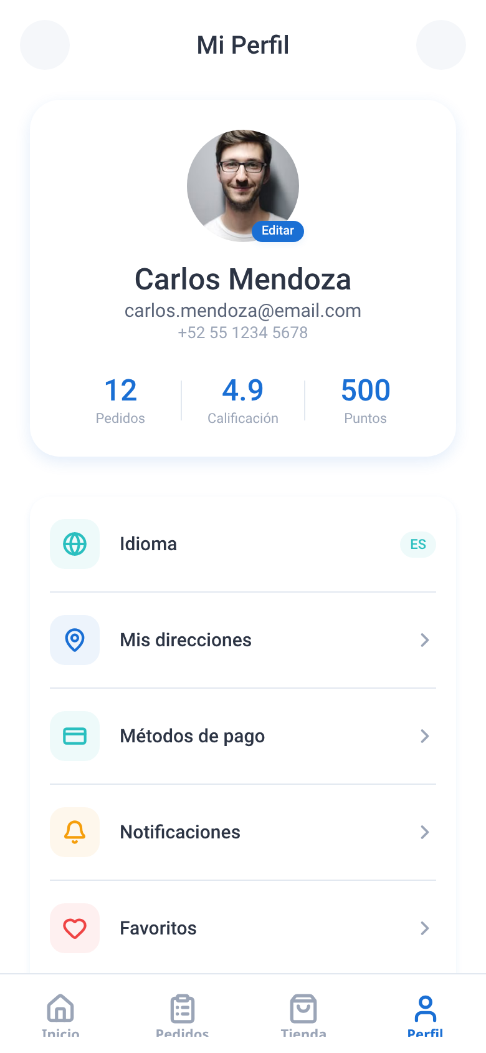
PROFILE
Account & Settings
• Profile summary with mock stats (orders, rating, points)
• Manage saved addresses and payment methods (add / delete) via modals
• Language switch (ES/EN) surfaced again here as a settings row
• Notifications, Favorites, Privacy and Help entries are placeholders (no linked screens yet)
• "Log out" button is present but not wired — there is no authentication yet
PULCRO | Profile
15

Slide 16
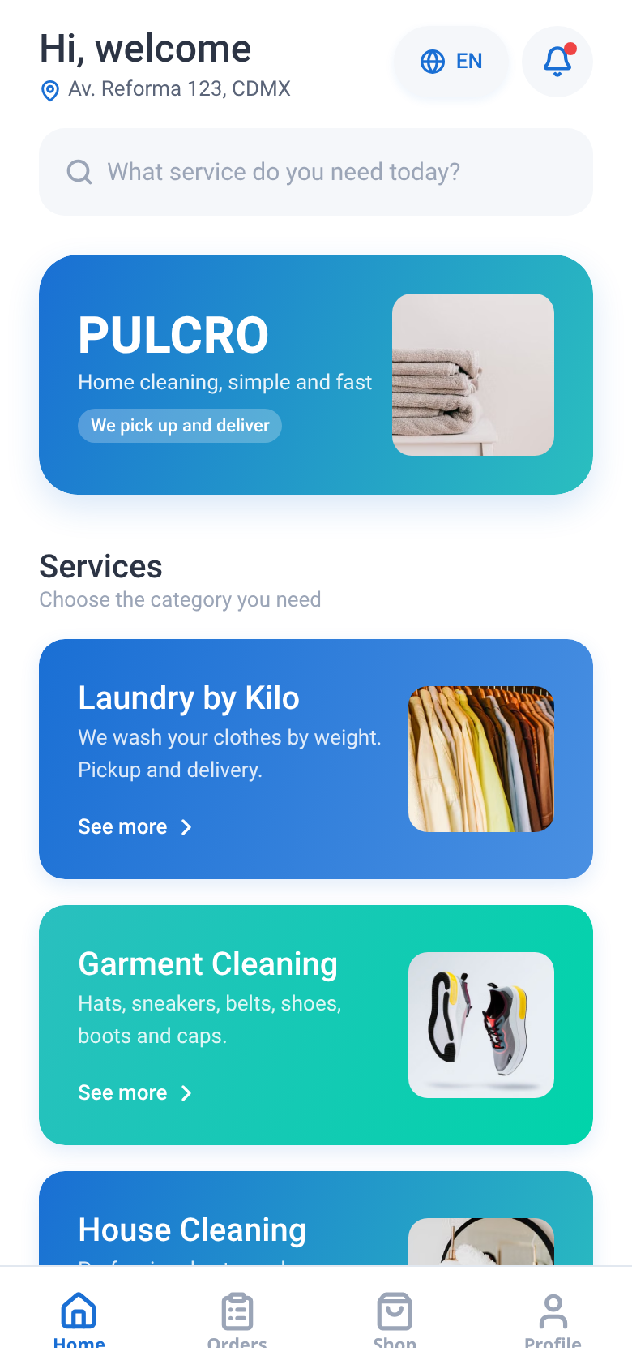
LOCALIZATION
Bilingual by Design (ES / EN)
Español (default)
English
One tap on the language chip swaps every screen instantly — no reload, no lost state. Built on a single typed dictionary (constants/translations.ts) and a React Context (contexts/LanguageContext.tsx), so every string in the app is centrally defined for both languages.
PULCRO | Localization
16

Slide 17
04
What's Missing
This build is a frontend prototype. Here is exactly what stands between it and a real product.
PULCRO | Section
17

Slide 18
REALITY CHECK
It's a Frontend Only — No Backend Yet
Every screen you just saw runs on local component state and hard-coded arrays — nothing is saved beyond the device.
No real accounts
No persisted data
No live services
• No login / signup / password reset
• Profile data (name, email, phone) is hard-coded
• "Log out" button does nothing
• Cart, orders, addresses & cards live only in memory
• Refreshing the app resets everything (except language & confirmed address)
• Supabase JS SDK is installed but not connected to any table
• No payment gateway is called on "Confirm order"
• Order status/tracking is static demo data, not real dispatch
• No push notifications, no SMS/email confirmations
PULCRO | What's Missing
18

Slide 19
05
Roadmap
Points to improve, grouped by what unlocks the most value first.
PULCRO | Section
19

Slide 20
ROADMAP · 1 OF 2
Backend & Live Features
HIGH
Real API + database — Supabase JS SDK is already installed; connect it (or a custom API) to back every screen
HIGH
Authentication — sign up / log in / log out / password reset; replace the hard-coded profile
HIGH
Persist orders, cart, addresses & payment methods server-side, tied to the account
HIGH
Real payment gateway for MXN (Mercado Pago, Stripe, OpenPay) at "Confirm order"
MED
Push notifications (expo-notifications) for order status changes
MED
Live order tracking: courier location + socket/real-time status updates
MED
Order detail screen, linked from Orders history
PULCRO | Roadmap
20

Slide 21
ROADMAP · 2 OF 2
Polish & Production Readiness
HIGH
Google Maps API key for Android + address autocomplete (Places API)
MED
Missing screens: Notifications, Favorites, Help & Support, Forgot Password
MED
Ratings & reviews after a service is completed
MED
Automated tests (unit + end-to-end) and CI/CD pipeline
MED
Error boundaries, loading/skeleton states, offline handling
LOW
Analytics & crash reporting (e.g. Sentry) before public release
LOW
Growth ideas from category leaders (Cleano): multi-vendor marketplace, promos & rewards ("4 orders, 5th free")
PULCRO | Roadmap
21

Slide 22
Thank You
Questions & discussion
PULCRO — Frontend prototype built with Expo, React Native & TypeScript

