Slide 1
Bankaya
Backend Software Engineer
César Luján Vásquez

Slide 2
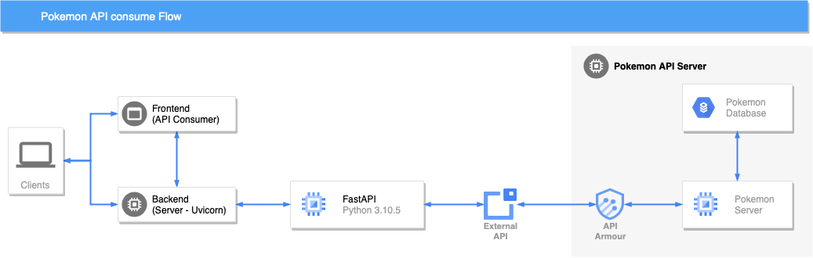
Flow for consume Pokemon API

Slide 3
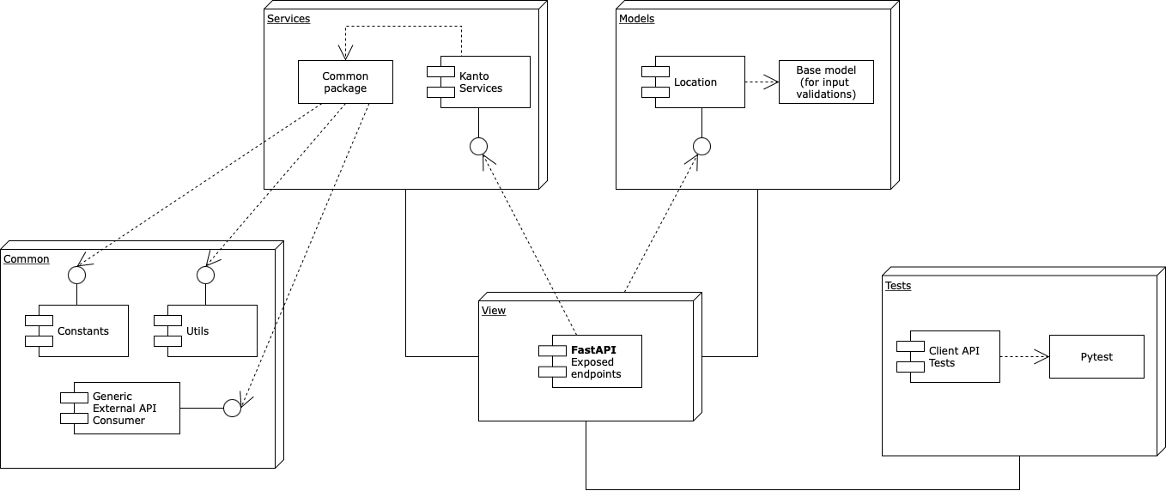
Project Package Structure

