Slide 1

AI Assistant for Industrial Manuals
Problem: Searching technical manuals is slow and inefficient.
Solution: An AI system that answers questions using Blucher manuals.

Slide 2

System Architecture
Tools Used:
LangChain
ChromaDB
OpenAI (GPT)
RAG systemProcess:
PDF
Text
Embeddings
Vector DB
AI Response

Slide 3
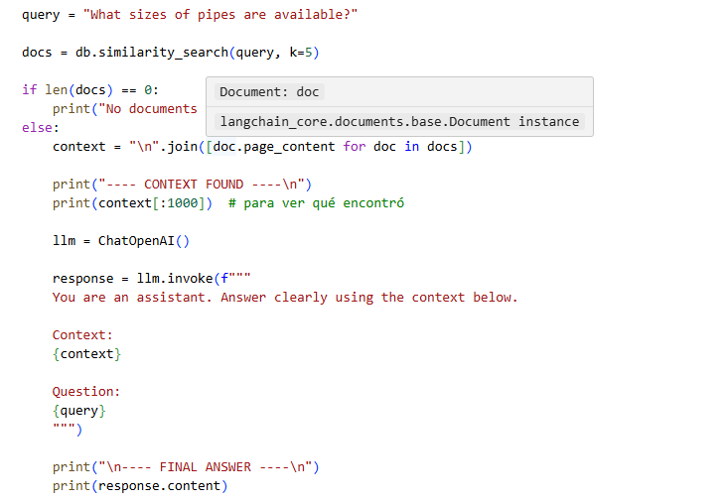
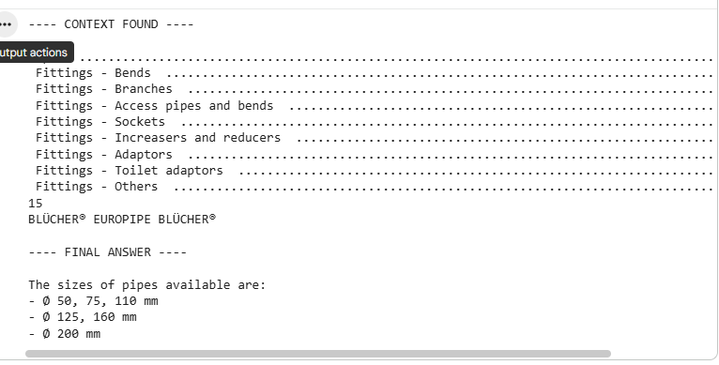
AI in Action

