Slide 1
Power Grid Analysis with Applications to Power Grid Security

Slide 2
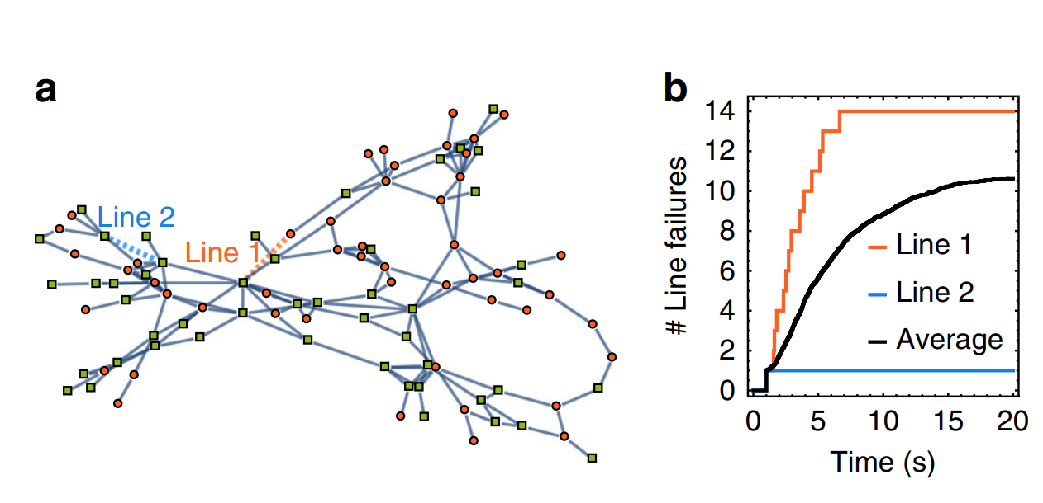
Why Do we care?
A failure in a line causes stress on the power grid.
When looking at the transient after failing a line, we can see other power line reach a flow higher than the lines capacity.
These additional failures can lead to a cascading failure.

Slide 3
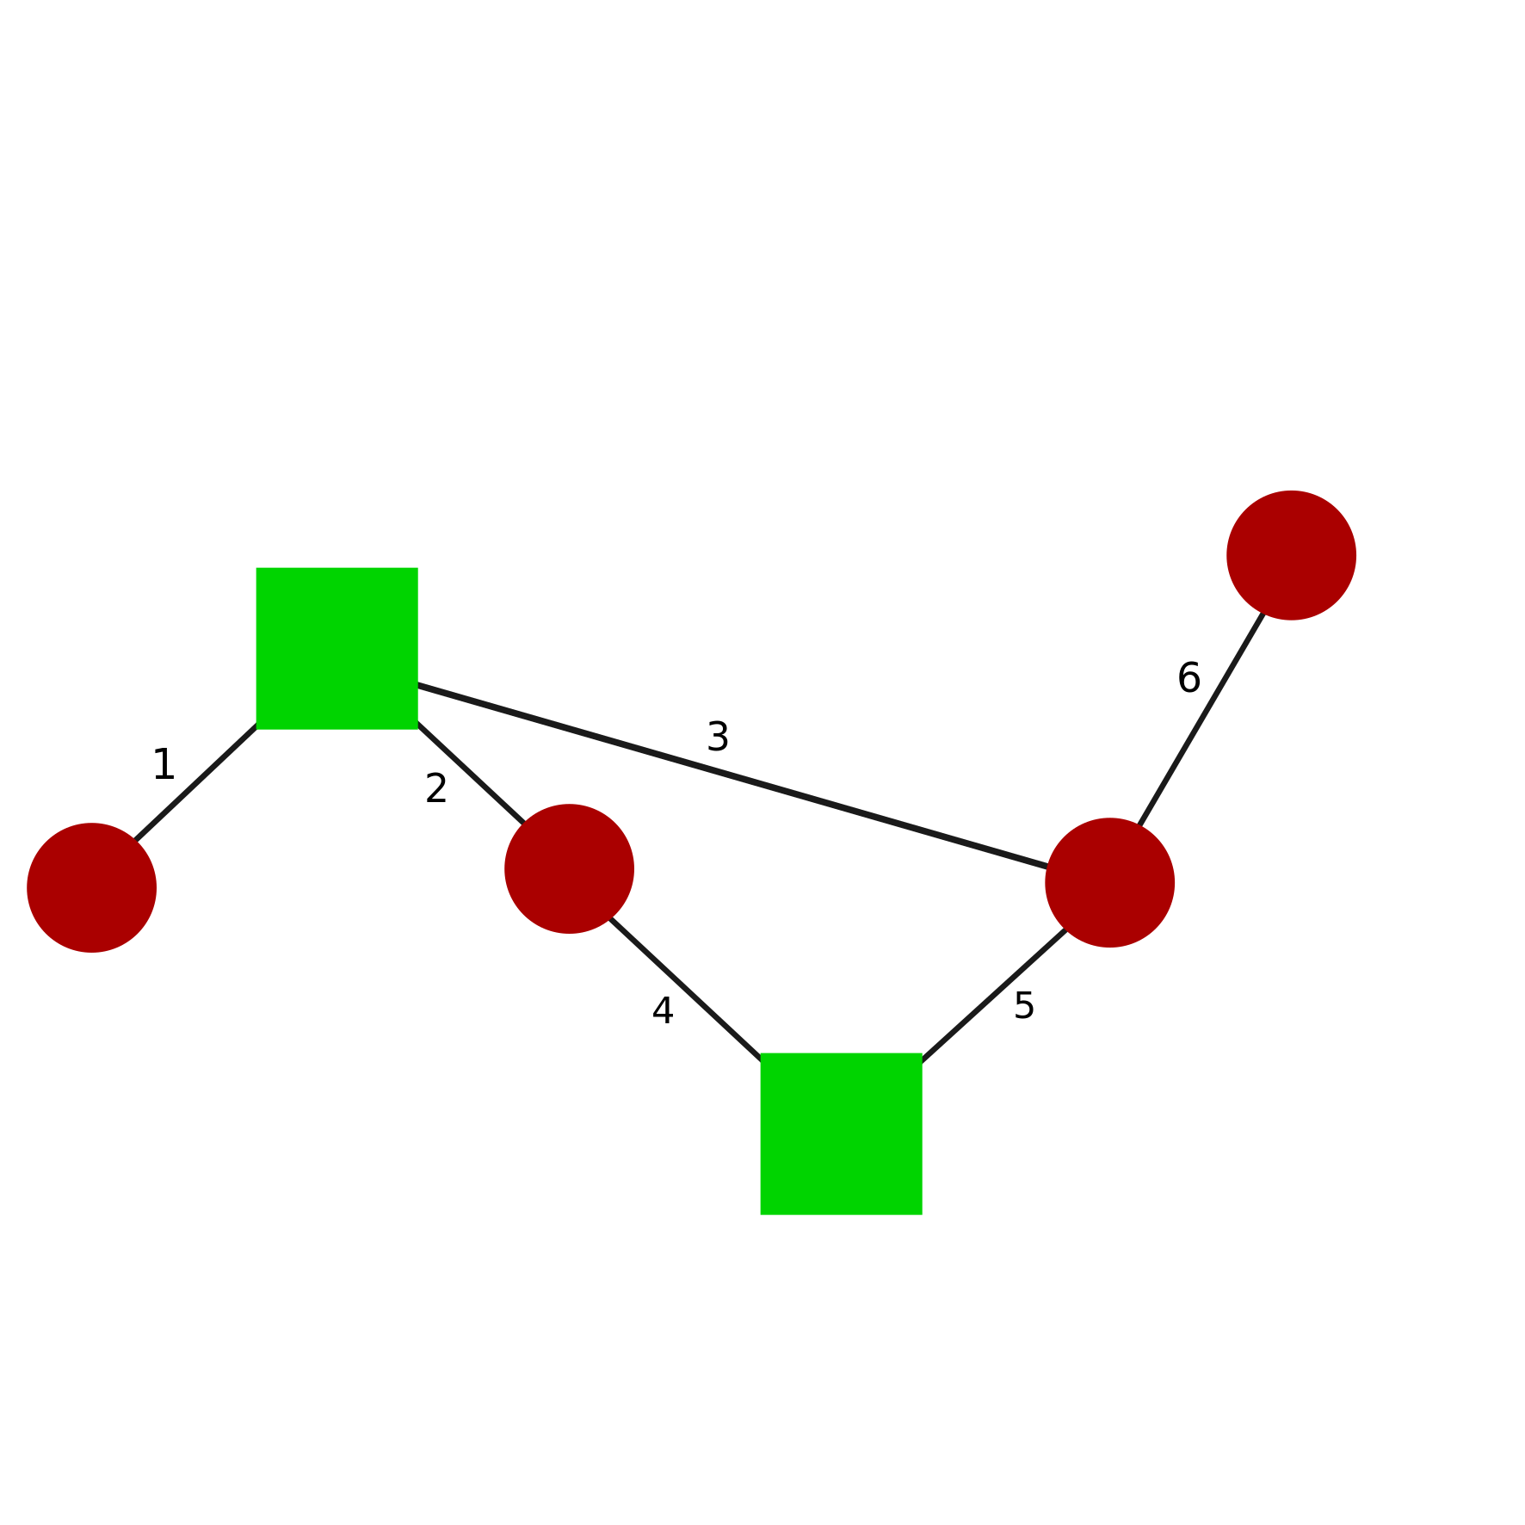
Power Grid Analysis
Swing Equation:
A line will fail if the power exceeds the threshold flow.

Slide 4
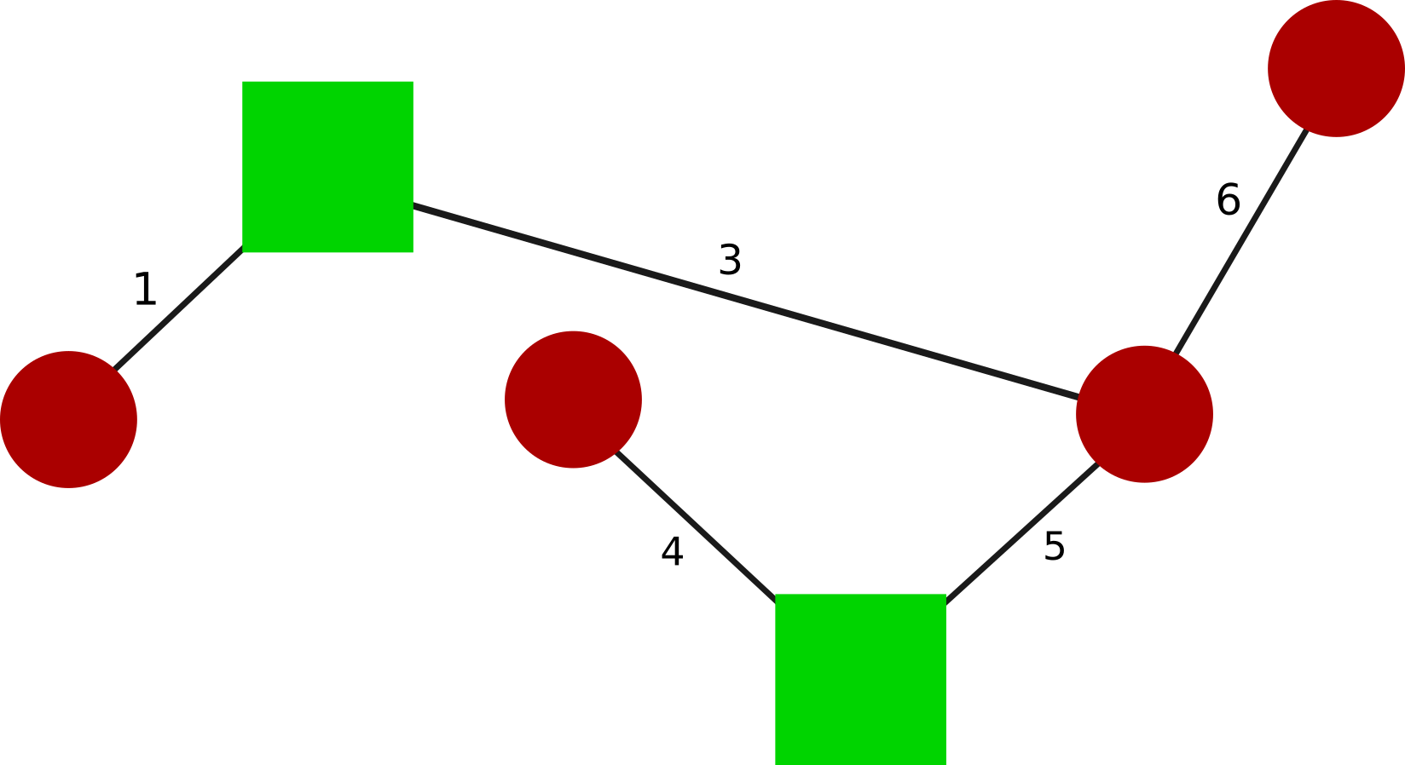
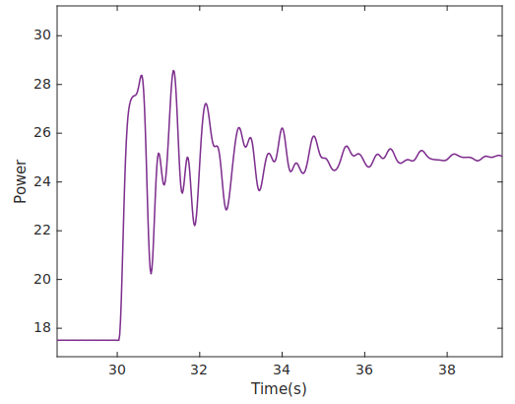
Example of a Line Failure
An example showing the transient after a line failure.
We can see how power flow jump much larger than the steady state.

Slide 5
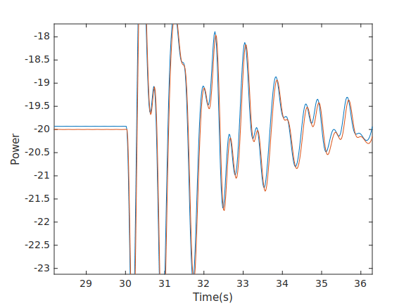
Linear Swing equation
Now we look at a linear swing equation:
The results of the transient is similar to the nonlinear swing equitation in the networks we are viewing.

Slide 6
Linearizing The Swing Equation
We now look at the linear swing equation.
Now we diagonalize L. Where V is the eigenvector matrix and Λ is a matrix with the eigenvalues along the main diagonal.
We now set
And get
We can break up this equation

Slide 7
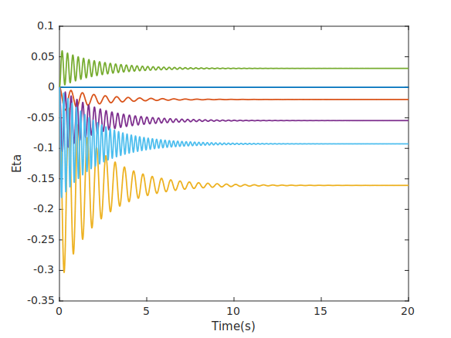
Linearize Swing Equation
We now have decoupled the systems. We can now analyze eta independently of other etas
To get back theta we use:

Slide 8
Conclusion
Gaining an understanding of the transient response will help to identify nodes of a network that will lead to a cascading failure.
Knowing nodes that vulnerable, allow for better security of the power grid. Allowing for more security of vulnerable nodes to protect the grid from Cyber attacks

Slide 9
References
Title:Dynamically induced cascading failures in power grids
Schäfer, B., Witthaut, D., Timme, M. et al. Dynamically induced cascading failures in power grids. Nat Commun 9, 1975 (2018). https://doi.org/10.1038/s41467-018-04287-5

