Slide 1
Objective
We will look at three networks and cut different lines to see the peak power error and peak time error.

Slide 2
Methods
Plotted the linear and non linear power of a line to calculate the peak power, peak time, and steady state error.
Formula used for percent error:

Slide 3
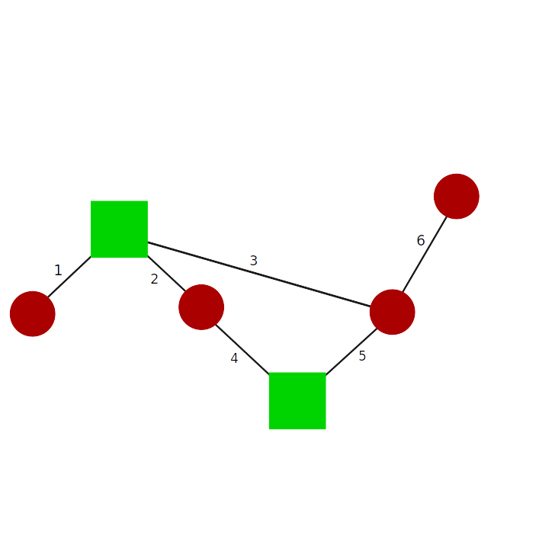

Slide 4
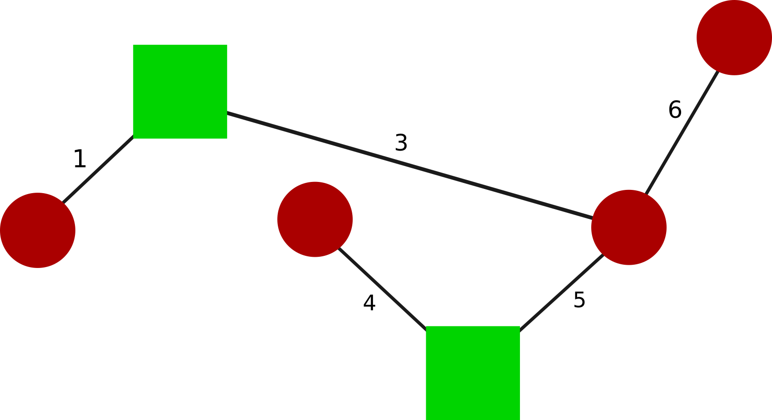
Network 1

Slide 5
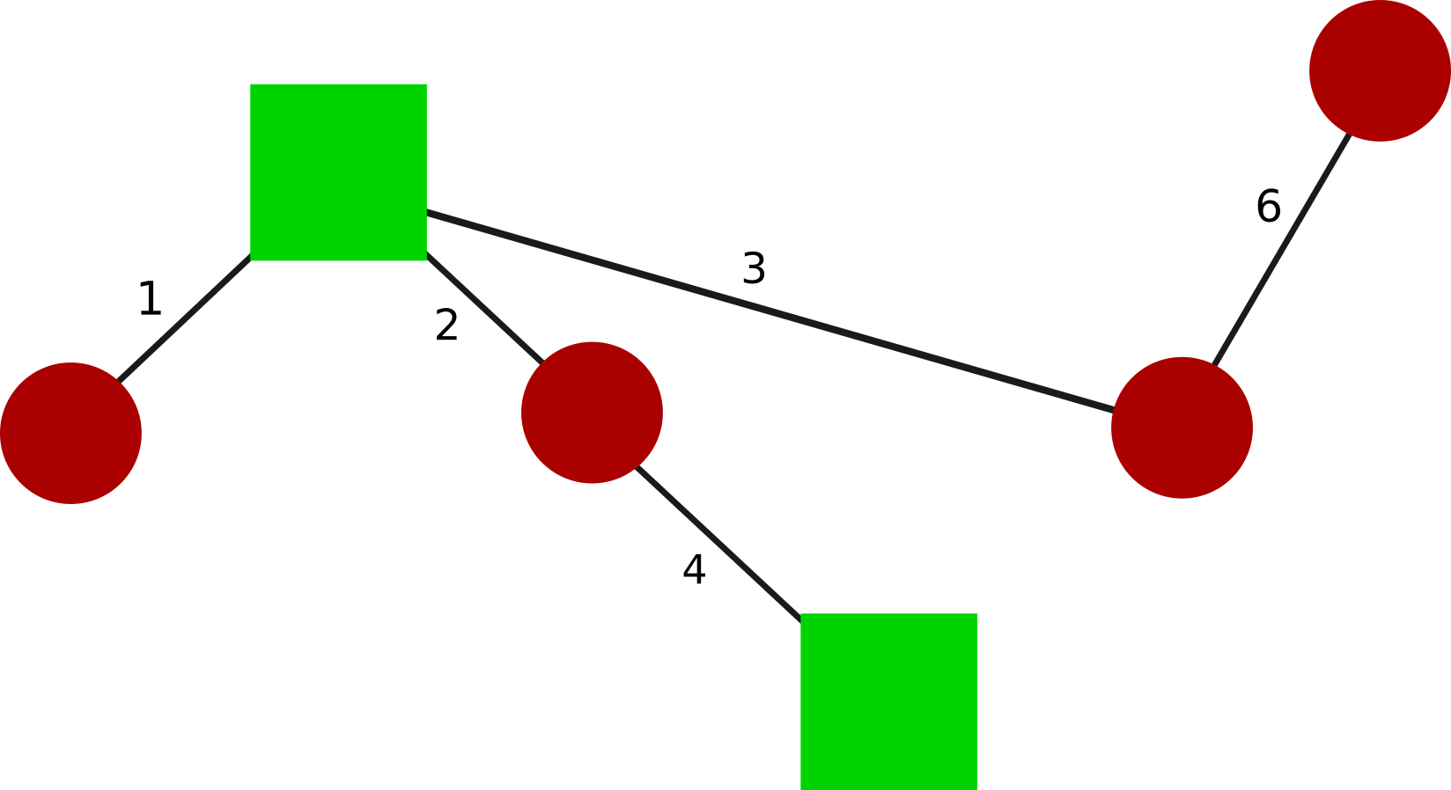

Slide 6
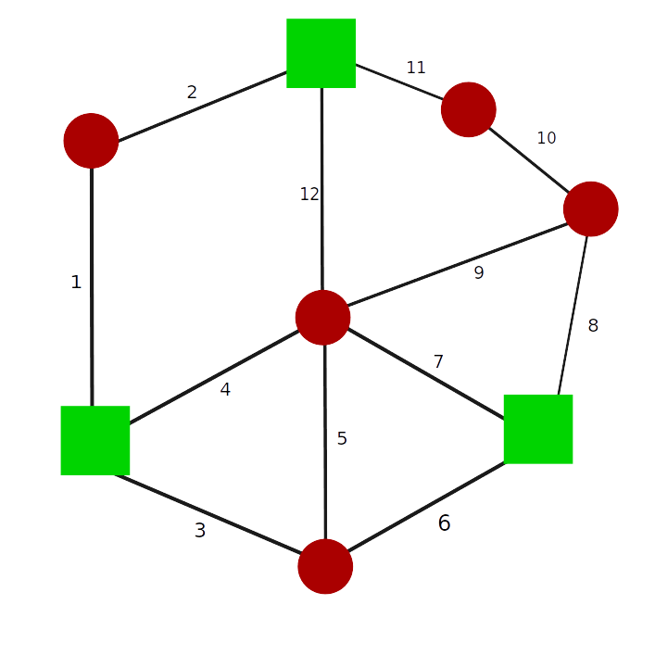
Network 2

Slide 7
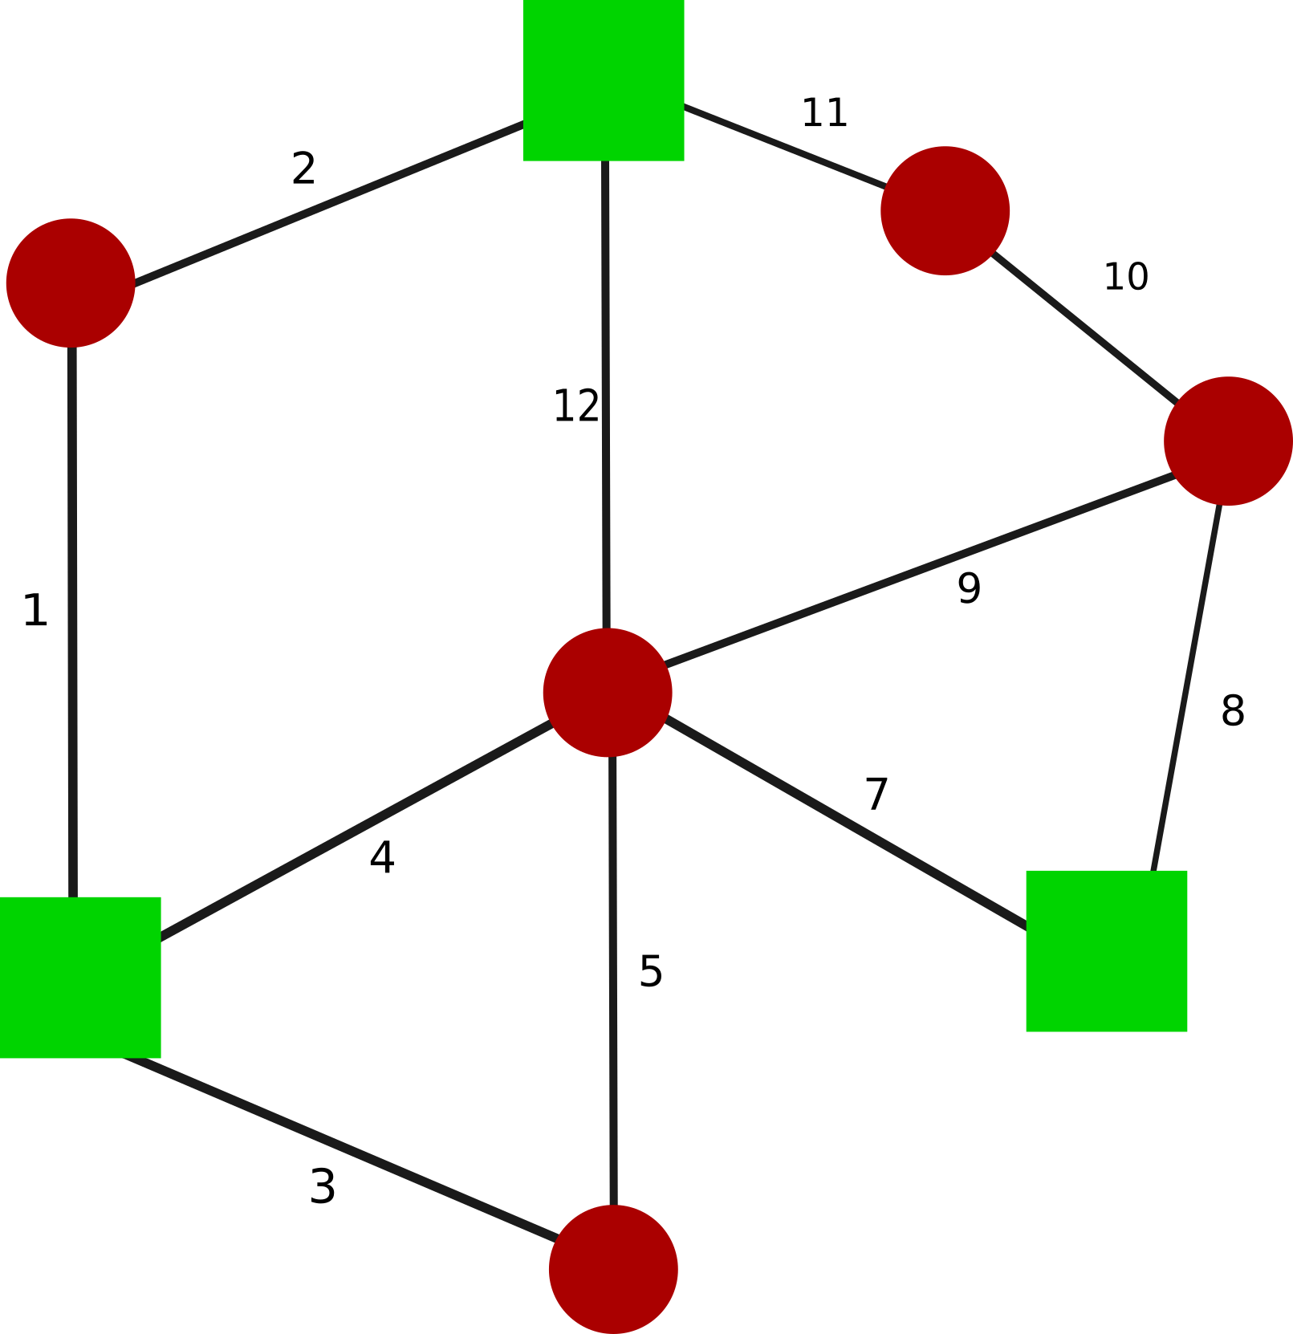

Slide 8
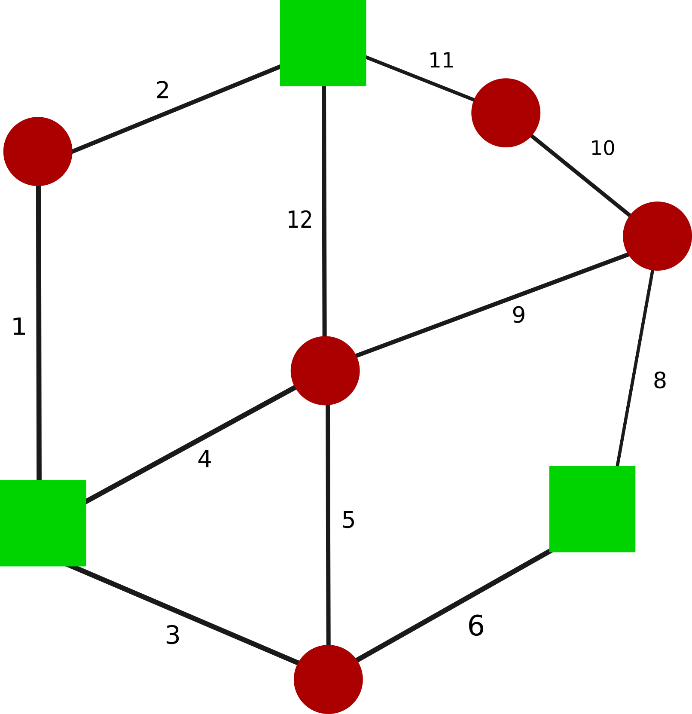

Slide 9
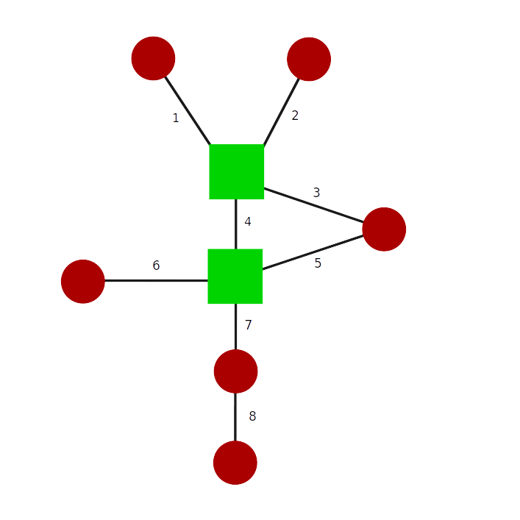
Network 3

Slide 10
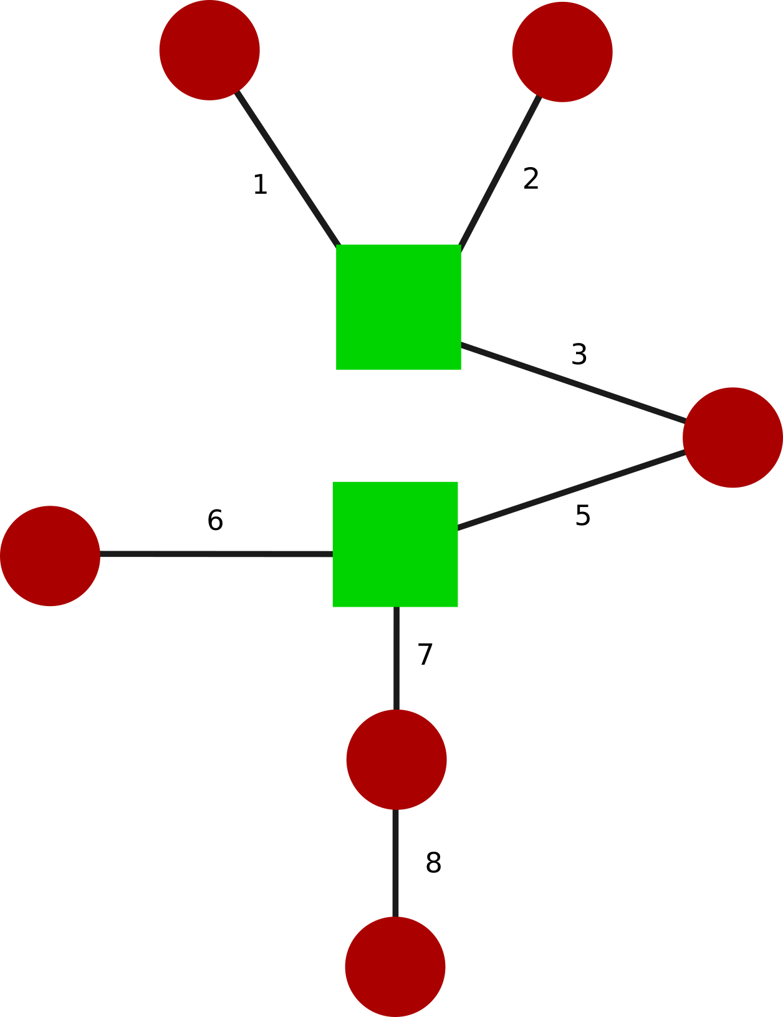

Slide 11
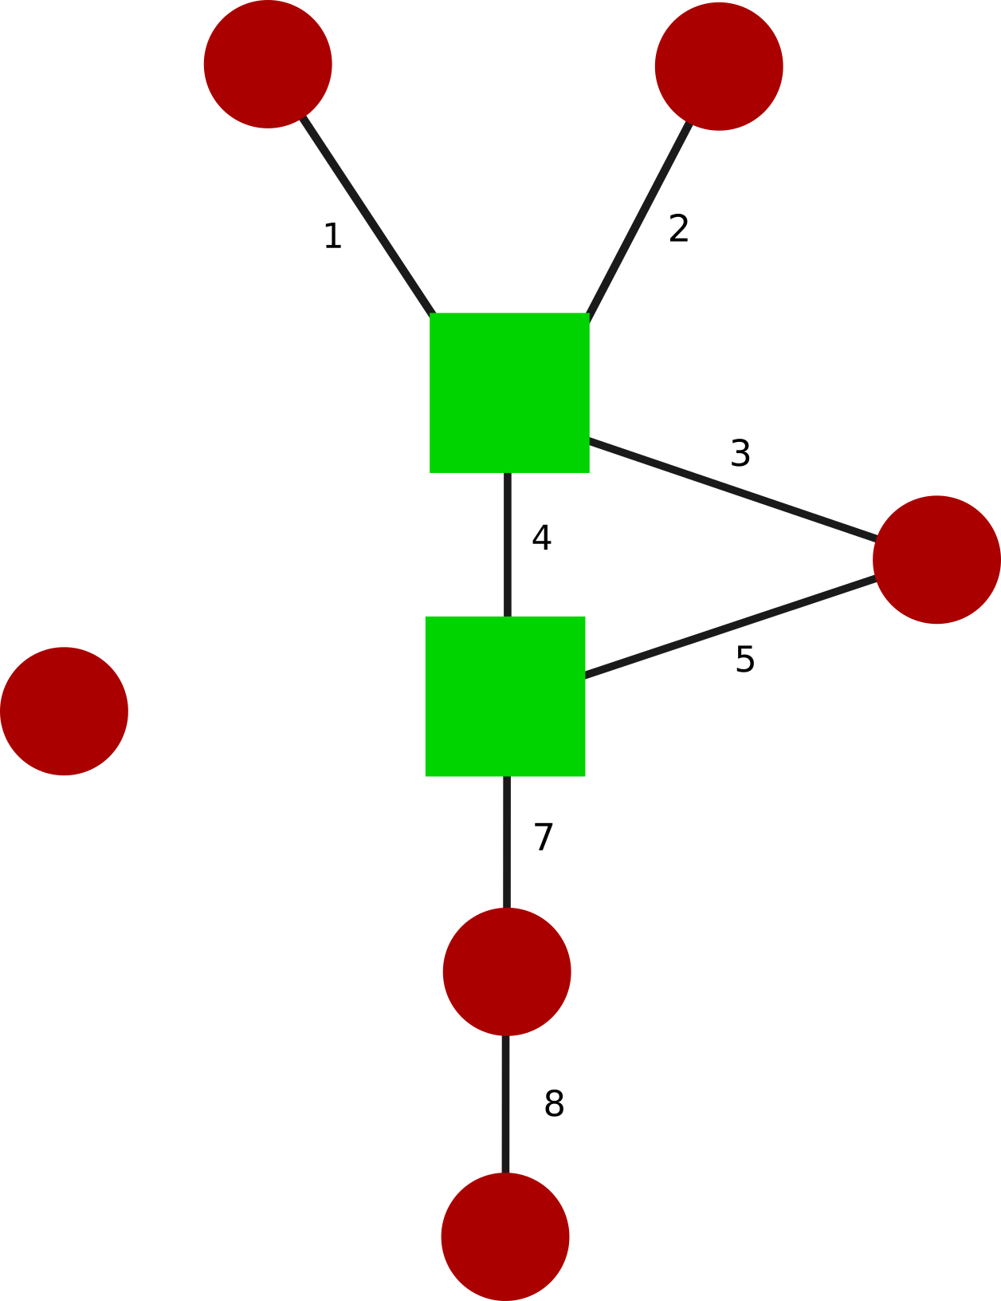

Slide 12


Slide 13
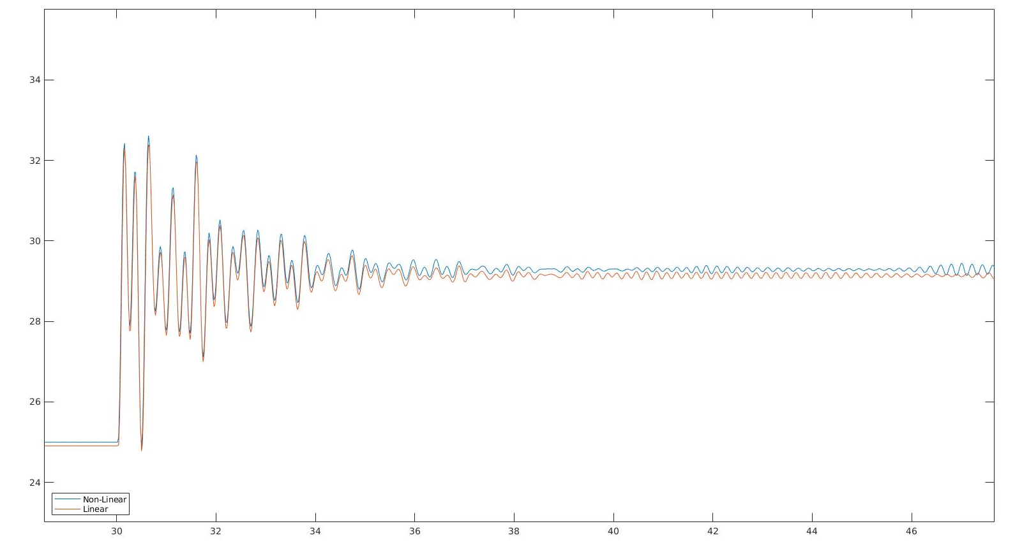
Example of Undefined steady state

Slide 14
Findings
Peak time error is usually less then 1%.
Peak power error usually can get in the 1 -5 percent error range.

