Slide 1

ROC Curve for Classification Cardio Disease
YAN GAO

Slide 2
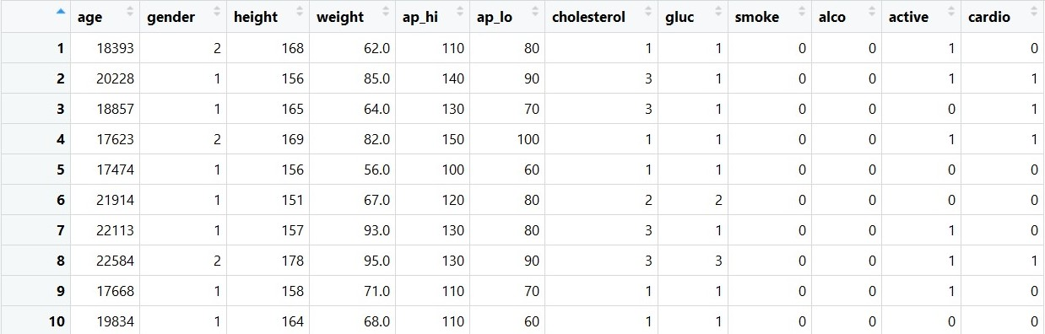
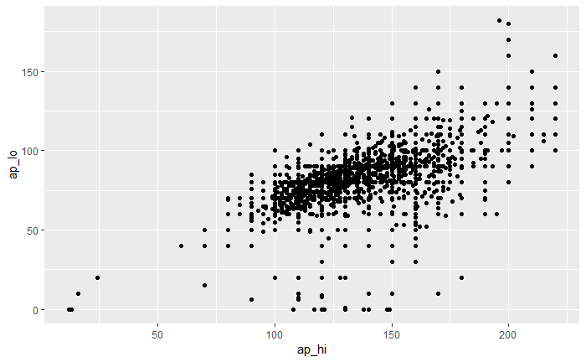
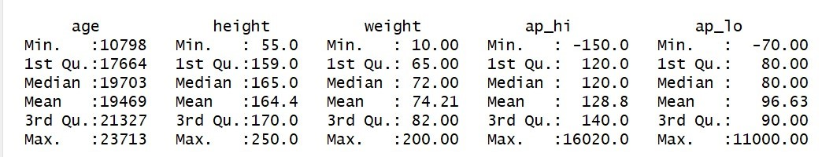
Data Source and Data exploratory
Cardiovascular Disease dataset by Svetlana Ulianova from Kaggle
Original:
Objective
Examination
Subjective
Stats analysis:

Slide 3
Research Question
Build a model, use the given features to train the model and predict how well the model behaves.
How to evaluate the goodness of model?
Accuracy?
Recall?
F1 score?
Preparation the data
Categorical Data
Numeric Data
Fit a model
Logistic Regression
Lasso Regression
Evaluate the model
Accuracy?
AUC-ROC Curve!

Slide 4
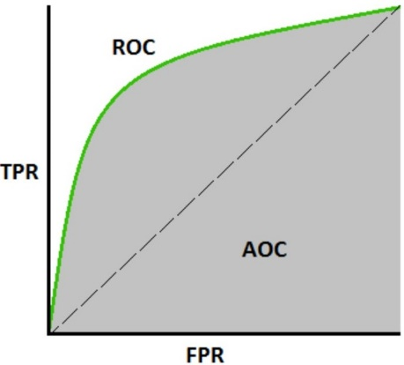
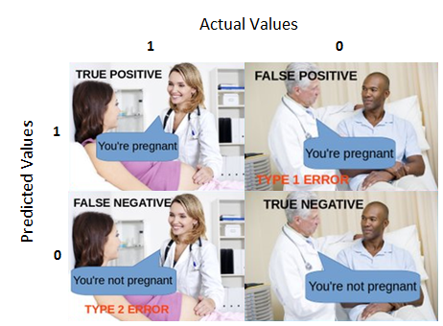

Primary Method – ROC Curve
Receiver Operating Characteristics Curve
Axis: $TPR= \frac{TP}{TP+FN}, FPR= \frac{FP}{FP+TN}$
Prediction:
Model A: 0.09 0.10 0.89 0.99
Model B: 0.45 0.49 0.51 0.60
Specificity: $\frac{TN}{TN+FP}=1−FPR$
AUC: Area Under The Curve

Slide 5
Data satisfaction and Model Application
Convert categorical features to independent dummy columns
Remove outliers from numeric data
Convert the explanatory dataframe to matrix to satisfy the requirement of cv.glmnet()
Use logistic regression with Lasso
Tune the model with hyperparameters:
cv.glmnet(x = dat.train,
y = dat.cardio[train==0,]$cardio,
family = 'binomial’,
alpha = 1,
type.measure = "auc",
nfolds = 10,
thresh = 1e-3,maxit = 1e3)

Slide 6
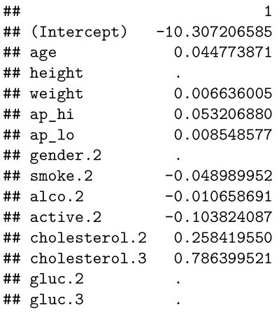
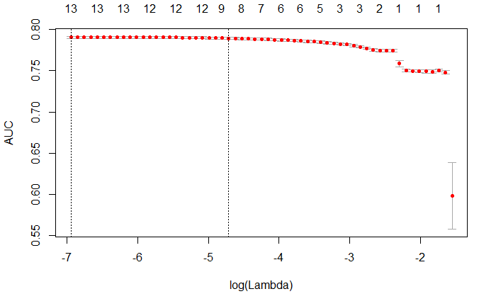
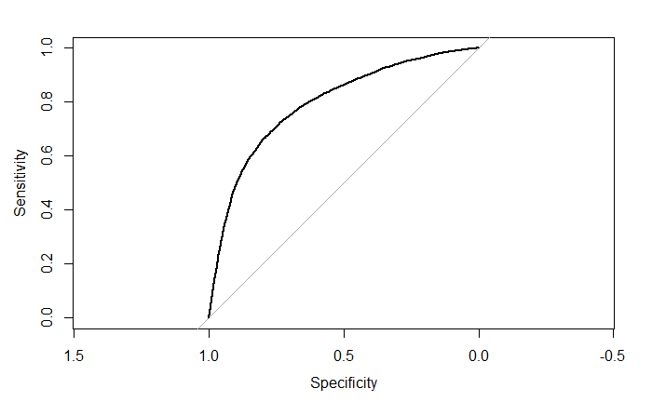
Interpretion
Model selection with lambda
ROC curve
AUC = 0.7932

Slide 7
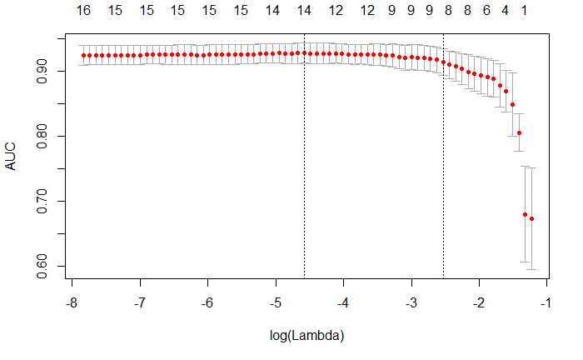
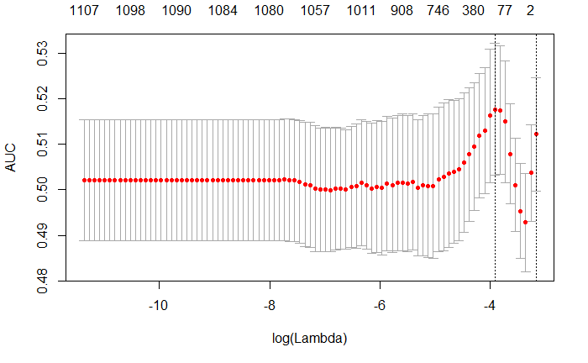
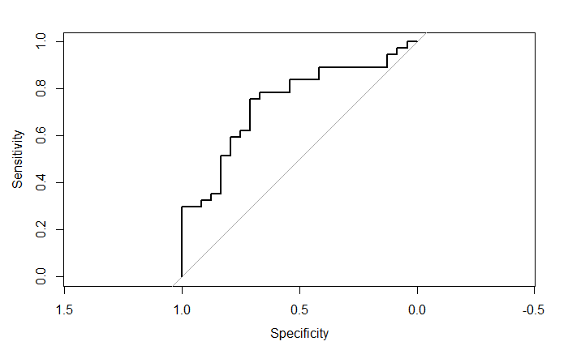
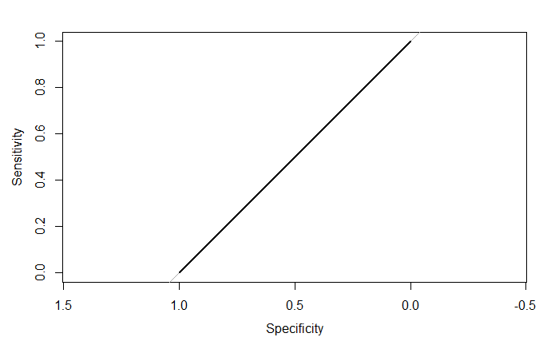
Performance Comparation (3 different datasets)
Cardiovascular Disease
Heart Disease UCI
Dow Jones & Reddit News headlines

Slide 8
Thank you!
Summary:
ROC curve: a really good way to access the model separate capability among different classed, widely used in classification problems.
Accuracy : tell us the model behavior with certain specificity
AUC : tell us the model performance with different specificity as a total evaluation score.
AUC = 1: exact fitted model
AUC = 0.5: poorly fitted model
AUC = 0: reverse exactly fitted model
Yan Gao
Email: Yan.Gao@du.edu
Instructor: Cathy Durso

