Slide 1
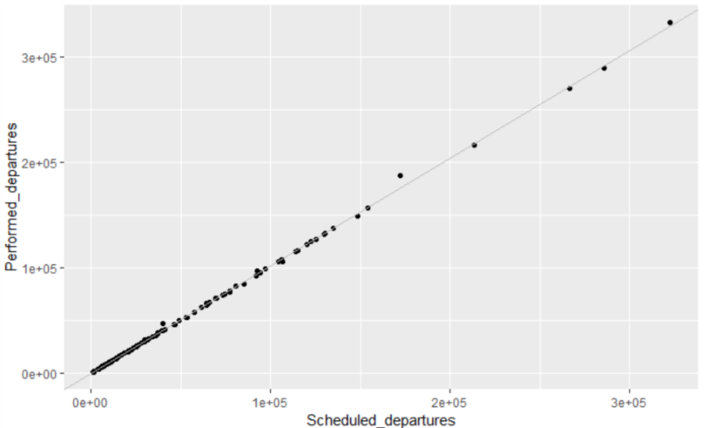


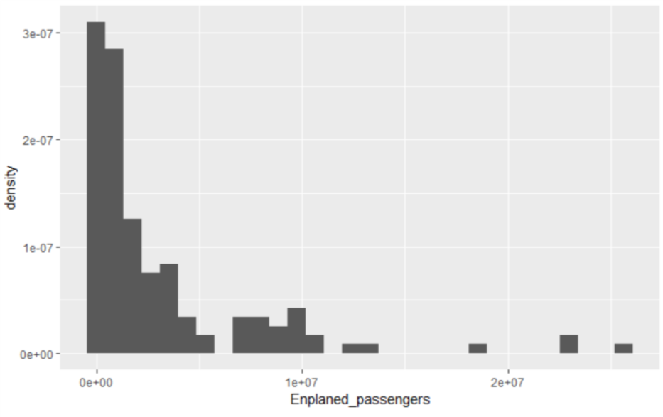


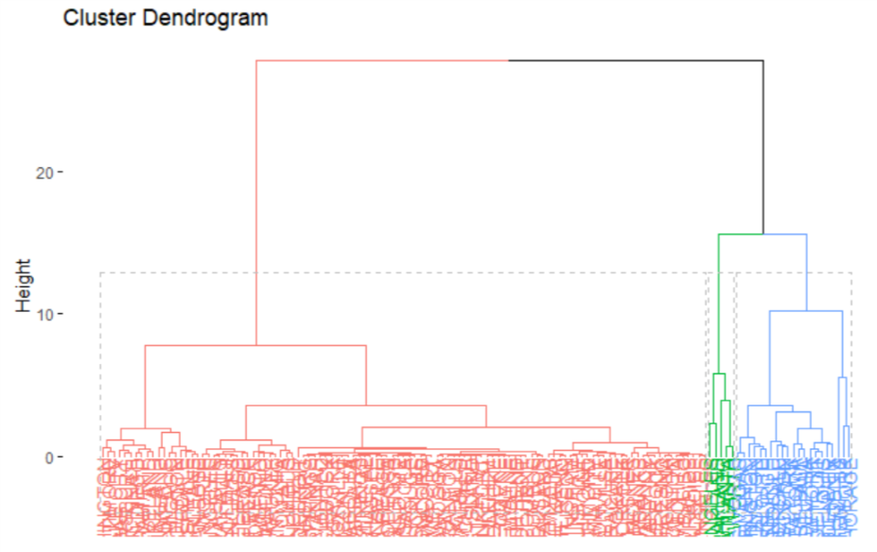




Education Infographic
Linearity between scheduled and performed departures
Main Features
The scheduled departure flights are almost symmetric with the performed ones, which could be considered as same distribution.
The dataset is ‘Airport Activity Statistics’ (1990). It is claimed that it consists of all 135 large and medium sized air hubs in the United States as deﬁned by the Federal Aviation Administration. I am interested in the claim that how to clustering the air hubs into large and medium size.
Density distribution of enplaned passengers
This is a vital variable to show the potential of clustering as it’s the most important air traﬃc metric. The picture tells me maybe its better to using 3 clutters.
33%
33%
33%
Enplaned Passengers
Performed Departures
Enplaned Revenue
AIRPORT CLUSTERING
Cluster the airports of medium and big size according to the data*
33%: the Enplaned Passengers is the most important air traffic metric because the majority of airport revenues are generated directly or indirectly from enplaned passengers.
33%: The Performed Departures has the same distribution as the Scheduled Departure. So we only count one column.
33%: The Enplaned Revenue Tons is the sum of all the revenue tons from both the freight and mail.
Setting Weight**
By using hierarchical clustering, the distance of the clusters is calculated by Euclidean distance, which compute the sum of square of each parameter. In this dataset, the scale of each parameter is quite different. So I have to merge the same meaning columns and define the weight.
Clustering Result
The top cluster air hubs is listed as follows:
HARTSFIELD INTL ATLANTA O'HARE INTL CHICAGO
DALLAS/FT WORTH INTL DALLAS/FT WORTH
LOS ANGELES INTL LOS ANGELES
SAN FRANCISCO INTL SAN FRANCISCO/OAKLAND
These results do match with the top largest air hubs showed on the Google
The dendrogram is quite obvious to cluster the air hubs. The result shows that the size of this dataset of the air hubs show be devided into 3 part as more precisely distinguishment, not just large and medium.
Sources of Information
* The dataset is collected from: http://jse.amstat.org/datasets/airport.dat.txt
** The parameter of each air hub: Airport(name), City(location), Scheduled_departures and Performed_departures(number of flights), Enplaned_passengers(number of total passengers), Enplaned_revenue_tons_of_freight and Enplaned_revenue_tons_of_mail(total revenue been charged).
http://jse.amstat.org/datasets/airport.txt
Yan.Gao@du.edu

