Slide 1

Analysis of Fountain pen purchase
Group member: Yan Gao
Instructor: Pooran Singh Negi

Slide 2

Motivation & Research Questions
Motivation A
Does the text description really make sense to the price tag when we purchase a product? Could it show some guide to how luxury the products are in same type of them?
Question A
Model: Predicting model
Input: Product text description
Output: Price of the product
Motivation B
How to find the most important features related to the price of the product. So that we can make choices to select a number of costy features and avoid the others according to our budget plan.
Question B
Model: Feature selection model
Input: Product features
Output: Important product features

Slide 3
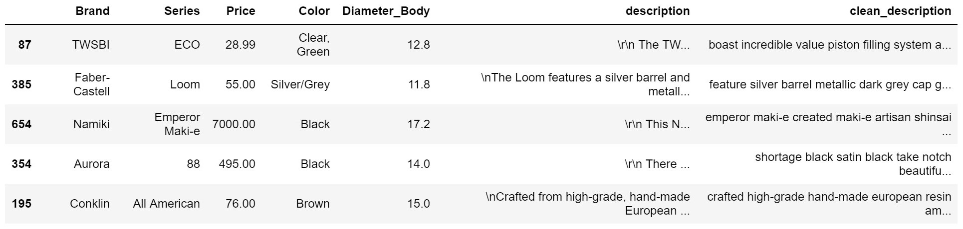
Dataset – Fountain pen infos
A small size(655 instances) dataset craped from Goulet Pens Company. It has rich amount detailed information about each fountain pen it has.

Slide 4
Data Cleaning
Cleaning activity
- Numeric features
- Datetime features
- Typos and duplicate expressions
- Columns with same spec
- Text description
Handle missing value
- Fill NaN with domain knowledge
- Drop rows with lots of missing data(more than 10 missing values)
Data summary statistics and interpretation
This cleaned dataset has lots of numeric and categorical data. In Question A, I only used the Prics as response variable and clean_description as explanatory variable, so I don't care about other NaN values. But in Question B, this will be cleaned in data preparation for model.

Slide 5
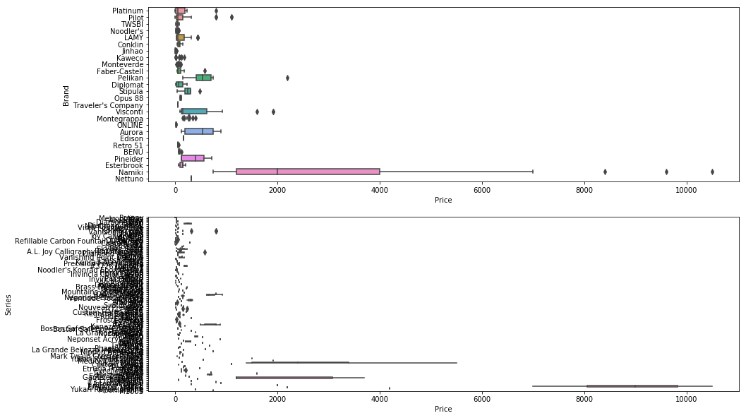
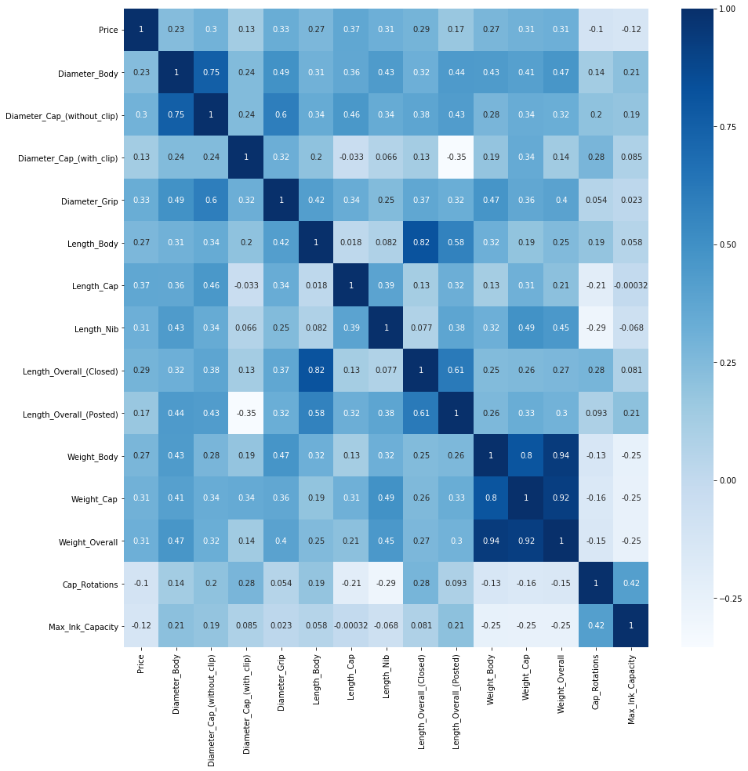
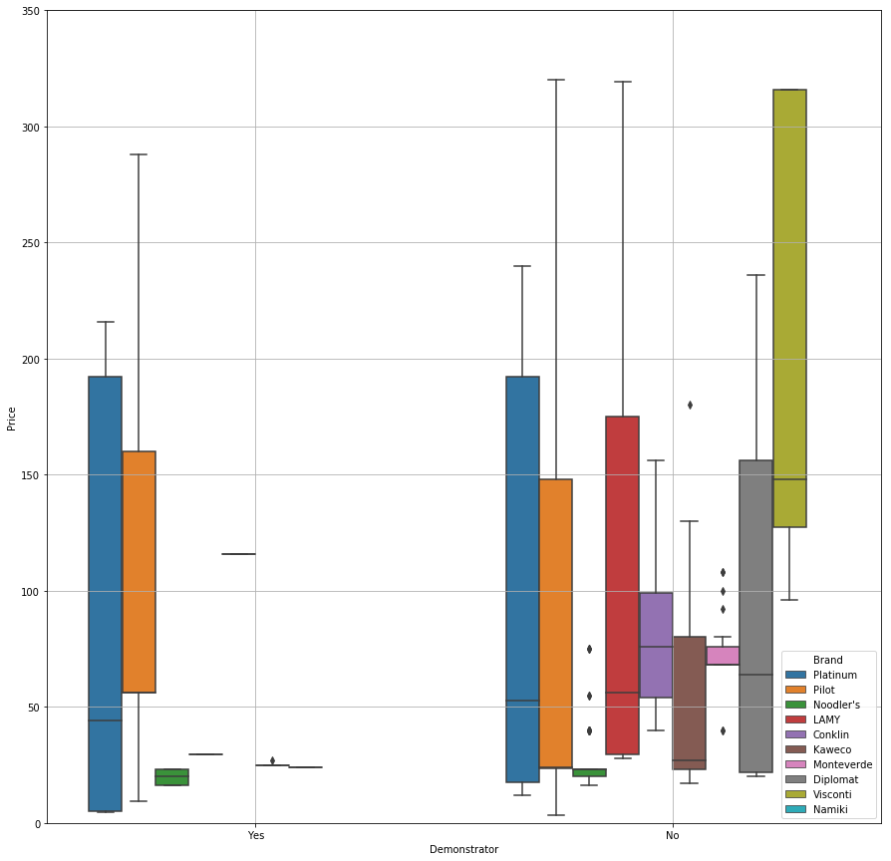
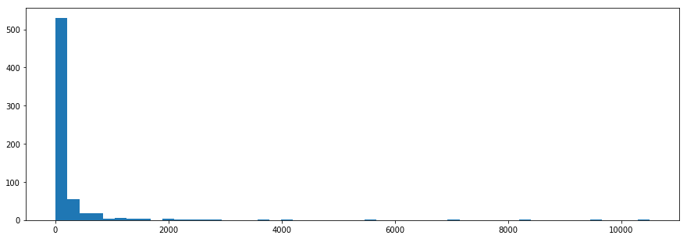
Data Visualizing
Numeric features’
correlation
Brands and series price box plot
Demonstrator choice with price
Price distribution

Slide 6
Data modelling – Model A
Schema: Find whether the text description of the fountain pen could predict its price
Response
Features
Fitting Model
Best performance
(score)
Ridge CV
Numeric price
Word frequency
0.9320
0.8707
0.9101
0.9771
PCA
Lasso CV
Affordable and luxury price label
Tf-idf
Logistic Regression CV
Is Lasso always better than Ridge?
Is Tf-idf always better than word frequency?

Slide 7
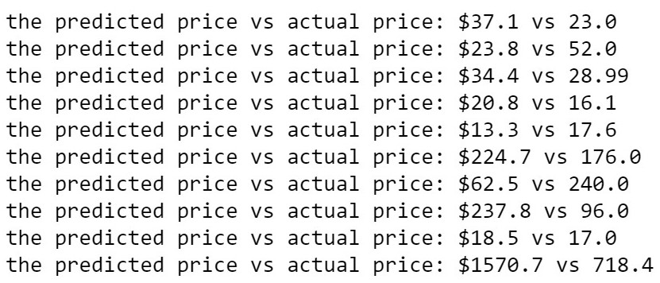
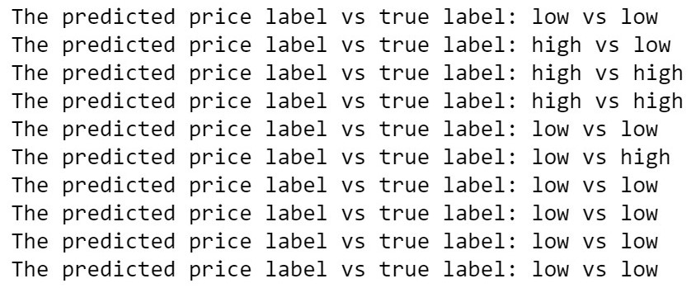
Prediction & Interpretation
Numeric response
Binary response
Numeric sub-model (a score of 93%)
Predict poorly
The distribution of the price
Binary sub-model (a score of 98%)
Predict quite well
Highly unbalanced label proportion
The model evaluation should not depend only on the score!

Slide 8
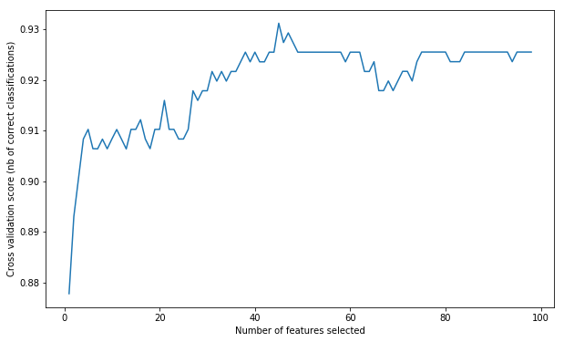
Model B – feature selection
Schema: Find those important features contribute to the price
Method:
RFECV: recursive feature elimination cross validation ( similar to backward feature selection in R )
Result: 45 features
'Color_Clear', 'Color_Copper', 'Color_Green', 'Color_Ivory', 'Color_Pink', 'Color_Purple', 'Color_Red', 'Nib_Material_14kt Gold', 'Nib_Material_18kt Gold', 'Nib_Material_23kt Palladium', 'Nib_Material_Steel'

Slide 9
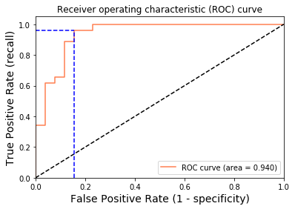
Prediction & Interpretation
Model method: Logistic Regression
Validation method:
Train-test validation
GridSearchCV evaluating using multiple scorers, RepeatedStratifiedKFold and pipeline
Result:
Accuracy: 0.9313
Log loss: 0.2054

Slide 10
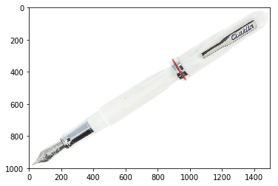
Notepad
Research Questions:
Can we tell price difference from the text description of similar products? Can we tell which features contribute to the price of same kind of product?
Result:
Text description predicts well about the labeled price, which indicate the model maybe useful if you have a clear budget.
Potential:
Numeric result predicting with more balanced dataset. Text feature engineering to check the text is intuiting or not. Estimate an unknown product price. Filter choice with a limited budget
Further to explore:
Look at the customer review
Try your prediction
Conklin is proud to introduce the Empire, a fountain pen with vintage appeal and elegance mixed with a modern bold style. The fluted cap and body design feature a shimmering white acrylic resin, and it opens/closes with Conklin's new twist magnet lock system. It comes with a silver #6 steel nib, and it fills via standard cartridge or converter (included). For over 120 years, Conklin has been applying methods new and old to each production of our luxury writing instruments, creating captivating collectibles loved by beginners and enthusiasts alike.

