Slide 1

Predicting Molecular Properties
Group member: Yan Gao
Instructor: Pooran Singh Negi

Slide 2

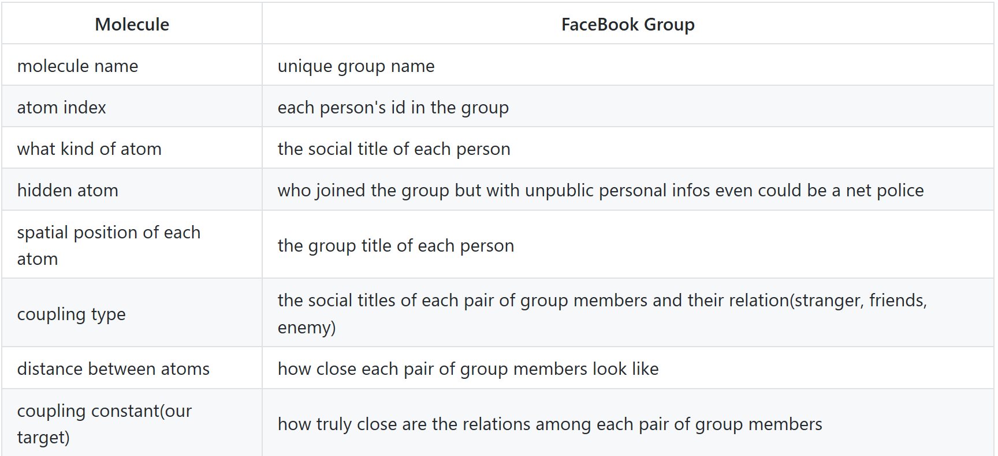
Research Questions
Small graph problem
Some particular large graph could be devided into many small connected components.
How to scale the influence of a small graph to each node in it?
How to build a efficient graph model to scale those features and feed them to machine learning model?
Model: Deep learning model with keras
Input: Numeric and categorical features
Output: Continuous response

Slide 3
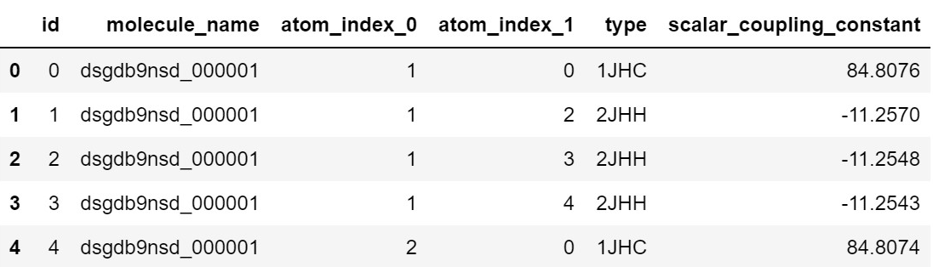
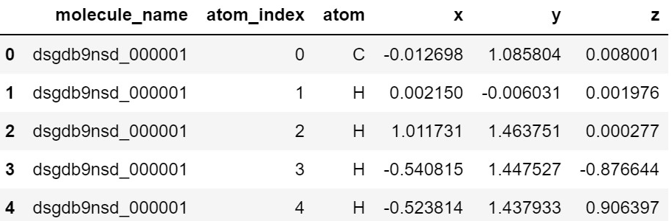
Dataset – Molecular Properties
This is a Kaggle competition dataset. This is a typical relational dataset. The train and test ﬁle contains the pairs relation of atoms in different molecules. There are 85003 molecules in train data and each of them contain 5 to 30 atoms.

Slide 4
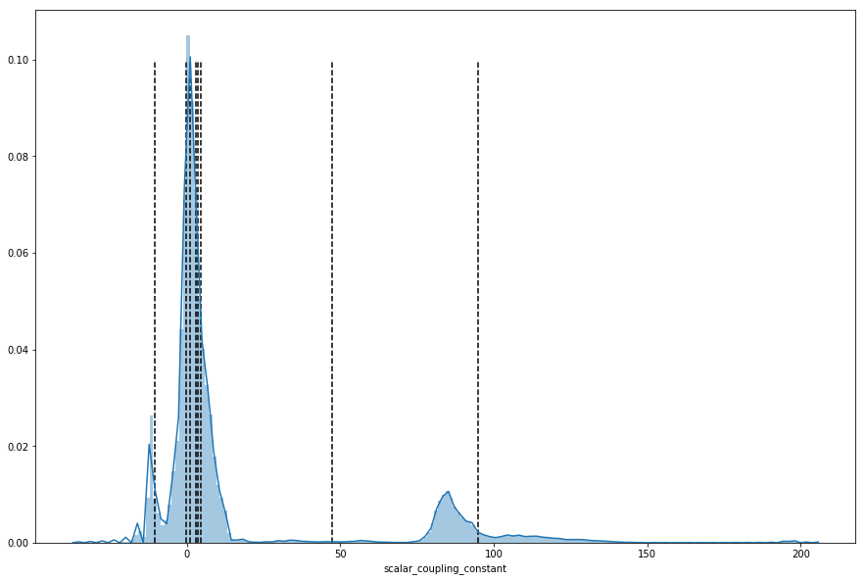
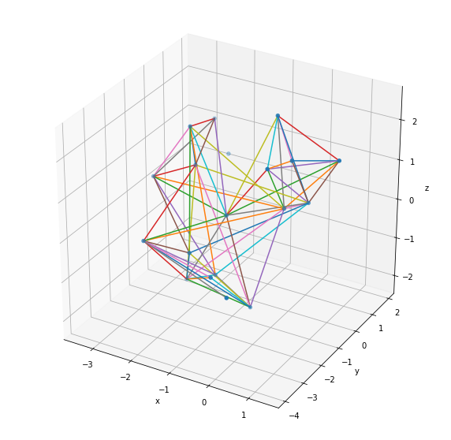
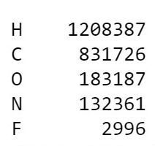
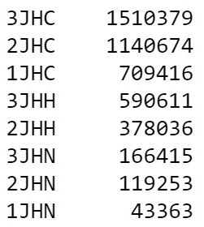
Data Exploring
Atom 3D structure
Coupling constant distribution
Atom coupling types and elements of atoms

Slide 5
Feature Engineering
Add more features by given parameters with domain knowledge:
- Relative distance between atoms
- Radius from the mass point
- Potential energy
- Number of atoms in molecule
- Number of neutrons and protons in atom
Add hidden information
- The coupling type between oxygen/fluorine and other atoms.
- The influence of oxygen/fluorine
Add graph influence( with Spark)
- The influence strength of different coupling types\elements for each atom in molecule

Slide 6
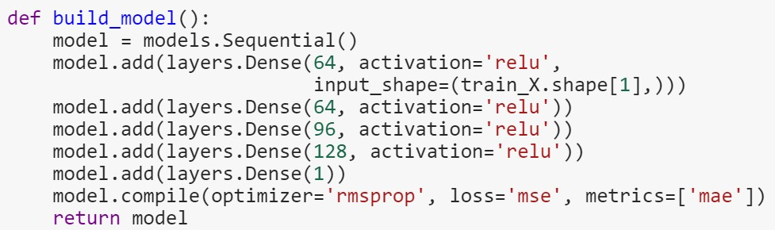
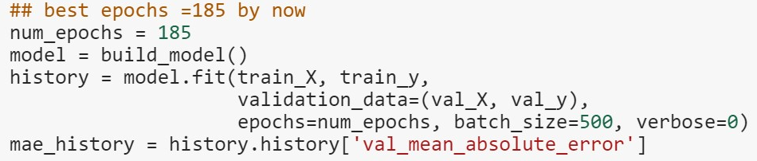
Data modelling – Deep learning
Schema: Build a neuron network model, set and tune the layers, activation function, estimators and loss to find the best performance
Requirement: the input data must be numeric data
Activation function: ‘RELU’, ‘ELU’, ‘PRELU’, ‘CRELU’
Optimizer: ‘rmsprop‘, ‘sigmoid’, ‘softmax’
Loss: mse, ε-loss, hinge loss
Epoch: how many round to modify the weight
Batch size: train size for each modification

Slide 7
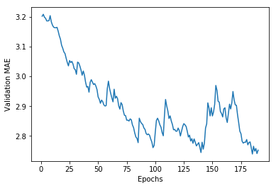
Prediction & Interpretation
K-fold validation
Choose number of epochs: 185
Result score: 0.744
Ranking on Kaggle: 1968

Slide 8
Thoughts
Spark with parallel:
I can’t run spark graphframe with whole file. The Pregel thing will quickly exceed the memory. I need more machines to get all this work.
Spark limitation:
The pregel can only create one field at a time on atoms. It can’t update the exist parameter and can’t modify the relationships. So for my problem this is not meaningful to use Spark.
Efficiency:
Feeding such a large dataset to the model takes lots of time. So I tried to run it on AWS but AWS doesn’t have the build-in image which saves the running result. I can’t get a GPU permission either.
Summary:
The small graph problem is really a deep field to explore. It’s especially inspiring on the feature engineering part, including building hidden effects.
Further to explore:
I’ll use Neo4j to build the graph database and try to query the results. It allows fast queries for updating data.
I’ll implement the code on the Google Cloud which has keras.

