Slide 1
CODING
CHALLENGE
PIPELINE PROPOSAL

Slide 2





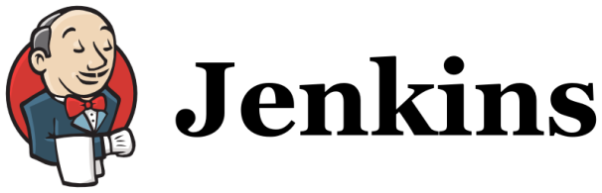

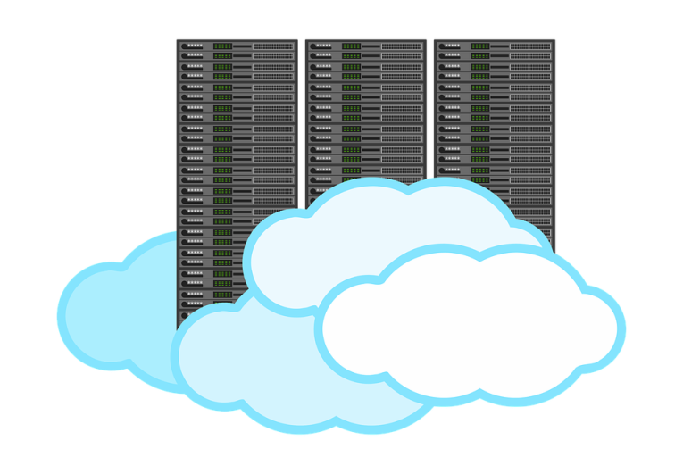
THE BIG PICTURE

Slide 3
Step 1 – Code Push
Code push to Jenkins, who starts the build
Using an Atlassian environment, the code can be tracked back to its original task

Slide 4
Step 2 – Code Analysis
Once Jenkins verifies that there are no conflicts with the branch, the code must be analyzed.
Sonarqube can analyze code quality
Fortify gets responsible for security and vulnerabilities

Slide 5
Step 3 – Build
If everything is ok so far, Jenkins will take care of running the automated tests and build the package.

Slide 6
Step 4 – Artifact publish
If everything is ok so far, the package will be sent to artifactory for publishing.

Slide 7
Final Step – Deployment
Once everything is completed, the artifact can be published.
For development should be automatic, further environments only after a product owner approval.

Slide 8
Monitoring
Once live, the application could be monitored using the cloud’s default dashboards or even use a proper logging monitor tool, like Splunk.

Slide 9
THANKS

