Slide 1
Towards The Sun
Storyboard

Slide 2

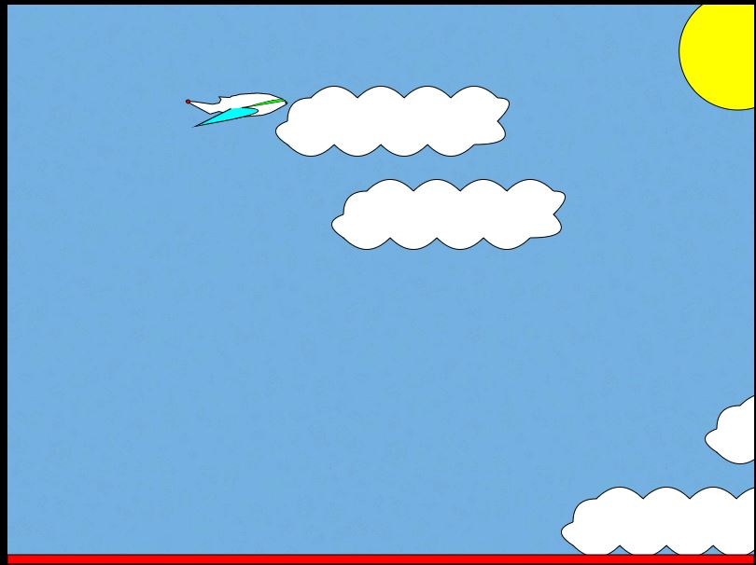
Game Start
The ship is varied with lights, elements that change colour.
The game starts dynamically, the arrows must be used to avoid the collision with clouds, otherwise life points are taken.
Gravity and air resistance act on the ship, which can be felt by steering.
We are constantly approaching the sun, which enlarges in the upper right corner.

Slide 3
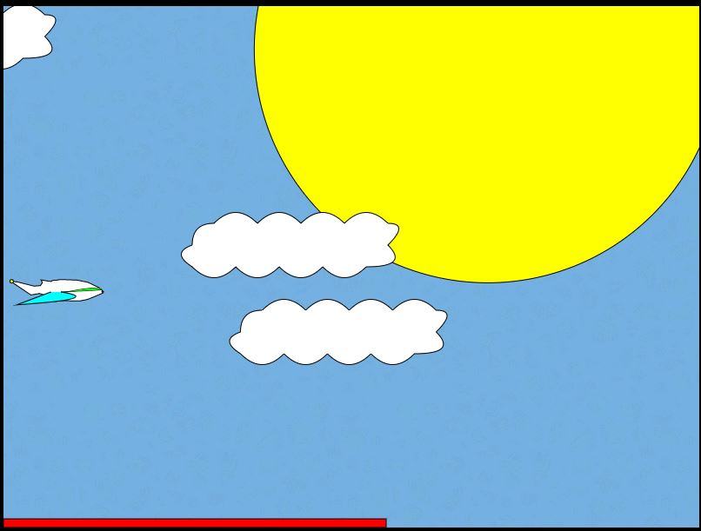
still in the game
Inadvertently we lose hit points visible on the red bottom bar.
The sun is clearly getting bigger, reaching the sun is the goal of the game.

Slide 4

Game Failure
After losing all one's life a picture informing about losing is displayed.

Slide 5

Game Success
After reaching the goal a picture is displayed informing about the victory.

Slide 6
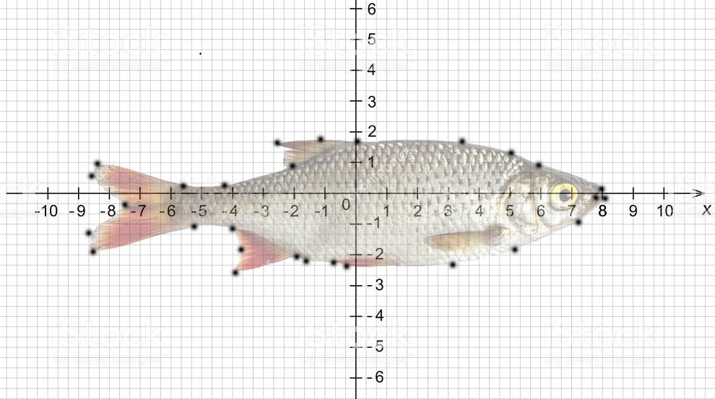
at the beginning I had a completely different idea for this game ☺
Thank you for your time
Cezary Szwalbe

