Slide 1
No Ticket 4 me

Slide 2
Introduction: Feature Responsibilities
Anthony: Home Page, Parking Page, Permit Page, Login Page, Sign-Up Page, Back-End logic (route handling)
Angel:Home page, Parking page, Sign-up Page
Brian: Project Leader, Home Page, Login Page, Wrote Project idea, Wrote project Proposal and vision, Named the Project. Backend-End Logic (route handling)
Braedon: Admin page, Account, Payment Systems.
Chiemela: Stripe API, Home Page, Create Account Page
Gabriel: Event Page, CSS/HTML clean-up, SRD/SDD Diagrams
Haonan: Shop cart, check out, event park
John: Vehicle Mangement, PostgreSQL(AWS) Ticket Payment,

Slide 3
Vision
Customers
Problem
Digital Solution
Our customers include:
Students,
Staff,
Faculty,
and any type of visitors.
CSULA has a very inefficient and spread out parking service which often confuses a lot of people as to where to go or what to buy
Redesigning the current parking system to provide a one stop place that makes it quick easy and fast for our customers to get their parking passes.

Slide 4
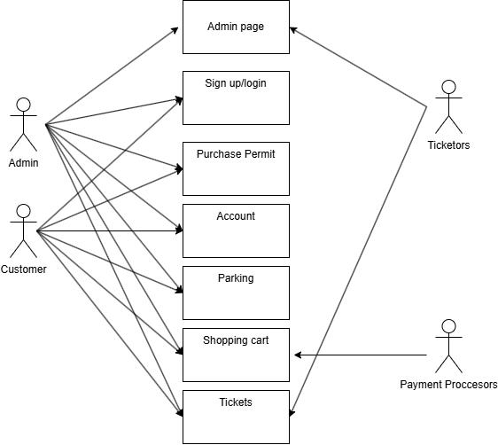
Requirements (Use case)
Admin: Administrators who can access certain backend features via the admin page
Customer: The users actually interacting with our platform to use it as a customer
Payment processors: Stripe, our payment system
Ticketors: The people actually distributing the tickets to guilty parties

Slide 5

Architectural Design
Client-Server Architectural Design.
Non-Functional Requirements Include.
Security.
Scalability.
Performance.
Reliability.
Usability.

Slide 6
Detailed Design
Technologies (used by the software, used to build the software), and how each was used
Python | Flask, SQL: Used for the backend logic and server side that process the flask application.
Flask: This is use for the framework that handles the routing, request, processing and the interaction of their templates.
PostgreSQL: Database to store and retrieve data such as vehicles. tickets , user accounts
JS: javascript used for the frontend, validate forms and adding UI functionality.
HTML: Templates for the pages such as Login mange Vehicles by adding defining the content layer.
Stripe: Handles payment functionality.

Slide 7
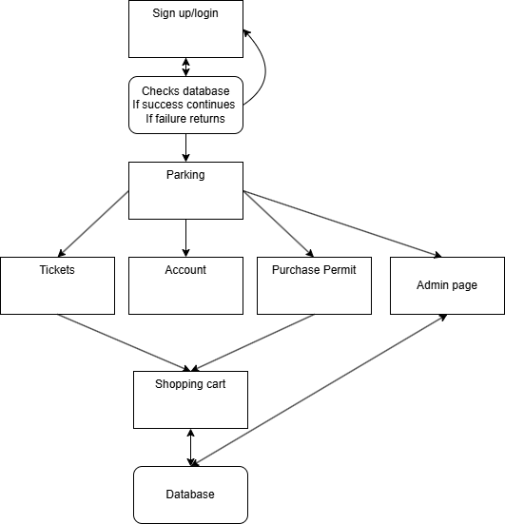
Detailed Design: Level 1 Data-flow Diagram
Implemented: All processes and features
Stubs: None
Hybrid:
None

Slide 8
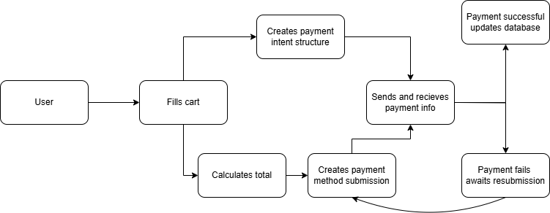
Detailed Design: Example behavioral diagram of shopping cart

Slide 9
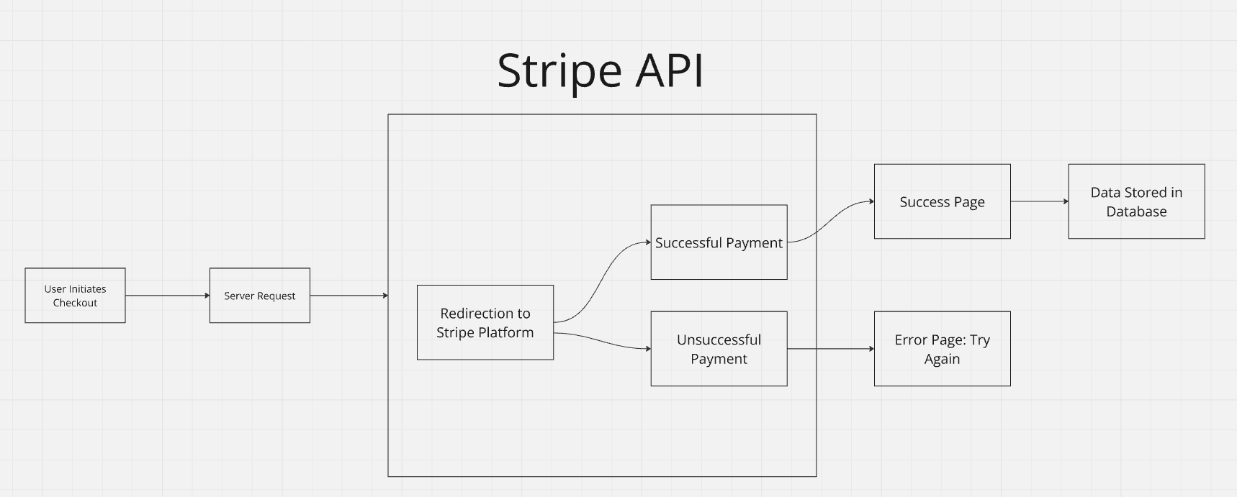
Payment Processing Design
https://youtu.be/Pk_W6Ny8wqQ
Different tickets are charged with different prices
Sensitive information is handled securely by Stripe
The user’s license plate and information is noted

Slide 10
Lessons Learned
Experience with the Agile development approach.
Experience with new technologies.
Experience with coordinated group efforts.
Experience with overcoming new unforeseen challenges.

Slide 11
4 column roadmap (24.0, 24.1, 24.2, Future Enhancements)
PI 24.0
Completed Features:
Finalized product proposal for "No Ticket For Me" parking registration system.
Outlined key customer objectives.
Created the GitHub repository for the project
PI 24.1
Completed Features:
GitHub Repository & Project Setup
Product Manager & Product Proposal
Completed UI/UX design
Event Parking
Shop Cart page
PI 24.2
Completed Features:
Vehicle Registration​
Permit Purchasing​
Ticket Payment & Appeal​
Account information overview
PI 24.X
Potential Features:
SMS notifications.
Proper DMV integration.

