Slide 1
Bioinformatics shell scripting, writing pipelines, and parallelizing tasks
Chapter 12
Benjamin Gansemer and Chris Youngstrom

Slide 2
Reproducibility and Robustness
Why do (should) we use scripts and pipelines for bioinformatic analyses?
How do scripts/pipelines contribute to reproducibility and robustness?
While you are discussing: clone the github repository with today’s materials into a directory of choice:
git clone https://github.com/Cfernz/Chapter12-challenge

Slide 3

Bash scripting
When you forget the one command that worked months ago
Scripts (along with some other programming tricks) allow us to automate repetitive tasks
Can serve as documentation!
Make it easier to re-run processes, possibly with different input/variables
Keep in mind: Bash scripts are shell scripts – not the best for long, complicated programs
Designed for “running and interfacing command line programs
And you have to piece back together from scraps of notes
https://i.imgflip.com/1j1pyb.jpg

Slide 4
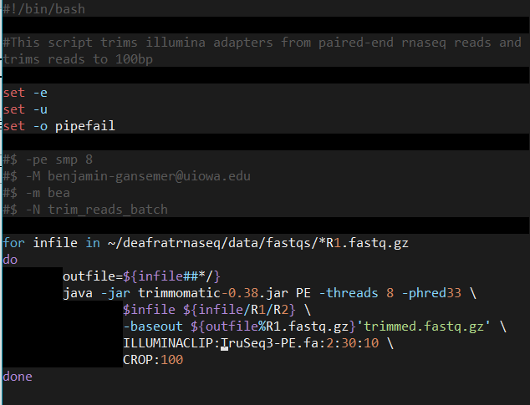
The anatomy of a script
shebang
Header
comment
Robustness options
set -e: terminates script if any command fails
set -u: stops script if any variable is unset
set -o pipefail: if any program returns a nonzero exit status, the whole pipe will return a nonzero exit status
HPC cluster options
Commands
Notes:
shebang = path to interpreter used to execute the script

Slide 5
Running scripts and variables
Two ways to run scripts
$ ./script.sh
$ bash script.sh
Script must be executable
$ chmod u+x script.sh
Variables
Variables can be used to store settings/parameters
Allow you to change one value rather than many hardcoded values
Bash variables do not have data types (i.e., string, int, character)
Variables are accessed by using ‘$’ in front of the variable name
Remember, no spaces!!
Notes:
Can also add script path to $PATH to run from any directory.
Can either “hardcode” variables into the script, or read in command line arguments

Slide 6
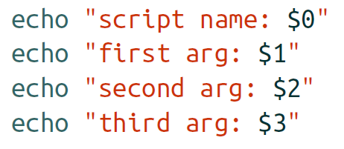
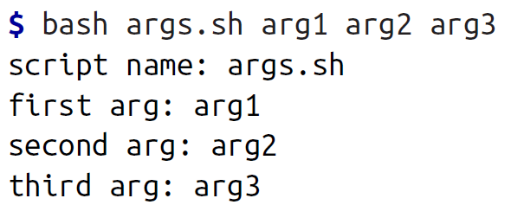
Arguments
args.sh script is in the repo (Activities folder)
Arguments are used to pass information to a script at run-time
Assigned to a value ($1, $2, $3, etc.)
$0 stores the script name
The rest are assign based on order
$# stores the number of arguments
Notes:
Ask to discuss what $0, $1, $2, etc. mean
Script is on repo, so you can execute the script at the command line.
Stop for questions here

Slide 7
Conditionals and loops
Conditionals: If statements
What can we use these for?
Generally used to check if an argument or variable meets a certain requirement
Loops: for loops and while loops
What can we use these for?
Used to perform the same command or set of commands many times
Notes:
Bash command exit status provides true and false – 0 = true/success, and nonzero = false/failure

Slide 8
If statements
Example
if grep “pattern” some_file.txt > /dev/null
then
echo “found ‘pattern’ in ‘some_file.txt’”
fi
Basic bash syntax
if [commands]
then
[if-statements]
else
[if-statements]
fi
Any command, pipeline, or test condition to evaluate
all statements/commands executed of [commands] evaluates to true/0
all statements/commands executed of [commands] evaluates to false/!0
This is optional
Can also chain commands with logical operators (&& and ||)

Slide 9
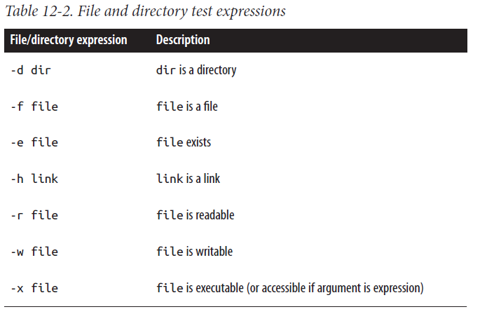
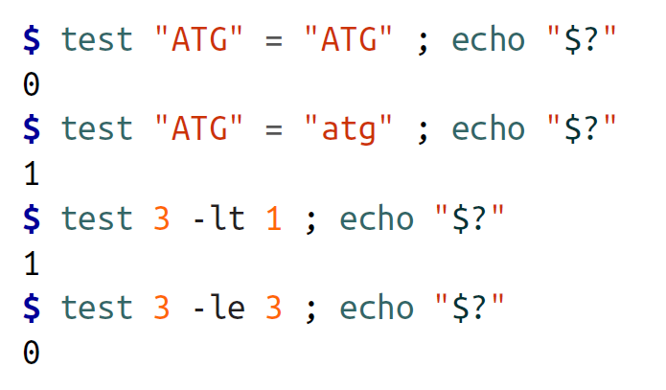
test
Indicates return value of the test specified through its arguments
Common uses include checking whether input is a file or a directory or whether something exists.
$ test –d some_dir ; echo $?
Can combine with if statements
Notes:
Used to test whether two strings are equal, whether one int is greater than/less than another, etc.
Another example from Bin: have 20 fq files to map and you submit the job. 10 finish and 10 fail due to some issue. You can resubmit the job and use test to test for existing bam files to indicate that mapping worked for the corresponding fastq, that way you only run mapping on the ones that failed.

Slide 10
For loops
Basic bash syntax
for file in directory
do
command $file
done
Used to iterate over a number (sometimes 100s-1000s) of files and perform the same command or set of commands
Three essential parts:
Selecting which files to apply commands to
Looping over files and performing the commands
Keeping track of output file names

Slide 11
Notes:
shebang = path to interpreter used to execute the script

Slide 12
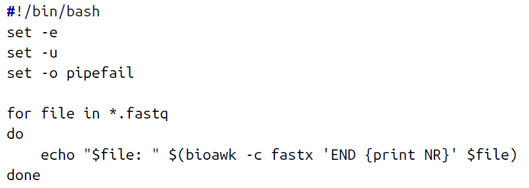
Selecting files
Can either glob files (use wildcards) to loop over
Or use bash arrays
Usually involves using a text file containing information about files
$sample_names=(zmaysA zmaysB zmaysC)
Notes:
Will use bash arrays in the activity

Slide 13
Notes on selecting files
Have the following files:
file a.txt
file b.txt
file c.txt
for f in file a.txt file b.txt file c.txt
do
cat $f
done
What will happen?
We assume filenames do not have whitespaces in them!
Bash splits fields into array elements using characters in the internal field separator (IFS) (‘ ‘, ‘\t’, and ‘\n’)
If a filename has a whitespace, bash will split that name into to values!
We can use basename to strip the path and extension from each filename
$ basename seqs/zmaysA_R1.fastq → zmaysA_R1.fastq
$ basename –s seqs/zmaysA_R1.fastq → zmaysA_R1
This can be used to get the essential part of filenames to then create output filenames
Notes:
test files are on repo, can demonstrate in class

Slide 14
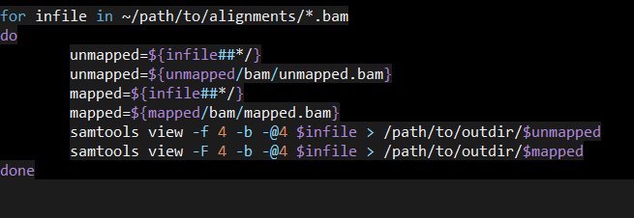
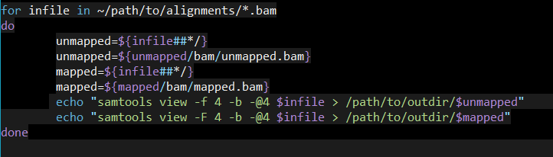
How can we test scripts/loops before running them?
ECHO!!!!
Notes:
demonstrate using examples from previous slide

Slide 15
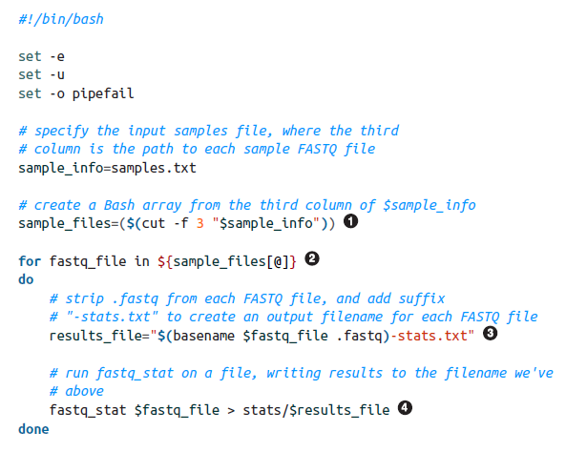
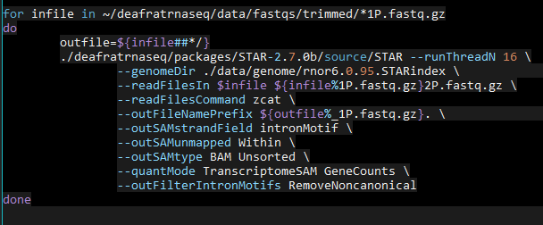
Looping, output, and other considerations
This is a fairly straightforward example: 1 input file → 1 output file
What if we have 2 input files → 1 output file (ex. paired-end sequencing alignment)?

Slide 16
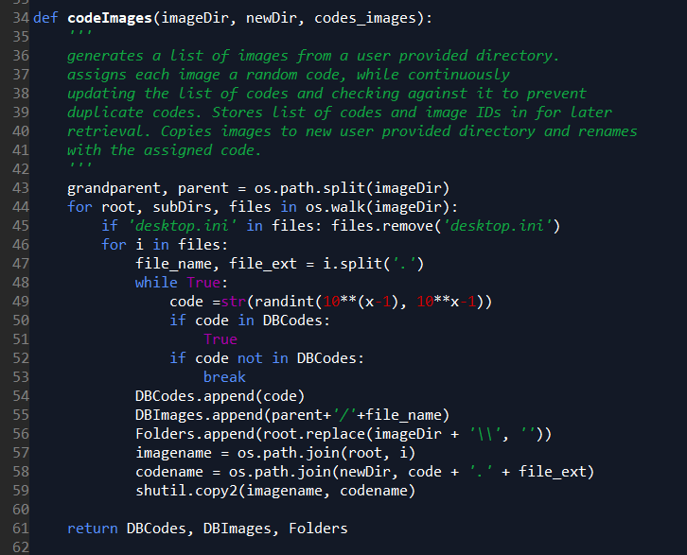
Loops in other languages
Loops are used in other languages as well
Biggest difference is syntax
Notes:
also note that you can nest loops and conditionals

Slide 17
How can we make scripts/pipelines more reproducible and robust?
Do Activity 1 (10-15 minutes)
Follow Activity1.md
https://github.com/Cfernz/Chapter12-challenge

Slide 18
Automating processes with find and xargs
find is used to specify files that match some criteria
Why use it when we can glob?
ls and wildcards is fragile – if a filename has a space, it gets interpreted as two files
I.e. treatment 02.fq → treatment, 02.fq
could use $ command *.fq
but there’s a limit to the number of files that can be specified as arguments
find is recursive
xargs takes input from stdin and passes it as arguments to another program

Slide 19
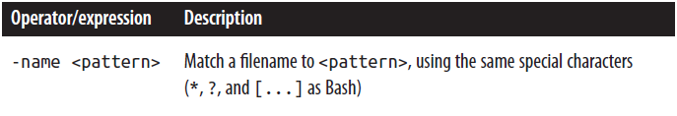
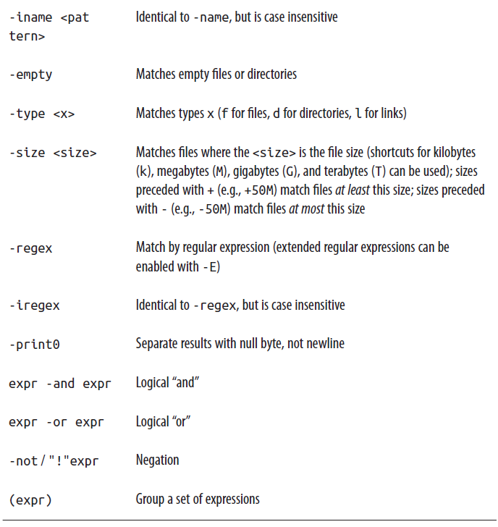

Let’s find some stuff
Basic bash syntax
$ find path expression
additional options:
specify predicates (see table)
can chain together expression using logical operators
limit recursive depth using –maxdepth

Slide 20
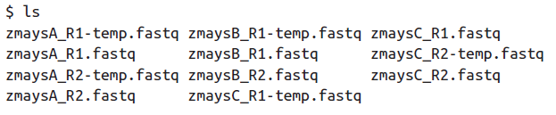
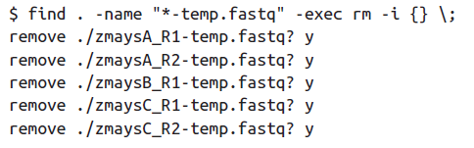
find -exec
using –exec runs commands on the results of find
Important thing to keep in mind:
check your expression first to make sure it is returning the files you want prior to running commands on them

Slide 21
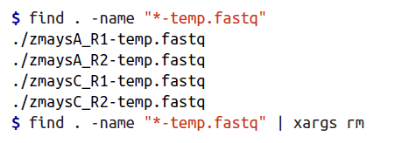

xargs
better for larger tasks (compared to find –exec)
basically splits the output from find into arguments and places them after the command
can set the number of arguments passed to the command using the -n option
can take input from other bash commands, such as cat or grep
Basic bash syntax (with find)
$ find path expression | xargs command

Slide 22

Other xargs tricks
can use it to build commands that are written to simple bash scripts
allows for inspection of commands before running them
Can combine with basename to help with looping
can use the -I option to control placement of arguments
$find path expression | xargs -I{} command --option1 {} --option2{}

Slide 23
xargs and parallelization
xargs allows you to limit the number of background processes running simultaneously
you cannot do this with a simple for loop
use the -P <num> option
Notes:
could include the part about xargs, Pipes, and Redirects (pg. 420) here
Do we need another discussion point here? (how do find and xargs contribute to repro and robust?)

Slide 24
A quick note about Make
Traditionally make is used to interpret makefiles to compile software.
makefiles are a set of rules, with each rule having three parts:
target - the file that is being built
prerequisites - specifies which files are needed to build the target
recipe - set of commands used to build the target
Our book provides an example of make used in a pipeline
Notes:
don’t know if we want to go into more detail than this. Could use the example from the book.

Slide 25
Activity 2 and BLAST Challenge

