Slide 1
For reference, the in-class presentation file is included after this page

Slide 2
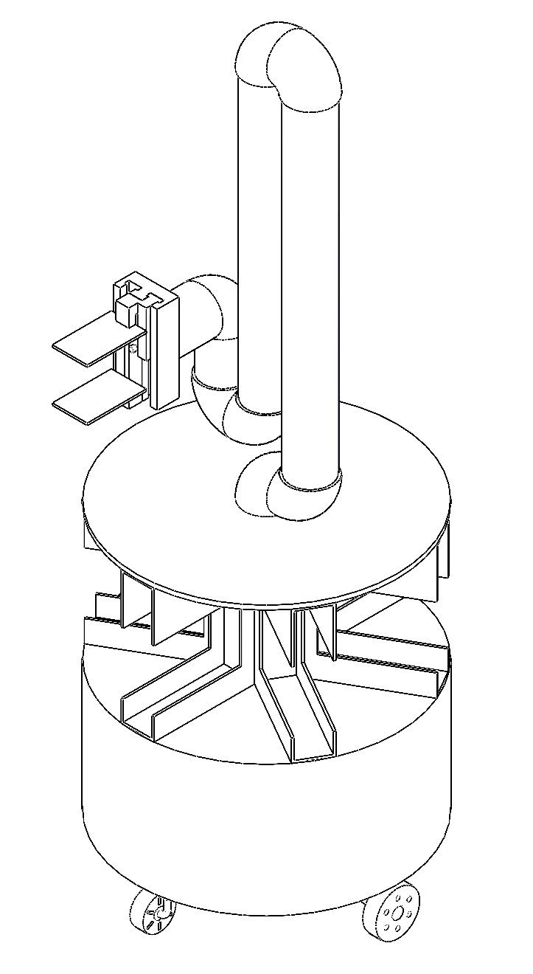
Project 2 – Group 1
ENPM662 – Introduction to Robot Modeling
The Library Robot

Slide 3
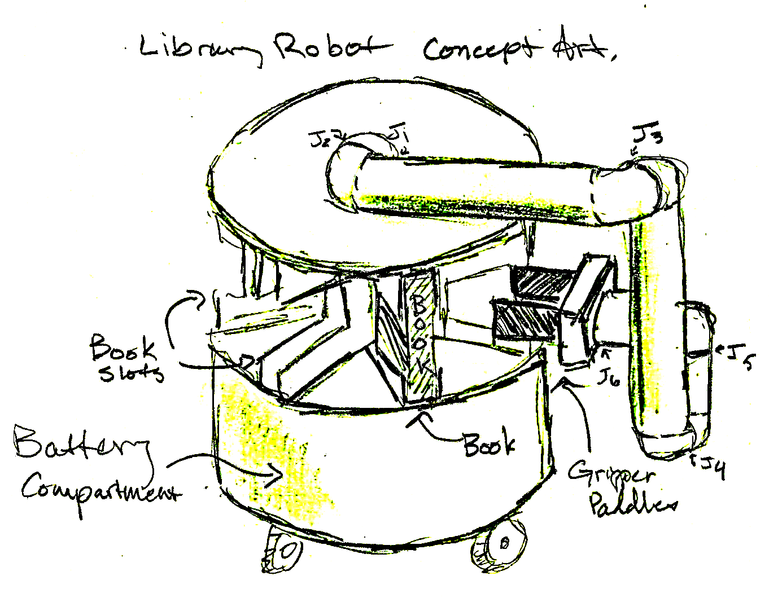
Topics
Team Members
Robot Design
ROS Nodes and Controllers
Autonomous Mode
Teleop Control
Demo
DH Table and Validation
Deployment Model
Challenges and Success

Slide 4
Team Members
Anne-Michelle, EE
ROS Development
Demo Orchestration
Chris Collins, AE
ROS Development
World Building
Daniel Zinobile, ME
Robot Design
SolidWorks Modeling
James Fehrmann, CS
DevOps
ROS Development
Collective ROS Knowledge as of September 1, 2024: 0 Hours

Slide 5
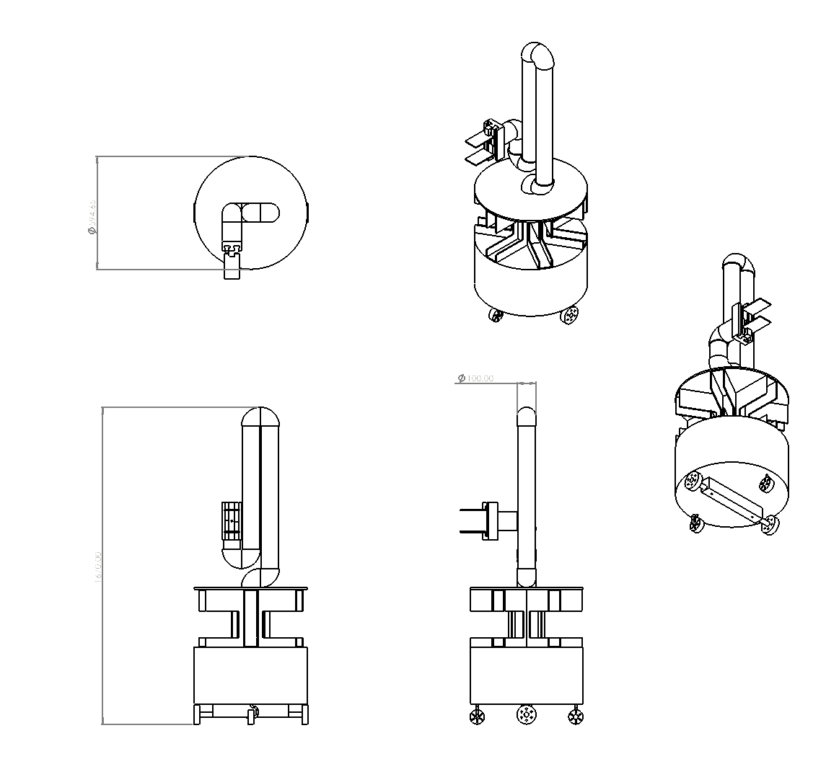
Robot Design

Slide 6
ROS Nodes and Controllers
terp2 launch file with nodes for robot state and control management. (python)
terp2_controller node for autonomous mode control. (cpp)
terp2_teleop node for manual control. (python)
terp2_monitor node for continuous monitoring of pose data. (cpp)

Slide 7
Autonomous Mode
terp2_controller designed to respond to various parameters
goal {x, y} parameter to send robot to specific location.
arm_goal {a, b, c, d, e} parameter to recall position of each arm joint.
gripper_goal {a, b, c, d} parameter to orient and manipulate the gripper.
parameter calls can be chained together in bash script files to orchestrate complex sequences.

Slide 8
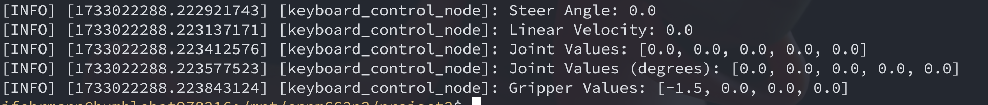
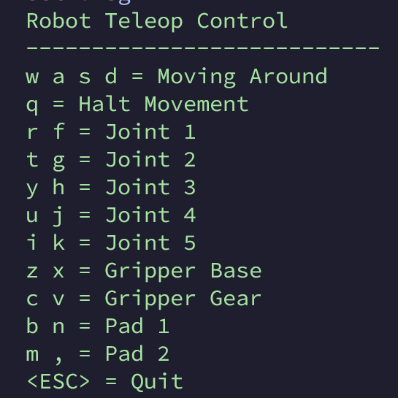
Teleop Control
Pressing movement keys increments velocity or changes yaw orientation.
Pressing joint and gripper controls step the joints forwards and backwards.
Screen displays values that can be transcribed into autonomous mode script files.

Slide 9
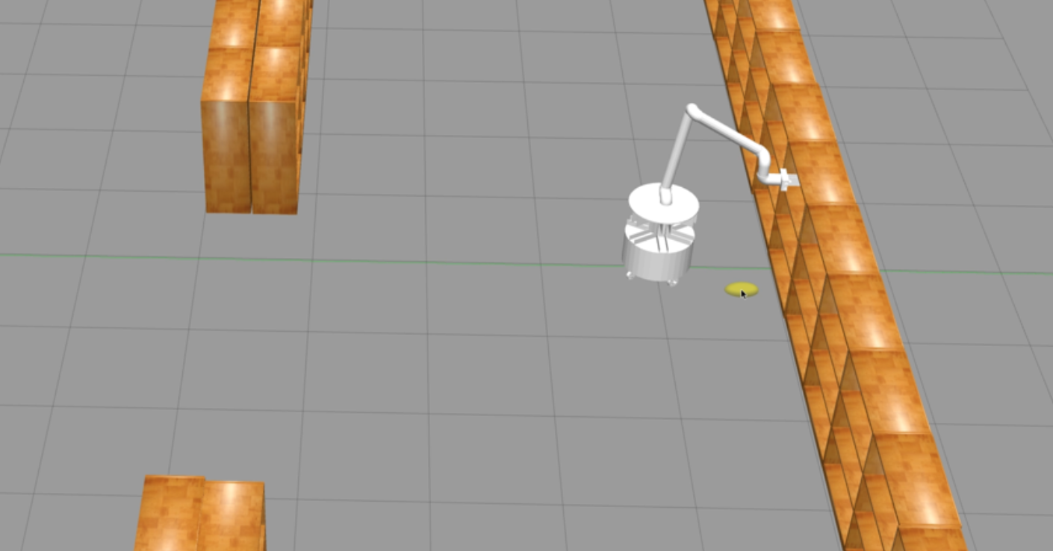
Demo
https://www.youtube.com/watch?v=lB9bhnnsFkw

Slide 10
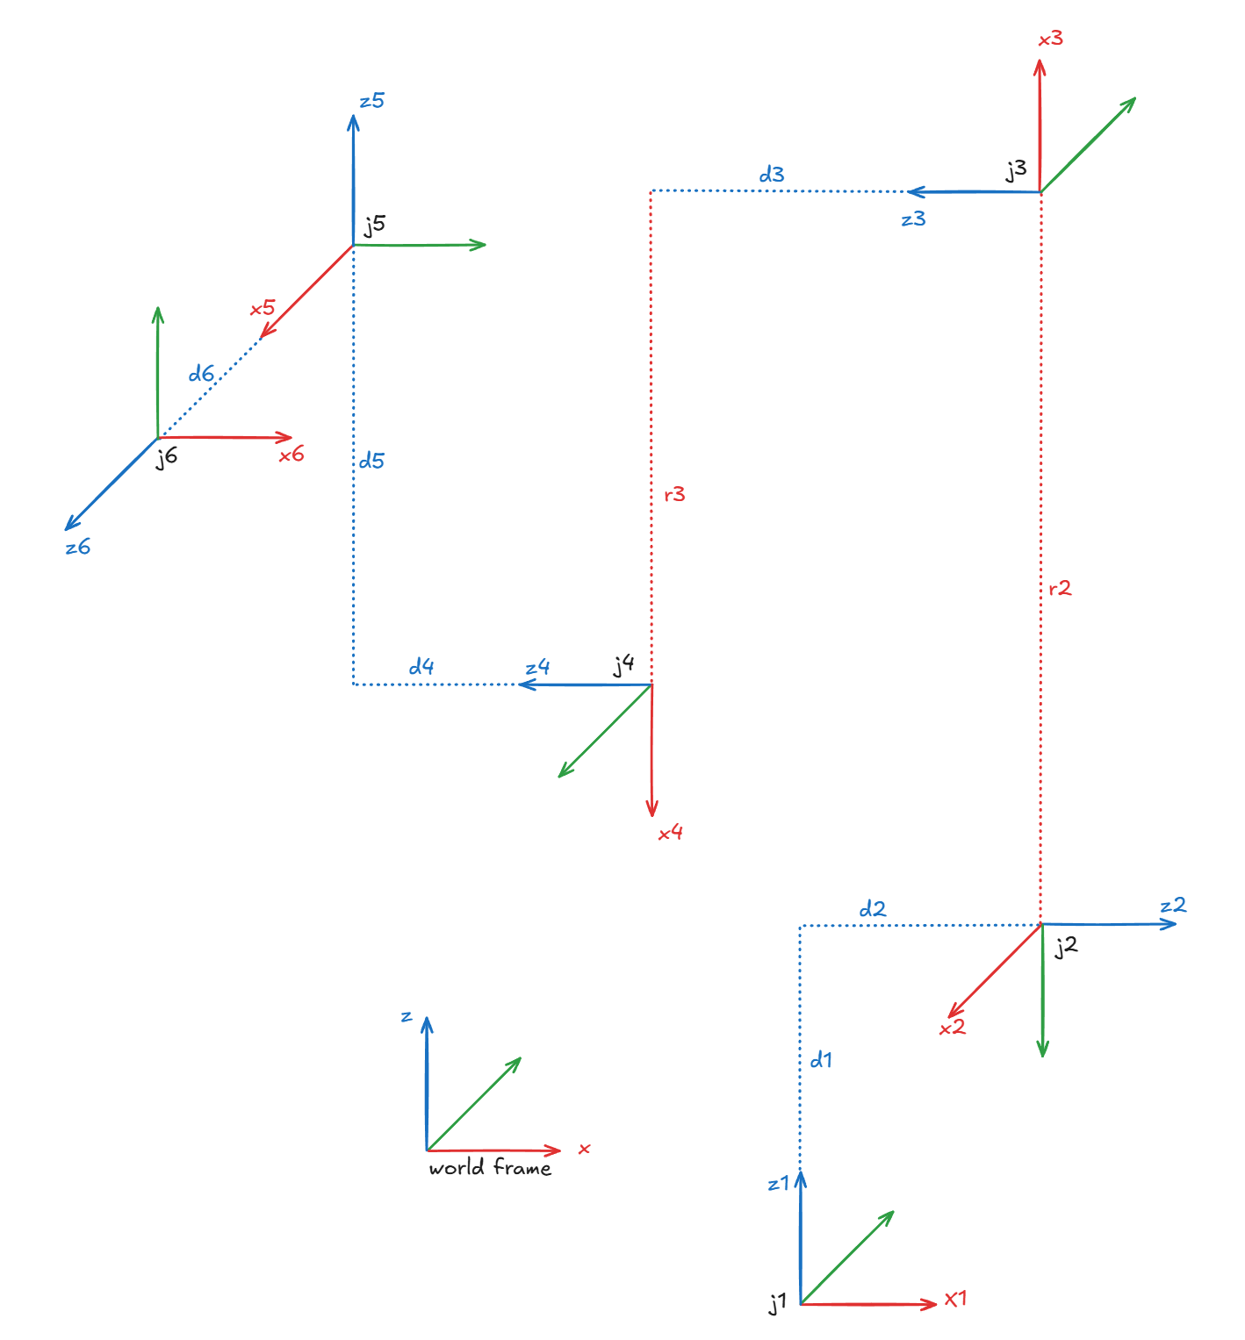
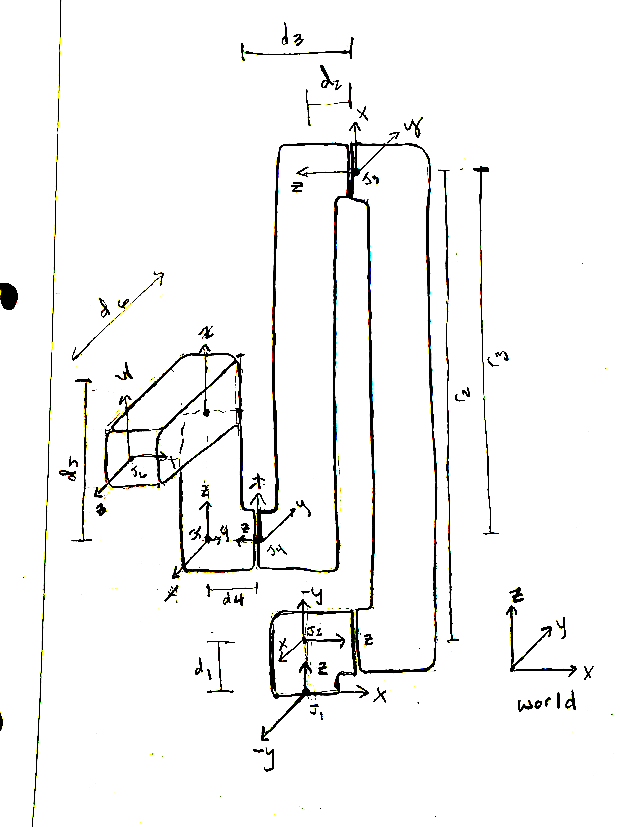
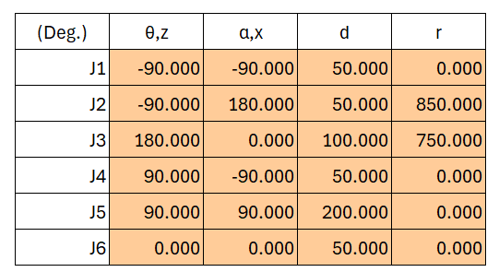
DH Table

Slide 11
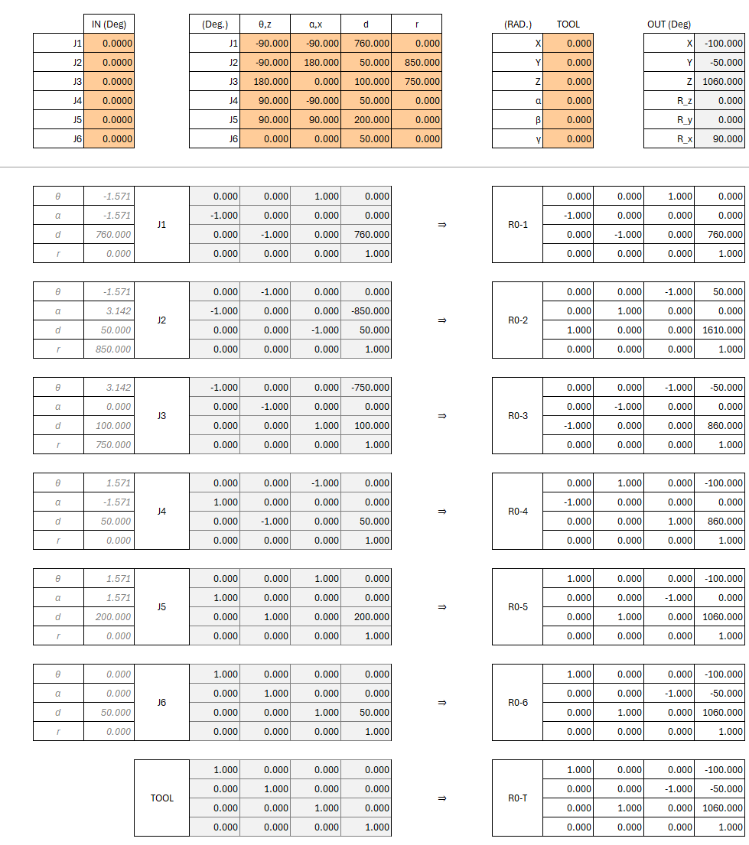
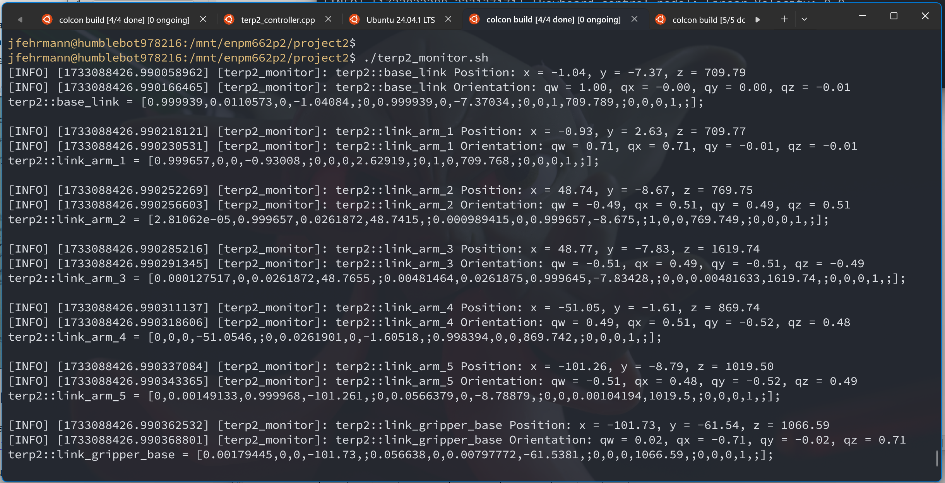
DH Table Validation
Transform Modeling in Excel
Output from terp2_monitor

Slide 12
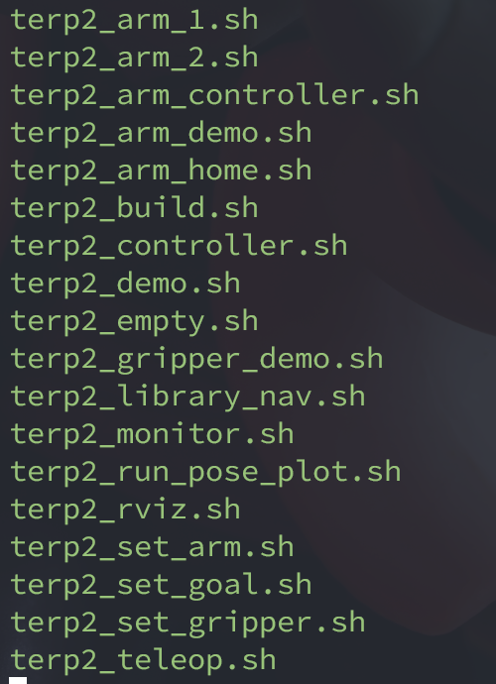
Deployment Model
Worked from OSRF docker image, osrf/ros:humble-desktop-full
Runtime and Development environment fully codified in Docker.
Developers working on Ubuntu, Arch, and Windows WSL environments.
No local dependencies except git and docker
Codify anything useful as a bash script.
Clean workflow facilitates fast iterative testing:
checkout code
update image (if required)
launch container
make edits
build and run scripts
push code updates

Slide 13
Challenges
Ambitious Project Scope: Many topics were new to everyone. Lots of “hack/slash” to get things working without fully understanding each software component.
No time for refinement or major changes.
Systemic Fragility: Too many sources for issues: tedious math, ROS and its ecosystem of plugins, multiple programming languages.
Very hard to narrow down and find root causes.
Time Management: Hard to balance time between learning mathematics modeling topics and spending time debugging ROS issues.
Accept best efforts over best outcomes.
Role Management: Time pressures forced team members into fixed roles. No time or capacity to switch roles.
No opportunity to step outside comfort zone.

Slide 14
Successes
DevOps: Codified and portable runtime and dev environment will be tremendously useful for future project.
ROS: Learned basic ROS concepts such as spawning a robot, creating nodes, topics, parameters, etc.
PID Controller: Implementing a PID Controller and seeing how changes to values affect the robot’s motion.
Quaternion Math: Worked with quaternion representations for robot orientation, and converting to roll-pitch-yaw, Euler angles, and Transform matrices.
Gazebo: Gained experience working in Gazebo and parsing Gazebo state data.

