Slide 1
Import Raw Data/Save copy
Import Raw Data
Import Raw Data
Do Data Cleaning Steps 1-30
Write Data Cleaning Steps 1-30 in Syntax
Run Syntax
Save clean copy
Export Clean Data
Export Clean Data
New version of the data
New version of the data

Slide 2


Slide 3


Slide 4
stu_id | Item1 | Item2 | item3
1234 | 4 | 3 | 2
1345 | 5 | 2 | 1
1456 | 3 | 1 | 4
stu_id | Item1 | Item2 | item3
1234 | 4 | 3 | 2
1345 | 5 | 2 | 1
1456 | 3 | 1 | 4
?
# Read in raw data
data <- read_csv(“file_raw.csv”)
# Delete duplicate cases
data <- data %>% distinct(stu_id, .keep_all = TRUE)
# Reverse code Item1
data <- data %>% mutate(Item1 = recode(Item1, `1` = 5, `2` = 4, `3` = 3, `4` = 2, `5` = 1)
# Export clean data
write_csv(data, “file_clean.csv”)

Slide 5
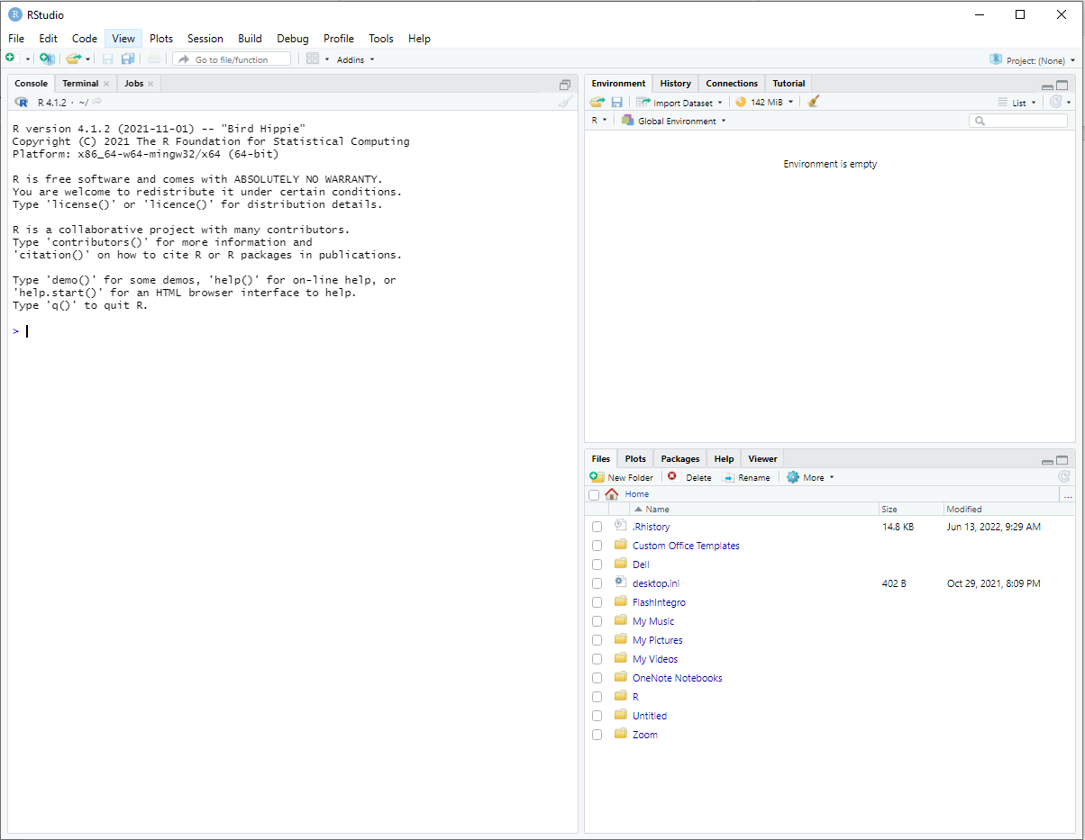
Environment Pane
Console Pane
Files Pane

Slide 6
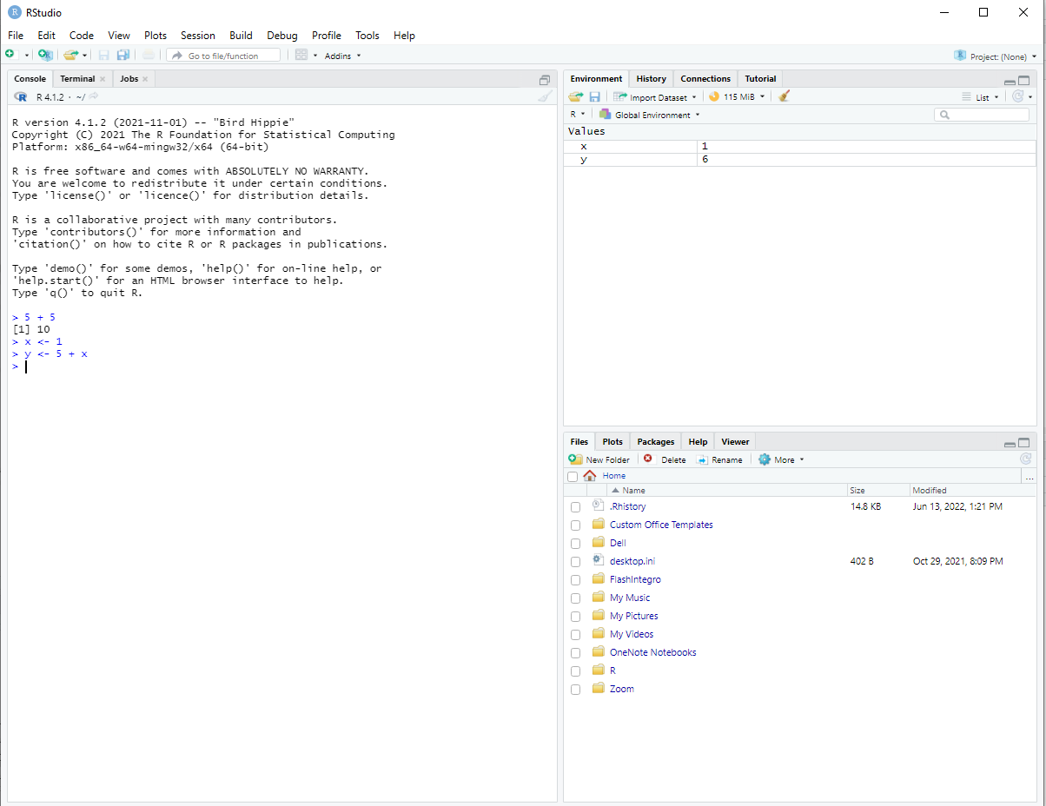
Sweep
Sweep
Directory
Objects
Assignment Operator

Slide 7
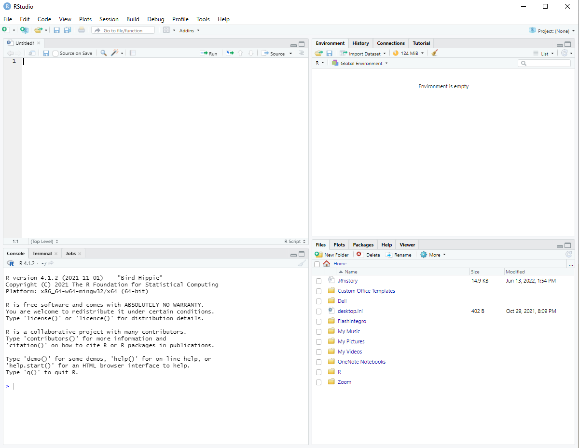
Source Pane

Slide 8
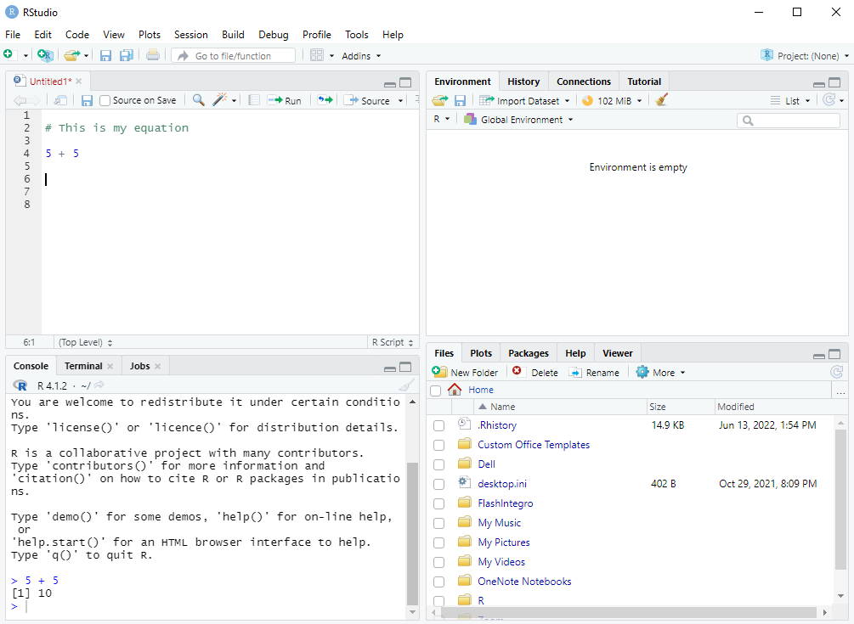
Save syntax
Run syntax
New syntax
Comment
Command
Output

Slide 9
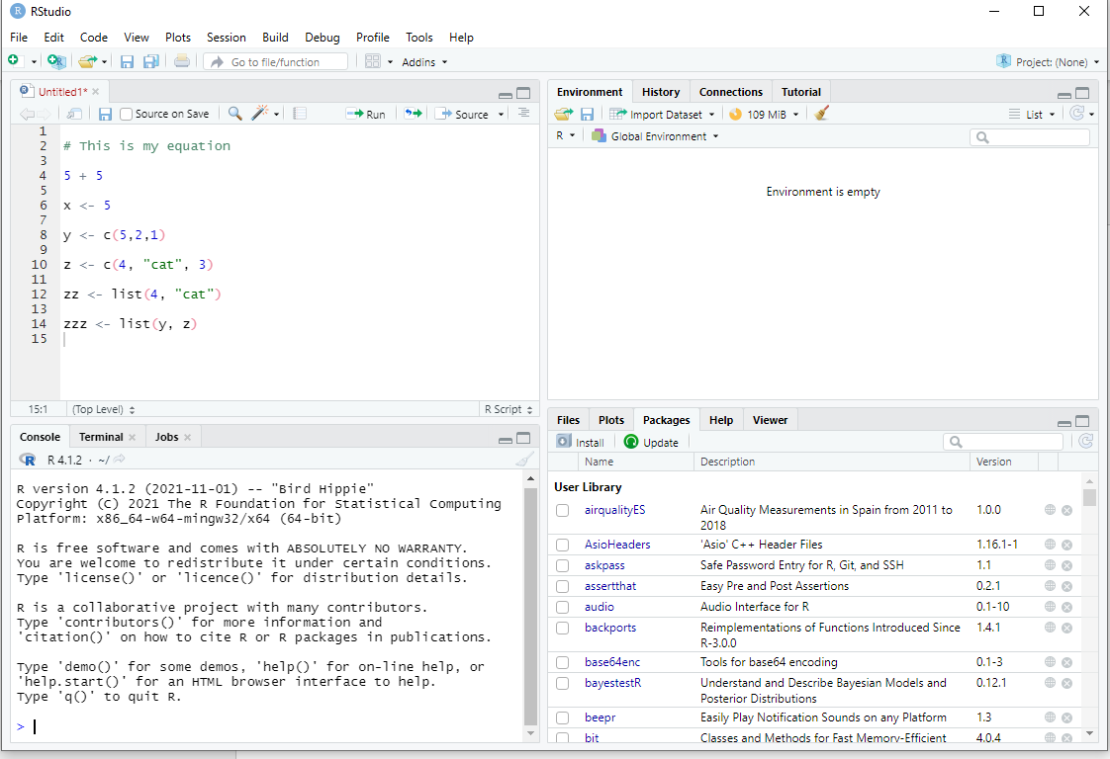
Install

Slide 10
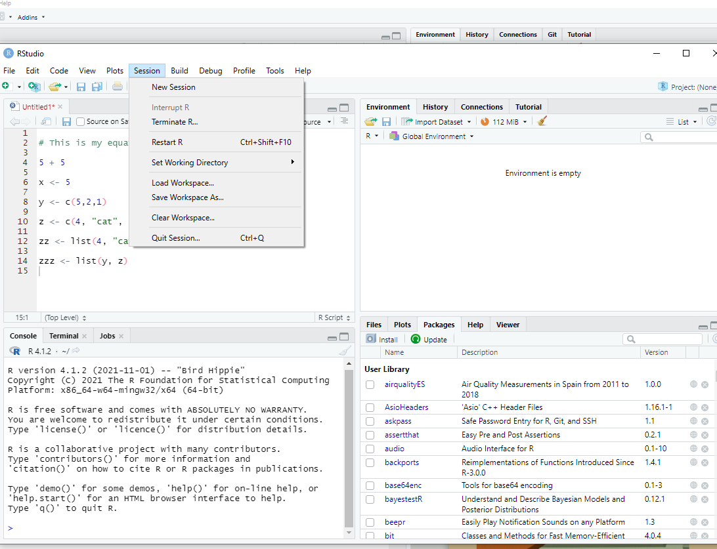

Slide 11
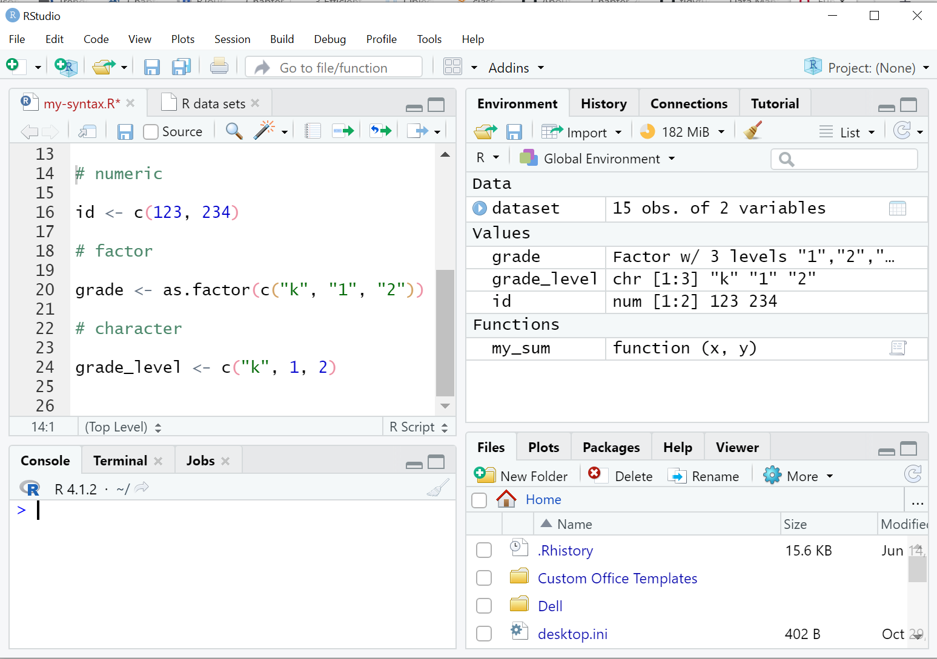
Objects

Slide 12
class(x)
mean(x, na.rm = FALSE)
na.rm is an argument that can be set to TRUE or FALSE. The default is FALSE
X = an R object
X = an R object

Slide 13
Write code here
Don’t write code here

Slide 14
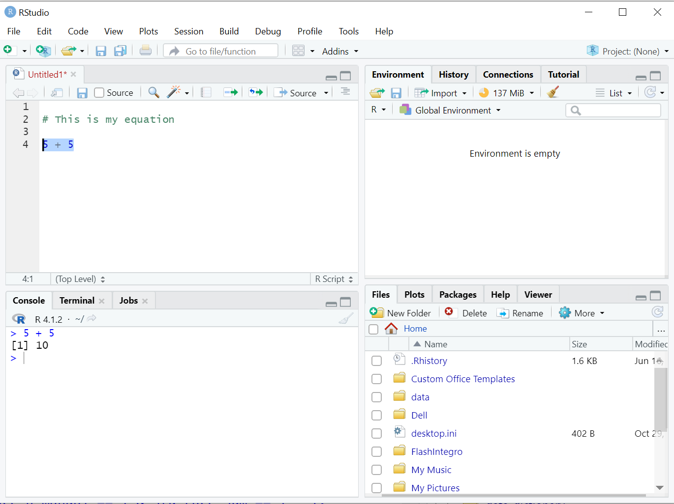
Run syntax
The code you ran
Output

Slide 15
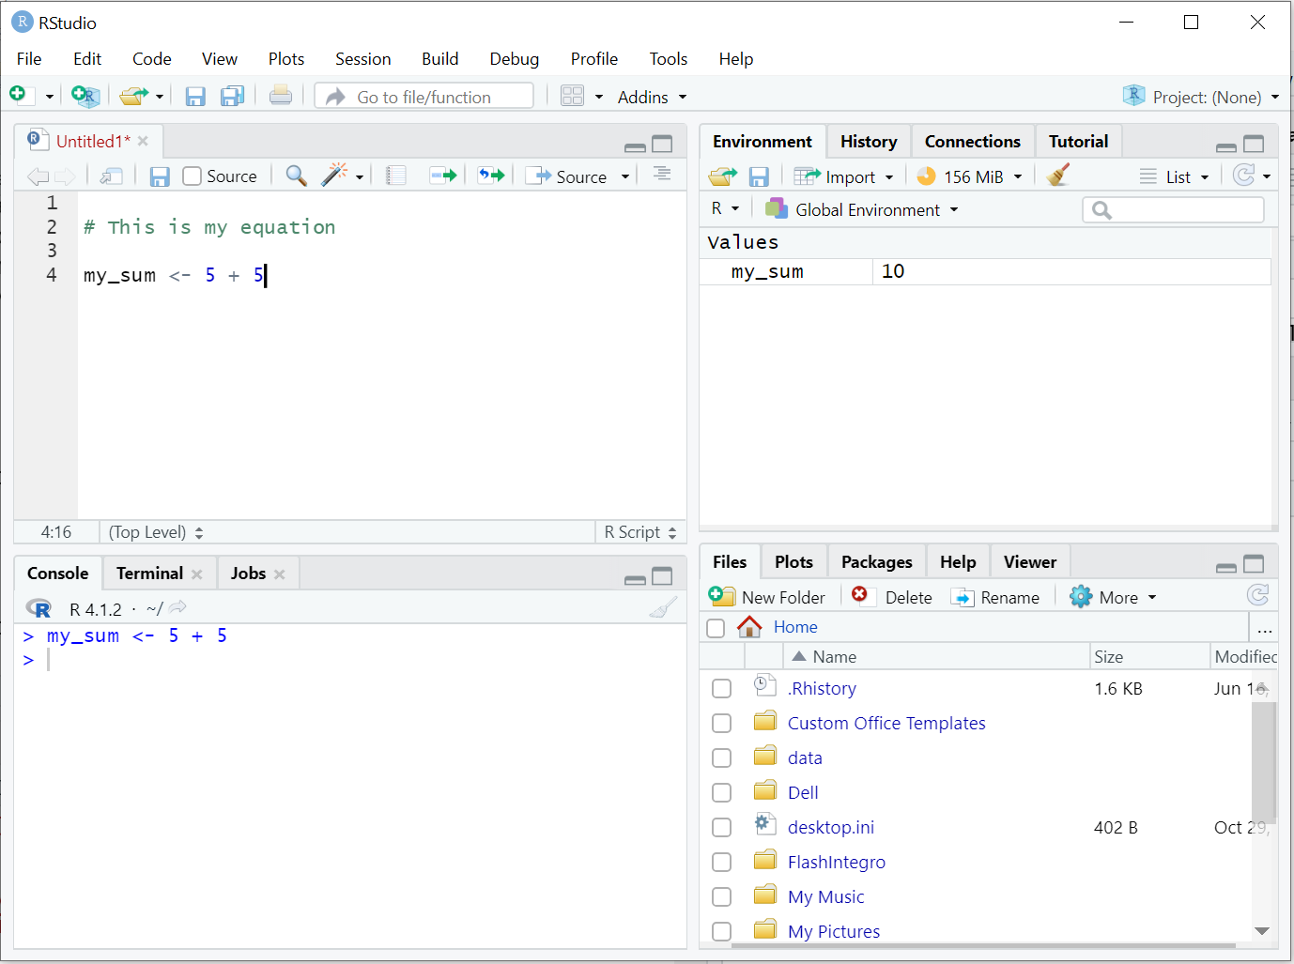
The object I am assigning my output to
The object you created
The code you ran

Slide 16
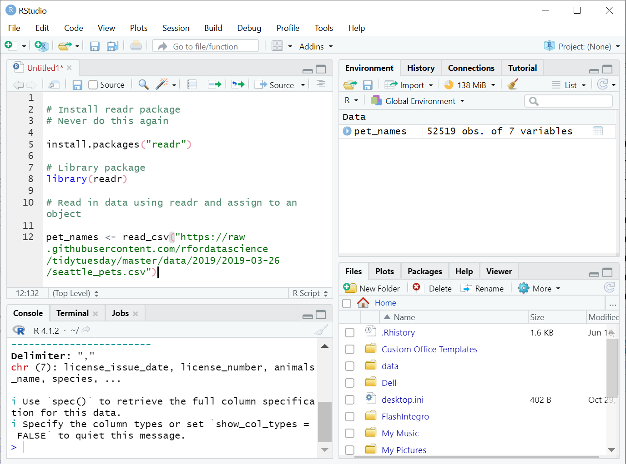

Slide 17
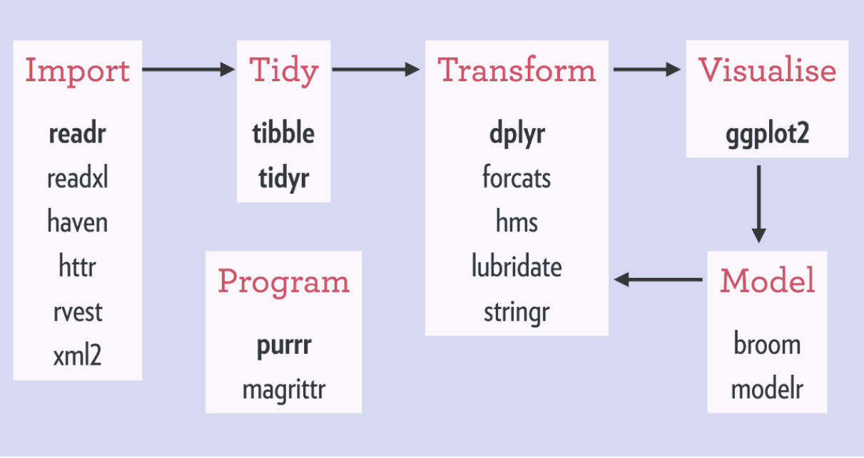

Slide 18
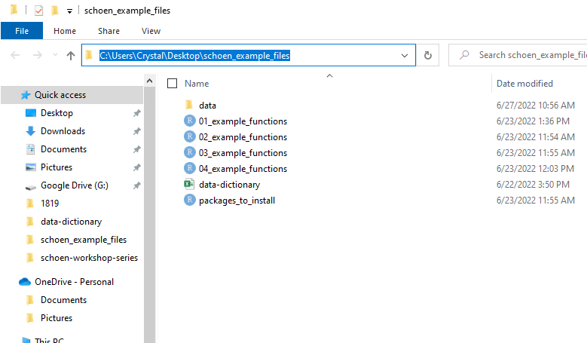
Our data files are in here

Slide 19
tch_id | score1_1819 | score2_1819 | score3_1819
2345 | 200 | 300 | 247
2346 | 256 | 302 | 253
2347 | 231 | 278 | 280
2348 | 258 | 269 | 290
tch_id | score1_1920 | score2_1920 | score3_1920
2345 | 220 | 301 | 250
2347 | 270 | 330 | 247
2348 | 241 | 270 | 300
2349 | 272 | 326 | 219
1819 Test Data
1920 Test Data
tch_id | score1_1819 | score2_1819 | score3_1819
2345 | 200 | 300 | 247
2346 | 256 | 302 | 253
2347 | 231 | 278 | 280
2348 | 258 | 269 | 290
score1_1920 | score2_1920 | score3_1920
220 | 301 | 250
NA | NA | NA
270 | 330 | 247
241 | 270 | 300
2349 | NA | NA | NA
272 | 326 | 219

Slide 20
tch_id | score1_1819 | score2_1819 | score3_1819
2345 | 200 | 300 | 247
2347 | 231 | 278 | 280
2348 | 258 | 269 | 290
score1_1920 | score2_1920 | score3_1920
2345 | 220 | 301
2347 | 270 | 330
2348 | 241 | 270
tch_id | score1_1819 | score2_1819 | score3_1819
2345 | 200 | 300 | 247
2346 | 256 | 302 | 253
2347 | 231 | 278 | 280
2348 | 258 | 269 | 290
score1_1920 | score2_1920 | score3_1920
2345 | 220 | 301
NA | NA | NA
2347 | 270 | 330
2348 | 241 | 270

Slide 21
tch_id | qualtrics_link | item1 | item2
2345 | 1 | 4 | 3
2346 | 1 | 5 | 2
2347 | 1 | 6 | 3
tch_id | qualtrics_link | item1 | item2
2348 | 2 | 3 | 1
2349 | 2 | 2 | 5
2350 | 2 | 2 | 6
Qualtrics link 1
Qualtrics link 2
tch_id | qualtrics_link | item1 | item2
2345 | 1 | 4 | 3
2346 | 1 | 5 | 2
2347 | 1 | 6 | 3
2348 | 2 | 3 | 1
2349 | 2 | 2 | 5
2350 | 2 | 2 | 6

Slide 22
tch_id | score1_1819 | score2_1819 | score3_1819
2345 | 200 | 300 | 247
2346 | 256 | 302 | 253
2347 | 231 | 278 | 280
2348 | 258 | 269 | 290
score1_1920 | score2_1920 | score3_1920
2345 | 220 | 301
NA | NA | NA
2347 | 270 | 330
2348 | 241 | 270
2349 | NA | NA | NA
272 | 326 | 219
tch_id | time | score1 | score2
2345
2346
2347
2348
2349
2345
2346
score3

Slide 23
tch_id | score1_1819 | score2_1819 | score3_1819 | score1_1920 | score2_1920 | score3_1920
2345 | 200 | 300 | 247 | 220 | 301 | 250
2346 | 256 | 302 | 253 | NA | NA | NA
2347 | 231 | 278 | 280 | 270 | 330 | 247
2348 | 258 | 269 | 290 | 241 | 270 | 300
2349 | NA | NA | NA | 272 | 326 | 219
tch_id | time | score1 | score2 | score3
2345 | 1819 | 200 | 300 | 247
2346 | 1819 | 256 | 302 | 253
2347 | 1819 | 231 | 278 | 280
2348 | 1819 | 258 | 269 | 290
2349 | 1819 | NA | NA | NA
2345 | 1920 | 220 | 301 | 250
2346 | 1920 | NA | NA | NA
2347 | 1920 | 270 | 330 | 247
2348 | 1920 | 241 | 270 | 300
2349 | 1920 | 272 | 326 | 219

Slide 24
tch_id | score1_1819 | score2_1819 | score3_1819 | score1_1920 | score2_1920 | score3_1920
2345 | 200 | 300 | 247 | 220 | 301 | 250
2346 | 256 | 302 | 253 | NA | NA | NA
2347 | 231 | 278 | 280 | 270 | 330 | 247
2348 | 258 | 269 | 290 | 241 | 270 | 300
2349 | NA | NA | NA | 272 | 326 | 219
tch_id | time | score1 | score2 | score3
2345 | 1819 | 200 | 300 | 247
2346 | 1819 | 256 | 302 | 253
2347 | 1819 | 231 | 278 | 280
2348 | 1819 | 258 | 269 | 290
2349 | 1819 | NA | NA | NA
2345 | 1920 | 220 | 301 | 250
2346 | 1920 | NA | NA | NA
2347 | 1920 | 270 | 330 | 247
2348 | 1920 | 241 | 270 | 300
2349 | 1920 | 272 | 326 | 219
WIDE
LONG

Slide 25
tch_id | time | score1 | score2 | score3
2345 | 1819 | 200 | 300 | 247
2346 | 1819 | 256 | 302 | 253
2347 | 1819 | 231 | 278 | 280
2348 | 1819 | 258 | 269 | 290
2349 | 1819 | NA | NA | NA
2345 | 1920 | 220 | 301 | 250
2346 | 1920 | NA | NA | NA
2347 | 1920 | 270 | 330 | 247
2348 | 1920 | 241 | 270 | 300
2349 | 1920 | 272 | 326 | 219
tch_id | score1_1819 | score2_1819 | score3_1819 | score1_1920 | score2_1920 | score3_1920
2345 | 200 | 300 | 247 | 220 | 301 | 250
2346 | 256 | 302 | 253 | NA | NA | NA
2347 | 231 | 278 | 280 | 270 | 330 | 247
2348 | 258 | 269 | 290 | 241 | 270 | 300
2349 | NA | NA | NA | 272 | 326 | 219
WIDE
LONG

Slide 26
Cols to pivot
names_to
values_to
tch_id | time1 | time2
2345 | 30 | 40
2346 | 30 | 50
2347 | NA | 40
2348 | 45 | NA
tch_id | time | score
2345 | time1 | 30
2345 | time2 | 40
2346 | time1 | 30
2346 | time2 | 50
2347 | time1 | NA
2347 | time2 | 40
2348 | time1 | 45
2348 | time2 | NA

Slide 27
Cols to pivot
names_to
(.value reference)
names_sep
tch_id | score1_1819 | score2_1819 | score3_1819 | score1_1920 | score2_1920 | score3_1920
2345 | 200 | 300 | 247 | 220 | 301 | 250
2346 | 256 | 302 | 253 | NA | NA | NA
2347 | 231 | 278 | 280 | 270 | 330 | 247
2348 | 258 | 269 | 290 | 241 | 270 | 300
2349 | NA | NA | NA | 272 | 326 | 219
names_to (categorical piece)

Slide 28
names_from
values_from
tch_id | time | score
2345 | time1 | 30
2345 | time2 | 40
2346 | time1 | 30
2346 | time2 | 50
2347 | time1 | NA
2347 | time2 | 40
2348 | time1 | 45
2348 | time2 | NA
tch_id | time1 | time2
2345 | 30 | 40
2346 | 30 | 50
2347 | NA | 40
2348 | 45 | NA

Slide 29
names_from
values_from
names_sep
tch_id | year | score1 | score2 | score3
2345 | 1819 | 200 | 300 | 247
2346 | 1819 | 256 | 302 | 253
2347 | 1819 | 231 | 278 | 280
2348 | 1819 | 258 | 269 | 290
2349 | 1819 | NA | NA | NA
2345 | 1920 | 220 | 301 | 250
2346 | 1920 | NA | NA | NA
2347 | 1920 | 270 | 330 | 247
2348 | 1920 | 241 | 270 | 300
2349 | 1920 | 272 | 326 | 219
tch_id | score1_1819 | score2_1819 | score3_1819 | score1_1920 | score2_1920 | score3_1920
2345 | 200 | 300 | 247 | 220 | 301 | 250
2346 | 256 | 302 | 253 | NA | NA | NA
2347 | 231 | 278 | 280 | 270 | 330 | 247
2348 | 258 | 269 | 290 | 241 | 270 | 300
2349 | NA | NA | NA | 272 | 326 | 219

