Slide 1
Import Raw Data/Save copy
Import Raw Data
Import Raw Data
Do Data Cleaning Steps 1-30
Write Data Cleaning Steps 1-30 in Syntax
Run Syntax
Save clean copy
Export Clean Data
Export Clean Data
New version of the data
New version of the data

Slide 2


Slide 3
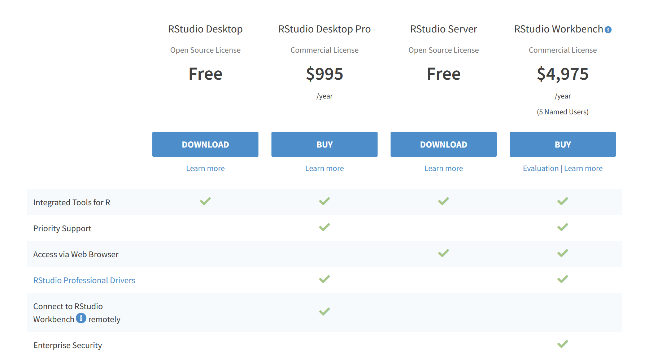

Slide 4
stu_id | Item1 | Item2 | item3
1234 | 4 | 3 | 2
1345 | 5 | 2 | 1
1456 | 3 | 1 | 4
stu_id | Item1 | Item2 | item3
1234 | 4 | 3 | 2
1345 | 5 | 2 | 1
1456 | 3 | 1 | 4
?
# Read in raw data
data <- read_csv(“file_raw.csv”)
# Delete duplicate cases
data <- data %>% distinct(stu_id, .keep_all = TRUE)
# Reverse code Item1
data <- data %>% mutate(Item1 = recode(Item1, `1` = 5, `2` = 4, `3` = 3, `4` = 2, `5` = 1)
# Export clean data
write_csv(data, “file_clean.csv”)

Slide 5
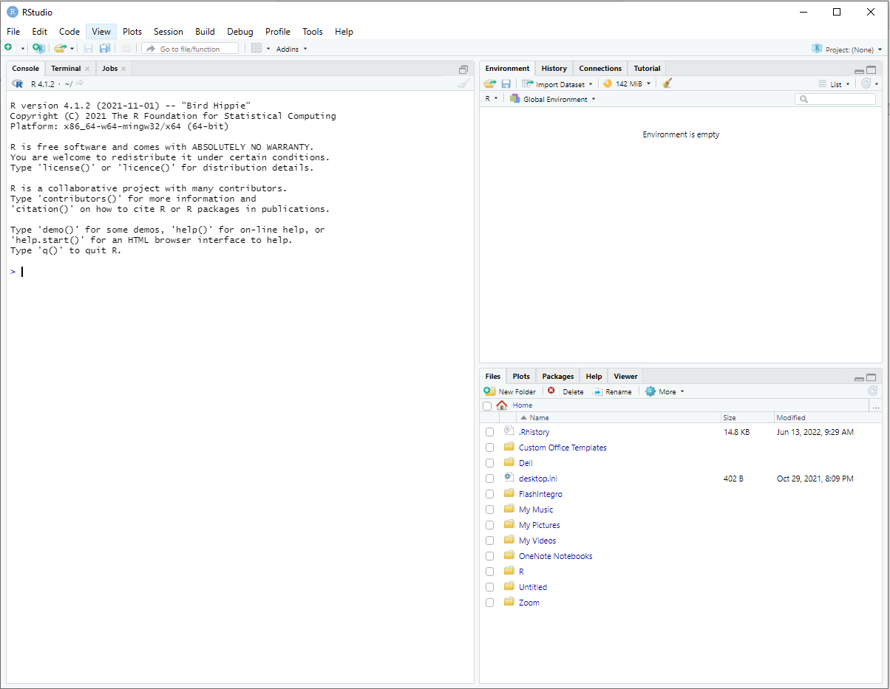
Environment Pane
Console Pane
Files Pane

Slide 6
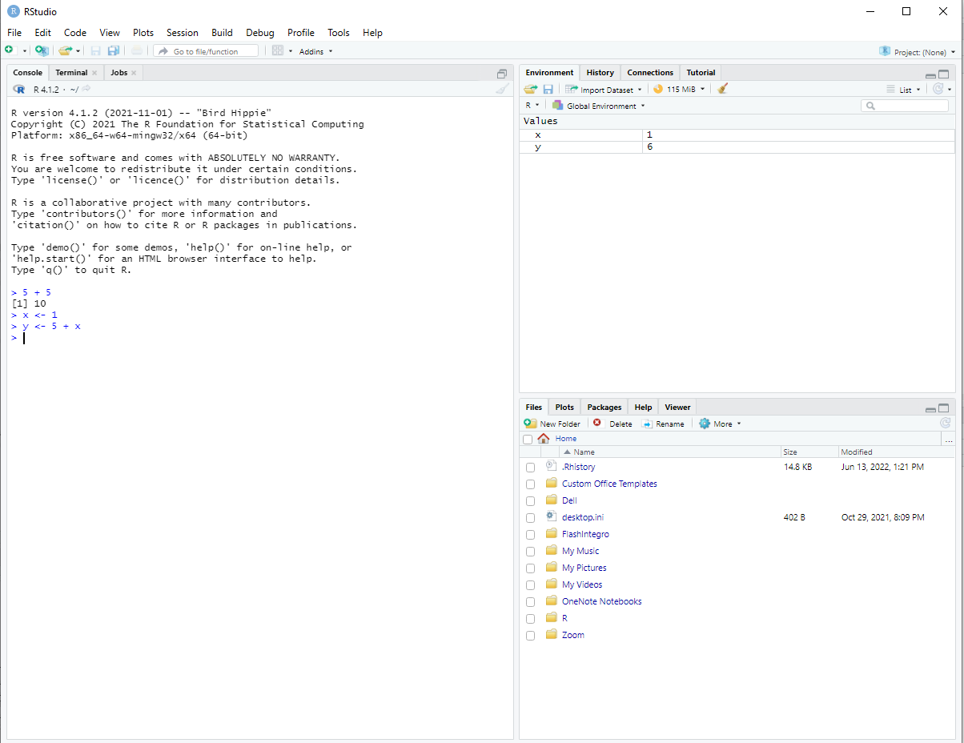
Sweep
Sweep
Directory
Objects
Assignment Operator

Slide 7
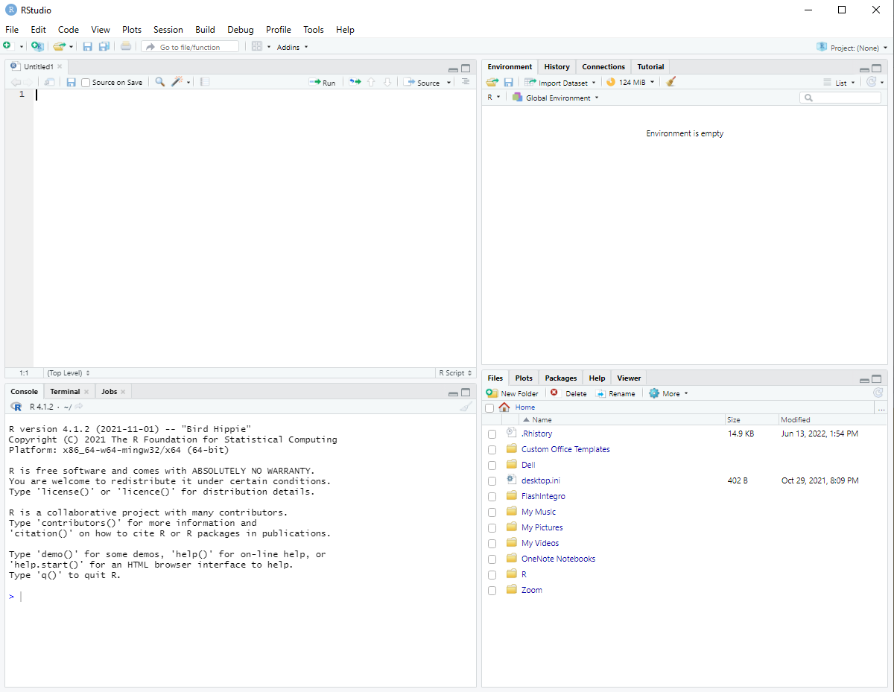
Source Pane

Slide 8
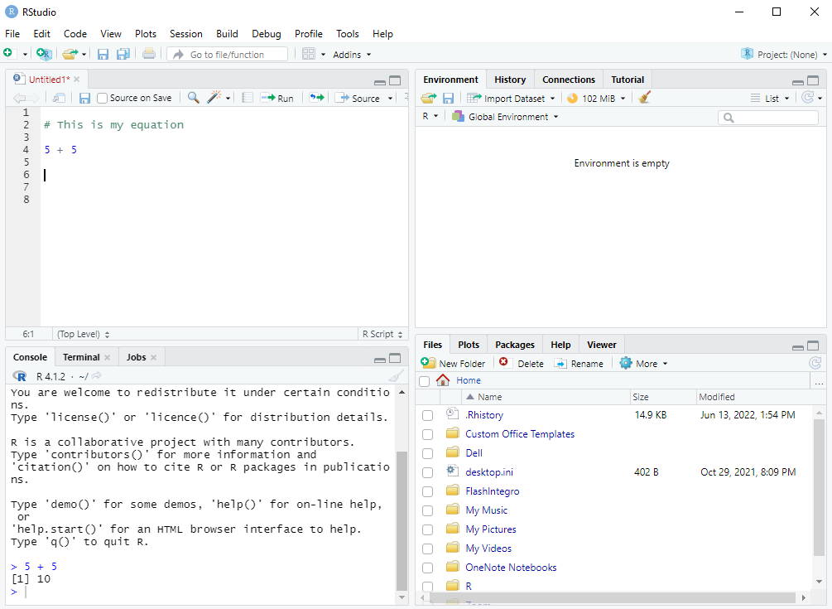
Save syntax
Run syntax
New syntax
Comment
Command
Output

Slide 9
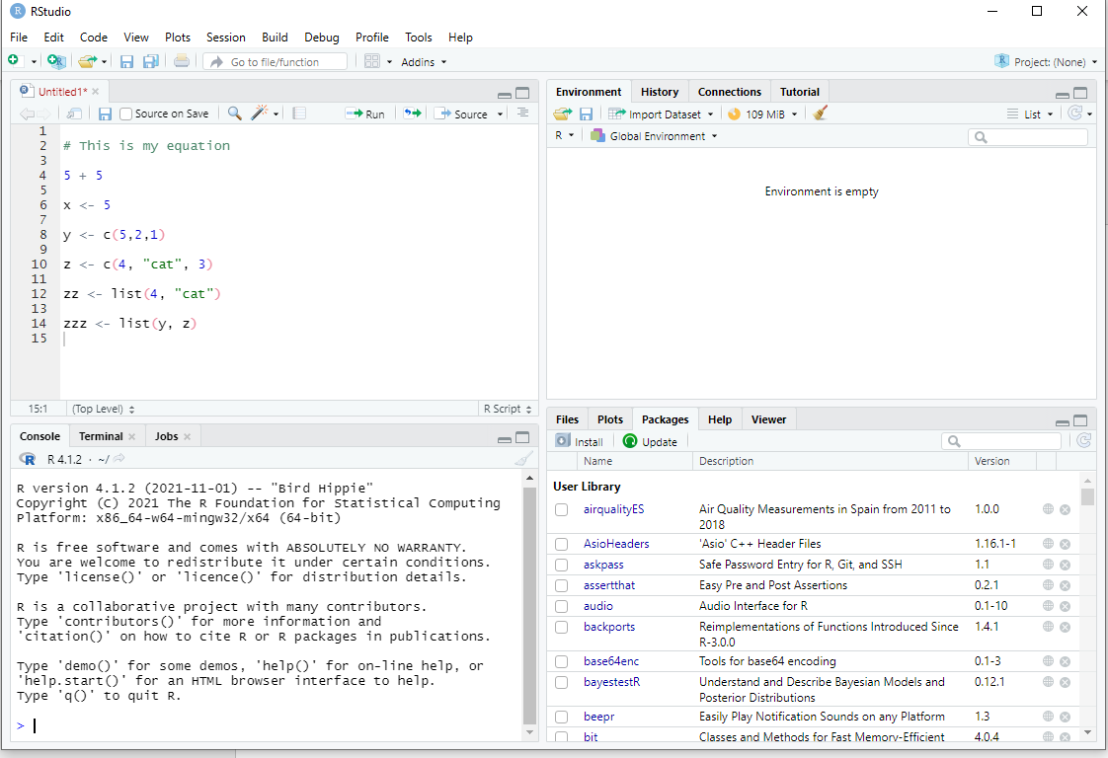
Install

Slide 10
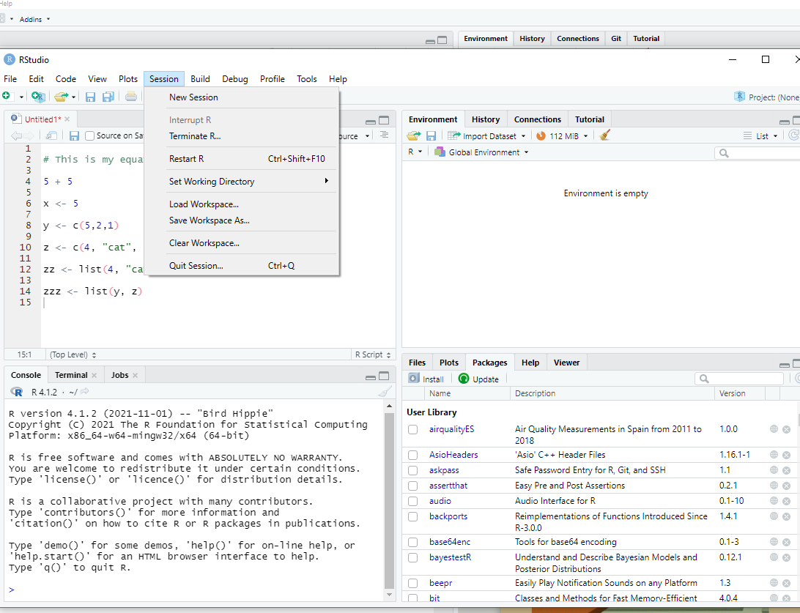

Slide 11
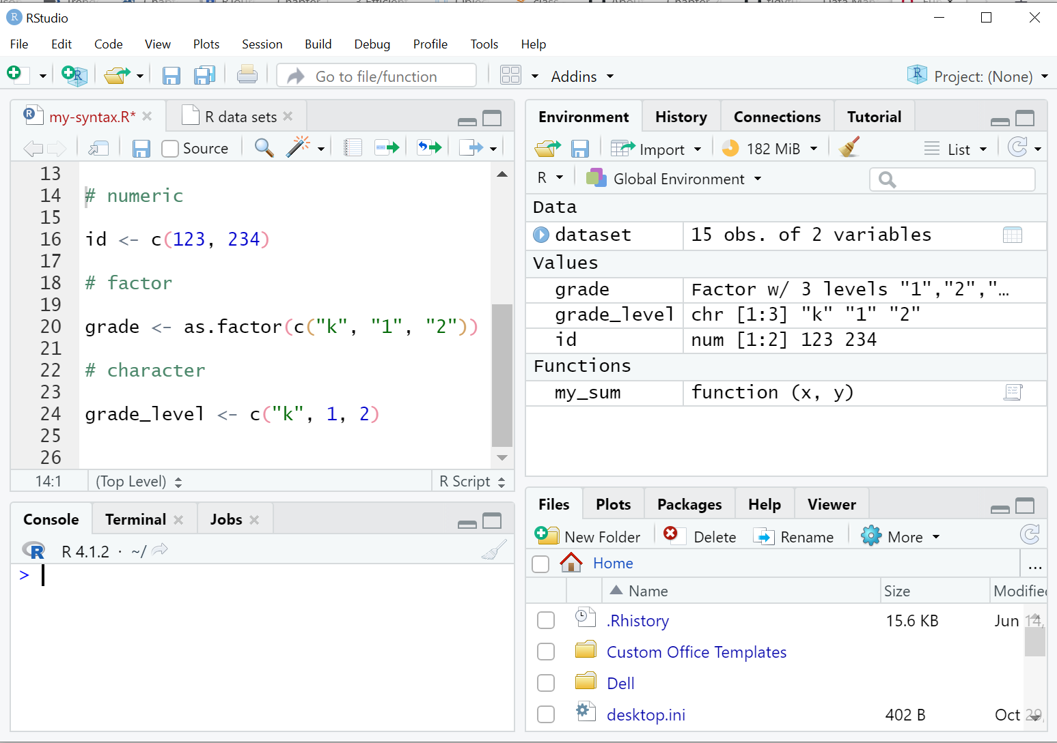
Objects

Slide 12
class(x)
mean(x, na.rm = FALSE)
na.rm is an argument that can be set to TRUE or FALSE. The default is FALSE
X = an R object
X = an R object

Slide 13
Write code here
Don’t write code here

Slide 14
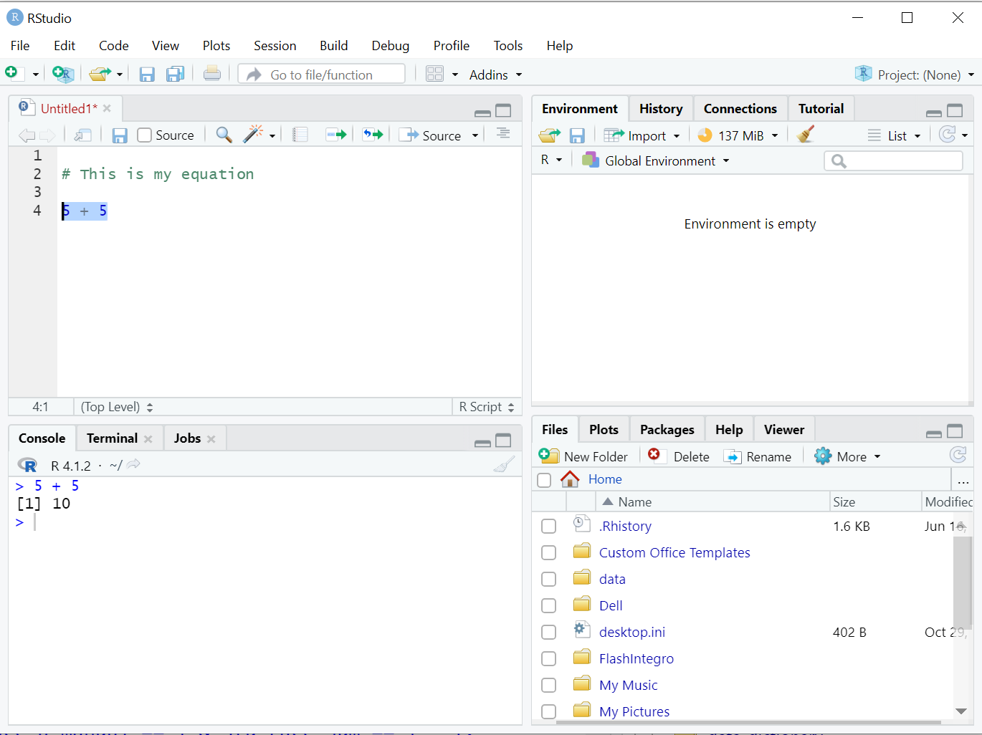
Run syntax
The code you ran
Output

Slide 15
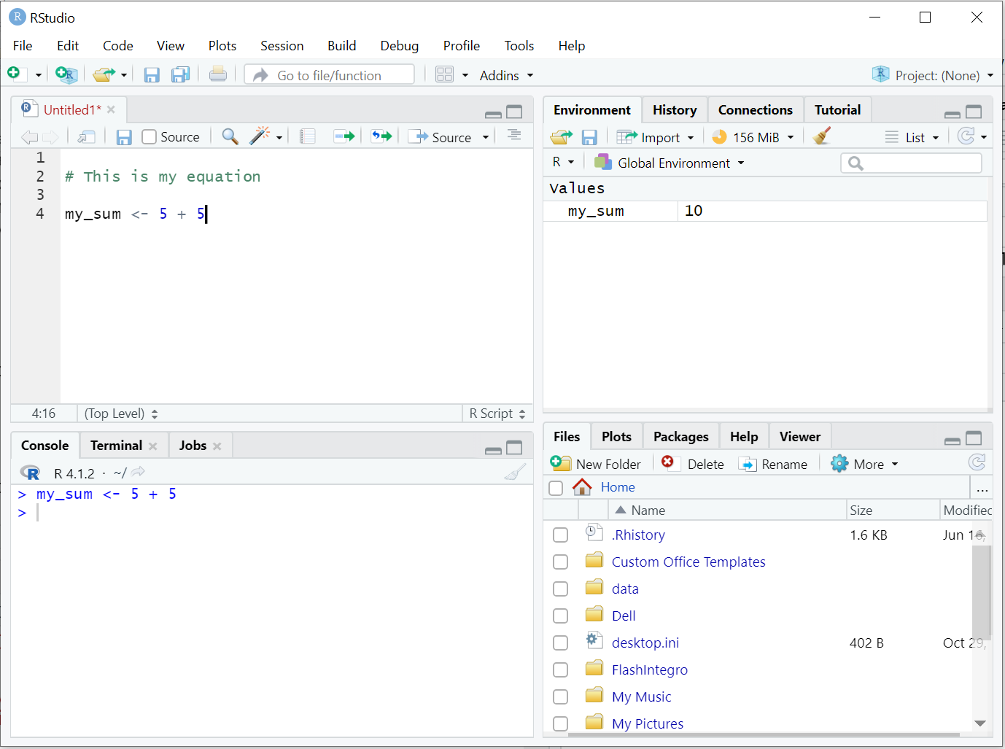
The object I am assigning my output to
The object you created
The code you ran

Slide 16
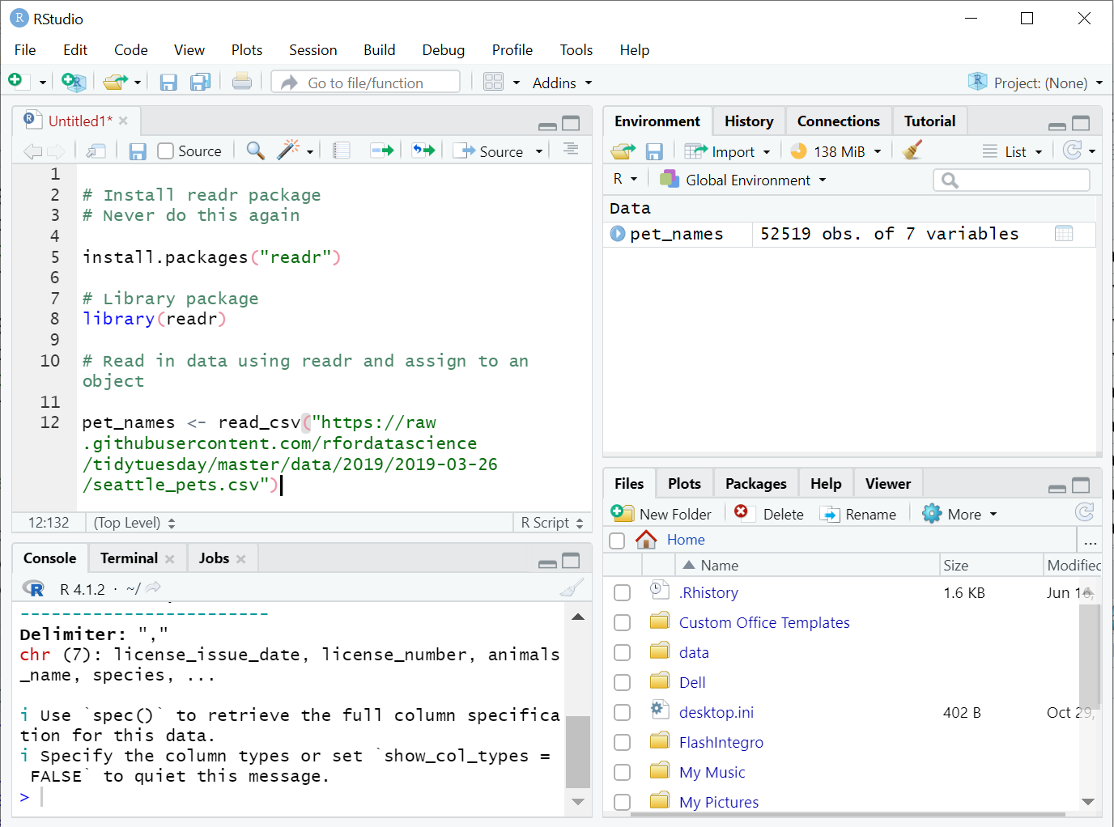

Slide 17
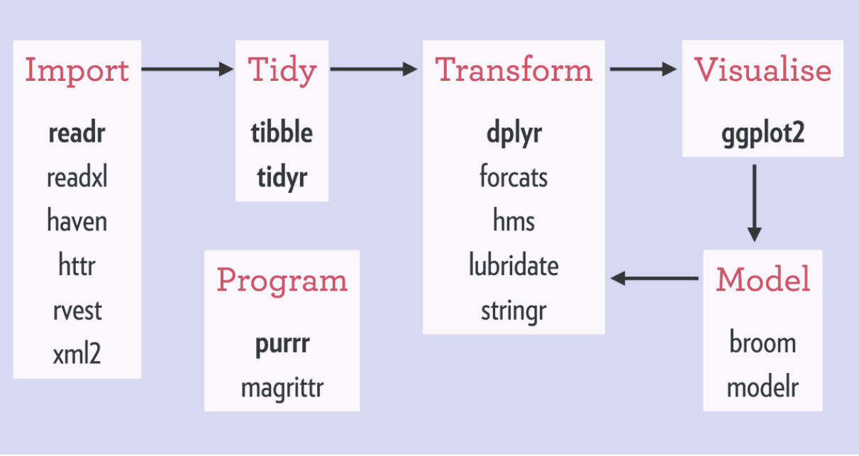

Slide 18
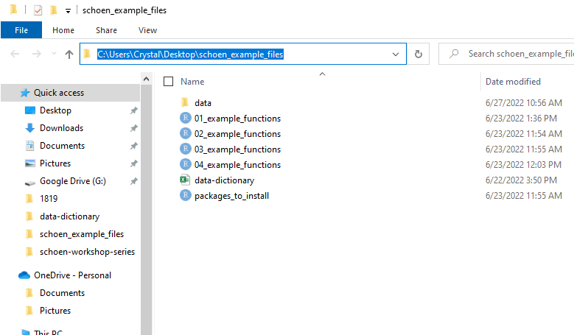
Our data files are in here

