Slide 1
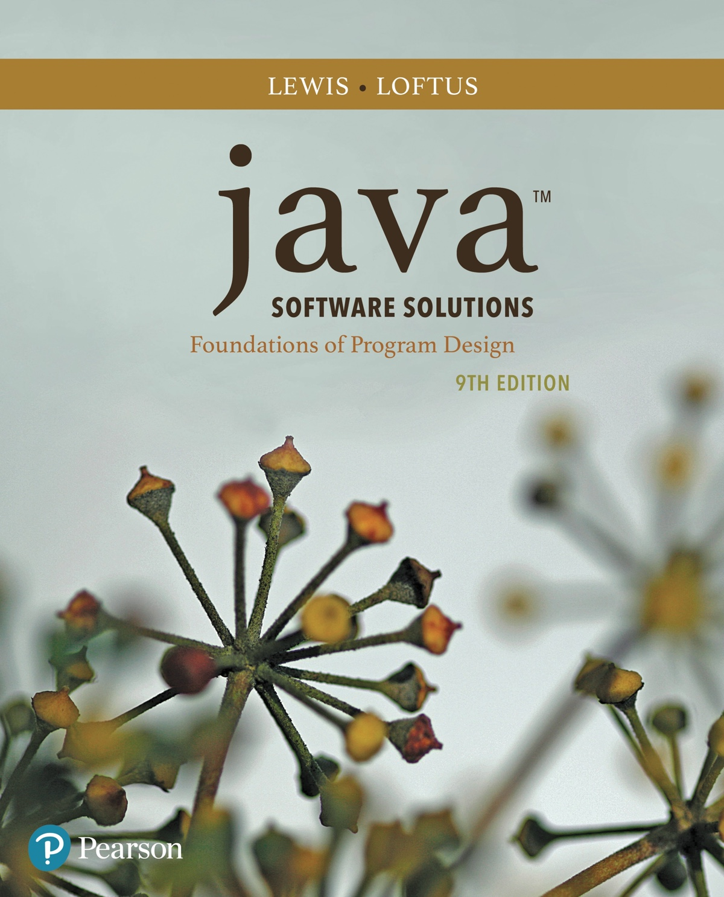
Chapter 7 Object-Oriented Design
Java Software Solutions
Foundations of Program Design
9th Edition
John Lewis
William Loftus

Slide 2
Object-Oriented Design
Now we can extend our discussion of the design of classes and objects
Chapter 7 focuses on:
software development activities
the relationships that can exist among classes
the static modifier
writing interfaces
the design of enumerated type classes
method design and method overloading
GUI design
mouse and keyboard events

Slide 3
Outline
Software Development Activities
Static Variables and Methods
Class Relationships
Interfaces
Enumerated Types Revisited
Method Design and Overloading
Testing
GUI Design
Mouse and Keyboard Events

Slide 4
Program Development
The creation of software involves four basic activities:
establishing the requirements
creating a design
implementing the code
testing the implementation
These activities are not strictly linear – they overlap and interact

Slide 5
Requirements
Software requirements specify the tasks that a program must accomplish
what to do, not how to do it
Often an initial set of requirements is provided, but they should be critiqued and expanded
It is difficult to establish detailed, unambiguous, and complete requirements
Careful attention to the requirements can save significant time and expense in the overall project

Slide 6
Design
A software design specifies how a program will accomplish its requirements
A software design specifies how the solution can be broken down into manageable pieces and what each piece will do
An object-oriented design determines which classes and objects are needed, and specifies how they will interact
Low level design details include how individual methods will accomplish their tasks

Slide 7
Implementation
Implementation is the process of translating a design into source code
Novice programmers often think that writing code is the heart of software development, but actually it should be the least creative step
Almost all important decisions are made during requirements and design stages
Implementation should focus on coding details, including style guidelines and documentation

Slide 8
Testing
Testing attempts to ensure that the program will solve the intended problem under all the constraints specified in the requirements
A program should be thoroughly tested with the goal of finding errors
Debugging is the process of determining the cause of a problem and fixing it
We revisit the details of the testing process later in this chapter

Slide 9
Identifying Classes and Objects
The core activity of object-oriented design is determining the classes and objects that will make up the solution
The classes may be part of a class library, reused from a previous project, or newly written
One way to identify potential classes is to identify the objects discussed in the requirements
Objects are generally nouns, and the services that an object provides are generally verbs

Slide 10
Identifying Classes and Objects (1)
A partial requirements document:
Of course, not all nouns will correspond to a class or object in the final solution
The user must be allowed to specify each product by
its primary characteristics, including its name and
product number. If the bar code does not match the
product, then an error should be generated to the
message window and entered into the error log. The
summary report of all transactions must be structured
as specified in section 7.A.

Slide 11
Identifying Classes and Objects (2)
Remember that a class represents a group (classification) of objects with the same behaviors
Generally, classes that represent objects should be given names that are singular nouns
Examples: Coin, Student, Message
A class represents the concept of one such object
We are free to instantiate as many of each object as needed

Slide 12
Identifying Classes and Objects (3)
Sometimes it is challenging to decide whether something should be represented as a class
For example, should an employee's address be represented as a set of instance variables or as an Address object
The more you examine the problem and its details the more clear these issues become
When a class becomes too complex, it often should be decomposed into multiple smaller classes to distribute the responsibilities

Slide 13
Identifying Classes and Objects (4)
We want to define classes with the proper amount of detail
For example, it may be unnecessary to create separate classes for each type of appliance in a house
It may be sufficient to define a more general Appliance class with appropriate instance data
It all depends on the details of the problem being solved

Slide 14
Identifying Classes and Objects (5)
Part of identifying the classes we need is the process of assigning responsibilities to each class
Every activity that a program must accomplish must be represented by one or more methods in one or more classes
We generally use verbs for the names of methods
In early stages it is not necessary to determine every method of every class – begin with primary responsibilities and evolve the design

Slide 15
Outline
Software Development Activities
Static Variables and Methods
Class Relationships
Interfaces
Enumerated Types Revisited
Method Design and Overloading
Testing
GUI Design
Mouse and Keyboard Events

Slide 16
Static Class Members
Recall that a static method is one that can be invoked through its class name
For example, the methods of the Math class are static:
result = Math.sqrt(25)
Variables can be static as well
Determining if a method or variable should be static is an important design decision

Slide 17
The static Modifier
We declare static methods and variables using the static modifier
It associates the method or variable with the class rather than with an object of that class
Static methods are sometimes called class methods and static variables are sometimes called class variables
Let's carefully consider the implications of each

Slide 18
Static Variables
Normally, each object has its own data space, but if a variable is declared as static, only one copy of the variable exists
private static float price;
Memory space for a static variable is created when the class is first referenced
All objects instantiated from the class share its static variables
Changing the value of a static variable in one object changes it for all others

Slide 19
Static Methods
public class Helper
{
public static int cube(int num)
{
return num * num * num;
}
}
Because it is declared as static, the cube method can be invoked through the class name:
value = Helper.cube(4);

Slide 20
Static Class Members
The order of the modifiers can be interchanged, but by convention visibility modifiers come first
Recall that the main method is static – it is invoked by the Java interpreter without creating an object
Static methods cannot reference instance variables because instance variables don't exist until an object exists
However, a static method can reference static variables or local variables

Slide 21
Static Class Members cont.
Static methods and static variables often work together
The following example keeps track of how many Slogan objects have been created using a static variable, and makes that information available using a static method
See SloganCounter.java
See Slogan.java

Slide 22
SloganCounter.java (1)
//********************************************************************
// SloganCounter.java Author: Lewis/Loftus
//
// Demonstrates the use of the static modifier.
//********************************************************************
public class SloganCounter
{
//-----------------------------------------------------------------
// Creates several Slogan objects and prints the number of
// objects that were created.
//-----------------------------------------------------------------
public static void main(String[] args)
{
Slogan obj;
obj = new Slogan("Remember the Alamo.");
System.out.println(obj);
obj = new Slogan("Don't Worry. Be Happy.");
System.out.println(obj);
continue

Slide 23
SloganCounter.java (2)
continue
obj = new Slogan("Live Free or Die.");
System.out.println(obj);
obj = new Slogan("Talk is Cheap.");
System.out.println(obj);
obj = new Slogan("Write Once, Run Anywhere.");
System.out.println(obj);
System.out.println();
System.out.println("Slogans created: " + Slogan.getCount());
}
}

Slide 24
SloganCounter.java (3)
Output
Remember the Alamo.
Don't Worry. Be Happy.
Live Free or Die.
Talk is Cheap.
Write Once, Run Anywhere.
Slogans created: 5
continue
obj = new Slogan("Live Free or Die.");
System.out.println(obj);
obj = new Slogan("Talk is Cheap.");
System.out.println(obj);
obj = new Slogan("Write Once, Run Anywhere.");
System.out.println(obj);
System.out.println();
System.out.println("Slogans created: " + Slogan.getCount());
}
}

Slide 25
Slogan.java
//********************************************************************
// Slogan.java Author: Lewis/Loftus
//
// Represents a single slogan string.
//********************************************************************
public class Slogan
{
private String phrase;
private static int count = 0;
//-----------------------------------------------------------------
// Constructor: Sets up the slogan and counts the number of
// instances created.
//-----------------------------------------------------------------
public Slogan(String str)
{
phrase = str;
count++;
}
continue

Slide 26
Slogan.java cont.
continue
//-----------------------------------------------------------------
// Returns this slogan as a string.
//-----------------------------------------------------------------
public String toString()
{
return phrase;
}
//-----------------------------------------------------------------
// Returns the number of instances of this class that have been
// created.
//-----------------------------------------------------------------
public static int getCount()
{
return count;
}
}

Slide 27
Quick Check
Why can't a static method refer to an instance variable?

Slide 28
Quick Check
Why can't a static method refer to an instance variable?
Because instance data is created only when an
object is created.
You don't need an object to execute a static method.
And even if you had an object, which object's instance
data would be referenced? (remember, the method is
invoked through the class name)

Slide 29
Outline
Software Development Activities
Static Variables and Methods
Class Relationships
Interfaces
Enumerated Types Revisited
Method Design and Overloading
Testing
GUI Design
Mouse and Keyboard Events

Slide 30
Class Relationships
Classes in a software system can have various types of relationships to each other
Three of the most common relationships:
Dependency: A uses B
Aggregation: A has-a B
Inheritance: A is-a B
Let's discuss dependency and aggregation further
Inheritance is discussed in detail in Chapter 9

Slide 31
Dependency
A dependency exists when one class relies on another in some way, usually by invoking the methods of the other
We've seen dependencies in many previous examples
We don't want numerous or complex dependencies among classes
Nor do we want complex classes that don't depend on others
A good design strikes the right balance

Slide 32
Dependency
Some dependencies occur between objects of the same class
A method of the class may accept an object of the same class as a parameter
For example, the concat method of the String class takes as a parameter another String object
str3 = str1.concat(str2);

Slide 33
Dependency cont.
The following example defines a class called RationalNumber
A rational number is a value that can be represented as the ratio of two integers
Several methods of the RationalNumber class accept another RationalNumber object as a parameter
See RationalTester.java
See RationalNumber.java

Slide 34
RationalTester.java (1)
//********************************************************************
// RationalTester.java Author: Lewis/Loftus
//
// Driver to exercise the use of multiple Rational objects.
//********************************************************************
public class RationalTester
{
//-----------------------------------------------------------------
// Creates some rational number objects and performs various
// operations on them.
//-----------------------------------------------------------------
public static void main(String[] args)
{
RationalNumber r1 = new RationalNumber(6, 8);
RationalNumber r2 = new RationalNumber(1, 3);
RationalNumber r3, r4, r5, r6, r7;
System.out.println("First rational number: " + r1);
System.out.println("Second rational number: " + r2);
continue

Slide 35
RationalTester.java (2)
continue
if (r1.isLike(r2))
System.out.println("r1 and r2 are equal.");
else
System.out.println("r1 and r2 are NOT equal.");
r3 = r1.reciprocal();
System.out.println("The reciprocal of r1 is: " + r3);
r4 = r1.add(r2);
r5 = r1.subtract(r2);
r6 = r1.multiply(r2);
r7 = r1.divide(r2);
System.out.println("r1 + r2: " + r4);
System.out.println("r1 - r2: " + r5);
System.out.println("r1 * r2: " + r6);
System.out.println("r1 / r2: " + r7);
}
}

Slide 36
RationalTester.java (3)
Output
First rational number: 3/4
Second rational number: 1/3
r1 and r2 are NOT equal.
The reciprocal of r1 is: 4/3
r1 + r2: 13/12
r1 - r2: 5/12
r1 * r2: 1/4
r1 / r2: 9/4
continue
if (r1.isLike(r2))
System.out.println("r1 and r2 are equal.");
else
System.out.println("r1 and r2 are NOT equal.");
r3 = r1.reciprocal();
System.out.println("The reciprocal of r1 is: " + r3);
r4 = r1.add(r2);
r5 = r1.subtract(r2);
r6 = r1.multiply(r2);
r7 = r1.divide(r2);
System.out.println("r1 + r2: " + r4);
System.out.println("r1 - r2: " + r5);
System.out.println("r1 * r2: " + r6);
System.out.println("r1 / r2: " + r7);
}
}

Slide 37
RationalNumber.java (1)
//********************************************************************
// RationalNumber.java Author: Lewis/Loftus
//
// Represents one rational number with a numerator and denominator.
//********************************************************************
public class RationalNumber
{
private int numerator, denominator;
//-----------------------------------------------------------------
// Constructor: Sets up the rational number by ensuring a nonzero
// denominator and making only the numerator signed.
//-----------------------------------------------------------------
public RationalNumber(int numer, int denom)
{
if (denom == 0)
denom = 1;
// Make the numerator "store" the sign
if (denom < 0)
{
numer = numer * -1;
denom = denom * -1;
}
continue

Slide 38
RationalNumber.java (2)
continue
numerator = numer;
denominator = denom;
reduce();
}
//-----------------------------------------------------------------
// Returns the numerator of this rational number.
//-----------------------------------------------------------------
public int getNumerator()
{
return numerator;
}
//-----------------------------------------------------------------
// Returns the denominator of this rational number.
//-----------------------------------------------------------------
public int getDenominator()
{
return denominator;
}
continue

Slide 39
RationalNumber.java (3)
continue
//-----------------------------------------------------------------
// Returns the reciprocal of this rational number.
//-----------------------------------------------------------------
public RationalNumber reciprocal()
{
return new RationalNumber(denominator, numerator);
}
//-----------------------------------------------------------------
// Adds this rational number to the one passed as a parameter.
// A common denominator is found by multiplying the individual
// denominators.
//-----------------------------------------------------------------
public RationalNumber add(RationalNumber op2)
{
int commonDenominator = denominator * op2.getDenominator();
int numerator1 = numerator * op2.getDenominator();
int numerator2 = op2.getNumerator() * denominator;
int sum = numerator1 + numerator2;
return new RationalNumber(sum, commonDenominator);
}
continue

Slide 40
RationalNumber.java (4)
continue
//-----------------------------------------------------------------
// Subtracts the rational number passed as a parameter from this
// rational number.
//-----------------------------------------------------------------
public RationalNumber subtract(RationalNumber op2)
{
int commonDenominator = denominator * op2.getDenominator();
int numerator1 = numerator * op2.getDenominator();
int numerator2 = op2.getNumerator() * denominator;
int difference = numerator1 - numerator2;
return new RationalNumber(difference, commonDenominator);
}
//-----------------------------------------------------------------
// Multiplies this rational number by the one passed as a
// parameter.
//-----------------------------------------------------------------
public RationalNumber multiply(RationalNumber op2)
{
int numer = numerator * op2.getNumerator();
int denom = denominator * op2.getDenominator();
return new RationalNumber(numer, denom);
}
continue

Slide 41
RationalNumber.java (5)
continue
//-----------------------------------------------------------------
// Divides this rational number by the one passed as a parameter
// by multiplying by the reciprocal of the second rational.
//-----------------------------------------------------------------
public RationalNumber divide(RationalNumber op2)
{
return multiply(op2.reciprocal());
}
//-----------------------------------------------------------------
// Determines if this rational number is equal to the one passed
// as a parameter. Assumes they are both reduced.
//-----------------------------------------------------------------
public boolean isLike(RationalNumber op2)
{
return ( numerator == op2.getNumerator() &&
denominator == op2.getDenominator() );
}
continue

Slide 42
RationalNumber.java (6)
continue
//-----------------------------------------------------------------
// Returns this rational number as a string.
//-----------------------------------------------------------------
public String toString()
{
String result;
if (numerator == 0)
result = "0";
else
if (denominator == 1)
result = numerator + "";
else
result = numerator + "/" + denominator;
return result;
}
continue

Slide 43
RationalNumber.java (7)
continue
//-----------------------------------------------------------------
// Reduces this rational number by dividing both the numerator
// and the denominator by their greatest common divisor.
//-----------------------------------------------------------------
private void reduce()
{
if (numerator != 0)
{
int common = gcd(Math.abs(numerator), denominator);
numerator = numerator / common;
denominator = denominator / common;
}
}
continue

Slide 44
RationalNumber.java (8)
continue
//-----------------------------------------------------------------
// Computes and returns the greatest common divisor of the two
// positive parameters. Uses Euclid's algorithm.
//-----------------------------------------------------------------
private int gcd(int num1, int num2)
{
while (num1 != num2)
if (num1 > num2)
num1 = num1 - num2;
else
num2 = num2 - num1;
return num1;
}
}

Slide 45
Aggregation
An aggregate is an object that is made up of other objects
Therefore aggregation is a has-a relationship
A car has a chassis
An aggregate object contains references to other objects as instance data
This is a special kind of dependency; the aggregate relies on the objects that compose it

Slide 46
Aggregation cont.
In the following example, a Student object is composed, in part, of Address objects
A student has an address (in fact each student has two addresses)
See StudentBody.java
See Student.java
See Address.java

Slide 47
StudentBody.java (1)
//********************************************************************
// StudentBody.java Author: Lewis/Loftus
//
// Demonstrates the use of an aggregate class.
//********************************************************************
public class StudentBody
{
//-----------------------------------------------------------------
// Creates some Address and Student objects and prints them.
//-----------------------------------------------------------------
public static void main(String[] args)
{
Address school = new Address("800 Lancaster Ave.", "Villanova",
"PA", 19085);
Address jHome = new Address("21 Jump Street", "Lynchburg",
"VA", 24551);
Student john = new Student("John", "Smith", jHome, school);
Address mHome = new Address("123 Main Street", "Euclid", "OH",
44132);
Student marsha = new Student("Marsha", "Jones", mHome, school);
System.out.println(john);
System.out.println();
System.out.println(marsha);
}
}

Slide 48
StudentBody.java (2)
Output
John Smith
Home Address:
21 Jump Street
Lynchburg, VA 24551
School Address:
800 Lancaster Ave.
Villanova, PA 19085
Marsha Jones
Home Address:
123 Main Street
Euclid, OH 44132
School Address:
800 Lancaster Ave.
Villanova, PA 19085
//********************************************************************
// StudentBody.java Author: Lewis/Loftus
//
// Demonstrates the use of an aggregate class.
//********************************************************************
public class StudentBody
{
//-----------------------------------------------------------------
// Creates some Address and Student objects and prints them.
//-----------------------------------------------------------------
public static void main(String[] args)
{
Address school = new Address("800 Lancaster Ave.", "Villanova",
"PA", 19085);
Address jHome = new Address("21 Jump Street", "Lynchburg",
"VA", 24551);
Student john = new Student("John", "Smith", jHome, school);
Address mHome = new Address("123 Main Street", "Euclid", "OH",
44132);
Student marsha = new Student("Marsha", "Jones", mHome, school);
System.out.println(john);
System.out.println();
System.out.println(marsha);
}
}

Slide 49
Student.java (1)
//********************************************************************
// Student.java Author: Lewis/Loftus
//
// Represents a college student.
//********************************************************************
public class Student
{
private String firstName, lastName;
private Address homeAddress, schoolAddress;
//-----------------------------------------------------------------
// Constructor: Sets up this student with the specified values.
//-----------------------------------------------------------------
public Student(String first, String last, Address home,
Address school)
{
firstName = first;
lastName = last;
homeAddress = home;
schoolAddress = school;
}
continue

Slide 50
Student.java (2)
continue
//-----------------------------------------------------------------
// Returns a string description of this Student object.
//-----------------------------------------------------------------
public String toString()
{
String result;
result = firstName + " " + lastName + "\n";
result += "Home Address:\n" + homeAddress + "\n";
result += "School Address:\n" + schoolAddress;
return result;
}
}

Slide 51
Student.java (3)
//********************************************************************
// Address.java Author: Lewis/Loftus
//
// Represents a street address.
//********************************************************************
public class Address
{
private String streetAddress, city, state;
private long zipCode;
//-----------------------------------------------------------------
// Constructor: Sets up this address with the specified data.
//-----------------------------------------------------------------
public Address(String street, String town, String st, long zip)
{
streetAddress = street;
city = town;
state = st;
zipCode = zip;
}
continue

Slide 52
Student.java (4)
continue
//-----------------------------------------------------------------
// Returns a description of this Address object.
//-----------------------------------------------------------------
public String toString()
{
String result;
result = streetAddress + "\n";
result += city + ", " + state + " " + zipCode;
return result;
}
}

Slide 53
Aggregation in UML
StudentBody
Student
- firstName : String
- lastName : String
- homeAddress : Address
- schoolAddress : Address
+ main (args : String[]) : void
+ toString() : String
Address
- streetAddress : String
- city : String
- state : String
- zipCode : long
+ toString() : String

Slide 54
The this Reference
The this reference allows an object to refer to itself
That is, the this reference, used inside a method, refers to the object through which the method is being executed
Suppose the this reference is used inside a method called tryMe, which is invoked as follows:
obj1.tryMe();
obj2.tryMe();
In the first invocation, the this reference refers to obj1; in the second it refers to obj2

Slide 55
The this reference cont.
The this reference can be used to distinguish the instance variables of a class from corresponding method parameters with the same names
The constructor of the Account class from Chapter 4 could have been written as follows:
public Account(String name, long acctNumber,
double balance)
{
this.name = name;
this.acctNumber = acctNumber;
this.balance = balance;
}

Slide 56
Outline
Software Development Activities
Static Variables and Methods
Class Relationships
Interfaces
Enumerated Types Revisited
Method Design and Overloading
Testing
GUI Design
Mouse and Keyboard Events

Slide 57
Interfaces
A Java interface is a collection of abstract methods and constants
An abstract method is a method header without a method body
An abstract method can be declared using the modifier abstract, but because all methods in an interface are abstract, usually it is left off
An interface is used to establish a set of methods that a class will implement

Slide 58
Interfaces (1)
None of the methods in
an interface are given
a definition (body)
interface is a reserved word
public interface Doable
{
public void doThis();
public int doThat();
public void doThis2(double value, char ch);
public boolean doTheOther(int num);
}
A semicolon immediately
follows each method header

Slide 59
Interfaces (2)
An interface cannot be instantiated
Methods in an interface have public visibility by default
A class formally implements an interface by:
stating so in the class header
providing implementations for every abstract method in the interface
If a class declares that it implements an interface, it must define all methods in the interface

Slide 60
Interfaces (3)
implements is a
reserved word
public class CanDo implements Doable
{
public void doThis()
{
// whatever
}
public void doThat()
{
// whatever
}
// etc.
}
Each method listed
in Doable is
given a definition

Slide 61
Interfaces (4)
In addition to (or instead of) abstract methods, an interface can contain constants
When a class implements an interface, it gains access to all its constants
A class that implements an interface can implement other methods as well
See Complexity.java
See Question.java
See MiniQuiz.java

Slide 62
Complexity.java
//********************************************************************
// Complexity.java Author: Lewis/Loftus
//
// Represents the interface for an object that can be assigned an
// explicit complexity.
//********************************************************************
public interface Complexity
{
public void setComplexity(int complexity);
public int getComplexity();
}

Slide 63
Question.java (1)
//********************************************************************
// Question.java Author: Lewis/Loftus
//
// Represents a question (and its answer).
//********************************************************************
public class Question implements Complexity
{
private String question, answer;
private int complexityLevel;
//-----------------------------------------------------------------
// Constructor: Sets up the question with a default complexity.
//-----------------------------------------------------------------
public Question(String query, String result)
{
question = query;
answer = result;
complexityLevel = 1;
}
continue

Slide 64
Question.java (2)
continue
//-----------------------------------------------------------------
// Sets the complexity level for this question.
//-----------------------------------------------------------------
public void setComplexity(int level)
{
complexityLevel = level;
}
//-----------------------------------------------------------------
// Returns the complexity level for this question.
//-----------------------------------------------------------------
public int getComplexity()
{
return complexityLevel;
}
//-----------------------------------------------------------------
// Returns the question.
//-----------------------------------------------------------------
public String getQuestion()
{
return question;
}
continue

Slide 65
Question.java (3)
continue
//-----------------------------------------------------------------
// Returns the answer to this question.
//-----------------------------------------------------------------
public String getAnswer()
{
return answer;
}
//-----------------------------------------------------------------
// Returns true if the candidate answer matches the answer.
//-----------------------------------------------------------------
public boolean answerCorrect(String candidateAnswer)
{
return answer.equals(candidateAnswer);
}
//-----------------------------------------------------------------
// Returns this question (and its answer) as a string.
//-----------------------------------------------------------------
public String toString()
{
return question + "\n" + answer;
}
}

Slide 66
MiniQuiz.java (1)
//********************************************************************
// MiniQuiz.java Author: Lewis/Loftus
//
// Demonstrates the use of a class that implements an interface.
//********************************************************************
import java.util.Scanner;
public class MiniQuiz
{
//-----------------------------------------------------------------
// Presents a short quiz.
//-----------------------------------------------------------------
public static void main(String[] args)
{
Question q1, q2;
String possible;
Scanner scan = new Scanner(System.in);
q1 = new Question("What is the capital of Jamaica?",
"Kingston");
q1.setComplexity(4);
q2 = new Question("Which is worse, ignorance or apathy?",
"I don't know and I don't care");
q2.setComplexity(10);
continue

Slide 67
MiniQuiz.java (2)
continue
System.out.print(q1.getQuestion());
System.out.println(" (Level: " + q1.getComplexity() + ")");
possible = scan.nextLine();
if (q1.answerCorrect(possible))
System.out.println("Correct");
else
System.out.println("No, the answer is " + q1.getAnswer());
System.out.println();
System.out.print(q2.getQuestion());
System.out.println(" (Level: " + q2.getComplexity() + ")");
possible = scan.nextLine();
if (q2.answerCorrect(possible))
System.out.println("Correct");
else
System.out.println("No, the answer is " + q2.getAnswer());
}
}

Slide 68
MiniQuiz.java (3)
Sample Run
What is the capital of Jamaica? (Level: 4)
Kingston
Correct
Which is worse, ignorance or apathy? (Level: 10)
apathy
No, the answer is I don't know and I don't care
continue
System.out.print(q1.getQuestion());
System.out.println(" (Level: " + q1.getComplexity() + ")");
possible = scan.nextLine();
if (q1.answerCorrect(possible))
System.out.println("Correct");
else
System.out.println("No, the answer is " + q1.getAnswer());
System.out.println();
System.out.print(q2.getQuestion());
System.out.println(" (Level: " + q2.getComplexity() + ")");
possible = scan.nextLine();
if (q2.answerCorrect(possible))
System.out.println("Correct");
else
System.out.println("No, the answer is " + q2.getAnswer());
}
}

Slide 69
Interfaces
A class can implement multiple interfaces
The interfaces are listed in the implements clause
The class must implement all methods in all interfaces listed in the header
class ManyThings implements interface1, interface2
{
// all methods of both interfaces
}

Slide 70
Interfaces cont.
The Java API contains many helpful interfaces
The Comparable interface contains one abstract method called compareTo, which is used to compare two objects
We discussed the compareTo method of the String class in Chapter 5
The String class implements Comparable, giving us the ability to put strings in lexicographic order

Slide 71
The Comparable Interface
Any class can implement Comparable to provide a mechanism for comparing objects of that type
if (obj1.compareTo(obj2) < 0)
System.out.println ("obj1 is less than obj2");
The value returned from compareTo should be negative is obj1 is less that obj2, 0 if they are equal, and positive if obj1 is greater than obj2
It's up to the programmer to determine what makes one object less than another

Slide 72
The Iterator Interface
As we discussed in Chapter 5, an iterator is an object that provides a means of processing a collection of objects one at a time
An iterator is created formally by implementing the Iterator interface, which contains three methods
The hasNext method returns a boolean result – true if there are items left to process
The next method returns the next object in the iteration
The remove method removes the object most recently returned by the next method

Slide 73
The Iterable Interface
Another interface, Iterable, establishes that an object provides an iterator
The Iterable interface has one method, iterator, that returns an Iterator object
Any Iterable object can be processed using the for-each version of the for loop
Note the difference: an Iterator has methods that perform an iteration; an Iterable object provides an iterator on request

Slide 74
Interfaces
You could write a class that implements certain methods (such as compareTo) without formally implementing the interface (Comparable)
However, formally establishing the relationship between a class and an interface allows Java to deal with an object in certain ways
Interfaces are a key aspect of object-oriented design in Java
We discuss this idea further in Chapter 10

Slide 75
Outline
Software Development Activities
Static Variables and Methods
Class Relationships
Interfaces
Enumerated Types Revisited
Method Design and Overloading
Testing
GUI Design
Mouse and Keyboard Events

Slide 76
Enumerated Types (1)
In Chapter 3 we introduced enumerated types, which define a new data type and list all possible values of that type:
enum Season {winter, spring, summer, fall}
Once established, the new type can be used to declare variables
Season time;
The only values this variable can be assigned are the ones established in the enum definition

Slide 77
Enumerated Types (2)
An enumerated type definition is a special kind of class
The values of the enumerated type are objects of that type
For example, fall is an object of type Season
That's why the following assignment is valid:
time = Season.fall;

Slide 78
Enumerated Types (3)
An enumerated type definition can be more interesting than a simple list of values
Because they are like classes, we can add additional instance data and methods
We can define an enum constructor as well
Each value listed for the enumerated type calls the constructor
See Season.java
See SeasonTester.java

Slide 79
Season.java (1)
//********************************************************************
// Season.java Author: Lewis/Loftus
//
// Enumerates the values for Season.
//********************************************************************
public enum Season
{
winter ("December through February"),
spring ("March through May"),
summer ("June through August"),
fall ("September through November");
private String span;
continue

Slide 80
Season.java (2)
continue
//-----------------------------------------------------------------
// Constructor: Sets up each value with an associated string.
//-----------------------------------------------------------------
Season(String months)
{
span = months;
}
//-----------------------------------------------------------------
// Returns the span message for this value.
//-----------------------------------------------------------------
public String getSpan()
{
return span;
}
}

Slide 81
SeasonTester.java (1)
//********************************************************************
// SeasonTester.java Author: Lewis/Loftus
//
// Demonstrates the use of a full enumerated type.
//********************************************************************
public class SeasonTester
{
//-----------------------------------------------------------------
// Iterates through the values of the Season enumerated type.
//-----------------------------------------------------------------
public static void main(String[] args)
{
for (Season time : Season.values())
System.out.println(time + "\t" + time.getSpan());
}
}

Slide 82
SeasonTester.java (2)
Output
winter December through February
spring March through May
summer June through August
fall September through November
//********************************************************************
// SeasonTester.java Author: Lewis/Loftus
//
// Demonstrates the use of a full enumerated type.
//********************************************************************
public class SeasonTester
{
//-----------------------------------------------------------------
// Iterates through the values of the Season enumerated type.
//-----------------------------------------------------------------
public static void main(String[] args)
{
for (Season time : Season.values())
System.out.println(time + "\t" + time.getSpan());
}
}

Slide 83
Enumerated Types
Every enumerated type contains a static method called values that returns a list of all possible values for that type
The list returned from values can be processed using a for-each loop
An enumerated type cannot be instantiated outside of its own definition
A carefully designed enumerated type provides a versatile and type-safe mechanism for managing data

Slide 84
Outline
Software Development Activities
Static Variables and Methods
Class Relationships
Interfaces
Enumerated Types Revisited
Method Design and Overloading
Testing
GUI Design
Mouse and Keyboard Events

Slide 85
Method Design
As we've discussed, high-level design issues include:
identifying primary classes and objects
assigning primary responsibilities
After establishing high-level design issues, its important to address low-level issues such as the design of key methods
For some methods, careful planning is needed to make sure they contribute to an efficient and elegant system design

Slide 86
Method Decomposition
A method should be relatively small, so that it can be understood as a single entity
A potentially large method should be decomposed into several smaller methods as needed for clarity
A public service method of an object may call one or more private support methods to help it accomplish its goal
Support methods might call other support methods if appropriate

Slide 87
Method Decomposition (1)
Let's look at an example that requires method decomposition – translating English into Pig Latin
Pig Latin is a language in which each word is modified by moving the initial sound of the word to the end and adding "ay"
Words that begin with vowels have the "yay" sound added on the end
book
ookbay
table
abletay
item
itemyay
chair
airchay

Slide 88
Method Decomposition (2)
The primary objective (translating a sentence) is too complicated for one method to accomplish
Therefore we look for natural ways to decompose the solution into pieces
Translating a sentence can be decomposed into the process of translating each word
The process of translating a word can be separated into translating words that:
begin with vowels
begin with consonant blends (sh, cr, th, etc.)
begin with single consonants

Slide 89
Method Decomposition (3)
In a UML class diagram, the visibility of a variable or method can be shown using special characters
Public members are preceded by a plus sign
Private members are preceded by a minus sign
See PigLatin.java
See PigLatinTranslator.java

Slide 90
PigLatin.java (1)
//********************************************************************
// PigLatin.java Author: Lewis/Loftus
//
// Demonstrates the concept of method decomposition.
//********************************************************************
import java.util.Scanner;
public class PigLatin
{
//-----------------------------------------------------------------
// Reads sentences and translates them into Pig Latin.
//-----------------------------------------------------------------
public static void main(String[] args)
{
String sentence, result, another;
Scanner scan = new Scanner(System.in);
continue

Slide 91
PigLatin.java (2)
continue
do
{
System.out.println();
System.out.println("Enter a sentence (no punctuation):");
sentence = scan.nextLine();
System.out.println();
result = PigLatinTranslator.translate(sentence);
System.out.println("That sentence in Pig Latin is:");
System.out.println(result);
System.out.println();
System.out.print("Translate another sentence (y/n)? ");
another = scan.nextLine();
}
while (another.equalsIgnoreCase("y"));
}
}

Slide 92
PigLatin.java (3)
Sample Run
Enter a sentence (no punctuation):
Do you speak Pig Latin
That sentence in Pig Latin is:
oday ouyay eakspay igpay atinlay
Translate another sentence (y/n)? y
Enter a sentence (no punctuation):
Play it again Sam
That sentence in Pig Latin is:
ayplay ityay againyay amsay
Translate another sentence (y/n)? n
continue
do
{
System.out.println();
System.out.println("Enter a sentence (no punctuation):");
sentence = scan.nextLine();
System.out.println();
result = PigLatinTranslator.translate (sentence);
System.out.println("That sentence in Pig Latin is:");
System.out.println(result);
System.out.println();
System.out.print("Translate another sentence (y/n)? ");
another = scan.nextLine();
}
while (another.equalsIgnoreCase("y"));
}
}

Slide 93
PigLatinTranslator.java (1)
//********************************************************************
// PigLatinTranslator.java Author: Lewis/Loftus
//
// Represents a translator from English to Pig Latin. Demonstrates
// method decomposition.
//********************************************************************
import java.util.Scanner;
public class PigLatinTranslator
{
//-----------------------------------------------------------------
// Translates a sentence of words into Pig Latin.
//-----------------------------------------------------------------
public static String translate(String sentence)
{
String result = "";
sentence = sentence.toLowerCase();
Scanner scan = new Scanner(sentence);
while (scan.hasNext())
{
result += translateWord(scan.next());
result += " ";
}
continue

Slide 94
PigLatinTranslator.java (2)
continue
return result;
}
//-----------------------------------------------------------------
// Translates one word into Pig Latin. If the word begins with a
// vowel, the suffix "yay" is appended to the word. Otherwise,
// the first letter or two are moved to the end of the word,
// and "ay" is appended.
//-----------------------------------------------------------------
private static String translateWord(String word)
{
String result = "";
if (beginsWithVowel(word))
result = word + "yay";
else
if (beginsWithBlend(word))
result = word.substring(2) + word.substring(0,2) + "ay";
else
result = word.substring(1) + word.charAt(0) + "ay";
return result;
}
continue

Slide 95
PigLatinTranslator.java (3)
continue
//-----------------------------------------------------------------
// Determines if the specified word begins with a vowel.
//-----------------------------------------------------------------
private static boolean beginsWithVowel(String word)
{
String vowels = "aeiou";
char letter = word.charAt(0);
return (vowels.indexOf(letter) != -1);
}
continue

Slide 96
PigLatinTranslator.java (4)
continue
//-----------------------------------------------------------------
// Determines if the specified word begins with a particular
// two-character consonant blend.
//-----------------------------------------------------------------
private static boolean beginsWithBlend(String word)
{
return ( word.startsWith("bl") || word.startsWith("sc") ||
word.startsWith("br") || word.startsWith("sh") ||
word.startsWith("ch") || word.startsWith("sk") ||
word.startsWith("cl") || word.startsWith("sl") ||
word.startsWith("cr") || word.startsWith("sn") ||
word.startsWith("dr") || word.startsWith("sm") ||
word.startsWith("dw") || word.startsWith("sp") ||
word.startsWith("fl") || word.startsWith("sq") ||
word.startsWith("fr") || word.startsWith("st") ||
word.startsWith("gl") || word.startsWith("sw") ||
word.startsWith("gr") || word.startsWith("th") ||
word.startsWith("kl") || word.startsWith("tr") ||
word.startsWith("ph") || word.startsWith("tw") ||
word.startsWith("pl") || word.startsWith("wh") ||
word.startsWith("pr") || word.startsWith("wr") );
}
}

Slide 97
Class Diagram for Pig Latin
PigLatin
+ main (args : String[]) : void
PigLatinTranslator
+ translate (sentence : String) : String
- translateWord (word : String) : String
- beginsWithVowel (word : String) : boolean
- beginsWithBlend (word : String) : boolean

Slide 98
Objects as Parameters
Another important issue related to method design involves parameter passing
Parameters in a Java method are passed by value
A copy of the actual parameter (the value passed in) is stored into the formal parameter (in the method header)
When an object is passed to a method, the actual parameter and the formal parameter become aliases of each other

Slide 99
Passing Objects to Methods
What a method does with a parameter may or may not have a permanent effect (outside the method)
Note the difference between changing the internal state of an object versus changing which object a reference points to
See ParameterTester.java
See ParameterModifier.java
See Num.java

Slide 100
ParameterTester.java (1)
//********************************************************************
// ParameterTester.java Author: Lewis/Loftus
//
// Demonstrates the effects of passing various types of parameters.
//********************************************************************
public class ParameterTester
{
//-----------------------------------------------------------------
// Sets up three variables (one primitive and two objects) to
// serve as actual parameters to the changeValues method. Prints
// their values before and after calling the method.
//-----------------------------------------------------------------
public static void main(String[] args)
{
ParameterModifier modifier = new ParameterModifier();
int a1 = 111;
Num a2 = new Num(222);
Num a3 = new Num(333);
continue

Slide 101
ParameterTester.java (2)
continue
System.out.println("Before calling changeValues:");
System.out.println("a1\ta2\ta3");
System.out.println(a1 + "\t" + a2 + "\t" + a3 + "\n");
modifier.changeValues(a1, a2, a3);
System.out.println("After calling changeValues:");
System.out.println("a1\ta2\ta3");
System.out.println(a1 + "\t" + a2 + "\t" + a3 + "\n");
}
}

Slide 102
ParameterTester.java (3)
Output
Before calling changeValues:
a1 a2 a3
111 222 333
Before changing the values:
f1 f2 f3
111 222 333
After changing the values:
f1 f2 f3
999 888 777
After calling changeValues:
a1 a2 a3
111 888 333
continue
System.out.println("Before calling changeValues:");
System.out.println("a1\ta2\ta3");
System.out.println(a1 + "\t" + a2 + "\t" + a3 + "\n");
modifier.changeValues(a1, a2, a3);
System.out.println("After calling changeValues:");
System.out.println("a1\ta2\ta3");
System.out.println(a1 + "\t" + a2 + "\t" + a3 + "\n");
}
}

Slide 103
ParameterModifier.java (1)
//********************************************************************
// ParameterModifier.java Author: Lewis/Loftus
//
// Demonstrates the effects of changing parameter values.
//********************************************************************
public class ParameterModifier
{
//-----------------------------------------------------------------
// Modifies the parameters, printing their values before and
// after making the changes.
//-----------------------------------------------------------------
public void changeValues(int f1, Num f2, Num f3)
{
System.out.println("Before changing the values:");
System.out.println("f1\tf2\tf3");
System.out.println(f1 + "\t" + f2 + "\t" + f3 + "\n");
f1 = 999;
f2.setValue(888);
f3 = new Num(777);
System.out.println("After changing the values:");
System.out.println("f1\tf2\tf3");
System.out.println(f1 + "\t" + f2 + "\t" + f3 + "\n");
}
}

Slide 104
Num.java (1)
//********************************************************************
// Num.java Author: Lewis/Loftus
//
// Represents a single integer as an object.
//********************************************************************
public class Num
{
private int value;
//-----------------------------------------------------------------
// Sets up the new Num object, storing an initial value.
//-----------------------------------------------------------------
public Num(int update)
{
value = update;
}
continue

Slide 105
Num.java (2)
continue
//-----------------------------------------------------------------
// Sets the stored value to the newly specified value.
//-----------------------------------------------------------------
public void setValue(int update)
{
value = update;
}
//-----------------------------------------------------------------
// Returns the stored integer value as a string.
//-----------------------------------------------------------------
public String toString()
{
return value + "";
}
}

Slide 106
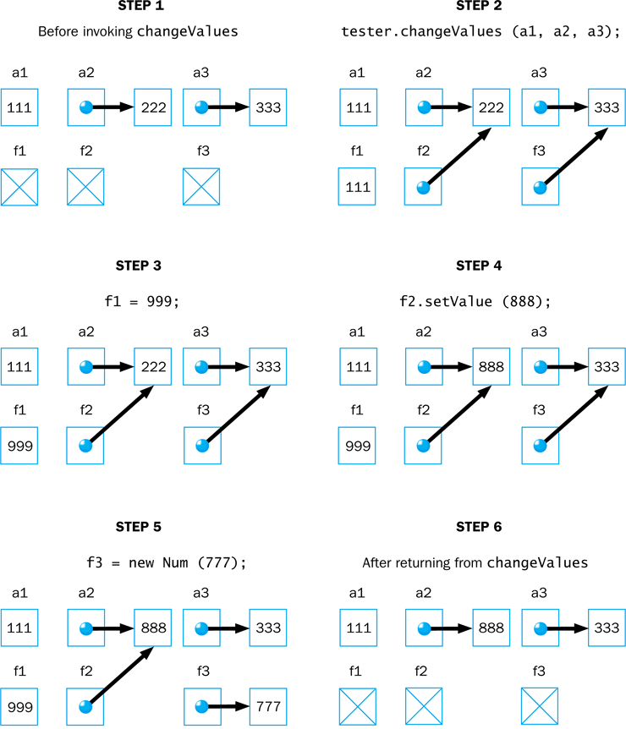
Num.java (3)

Slide 107
Method Overloading
Let's look at one more important method design issue: method overloading
Method overloading is the process of giving a single method name multiple definitions in a class
If a method is overloaded, the method name is not sufficient to determine which method is being called
The signature of each overloaded method must be unique
The signature includes the number, type, and order of the parameters

Slide 108
Method Overloading cont.
The compiler determines which method is being invoked by analyzing the parameters
float tryMe(int x)
{
return x + .375;
}
Invocation
result = tryMe(25, 4.32)
float tryMe(int x, float y)
{
return x*y;
}

Slide 109
Method Overloading
The println method is overloaded:
println(String s)
println(int i)
println(double d)
and so on...
The following lines invoke different versions of the println method:
System.out.println("The total is:");
System.out.println(total);

Slide 110
Overloading Methods
The return type of the method is not part of the signature
That is, overloaded methods cannot differ only by their return type
Constructors can be overloaded
Overloaded constructors provide multiple ways to initialize a new object

Slide 111
Outline
Software Development Activities
Static Variables and Methods
Class Relationships
Interfaces
Enumerated Types Revisited
Method Design and Overloading
Testing
GUI Design
Mouse and Keyboard Events

Slide 112
Testing
Testing can mean many different things
It certainly includes running a completed program with various inputs
It also includes any evaluation performed by human or computer to assess quality
Some evaluations should occur before coding even begins
The earlier we find an problem, the easier and cheaper it is to fix

Slide 113
Testing cont.
The goal of testing is to find errors
As we find and fix errors, we raise our confidence that a program will perform as intended
We can never really be sure that all errors have been eliminated
So when do we stop testing?
Conceptual answer: Never
Cynical answer: When we run out of time
Better answer: When we are willing to risk that an undiscovered error still exists

Slide 114
Reviews
A review is a meeting in which several people examine a design document or section of code
It is a common and effective form of human-based testing
Presenting a design or code to others:
makes us think more carefully about it
provides an outside perspective
Reviews are sometimes called inspections or walkthroughs

Slide 115
Test Cases
A test case is a set of input and user actions, coupled with the expected results
Often test cases are organized formally into test suites which are stored and reused as needed
For medium and large systems, testing must be a carefully managed process
Many organizations have a separate Quality Assurance (QA) department to lead testing efforts

Slide 116
Defect and Regression Testing
Defect testing is the execution of test cases to uncover errors
The act of fixing an error may introduce new errors
After fixing a set of errors we should perform regression testing – running previous test suites to ensure new errors haven't been introduced
It is not possible to create test cases for all possible input and user actions
Therefore we should design tests to maximize their ability to find problems

Slide 117
Black-Box Testing
In black-box testing, test cases are developed without considering the internal logic
They are based on the input and expected output
Input can be organized into equivalence categories
Two input values in the same equivalence category would produce similar results
Therefore a good test suite will cover all equivalence categories and focus on the boundaries between categories

Slide 118
White-Box Testing
White-box testing focuses on the internal structure of the code
The goal is to ensure that every path through the code is tested
Paths through the code are governed by any conditional or looping statements in a program
A good testing effort will include both black-box and white-box tests

Slide 119
Outline
Software Development Activities
Static Variables and Methods
Class Relationships
Interfaces
Enumerated Types Revisited
Method Design and Overloading
Testing
GUI Design
Mouse and Keyboard Events

Slide 120
GUI Design
We must remember that the goal of software is to help the user solve the problem
To that end, the GUI designer should:
Know the user
Prevent user errors
Optimize user abilities
Be consistent
Let's discuss each of these in more detail

Slide 121
Know the User
Knowing the user implies an understanding of:
the user's true needs
the user's common activities
the user's level of expertise in the problem domain and in computer processing
We should also realize these issues may differ for different users
Remember, to the user, the interface is the program

Slide 122
Prevent User Errors
Whenever possible, we should design user interfaces that minimize possible user mistakes
We should choose the best GUI components for each task
For example, in a situation where there are only a few valid options, using a menu or radio buttons would be better than an open text field
Error messages should guide the user appropriately

Slide 123
Optimize User Abilities
Not all users are alike – some may be more familiar with the system than others
Knowledgeable users are sometimes called power users
We should provide multiple ways to accomplish a task whenever reasonable
"wizards" to walk a user through a process
short cuts for power users
Help facilities should be available but not intrusive

Slide 124
Be Consistent
Consistency is important – users get used to things appearing and working in certain ways
Colors should be used consistently to indicate similar types of information or processing
Screen layout should be consistent from one part of a system to another
For example, error messages should appear in consistent locations

Slide 125
Outline
Software Development Activities
Static Variables and Methods
Class Relationships
Interfaces
Enumerated Types Revisited
Method Design and Overloading
Testing
GUI Design
Mouse and Keyboard Events

Slide 126
Mouse Events
JavaFX nodes can generate several types of mouse-based events:
Event | Description
mouse pressed | mouse button is pressed
mouse released | mouse button is released
mouse clicked | mouse button is pressed and released
mouse entered | mouse pointer is moved onto a node
mouse exited | mouse is moved off of a node
mouse moved | mouse is moved
mouse dragged | mouse is moved while holding the mouse button down

Slide 127
Mouse Events
The MouseEvent object representing the event can be used to obtain the mouse position
There are convenience methods for setting the handler for each type of mouse event (such as setOnMousePressed)
See ClickDistance.java

Slide 128
ClickDistance.java (1)
import javafx.application.Application;
import javafx.scene.Group;
import javafx.scene.Scene;
import javafx.scene.input.MouseEvent;
import javafx.scene.paint.Color;
import javafx.scene.shape.Line;
import javafx.scene.text.Text;
import javafx.stage.Stage;
//************************************************************************
// ClickDistance.java Author: Lewis/Loftus
//
// Demonstrates the handling of a mouse click event.
//************************************************************************
public class ClickDistance extends Application
{
private Line line;
private Text distanceText;
//--------------------------------------------------------------------
// Shows the distance between the origin (0, 0) and the point where
// the mouse is clicked.
//--------------------------------------------------------------------
public void start(Stage primaryStage)
{
line = new Line(0, 0, 0, 0);
distanceText = new Text(150, 30, "Distance: --");
continue

Slide 129
ClickDistance.java (2)
continue
Group root = new Group(distanceText, line);
Scene scene = new Scene(root, 400, 300, Color.LIGHTYELLOW);
scene.setOnMouseClicked(this::processMouseClick);
primaryStage.setTitle("Click Distance");
primaryStage.setScene(scene);
primaryStage.show();
}
continue

Slide 130
ClickDistance.java (3)
continue
//--------------------------------------------------------------------
// Resets the end point of the line to the location of the mouse
// click event and updates the distance displayed.
//--------------------------------------------------------------------
public void processMouseClick(MouseEvent event)
{
double clickX = event.getX();
double clickY = event.getY();
line.setEndX(clickX);
line.setEndY(clickY);
double distance = Math.sqrt(clickX * clickX + clickY * clickY);
String distanceStr = String.format("%.2f", distance);
distanceText.setText("Distance: " + distanceStr);
}
}

Slide 131
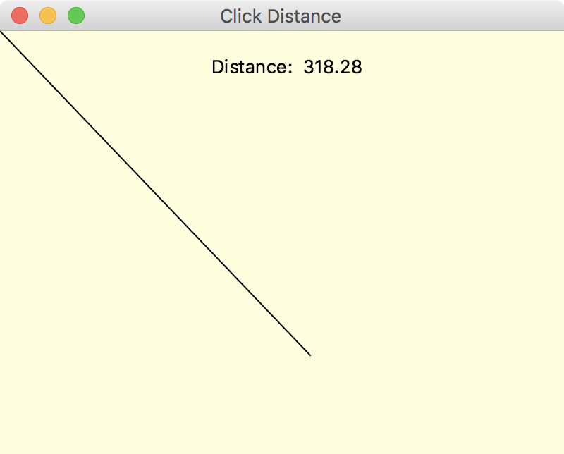
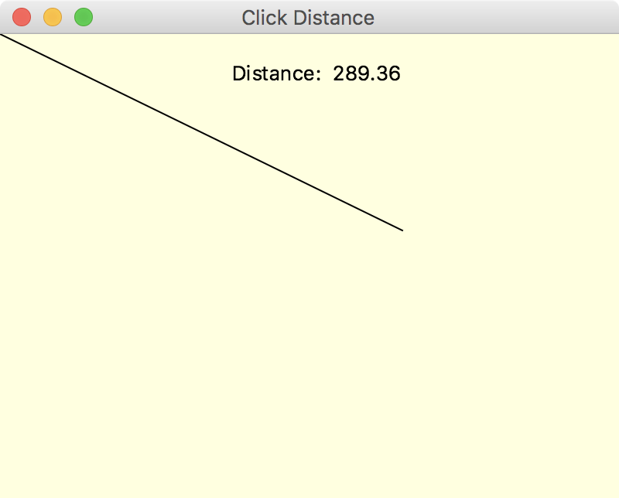
ClickDistance.java (4)
continue
//--------------------------------------------------------------------
// Resets the end point of the line to the location of the mouse
// click event and updates the distance displayed.
//--------------------------------------------------------------------
public void processMouseClick(MouseEvent event)
{
double clickX = event.getX();
double clickY = event.getY();
line.setEndX(clickX);
line.setEndY(clickY);
double distance = Math.sqrt(clickX * clickX + clickY * clickY);
String distanceStr = String.format("%.2f", distance);
distanceText.setText("Distance: " + distanceStr);
}
}

Slide 132
Mouse Events cont.
A stream of mouse moved or mouse dragged events occur while the mouse is in motion
This essentially allows the program to track the movement in real time
Using the mouse to "draw" a shape into place is called rubberbanding
See RubberLines.java

Slide 133
RubberLines.java (1)
import javafx.application.Application;
import javafx.scene.Group;
import javafx.scene.Scene;
import javafx.scene.input.MouseEvent;
import javafx.scene.paint.Color;
import javafx.scene.shape.Line;
import javafx.stage.Stage;
//************************************************************************
// RubberLines.java Author: Lewis/Loftus
//
// Demonstrates the handling of mouse press and mouse drag events.
//************************************************************************
public class RubberLines extends Application
{
private Line currentLine;
private Group root;
//--------------------------------------------------------------------
// Displays an initially empty scene, waiting for the user to
// draw lines with the mouse.
//--------------------------------------------------------------------
public void start(Stage primaryStage)
{
root = new Group();
Scene scene = new Scene(root, 500, 300, Color.BLACK);
continue

Slide 134
RubberLines.java (2)
continue
scene.setOnMousePressed(this::processMousePress);
scene.setOnMouseDragged(this::processMouseDrag);
primaryStage.setTitle("Rubber Lines");
primaryStage.setScene(scene);
primaryStage.show();
}
//--------------------------------------------------------------------
// Adds a new line to the scene when the mouse button is pressed.
//--------------------------------------------------------------------
public void processMousePress(MouseEvent event)
{
currentLine = new Line(event.getX(), event.getY(), event.getX(),
event.getY());
currentLine.setStroke(Color.CYAN);
currentLine.setStrokeWidth(3);
root.getChildren().add(currentLine);
}
continue

Slide 135
RubberLines.java (3)
continue
//--------------------------------------------------------------------
// Updates the end point of the current line as the mouse is
// dragged, creating the rubber band effect.
//--------------------------------------------------------------------
public void processMouseDrag(MouseEvent event)
{
currentLine.setEndX(event.getX());
currentLine.setEndY(event.getY());
}
}

Slide 136
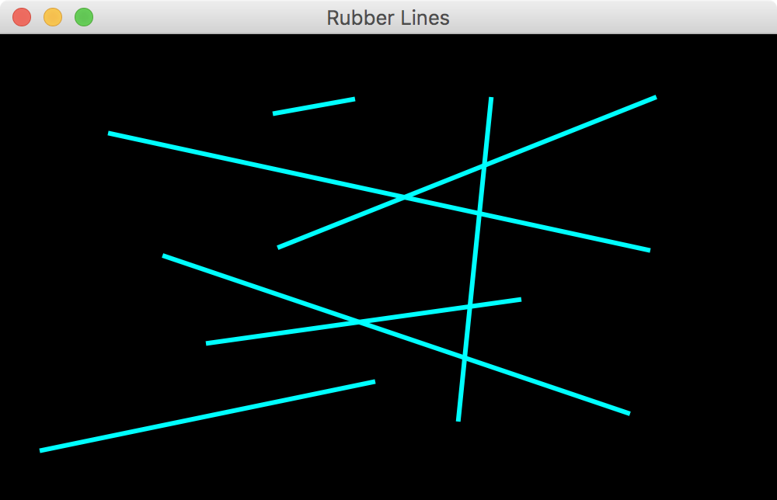
RubberLines.java (4)
continue
//--------------------------------------------------------------------
// Updates the end point of the current line as the mouse is
// dragged, creating the rubber band effect.
//--------------------------------------------------------------------
public void processMouseDrag(MouseEvent event)
{
currentLine.setEndX(event.getX());
currentLine.setEndY(event.getY());
}
}

Slide 137
Key Events
There are three JavaFX events related to the user typing at the keyboard:
The getCode method of the event object returns a code that represents the key that was pressed
See AlienDirection.java
Event | Description
key pressed | a keyboard key is pressed down
key released | a keyboard key is released
key typed | a keyboard key that generates a character is typed (pressed and released)

Slide 138
AlienDirection.java (1)
import javafx.application.Application;
import javafx.scene.Group;
import javafx.scene.Scene;
import javafx.scene.image.Image;
import javafx.scene.image.ImageView;
import javafx.scene.input.KeyEvent;
import javafx.scene.paint.Color;
import javafx.stage.Stage;
//************************************************************************
// AlienDirection.java Author: Lewis/Loftus
//
// Demonstrates the handling of keyboard events.
//************************************************************************
public class AlienDirection extends Application
{
public final static int JUMP = 10;
private ImageView imageView;
continue

Slide 139
AlienDirection.java (2)
continue
//--------------------------------------------------------------------
// Displays an image that can be moved using the arrow keys.
//--------------------------------------------------------------------
public void start(Stage primaryStage)
{
Image alien = new Image("alien.png");
imageView = new ImageView(alien);
imageView.setX(20);
imageView.setY(20);
Group root = new Group(imageView);
Scene scene = new Scene(root, 400, 200, Color.BLACK);
scene.setOnKeyPressed(this::processKeyPress);
primaryStage.setTitle("Alien Direction");
primaryStage.setScene(scene);
primaryStage.show();
}
continue

Slide 140
AlienDirection.java (3)
continue
//--------------------------------------------------------------------
// Modifies the position of the image view when an arrow key is
// pressed.
//--------------------------------------------------------------------
public void processKeyPress(KeyEvent event)
{
switch (event.getCode())
{
case UP:
imageView.setY(imageView.getY() - JUMP);
break;
case DOWN:
imageView.setY(imageView.getY() + JUMP);
break;
case RIGHT:
imageView.setX(imageView.getX() + JUMP);
break;
case LEFT:
imageView.setX(imageView.getX() - JUMP);
break;
default:
break; // do nothing if it's not an arrow key
}
}
}

Slide 141
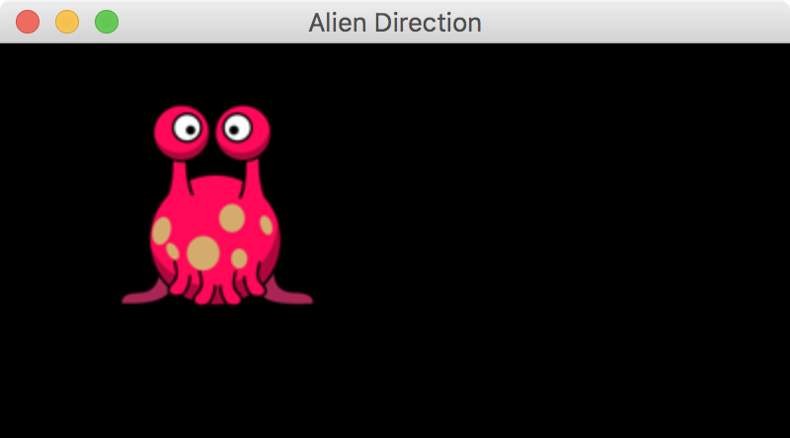
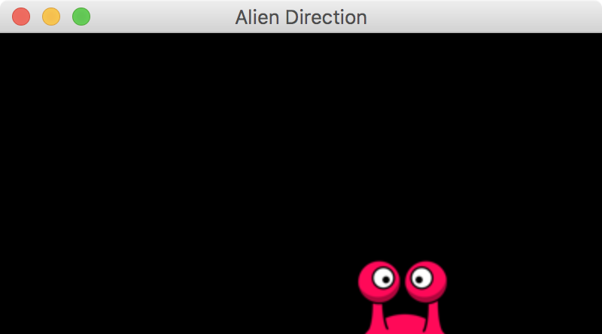
AlienDirection.java (4)
continue
//--------------------------------------------------------------------
// Modifies the position of the image view when an arrow key is
// pressed.
//--------------------------------------------------------------------
public void processKeyPress(KeyEvent event)
{
switch (event.getCode())
{
case UP:
imageView.setY(imageView.getY() - JUMP);
break;
case DOWN:
imageView.setY(imageView.getY() + JUMP);
break;
case RIGHT:
imageView.setX(imageView.getX() + JUMP);
break;
case LEFT:
imageView.setX(imageView.getX() - JUMP);
break;
default:
break; // do nothing if it's not an arrow key
}
}
}

Slide 142
Summary
Chapter 7 has focused on:
software development activities
the relationships that can exist among classes
the static modifier
writing interfaces
the design of enumerated type classes
method design and method overloading
GUI design
mouse and keyboard events

