Slide 1

Chapter 9 Inheritance
Java Software Solutions
Foundations of Program Design
9th Edition
John Lewis
William Loftus

Slide 2
Inheritance
Inheritance is a fundamental object-oriented design technique used to create and organize reusable classes
Chapter 9 focuses on:
deriving new classes from existing classes
the protected modifier
creating class hierarchies
abstract classes
indirect visibility of inherited members
designing for inheritance
the JavaFX class hierarchy
color and date pickers
dialog boxes

Slide 3
Outline
Creating Subclasses
Overriding Methods
Class Hierarchies
Visibility
Designing for Inheritance
Inheritance in JavaFX
Color and Date Pickers
Dialog Boxes

Slide 4
Inheritance
Inheritance allows a software developer to derive a new class from an existing one
The existing class is called the parent class, or superclass, or base class
The derived class is called the child class or subclass
As the name implies, the child inherits characteristics of the parent
That is, the child class inherits the methods and data defined by the parent class

Slide 5
Inheritance
Inheritance relationships are shown in a UML class diagram using a solid arrow with an unfilled triangular arrowhead pointing to the parent class
Vehicle
Car
Proper inheritance creates an is-a relationship, meaning the child is a more specific version of the parent

Slide 6
Inheritance
A programmer can tailor a derived class as needed by adding new variables or methods, or by modifying the inherited ones
One benefit of inheritance is software reuse
By using existing software components to create new ones, we capitalize on all the effort that went into the design, implementation, and testing of the existing software

Slide 7
Deriving Subclasses
In Java, we use the reserved word extends to establish an inheritance relationship
public class Car extends Vehicle
{
// class contents
}
See Words.java
See Book.java
See Dictionary.java

Slide 8
Words.java (1)
//********************************************************************
// Words.java Author: Lewis/Loftus
//
// Demonstrates the use of an inherited method.
//********************************************************************
public class Words
{
//-----------------------------------------------------------------
// Instantiates a derived class and invokes its inherited and
// local methods.
//-----------------------------------------------------------------
public static void main(String[] args)
{
Dictionary webster = new Dictionary();
System.out.println("Number of pages: " + webster.getPages());
System.out.println("Number of definitions: " +
webster.getDefinitions());
System.out.println("Definitions per page: " +
webster.computeRatio());
}
}

Slide 9
Words.java (2)
Output
Number of pages: 1500
Number of definitions: 52500
Definitions per page: 35.0
//********************************************************************
// Words.java Author: Lewis/Loftus
//
// Demonstrates the use of an inherited method.
//********************************************************************
public class Words
{
//-----------------------------------------------------------------
// Instantiates a derived class and invokes its inherited and
// local methods.
//-----------------------------------------------------------------
public static void main(String[] args)
{
Dictionary webster = new Dictionary();
System.out.println("Number of pages: " + webster.getPages());
System.out.println("Number of definitions: " +
webster.getDefinitions());
System.out.println("Definitions per page: " +
webster.computeRatio());
}
}

Slide 10
Book.java
//********************************************************************
// Book.java Author: Lewis/Loftus
//
// Represents a book. Used as the parent of a derived class to
// demonstrate inheritance.
//********************************************************************
public class Book
{
protected int pages = 1500;
//----------------------------------------------------------------
// Pages mutator.
//----------------------------------------------------------------
public void setPages(int numPages)
{
pages = numPages;
}
//----------------------------------------------------------------
// Pages accessor.
//----------------------------------------------------------------
public int getPages()
{
return pages;
}
}

Slide 11
Dictionary.java (1)
//********************************************************************
// Dictionary.java Author: Lewis/Loftus
//
// Represents a dictionary, which is a book. Used to demonstrate
// inheritance.
//********************************************************************
public class Dictionary extends Book
{
private int definitions = 52500;
//-----------------------------------------------------------------
// Prints a message using both local and inherited values.
//-----------------------------------------------------------------
public double computeRatio()
{
return (double) definitions/pages;
}
continue

Slide 12
Dictionary.java (2)
continue
//----------------------------------------------------------------
// Definitions mutator.
//----------------------------------------------------------------
public void setDefinitions(int numDefinitions)
{
definitions = numDefinitions;
}
//----------------------------------------------------------------
// Definitions accessor.
//----------------------------------------------------------------
public int getDefinitions()
{
return definitions;
}
}

Slide 13
The protected Modifier
Visibility modifiers affect the way that class members can be used in a child class
Variables and methods declared with private visibility cannot be referenced in a child class
They can be referenced in the child class if they are declared with public visibility -- but public variables violate the principle of encapsulation
There is a third visibility modifier that helps in inheritance situations: protected

Slide 14
The protected Modifier
The protected modifier allows a child class to reference a variable or method in the child class
It provides more encapsulation than public visibility, but is not as tightly encapsulated as private visibility
A protected variable is also visible to any class in the same package as the parent class
See Appendix E for details of all Java modifiers
Protected variables and methods can be shown with a # symbol preceding them in UML diagrams

Slide 15
Class Diagram for Words
Book
# pages : int
+ pageMessage() : void
Words
Dictionary
- definitions : int
+ main (args : String[]) : void
+ definitionMessage() : void

Slide 16
The super Reference
Constructors are not inherited, even though they have public visibility
Yet we often want to use the parent's constructor to set up the "parent's part" of the object
The super reference can be used to refer to the parent class, and often is used to invoke the parent's constructor
A child’s constructor is responsible for calling the parent’s constructor

Slide 17
The super Reference
The first line of a child’s constructor should use the super reference to call the parent’s constructor
The super reference can also be used to reference other variables and methods defined in the parent’s class
See Words2.java
See Book2.java
See Dictionary2.java

Slide 18
Words2.java (1)
//********************************************************************
// Words2.java Author: Lewis/Loftus
//
// Demonstrates the use of the super reference.
//********************************************************************
public class Words2
{
//-----------------------------------------------------------------
// Instantiates a derived class and invokes its inherited and
// local methods.
//-----------------------------------------------------------------
public static void main(String[] args)
{
Dictionary2 webster = new Dictionary2(1500, 52500);
System.out.println("Number of pages: " + webster.getPages());
System.out.println("Number of definitions: " +
webster.getDefinitions());
System.out.println("Definitions per page: " +
webster.computeRatio());
}
}

Slide 19
Words2.java (2)
Output
Number of pages: 1500
Number of definitions: 52500
Definitions per page: 35.0
//********************************************************************
// Words2.java Author: Lewis/Loftus
//
// Demonstrates the use of the super reference.
//********************************************************************
public class Words2
{
//-----------------------------------------------------------------
// Instantiates a derived class and invokes its inherited and
// local methods.
//-----------------------------------------------------------------
public static void main(String[] args)
{
Dictionary2 webster = new Dictionary2(1500, 52500);
System.out.println("Number of pages: " + webster.getPages());
System.out.println("Number of definitions: " +
webster.getDefinitions());
System.out.println("Definitions per page: " +
webster.computeRatio());
}
}

Slide 20
Book2.java (1)
//********************************************************************
// Book2.java Author: Lewis/Loftus
//
// Represents a book. Used as the parent of a derived class to
// demonstrate inheritance and the use of the super reference.
//********************************************************************
public class Book2
{
protected int pages;
//----------------------------------------------------------------
// Constructor: Sets up the book with the specified number of
// pages.
//----------------------------------------------------------------
public Book2(int numPages)
{
pages = numPages;
}
continue

Slide 21
Book2.java (2)
continue
//----------------------------------------------------------------
// Pages mutator.
//----------------------------------------------------------------
public void setPages(int numPages)
{
pages = numPages;
}
//----------------------------------------------------------------
// Pages accessor.
//----------------------------------------------------------------
public int getPages()
{
return pages;
}
}

Slide 22
Dictonary2.java (1)
//********************************************************************
// Dictionary2.java Author: Lewis/Loftus
//
// Represents a dictionary, which is a book. Used to demonstrate
// the use of the super reference.
//********************************************************************
public class Dictionary2 extends Book2
{
private int definitions;
//-----------------------------------------------------------------
// Constructor: Sets up the dictionary with the specified number
// of pages and definitions.
//-----------------------------------------------------------------
public Dictionary2(int numPages, int numDefinitions)
{
super(numPages);
definitions = numDefinitions;
}
continue

Slide 23
Dictonary2.java (2)
continue
//-----------------------------------------------------------------
// Prints a message using both local and inherited values.
//-----------------------------------------------------------------
public double computeRatio()
{
return (double) definitions/pages;
}
//----------------------------------------------------------------
// Definitions mutator.
//----------------------------------------------------------------
public void setDefinitions(int numDefinitions)
{
definitions = numDefinitions;
}
//----------------------------------------------------------------
// Definitions accessor.
//----------------------------------------------------------------
public int getDefinitions()
{
return definitions;
}
}

Slide 24
Multiple Inheritance
Java supports single inheritance, meaning that a derived class can have only one parent class
Multiple inheritance allows a class to be derived from two or more classes, inheriting the members of all parents
Collisions, such as the same variable name in two parents, have to be resolved
Multiple inheritance is generally not needed, and Java does not support it

Slide 25
Outline
Creating Subclasses
Overriding Methods
Class Hierarchies
Visibility
Designing for Inheritance
Inheritance in JavaFX
Color and Date Pickers
Dialog Boxes

Slide 26
Overriding Methods
A child class can override the definition of an inherited method in favor of its own
The new method must have the same signature as the parent's method, but can have a different body
The type of the object executing the method determines which version of the method is invoked
See Messages.java
See Thought.java
See Advice.java

Slide 27
Messages.java (1)
//********************************************************************
// Messages.java Author: Lewis/Loftus
//
// Demonstrates the use of an overridden method.
//********************************************************************
public class Messages
{
//-----------------------------------------------------------------
// Creates two objects and invokes the message method in each.
//-----------------------------------------------------------------
public static void main(String[] args)
{
Thought parked = new Thought();
Advice dates = new Advice();
parked.message();
dates.message(); // overridden
}
}

Slide 28
Messages.java (2)
Output
I feel like I'm diagonally parked in a parallel universe.
Warning: Dates in calendar are closer than they appear.
I feel like I'm diagonally parked in a parallel universe.
//********************************************************************
// Messages.java Author: Lewis/Loftus
//
// Demonstrates the use of an overridden method.
//********************************************************************
public class Messages
{
//-----------------------------------------------------------------
// Creates two objects and invokes the message method in each.
//-----------------------------------------------------------------
public static void main(String[] args)
{
Thought parked = new Thought();
Advice dates = new Advice();
parked.message();
dates.message(); // overridden
}
}

Slide 29
Thought.java
//********************************************************************
// Thought.java Author: Lewis/Loftus
//
// Represents a stray thought. Used as the parent of a derived
// class to demonstrate the use of an overridden method.
//********************************************************************
public class Thought
{
//-----------------------------------------------------------------
// Prints a message.
//-----------------------------------------------------------------
public void message()
{
System.out.println("I feel like I'm diagonally parked in a " +
"parallel universe.");
System.out.println();
}
}

Slide 30
Advice.java
//********************************************************************
// Advice.java Author: Lewis/Loftus
//
// Represents some thoughtful advice. Used to demonstrate the use
// of an overridden method.
//********************************************************************
public class Advice extends Thought
{
//-----------------------------------------------------------------
// Prints a message. This method overrides the parent's version.
//-----------------------------------------------------------------
public void message()
{
System.out.println("Warning: Dates in calendar are closer " +
"than they appear.");
System.out.println();
super.message(); // explicitly invokes the parent's version
}
}

Slide 31
Overriding
A method in the parent class can be invoked explicitly using the super reference
If a method is declared with the final modifier, it cannot be overridden
The concept of overriding can be applied to data and is called shadowing variables
Shadowing variables should be avoided because it tends to cause unnecessarily confusing code

Slide 32
Overloading vs. Overriding
Overloading deals with multiple methods with the same name in the same class, but with different signatures
Overriding deals with two methods, one in a parent class and one in a child class, that have the same signature
Overloading lets you define a similar operation in different ways for different parameters
Overriding lets you define a similar operation in different ways for different object types

Slide 33
Quick Check
True or False?
A child class may define a method with
the same name as a method in the parent.
A child class can override the constructor
of the parent class.
A child class cannot override a final method
of the parent class.
It is considered poor design when a child
class overrides a method from the parent.
A child class may define a variable with the
same name as a variable in the parent.

Slide 34
Quick Check
True or False?
A child class may define a method with
the same name as a method in the parent.
A child class can override the constructor
of the parent class.
A child class cannot override a final method
of the parent class.
It is considered poor design when a child
class overrides a method from the parent.
A child class may define a variable with the
same name as a variable in the parent.
True
False
True
False
True, but
shouldn't

Slide 35
Outline
Creating Subclasses
Overriding Methods
Class Hierarchies
Visibility
Designing for Inheritance
Inheritance in JavaFX
Color and Date Pickers
Dialog Boxes

Slide 36
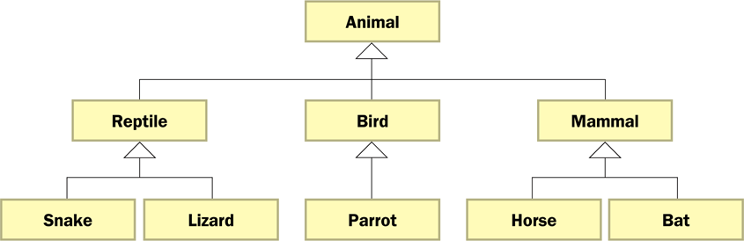
Class Hierarchies
A child class of one parent can be the parent of another child, forming a class hierarchy

Slide 37
Class Hierarchies
Two children of the same parent are called siblings
Common features should be put as high in the hierarchy as is reasonable
An inherited member is passed continually down the line
Therefore, a child class inherits from all its ancestor classes
There is no single class hierarchy that is appropriate for all situations

Slide 38
The Object Class
A class called Object is defined in the java.lang package of the Java standard class library
All classes are derived from the Object class
If a class is not explicitly defined to be the child of an existing class, it is assumed to be the child of the Object class
Therefore, the Object class is the ultimate root of all class hierarchies

Slide 39
The Object Class
The Object class contains a few useful methods, which are inherited by all classes
For example, the toString method is defined in the Object class
Every time we define the toString method, we are actually overriding an inherited definition
The toString method in the Object class is defined to return a string that contains the name of the object’s class along with a hash code

Slide 40
The Object Class
The equals method of the Object class returns true if two references are aliases
We can override equals in any class to define equality in some more appropriate way
As we've seen, the String class defines the equals method to return true if two String objects contain the same characters
The designers of the String class have overridden the equals method inherited from Object in favor of a more useful version

Slide 41
Abstract Classes
An abstract class is a placeholder in a class hierarchy that represents a generic concept
An abstract class cannot be instantiated
We use the modifier abstract on the class header to declare a class as abstract:
public abstract class Product
{
// class contents
}

Slide 42
Abstract Classes
An abstract class often contains abstract methods with no definitions (like an interface)
Unlike an interface, the abstract modifier must be applied to each abstract method
Also, an abstract class typically contains non-abstract methods with full definitions
A class declared as abstract does not have to contain abstract methods -- simply declaring it as abstract makes it so

Slide 43
Abstract Classes
The child of an abstract class must override the abstract methods of the parent, or it too will be considered abstract
An abstract method cannot be defined as final or static
The use of abstract classes is an important element of software design – it allows us to establish common elements in a hierarchy that are too general to instantiate

Slide 44
Interface Hierarchies
Inheritance can be applied to interfaces
That is, one interface can be derived from another interface
The child interface inherits all abstract methods of the parent
A class implementing the child interface must define all methods from both interfaces
Class hierarchies and interface hierarchies are distinct (they do not overlap)

Slide 45
Quick Check
What are some methods defined by the Object class?
What is an abstract class?

Slide 46
Quick Check
What are some methods defined by the Object class?
String toString()
boolean equals(Object obj)
Object clone()
What is an abstract class?
An abstract class is a placeholder in the class
hierarchy, defining a general concept and gathering
elements common to all derived classes. An abstract
class cannot be instantiated.

Slide 47
Outline
Creating Subclasses
Overriding Methods
Class Hierarchies
Visibility
Designing for Inheritance
Inheritance in JavaFX
Color and Date Pickers
Dialog Boxes

Slide 48
Visibility Revisited
It's important to understand one subtle issue related to inheritance and visibility
All variables and methods of a parent class, even private members, are inherited by its children
As we've mentioned, private members cannot be referenced by name in the child class
However, private members inherited by child classes exist and can be referenced indirectly

Slide 49
Visibility Revisited
Because the parent can refer to the private member, the child can reference it indirectly using its parent's methods
The super reference can be used to refer to the parent class, even if no object of the parent exists
See FoodAnalyzer.java
See FoodItem.java
See Pizza.java

Slide 50
FoodAnalyzer.java (1)
//********************************************************************
// FoodAnalyzer.java Author: Lewis/Loftus
//
// Demonstrates indirect access to inherited private members.
//********************************************************************
public class FoodAnalyzer
{
//-----------------------------------------------------------------
// Instantiates a Pizza object and prints its calories per
// serving.
//-----------------------------------------------------------------
public static void main(String[] args)
{
Pizza special = new Pizza(275);
System.out.println("Calories per serving: " +
special.caloriesPerServing());
}
}

Slide 51
FoodAnalyzer.java (2)
Output
Calories per serving: 309
//********************************************************************
// FoodAnalyzer.java Author: Lewis/Loftus
//
// Demonstrates indirect access to inherited private members.
//********************************************************************
public class FoodAnalyzer
{
//-----------------------------------------------------------------
// Instantiates a Pizza object and prints its calories per
// serving.
//-----------------------------------------------------------------
public static void main(String[] args)
{
Pizza special = new Pizza(275);
System.out.println("Calories per serving: " +
special.caloriesPerServing());
}
}

Slide 52
FoodItem.java (1)
//********************************************************************
// FoodItem.java Author: Lewis/Loftus
//
// Represents an item of food. Used as the parent of a derived class
// to demonstrate indirect referencing.
//********************************************************************
public class FoodItem
{
final private int CALORIES_PER_GRAM = 9;
private int fatGrams;
protected int servings;
//-----------------------------------------------------------------
// Sets up this food item with the specified number of fat grams
// and number of servings.
//-----------------------------------------------------------------
public FoodItem(int numFatGrams, int numServings)
{
fatGrams = numFatGrams;
servings = numServings;
}
continue

Slide 53
FoodItem.java (2)
continue
//-----------------------------------------------------------------
// Computes and returns the number of calories in this food item
// due to fat.
//-----------------------------------------------------------------
private int calories()
{
return fatGrams * CALORIES_PER_GRAM;
}
//-----------------------------------------------------------------
// Computes and returns the number of fat calories per serving.
//-----------------------------------------------------------------
public int caloriesPerServing()
{
return (calories() / servings);
}
}

Slide 54
Pizza.java
//********************************************************************
// Pizza.java Author: Lewis/Loftus
//
// Represents a pizza, which is a food item. Used to demonstrate
// indirect referencing through inheritance.
//********************************************************************
public class Pizza extends FoodItem
{
//-----------------------------------------------------------------
// Sets up a pizza with the specified amount of fat (assumes
// eight servings).
//-----------------------------------------------------------------
public Pizza(int fatGrams)
{
super(fatGrams, 8);
}
}

Slide 55
Outline
Creating Subclasses
Overriding Methods
Class Hierarchies
Visibility
Designing for Inheritance
Inheritance in JavaFX
Color and Date Pickers
Dialog Boxes

Slide 56
Designing for Inheritance
As we've discussed, taking the time to create a good software design reaps long-term benefits
Inheritance issues are an important part of an object-oriented design
Properly designed inheritance relationships can contribute greatly to the elegance, maintainability, and reuse of the software
Let's summarize some of the issues regarding inheritance that relate to a good software design

Slide 57
Inheritance Design Issues
Every derivation should be an is-a relationship
Think about the potential future of a class hierarchy, and design classes to be reusable and flexible
Find common characteristics of classes and push them as high in the class hierarchy as appropriate
Override methods as appropriate to tailor or change the functionality of a child
Add new variables to children, but don't redefine (shadow) inherited variables

Slide 58
Inheritance Design Issues
Allow each class to manage its own data; use the super reference to invoke the parent's constructor to set up its data
Override general methods such as toString and equals with appropriate definitions
Use abstract classes to represent general concepts that derived classes have in common
Use visibility modifiers carefully to provide needed access without violating encapsulation

Slide 59
Restricting Inheritance
If the final modifier is applied to a method, that method cannot be overridden in any derived classes
If the final modifier is applied to an entire class, then that class cannot be used to derive any children at all
Therefore, an abstract class cannot be declared as final

Slide 60
Outline
Creating Subclasses
Overriding Methods
Class Hierarchies
Visibility
Designing for Inheritance
Inheritance in JavaFX
Color and Date Pickers
Dialog Boxes

Slide 61
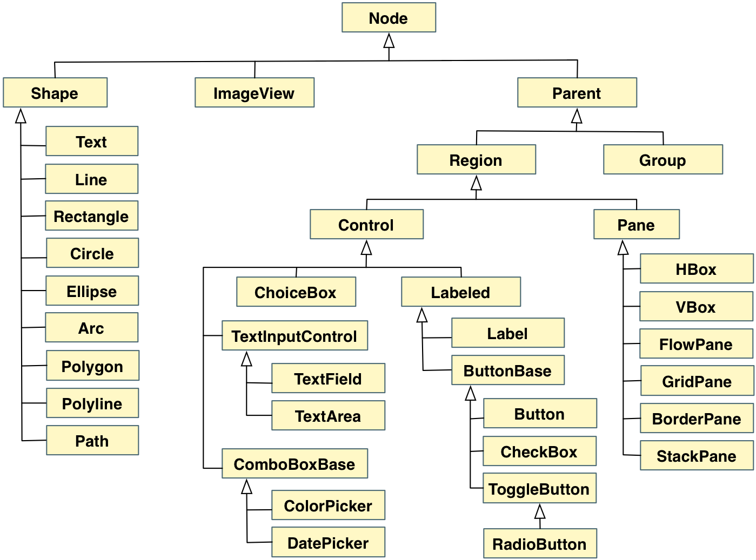
Inheritance in JavaFX

Slide 62
Inheritance in JavaFX
All shape classes are derived from Shape, which manages stroke and fill
Nodes derived from Parent can hold other nodes
So shapes cannot hold other nodes
Any Region can be styled with CSS
All layout panes are derived from Pane
Controls have various intermediate classes to organize common characteristics

Slide 63
Inheritance in JavaFX
Note the difference between the scene graph (containment) and the inheritance hierarchy
Only a Parent can serve as the root node of a scene
So a Pane can be the root node of a scene, and could contain a Circle and a Button
A ChoiceBox could be the root node of a scene, but a Rectangle could not

Slide 64
Outline
Creating Subclasses
Overriding Methods
Class Hierarchies
Visibility
Designing for Inheritance
Inheritance in JavaFX
Color and Date Pickers
Dialog Boxes

Slide 65
Color and Date Pickers
A color picker is a control that allows the user to select a color from a palette or other model
A date picker allows the user to select a calendar date
Both appear as a single field and use drop-down panes for the selection
See PickerDemo.java

Slide 66
PickerDemo.java (1)
import java.time.LocalDate;
import javafx.application.Application;
import javafx.event.ActionEvent;
import javafx.geometry.Pos;
import javafx.scene.Scene;
import javafx.scene.control.ColorPicker;
import javafx.scene.control.DatePicker;
import javafx.scene.layout.HBox;
import javafx.scene.layout.VBox;
import javafx.scene.paint.Color;
import javafx.scene.text.Font;
import javafx.scene.text.FontPosture;
import javafx.scene.text.FontWeight;
import javafx.scene.text.Text;
import javafx.stage.Stage;
//************************************************************************
// PickerDemo.java Author: Lewis/Loftus
//
// Demonstrates the use of color picker and date picker controls.
//************************************************************************
public class PickerDemo extends Application
{
private Text message;
private DatePicker datePicker;
private ColorPicker colorPicker;
continue

Slide 67
PickerDemo.java (2)
continue
//--------------------------------------------------------------------
// Allows the user to select a date and a color. A Text object
// displays the day of the week in the color specified.
//--------------------------------------------------------------------
public void start(Stage primaryStage)
{
datePicker = new DatePicker(LocalDate.now());
datePicker.setOnAction(this::processDateChoice);
colorPicker = new ColorPicker(Color.BLACK);
colorPicker.setOnAction(this::processColorChoice);
message = new Text("HAPPY " + LocalDate.now().getDayOfWeek());
message.setFont(Font.font("Helvetica", FontWeight.BOLD,
FontPosture.REGULAR, 24));
HBox pickers = new HBox(datePicker, colorPicker);
pickers.setSpacing(15);
pickers.setAlignment(Pos.CENTER);
VBox root = new VBox();
root.setStyle("-fx-background-color: white");
root.setSpacing(20);
root.setAlignment(Pos.CENTER);
root.getChildren().addAll(pickers, message);
continue

Slide 68
PickerDemo.java (3)
continue
Scene scene = new Scene(root, 400, 150);
primaryStage.setTitle("Picker Demo");
primaryStage.setScene(scene);
primaryStage.show();
}
//--------------------------------------------------------------------
// Gets the value of the date from the date picker and updates the
// message with the corresponding day of the week.
//--------------------------------------------------------------------
public void processDateChoice(ActionEvent event)
{
LocalDate date = datePicker.getValue();
message.setText("HAPPY " + date.getDayOfWeek());
}
//--------------------------------------------------------------------
// Gets the color specified in the color picker and sets the
// color of the displayed message.
//--------------------------------------------------------------------
public void processColorChoice(ActionEvent event)
{
message.setFill(colorPicker.getValue());
}
}

Slide 69
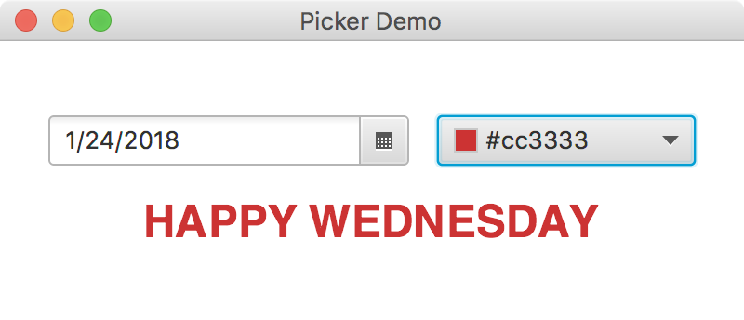
PickerDemo.java (4)
continue
Scene scene = new Scene(root, 400, 150);
primaryStage.setTitle("Picker Demo");
primaryStage.setScene(scene);
primaryStage.show();
}
//--------------------------------------------------------------------
// Gets the value of the date from the date picker and updates the
// message with the corresponding day of the week.
//--------------------------------------------------------------------
public void processDateChoice(ActionEvent event)
{
LocalDate date = datePicker.getValue();
message.setText("HAPPY " + date.getDayOfWeek());
}
//--------------------------------------------------------------------
// Gets the color specified in the color picker and sets the
// color of the displayed message.
//--------------------------------------------------------------------
public void processColorChoice(ActionEvent event)
{
message.setFill(colorPicker.getValue());
}
}

Slide 70
Outline
Creating Subclasses
Overriding Methods
Class Hierarchies
Visibility
Designing for Inheritance
Inheritance in JavaFX
Color and Date Pickers
Dialog Boxes

Slide 71
Dialog Boxes
A dialog box is a window that pops up to provide brief user interaction with a specific purpose
The Alert class provides support for several basic dialog box types:
AlertType.INFORMATION
AlertType.CONFIRMATION
AlertType.WARNING
AlertType.ERROR

Slide 72
Dialog Boxes
Two other dialog box classes are TextInputDialog and ChoiceDialog
They allow the user to enter input using a text field or a drop-down choice box, respectively
See EventOdd.java

Slide 73
EvenOdd.java (1)
import java.util.Optional;
import javafx.application.Application;
import javafx.scene.control.Alert;
import javafx.scene.control.Alert.AlertType;
import javafx.scene.control.ButtonType;
import javafx.scene.control.TextInputDialog;
import javafx.stage.Stage;
//************************************************************************
// EvenOdd.java Author: Lewis/Loftus
//
// Demonstrates the use of information and confirmation alerts, as well
// as text input dialog boxes.
//************************************************************************
public class EvenOdd extends Application
{
//--------------------------------------------------------------------
// Prompts the user for an integer, informs the user if that value
// is even or odd, then asks if the user would like to process
// another value. All interaction is performed using dialog boxes.
//--------------------------------------------------------------------
public void start(Stage primaryStage) throws Exception
{
boolean doAnother = true;
continue

Slide 74
EvenOdd.java (2)
continue
while (doAnother)
{
TextInputDialog inputDialog = new TextInputDialog();
inputDialog.setHeaderText(null);
inputDialog.setTitle(null);
inputDialog.setContentText("Enter an integer:");
Optional<String> numString = inputDialog.showAndWait();
if (numString.isPresent())
{
int num = Integer.parseInt(numString.get());
String result = "That number is " +
((num % 2 == 0) ? "even." : "odd.");
Alert answerDialog = new Alert(AlertType.INFORMATION);
answerDialog.setHeaderText(null);
answerDialog.setContentText(result);
answerDialog.showAndWait();
Alert confirmDialog = new Alert(AlertType.CONFIRMATION);
confirmDialog.setHeaderText(null);
confirmDialog.setContentText("Do another?");
Optional<ButtonType> another = confirmDialog.showAndWait();
continue

Slide 75
EvenOdd.java (3)
continue
if (another.get() != ButtonType.OK)
doAnother = false;
}
else
doAnother = false;
}
}
}

Slide 76
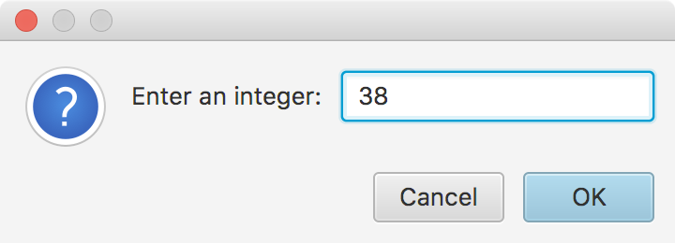
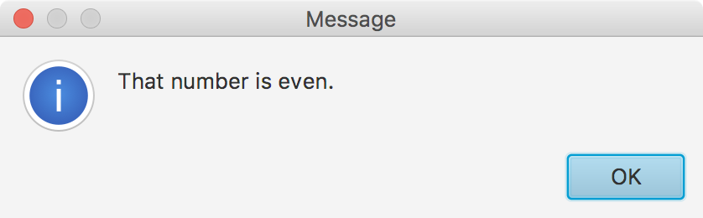
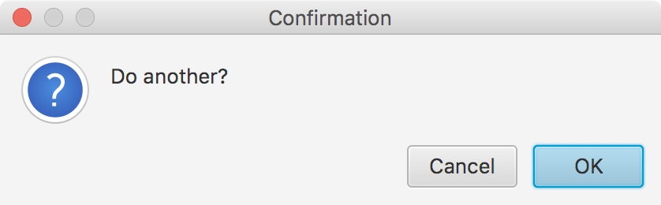
EvenOdd.java (4)
continue
if (another.get() != ButtonType.OK)
doAnother = false;
}
else
doAnother = false;
}
}
}

Slide 77
File Choosers
A file chooser is a specialized dialog box that allows the user to select a file from the hard drive
The following example opens a text file using a file chooser and displays its contents in a text area
See DisplayFile.java

Slide 78
DisplayFile.java (1)
import java.io.File;
import java.io.IOException;
import java.util.Scanner;
import javafx.application.Application;
import javafx.scene.Scene;
import javafx.scene.control.TextArea;
import javafx.scene.text.Font;
import javafx.stage.FileChooser;
import javafx.stage.Stage;
//************************************************************************
// DisplayFile.java Author: Lewis/Loftus
//
// Demonstrates the use of a file chooser dialog box and a text area.
//************************************************************************
public class DisplayFile extends Application
{
//--------------------------------------------------------------------
// Presents a file chooser dialog, reads the selected file and
// loads it into a text area.
//--------------------------------------------------------------------
public void start(Stage primaryStage) throws IOException
{
FileChooser chooser = new FileChooser();
File selectedFile = chooser.showOpenDialog(primaryStage);
continue

Slide 79
DisplayFile.java (2)
continue
TextArea content = new TextArea();
content.setFont(new Font("Courier", 12));
content.setEditable(false);
if (selectedFile == null)
content.setText("No file chosen.");
else
{
Scanner scan = new Scanner(selectedFile);
String info = "";
while (scan.hasNext())
info += scan.nextLine() + "\n";
content.setText(info);
}
Scene scene = new Scene(content, 500, 500);
primaryStage.setTitle("Display File");
primaryStage.setScene(scene);
primaryStage.show();
}
}

Slide 80
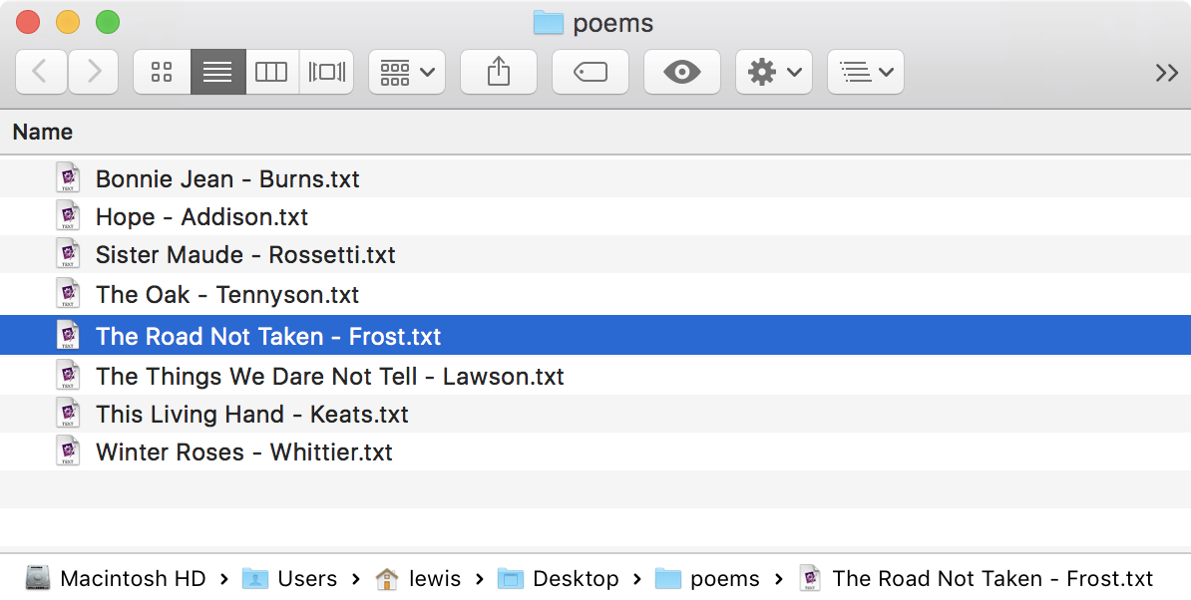
DisplayFile.java (3)
continue
TextArea content = new TextArea();
content.setFont(new Font("Courier", 12));
content.setEditable(false);
if (selectedFile == null)
content.setText("No file chosen.");
else
{
Scanner scan = new Scanner(selectedFile);
String info = "";
while (scan.hasNext())
info += scan.nextLine() + "\n";
content.setText(info);
}
Scene scene = new Scene(content, 500, 500);
primaryStage.setTitle("Display File");
primaryStage.setScene(scene);
primaryStage.show();
}
}

Slide 81
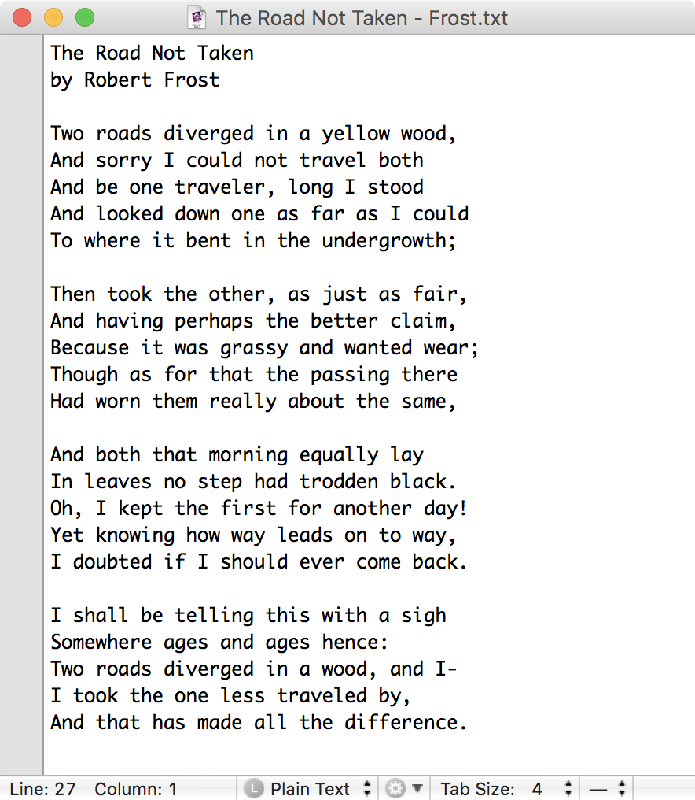
DisplayFile.java (4)
continue
TextArea content = new TextArea();
content.setFont(new Font("Courier", 12));
content.setEditable(false);
if (selectedFile == null)
content.setText("No file chosen.");
else
{
Scanner scan = new Scanner(selectedFile);
String info = "";
while (scan.hasNext())
info += scan.nextLine() + "\n";
content.setText(info);
}
Scene scene = new Scene(content, 500, 500);
primaryStage.setTitle("Display File");
primaryStage.setScene(scene);
primaryStage.show();
}
}

Slide 82
Summary
Chapter 9 focused on:
deriving new classes from existing classes
the protected modifier
creating class hierarchies
abstract classes
indirect visibility of inherited members
designing for inheritance
the JavaFX class hierarchy
color and date pickers
dialog boxes

