Slide 1

Chapter 10 Polymorphism
Java Software Solutions
Foundations of Program Design
9th Edition
John Lewis
William Loftus

Slide 2
Polymorphism
Polymorphism is an object-oriented concept that allows us to create versatile software designs
Chapter 10 focuses on:
defining polymorphism and its benefits
using inheritance to create polymorphic references
using interfaces to create polymorphic references
using polymorphism to implement sorting and searching algorithms
property binding
additional GUI components

Slide 3
Outline
Late Binding
Polymorphism via Inheritance
Polymorphism via Interfaces
Sorting
Searching
Properties
Sliders
Spinners

Slide 4
Binding
Consider the following method invocation:
obj.doIt();
At some point, this invocation is bound to the definition of the method that it invokes
If this binding occurred at compile time, then that line of code would call the same method every time
However, Java defers method binding until run time -- this is called dynamic binding or late binding

Slide 5
Polymorphism
The term polymorphism literally means "having many forms"
A polymorphic reference is a variable that can refer to different types of objects at different points in time
The method called through a polymorphic reference can change from one invocation to the next
All object references in Java are potentially polymorphic

Slide 6
Polymorphism
Suppose we create the following reference variable:
Occupation job;
This reference can point to an Occupation object, or to any object of any compatible type
This compatibility can be established using inheritance or using interfaces
Careful use of polymorphic references can lead to elegant, robust software designs

Slide 7
Outline
Late Binding
Polymorphism via Inheritance
Polymorphism via Interfaces
Sorting
Searching
Properties
Sliders
Spinners

Slide 8
References and Inheritance
An object reference can refer to an object of any class related to it by inheritance
For example, if Holiday is the superclass of Christmas, then a Holiday reference could be used to refer to a Christmas object
Holiday
Holiday day;
day = new Christmas();
Christmas

Slide 9
References and Inheritance
These type compatibility rules are just an extension of the is-a relationship established by inheritance
Assigning a Christmas object to a Holiday reference is fine because Christmas is-a holiday
Assigning a child object to a parent reference can be performed by simple assignment
Assigning an parent object to a child reference can be done also, but must be done with a cast
After all, Christmas is a holiday but not all holidays are Christmas

Slide 10
Polymorphism via Inheritance
Now suppose the Holiday class has a method called celebrate, and Christmas overrides it
What method is invoked by the following?
day.celebrate();
The type of the object being referenced, not the reference type, determines which method is invoked
If day refers to a Holiday object, it invokes the Holiday version of celebrate; if it refers to a Christmas object, it invokes that version

Slide 11
Polymorphism via Inheritance
Note that the compiler restricts invocations based on the type of the reference
So if Christmas had a method called getTree that Holiday didn't have, the following would cause a compiler error:
day.getTree(); // compiler error
Remember, the compiler doesn't "know" which type of holiday is being referenced
A cast can be used to allow the call:
((Christmas)day).getTree();

Slide 12
Quick Check
If MusicPlayer is the parent of CDPlayer, are the following assignments valid?
MusicPlayer mplayer = new CDPlayer();
CDPlayer cdplayer = new MusicPlayer();

Slide 13
Quick Check
If MusicPlayer is the parent of CDPlayer, are the following assignments valid?
MusicPlayer mplayer = new CDPlayer();
CDPlayer cdplayer = new MusicPlayer();
Yes, because a CDPlayer is-a MusicPlayer
No, you'd have to use a cast (and you shouldn't
knowingly assign a super class object to a
subclass reference)

Slide 14
Polymorphism via Inheritance
Consider the following class hierarchy:
StaffMember
Volunteer
Employee
Executive
Hourly

Slide 15
Polymorphism via Inheritance
Let's look at an example that pays a set of diverse employees using a polymorphic method
See Firm.java
See Staff.java
See StaffMember.java
See Volunteer.java
See Employee.java
See Executive.java
See Hourly.java

Slide 16
Firm.java (1)
//********************************************************************
// Firm.java Author: Lewis/Loftus
//
// Demonstrates polymorphism via inheritance.
//********************************************************************
public class Firm
{
//-----------------------------------------------------------------
// Creates a staff of employees for a firm and pays them.
//-----------------------------------------------------------------
public static void main(String[] args)
{
Staff personnel = new Staff();
personnel.payday();
}
}

Slide 17
Firm.java (2)
Output
Name: Sam
Address: 123 Main Line
Phone: 555-0469
Social Security Number: 123-45-6789
Paid: 2923.07
-----------------------------------
Name: Carla
Address: 456 Off Line
Phone: 555-0101
Social Security Number: 987-65-4321
Paid: 1246.15
-----------------------------------
Name: Woody
Address: 789 Off Rocker
Phone: 555-0000
Social Security Number: 010-20-3040
Paid: 1169.23
-----------------------------------
Output (continued)
Name: Diane
Address: 678 Fifth Ave.
Phone: 555-0690
Social Security Number: 958-47-3625
Current hours: 40
Paid: 422.0
-----------------------------------
Name: Norm
Address: 987 Suds Blvd.
Phone: 555-8374
Thanks!
-----------------------------------
Name: Cliff
Address: 321 Duds Lane
Phone: 555-7282
Thanks!
-----------------------------------
//********************************************************************
// Firm.java Author: Lewis/Loftus
//
// Demonstrates polymorphism via inheritance.
//********************************************************************
public class Firm
{
//-----------------------------------------------------------------
// Creates a staff of employees for a firm and pays them.
//-----------------------------------------------------------------
public static void main(String[] args)
{
Staff personnel = new Staff();
personnel.payday();
}
}

Slide 18
Staff.java (1)
//********************************************************************
// Staff.java Author: Lewis/Loftus
//
// Represents the personnel staff of a particular business.
//********************************************************************
public class Staff
{
private StaffMember[] staffList;
//-----------------------------------------------------------------
// Constructor: Sets up the list of staff members.
//-----------------------------------------------------------------
public Staff()
{
staffList = new StaffMember[6];
continue

Slide 19
Staff.java (2)
continue
staffList[0] = new Executive("Sam", "123 Main Line",
"555-0469", "123-45-6789", 2423.07);
staffList[1] = new Employee("Carla", "456 Off Line",
"555-0101", "987-65-4321", 1246.15);
staffList[2] = new Employee("Woody", "789 Off Rocker",
"555-0000", "010-20-3040", 1169.23);
staffList[3] = new Hourly("Diane", "678 Fifth Ave.",
"555-0690", "958-47-3625", 10.55);
staffList[4] = new Volunteer("Norm", "987 Suds Blvd.",
"555-8374");
staffList[5] = new Volunteer("Cliff", "321 Duds Lane",
"555-7282");
((Executive)staffList[0]).awardBonus(500.00);
((Hourly)staffList[3]).addHours(40);
}
continue

Slide 20
Staff.java (3)
continue
//-----------------------------------------------------------------
// Pays all staff members.
//-----------------------------------------------------------------
public void payday()
{
double amount;
for (int count=0; count < staffList.length; count++)
{
System.out.println(staffList[count]);
amount = staffList[count].pay(); // polymorphic
if (amount == 0.0)
System.out.println("Thanks!");
else
System.out.println("Paid: " + amount);
System.out.println("-----------------------------------");
}
}
}

Slide 21
StaffMember.java (1)
//********************************************************************
// StaffMember.java Author: Lewis/Loftus
//
// Represents a generic staff member.
//********************************************************************
abstract public class StaffMember
{
protected String name;
protected String address;
protected String phone;
//-----------------------------------------------------------------
// Constructor: Sets up this staff member using the specified
// information.
//-----------------------------------------------------------------
public StaffMember(String eName, String eAddress, String ePhone)
{
name = eName;
address = eAddress;
phone = ePhone;
}
continue

Slide 22
StaffMember.java (2)
continue
//-----------------------------------------------------------------
// Returns a string including the basic employee information.
//-----------------------------------------------------------------
public String toString()
{
String result = "Name: " + name + "\n";
result += "Address: " + address + "\n";
result += "Phone: " + phone;
return result;
}
//-----------------------------------------------------------------
// Derived classes must define the pay method for each type of
// employee.
//-----------------------------------------------------------------
public abstract double pay();
}

Slide 23
Volunteer.java
//********************************************************************
// Volunteer.java Author: Lewis/Loftus
//
// Represents a staff member that works as a volunteer.
//********************************************************************
public class Volunteer extends StaffMember
{
//-----------------------------------------------------------------
// Constructor: Sets up this volunteer using the specified
// information.
//-----------------------------------------------------------------
public Volunteer(String eName, String eAddress, String ePhone)
{
super(eName, eAddress, ePhone);
}
//-----------------------------------------------------------------
// Returns a zero pay value for this volunteer.
//-----------------------------------------------------------------
public double pay()
{
return 0.0;
}
}

Slide 24
Employee.java (1)
//********************************************************************
// Employee.java Author: Lewis/Loftus
//
// Represents a general paid employee.
//********************************************************************
public class Employee extends StaffMember
{
protected String socialSecurityNumber;
protected double payRate;
//-----------------------------------------------------------------
// Constructor: Sets up this employee with the specified
// information.
//-----------------------------------------------------------------
public Employee(String eName, String eAddress, String ePhone,
String socSecNumber, double rate)
{
super(eName, eAddress, ePhone);
socialSecurityNumber = socSecNumber;
payRate = rate;
}
continue

Slide 25
Employee.java (2)
continue
//-----------------------------------------------------------------
// Returns information about an employee as a string.
//-----------------------------------------------------------------
public String toString()
{
String result = super.toString();
result += "\nSocial Security Number: " + socialSecurityNumber;
return result;
}
//-----------------------------------------------------------------
// Returns the pay rate for this employee.
//-----------------------------------------------------------------
public double pay()
{
return payRate;
}
}

Slide 26
Executive.java (1)
//********************************************************************
// Executive.java Author: Lewis/Loftus
//
// Represents an executive staff member, who can earn a bonus.
//********************************************************************
public class Executive extends Employee
{
private double bonus;
//-----------------------------------------------------------------
// Constructor: Sets up this executive with the specified
// information.
//-----------------------------------------------------------------
public Executive(String eName, String eAddress, String ePhone,
String socSecNumber, double rate)
{
super(eName, eAddress, ePhone, socSecNumber, rate);
bonus = 0; // bonus has yet to be awarded
}
continue

Slide 27
Executive.java (2)
continue
//-----------------------------------------------------------------
// Awards the specified bonus to this executive.
//-----------------------------------------------------------------
public void awardBonus(double execBonus)
{
bonus = execBonus;
}
//-----------------------------------------------------------------
// Computes and returns the pay for an executive, which is the
// regular employee payment plus a one-time bonus.
//-----------------------------------------------------------------
public double pay()
{
double payment = super.pay() + bonus;
bonus = 0;
return payment;
}
}

Slide 28
Hourly.java (1)
//********************************************************************
// Hourly.java Author: Lewis/Loftus
//
// Represents an employee that gets paid by the hour.
//********************************************************************
public class Hourly extends Employee
{
private int hoursWorked;
//-----------------------------------------------------------------
// Constructor: Sets up this hourly employee using the specified
// information.
//-----------------------------------------------------------------
public Hourly(String eName, String eAddress, String ePhone,
String socSecNumber, double rate)
{
super(eName, eAddress, ePhone, socSecNumber, rate);
hoursWorked = 0;
}
continue

Slide 29
Hourly.java (2)
continue
//-----------------------------------------------------------------
// Adds the specified number of hours to this employee's
// accumulated hours.
//-----------------------------------------------------------------
public void addHours(int moreHours)
{
hoursWorked += moreHours;
}
//-----------------------------------------------------------------
// Computes and returns the pay for this hourly employee.
//-----------------------------------------------------------------
public double pay()
{
double payment = payRate * hoursWorked;
hoursWorked = 0;
return payment;
}
continue

Slide 30
Hourly.java (3)
continue
//-----------------------------------------------------------------
// Returns information about this hourly employee as a string.
//-----------------------------------------------------------------
public String toString()
{
String result = super.toString();
result += "\nCurrent hours: " + hoursWorked;
return result;
}
}

Slide 31
Outline
Late Binding
Polymorphism via Inheritance
Polymorphism via Interfaces
Sorting
Searching
Properties
Sliders
Spinners

Slide 32
Polymorphism via Interfaces
Interfaces can be used to set up polymorphic references as well
Suppose we declare an interface called Speaker as follows:
public interface Speaker
{
public void speak();
public void announce(String str);
}

Slide 33
Polymorphism via Interfaces
An interface name can be used as the type of an object reference variable:
Speaker current;
The current reference can be used to point to any object of any class that implements the Speaker interface
The version of speak invoked by the following line depends on the type of object that current is referencing:
current.speak();

Slide 34
Polymorphism via Interfaces
Now suppose two classes, Philosopher and Dog, both implement the Speaker interface, providing distinct versions of the speak method
In the following code, the first call to speak invokes one version and the second invokes another:
Speaker guest = new Philospher();
guest.speak();
guest = new Dog();
guest.speak();

Slide 35
Polymorphism via Interfaces
As with class reference types, the compiler will restrict invocations to methods in the interface
For example, even if Philosopher also had a method called pontificate, the following would still cause a compiler error:
Speaker special = new Philospher();
special.pontificate(); // compiler error
Remember, the compiler bases its rulings on the type of the reference

Slide 36
Quick Check
Would the following statements be valid?
Speaker first = new Dog();
Philosopher second = new Philosopher();
second.pontificate();
first = second;

Slide 37
Quick Check
Would the following statements be valid?
Speaker first = new Dog();
Philosopher second = new Philosopher();
second.pontificate();
first = second;
Yes, all assignments and method calls are
valid as written

Slide 38
Outline
Late Binding
Polymorphism via Inheritance
Polymorphism via Interfaces
Sorting
Searching
Properties
Sliders
Spinners

Slide 39
Sorting
Sorting is the process of arranging a list of items in a particular order
The sorting process is based on specific criteria:
sort test scores in ascending numeric order
sort a list of people alphabetically by last name
There are many algorithms, which vary in efficiency, for sorting a list of items
We will examine two specific algorithms:
Selection Sort
Insertion Sort

Slide 40
Selection Sort
The strategy of Selection Sort:
select a value and put it in its final place in the list
repeat for all other values
In more detail:
find the smallest value in the list
switch it with the value in the first position
find the next smallest value in the list
switch it with the value in the second position
repeat until all values are in their proper places

Slide 41
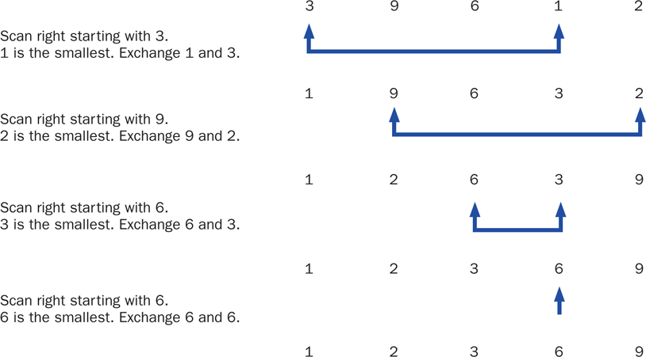
Selection Sort

Slide 42
Swapping
The processing of the selection sort algorithm includes the swapping of two values
Swapping requires three assignment statements and a temporary storage location
To swap the values of first and second:
temp = first;
first = second;
second = temp;

Slide 43
Polymorphism in Sorting
Recall that a class that implements the Comparable interface defines a compareTo method to determine the relative order of its objects
We can use polymorphism to develop a generic sort for any set of Comparable objects
The sorting method accepts as a parameter an array of Comparable objects
That way, one method can be used to sort an array of People, or Books, or whatever

Slide 44
Selection Sort
This technique allows each class to decide for itself what it means for one object to be less than another
Let's look at an example that sorts an array of Contact objects
The selectionSort method is a static method in the Sorting class
See PhoneList.java
See Sorting.java
See Contact.java

Slide 45
PhoneList.java (1)
//********************************************************************
// PhoneList.java Author: Lewis/Loftus
//
// Driver for testing a sorting algorithm.
//********************************************************************
public class PhoneList
{
//-----------------------------------------------------------------
// Creates an array of Contact objects, sorts them, then prints
// them.
//-----------------------------------------------------------------
public static void main(String[] args)
{
Contact[] friends = new Contact[8];
friends[0] = new Contact("John", "Smith", "610-555-7384");
friends[1] = new Contact("Sarah", "Barnes", "215-555-3827");
friends[2] = new Contact("Mark", "Riley", "733-555-2969");
friends[3] = new Contact("Laura", "Getz", "663-555-3984");
friends[4] = new Contact("Larry", "Smith", "464-555-3489");
friends[5] = new Contact("Frank", "Phelps", "322-555-2284");
friends[6] = new Contact("Mario", "Guzman", "804-555-9066");
friends[7] = new Contact("Marsha", "Grant", "243-555-2837");
continue

Slide 46
PhoneList.java (2)
continue
Sorting.selectionSort(friends);
for (Contact friend : friends)
System.out.println(friend);
}
}

Slide 47
PhoneList.java (3)
Output
Barnes, Sarah 215-555-3827
Getz, Laura 663-555-3984
Grant, Marsha 243-555-2837
Guzman, Mario 804-555-9066
Phelps, Frank 322-555-2284
Riley, Mark 733-555-2969
Smith, John 610-555-7384
Smith, Larry 464-555-3489
continue
Sorting.selectionSort(friends);
for (Contact friend : friends)
System.out.println(friend);
}
}

Slide 48
The selectionSort method in the Sorting<T> class:
//-----------------------------------------------------------------
// Sorts the specified array of objects using the selection
// sort algorithm.
//-----------------------------------------------------------------
public void selectionSort(Comparable<T>[] list)
{
int min;
Comparable<T> temp;
for (int index = 0; index < list.length - 1; index++)
{
min = index;
for (int scan = index + 1; scan < list.length; scan++)
if (list[scan].compareTo((T)list[min]) < 0)
min = scan;
// Swap the values
temp = list[min];
list[min] = list[index];
list[index] = temp;
}
}

Slide 49
Contact.java (1)
//********************************************************************
// Contact.java Author: Lewis/Loftus
//
// Represents a phone contact.
//********************************************************************
public class Contact implements Comparable<Contact>
{
private String firstName, lastName, phone;
//-----------------------------------------------------------------
// Constructor: Sets up this contact with the specified data.
//-----------------------------------------------------------------
public Contact(String first, String last, String telephone)
{
firstName = first;
lastName = last;
phone = telephone;
}
continue

Slide 50
Contact.java (2)
continue
//-----------------------------------------------------------------
// Returns a description of this contact as a string.
//-----------------------------------------------------------------
public String toString()
{
return lastName + ", " + firstName + "\t" + phone;
}
//-----------------------------------------------------------------
// Returns a description of this contact as a string.
//-----------------------------------------------------------------
public boolean equals(Object other)
{
return (lastName.equals(((Contact)other).getLastName()) &&
firstName.equals(((Contact)other).getFirstName()));
}
continue

Slide 51
Contact.java (3)
continue
//-----------------------------------------------------------------
// Uses both last and first names to determine ordering.
//-----------------------------------------------------------------
public int compareTo(Contact other)
{
int result;
if (lastName.equals(other.getLastName()))
result = firstName.compareTo(other.getFirstName());
else
result = lastName.compareTo(other.getLastName());
return result;
}
continue

Slide 52
Contact.java (4)
continue
//-----------------------------------------------------------------
// First name accessor.
//-----------------------------------------------------------------
public String getFirstName()
{
return firstName;
}
//-----------------------------------------------------------------
// Last name accessor.
//-----------------------------------------------------------------
public String getLastName()
{
return lastName;
}
}

Slide 53
Insertion Sort
The strategy of Insertion Sort:
pick any item and insert it into its proper place in a sorted sublist
repeat until all items have been inserted
In more detail:
consider the first item to be a sorted sublist (of one item)
insert the second item into the sorted sublist, shifting the first item as needed to make room to insert the new one
insert the third item into the sorted sublist (of two items), shifting items as necessary
repeat until all values are inserted into their proper positions

Slide 54
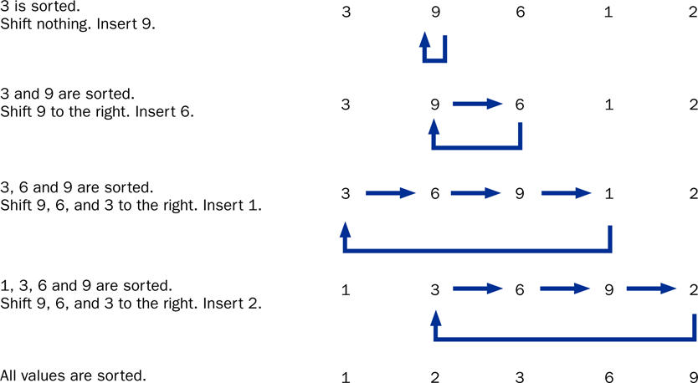
Insertion Sort

Slide 55
The insertionSort method in the Sorting<T> class:
//-----------------------------------------------------------------
// Sorts the specified array of objects using the insertion
// sort algorithm.
//-----------------------------------------------------------------
public void insertionSort(Comparable<T>[] list)
{
for (int index = 1; index < list.length; index++)
{
Comparable<T> key = list[index];
int position = index;
// Shift larger values to the right
while (position > 0 && key.compareTo((T)list[position-1]) < 0)
{
list[position] = list[position - 1];
position--;
}
list[position] = key;
}
}

Slide 56
Comparing Sorts
The Selection and Insertion sort algorithms are similar in efficiency
They both have outer loops that scan all elements, and inner loops that compare the value of the outer loop with almost all values in the list
Approximately n² number of comparisons are made to sort a list of size n
We therefore say that these sorts are of order n²
Other sorts are more efficient: order n log₂ n

Slide 57
Outline
Late Binding
Polymorphism via Inheritance
Polymorphism via Interfaces
Sorting
Searching
Properties
Sliders
Spinners

Slide 58
Searching
Searching is the process of finding a target element within a group of items called the search pool
The target may or may not be in the search pool
We want to perform the search efficiently, minimizing the number of comparisons
Let's look at two classic searching approaches: linear search and binary search
As we did with sorting, we'll implement the searches with polymorphic Comparable parameters

Slide 59
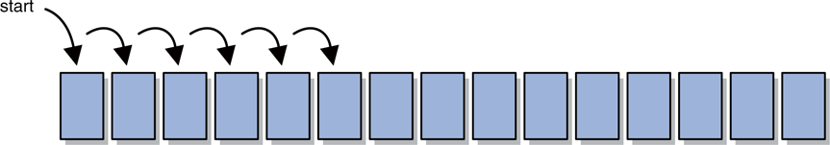
Linear Search
A linear search begins at one end of a list and examines each element in turn
Eventually, either the item is found or the end of the list is encountered

Slide 60
Binary Search
A binary search assumes the list of items in the search pool is sorted
It eliminates a large part of the search pool with a single comparison
A binary search first examines the middle element of the list -- if it matches the target, the search is over
If it doesn't, only one half of the remaining elements need be searched
Since they are sorted, the target can only be in one half of the other

Slide 61
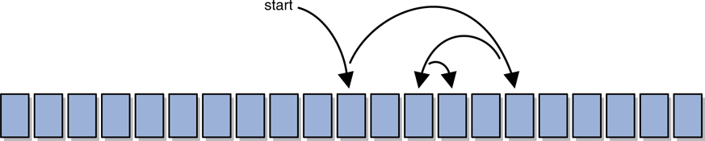
Binary Search
The process continues by comparing the middle element of the remaining viable candidates
Each comparison eliminates approximately half of the remaining data
Eventually, the target is found or the data is exhausted

Slide 62
Searching
The search methods are implemented as static methods in the Searching class
See PhoneList2.java
See Searching.java

Slide 63
PhoneList2.java (1)
//********************************************************************
// PhoneList2.java Author: Lewis/Loftus
//
// Driver for testing searching algorithms.
//********************************************************************
public class PhoneList2
{
//-----------------------------------------------------------------
// Creates an array of Contact objects, sorts them, then prints
// them.
//-----------------------------------------------------------------
public static void main(String[] args)
{
Contact test, found;
Contact[] friends = new Contact[8];
friends[0] = new Contact("John", "Smith", "610-555-7384");
friends[1] = new Contact("Sarah", "Barnes", "215-555-3827");
friends[2] = new Contact("Mark", "Riley", "733-555-2969");
friends[3] = new Contact("Laura", "Getz", "663-555-3984");
friends[4] = new Contact("Larry", "Smith", "464-555-3489");
friends[5] = new Contact("Frank", "Phelps", "322-555-2284");
friends[6] = new Contact("Mario", "Guzman", "804-555-9066");
friends[7] = new Contact("Marsha", "Grant", "243-555-2837");
continue

Slide 64
PhoneList2.java (2)
continue
test = new Contact("Frank", "Phelps", "");
found = Searching.linearSearch(friends, test);
if (found != null)
System.out.println("Found: " + found);
else
System.out.println("The contact was not found.");
System.out.println();
Sorting<Contact> sorts = new Sorting<Contact>();
sorts.selectionSort(friends);
test = new Contact("Mario", "Guzman", "");
found = (Contact) Searching.binarySearch(friends, test);
if (found != null)
System.out.println("Found: " + found);
else
System.out.println("The contact was not found.");
}
}

Slide 65
PhoneList2.java (3)
Output
Found: Phelps, Frank 322-555-2284
Found: Guzman, Mario 804-555-9066
continue
test = new Contact("Frank", "Phelps", "");
found = Searching.linearSearch(friends, test);
if (found != null)
System.out.println("Found: " + found);
else
System.out.println("The contact was not found.");
System.out.println();
Sorting<Contact> sorts = new Sorting<Contact>();
sorts.selectionSort(friends);
test = new Contact("Mario", "Guzman", "");
found = (Contact) Searching.binarySearch(friends, test);
if (found != null)
System.out.println("Found: " + found);
else
System.out.println("The contact was not found.");
}
}

Slide 66
The linearSearch method in the Searching<T> class:
//-----------------------------------------------------------------
// Searches the specified array of objects for the target using
// a linear search. Returns a reference to the target object from
// the array if found, and null otherwise.
//-----------------------------------------------------------------
public T linearSearch(T[] list, T target)
{
int index = 0;
boolean found = false;
while (!found && index < list.length)
{
if (list[index].equals(target))
found = true;
else
index++;
}
if (found)
return list[index];
else
return null;
}

Slide 67
The binarySearch method in the Searching<T> class:
//-----------------------------------------------------------------
// Searches the specified array of objects for the target using
// a binary search. Assumes the array is already sorted in
// ascending order when it is passed in. Returns a reference to
// the target object from the array if found, and null otherwise.
//-----------------------------------------------------------------
public Comparable<T> binarySearch(Comparable<T>[] list,
Comparable<T> target)
{
int min = 0, max = list.length - 1, mid = 0;
boolean found = false;
while (!found && min <= max)
{
mid = (min + max) / 2;
if (list[mid].equals(target))
found = true;
else
if (target.compareTo((T)list[mid]) < 0)
max = mid - 1;
else
min = mid + 1;
}
continue

Slide 68
The binarySearch method in the Searching<T> class cont.
continue
if (found)
return list[mid];
else
return null;
}

Slide 69
Outline
Late Binding
Polymorphism via Inheritance
Polymorphism via Interfaces
Sorting
Searching
Properties
Sliders
Spinners

Slide 70
Properties
A JavaFX property is an object that holds a value
A property is observable – it can be monitored and changed as needed
So, instead of holding an int primitive or an Integer object, a JavaFX class might store an IntegerProperty object
Most values of JavaFX classes, such as the width of a Rectangle, are stored as properties

Slide 71
Properties
A key benefit of properties is property binding
A property can be bound to another property so that when the value of one changes, the other is automatically updated
No explicit event handling is needed
Let's look at an example that binds the center point of a circle, and the text of a Text object, to the size of the scene
See PropertyBindingDemo.java

Slide 72
PropertyBindingDemo.java (1)
import javafx.application.Application;
import javafx.beans.property.SimpleStringProperty;
import javafx.beans.property.StringProperty;
import javafx.scene.Group;
import javafx.scene.Scene;
import javafx.scene.paint.Color;
import javafx.scene.shape.Circle;
import javafx.scene.text.Text;
import javafx.stage.Stage;
//************************************************************************
// PropertyBindingDemo.java Author: Lewis/Loftus
//
// Demonstrates the ability to bind one property to another.
//************************************************************************
public class PropertyBindingDemo extends Application
{
//--------------------------------------------------------------------
// Displays the width and height of the scene, as well as a circle
// in the center of the scene. The scene is updated using property
// bindings as the window is resized.
//--------------------------------------------------------------------
public void start(Stage primaryStage)
{
Group root = new Group();
Scene scene = new Scene(root, 300, 200, Color.SKYBLUE);
continue

Slide 73
PropertyBindingDemo.java (2)
continue
Circle center = new Circle(6);
center.centerXProperty().bind(scene.widthProperty().divide(2));
center.centerYProperty().bind(scene.heightProperty().divide(2));
StringProperty width = new SimpleStringProperty("Width: ");
StringProperty height = new SimpleStringProperty("Height: ");
Text widthText = new Text(20, 30, "");
widthText.textProperty().bind(width.concat(scene.widthProperty()));
Text heightText = new Text(20, 60, "");
heightText.textProperty().bind(height.concat(scene.heightProperty()));
root.getChildren().addAll(center, widthText, heightText);
primaryStage.setTitle("Property Binding Demo");
primaryStage.setScene(scene);
primaryStage.show();
}
}

Slide 74
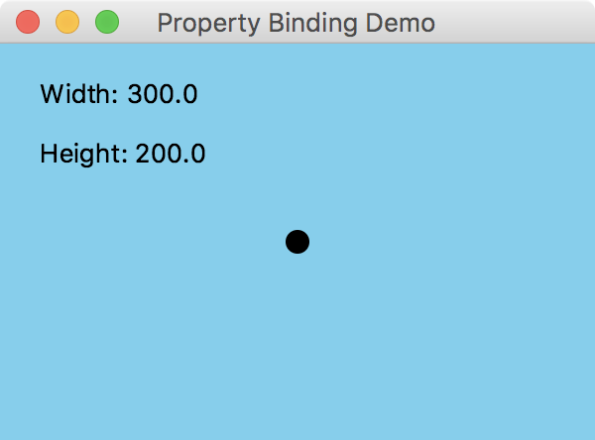
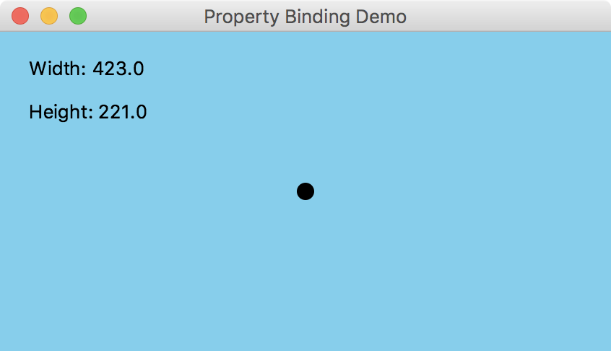
PropertyBindingDemo.java (3)
continue
Circle center = new Circle(6);
center.centerXProperty().bind(scene.widthProperty().divide(2));
center.centerYProperty().bind(scene.heightProperty().divide(2));
StringProperty width = new SimpleStringProperty("Width: ");
StringProperty height = new SimpleStringProperty("Height: ");
Text widthText = new Text(20, 30, "");
widthText.textProperty().bind(width.concat(scene.widthProperty()));
Text heightText = new Text(20, 60, "");
heightText.textProperty().bind(height.concat(scene.heightProperty()));
root.getChildren().addAll(center, widthText, heightText);
primaryStage.setTitle("Property Binding Demo");
primaryStage.setScene(scene);
primaryStage.show();
}
}

Slide 75
Change Listeners
A property can have a change listener, similar to an event handler
Properties have an addListener method:
myProperty.addListener(this::processChange);
A change listener method accepts three parameters:
the ObservableValue (the property)
the old value
the new value

Slide 76
Change Listeners
The types of the old and new values depend on the type of value the property holds
See ChangeListenerDemo.java
public void processChange(ObservableValue<? extends String> val,
String oldValue, String newValue) {
// whatever
}
public void processChange(ObservableValue<? extends Integer> val,
Integer oldValue, Integer newValue) {
// whatever
}

Slide 77
ChangeListenerDemo.java (1)
import javafx.application.Application;
import javafx.beans.value.ObservableValue;
import javafx.scene.Group;
import javafx.scene.Scene;
import javafx.scene.paint.Color;
import javafx.scene.shape.Circle;
import javafx.scene.text.Text;
import javafx.stage.Stage;
//************************************************************************
// ChangeListenerDemo.java Author: Lewis/Loftus
//
// Demonstrates the ability to respond to property changes using
// change listeners. Functionally equivalent to PropertyBindingDemo.
//************************************************************************
public class ChangeListenerDemo extends Application
{
private Scene scene;
private Circle center;
private Text widthText, heightText;
continue

Slide 78
ChangeListenerDemo.java (2)
continue
//--------------------------------------------------------------------
// Displays the width and height of the scene, as well as a circle
// in the center of the scene. The scene is updated using a change
// listener as the window is resized.
//--------------------------------------------------------------------
public void start(Stage primaryStage)
{
Group root = new Group();
scene = new Scene(root, 300, 200, Color.SKYBLUE);
scene.widthProperty().addListener(this::processResize);
scene.heightProperty().addListener(this::processResize);
center = new Circle(6);
center.setCenterX(scene.getWidth() / 2);
center.setCenterY(scene.getHeight() / 2);
widthText = new Text(20, 30, "Width: " + scene.getWidth());
heightText = new Text(20, 60, "Height: " + scene.getHeight());
root.getChildren().addAll(center, widthText, heightText);
primaryStage.setTitle("Change Listener Demo");
primaryStage.setScene(scene);
primaryStage.show();
}
continue

Slide 79
ChangeListenerDemo.java (3)
continue
//--------------------------------------------------------------------
// Updates the position of the circle and the displayed width and
// height when the window is resized.
//--------------------------------------------------------------------
public void processResize(ObservableValue<? extends Number> property,
Object oldValue, Object newValue)
{
center.setCenterX(scene.getWidth() / 2);
center.setCenterY(scene.getHeight() / 2);
widthText.setText("Width: " + scene.getWidth());
heightText.setText("Height: " + scene.getHeight());
}
}

Slide 80
Outline
Late Binding
Polymorphism via Inheritance
Polymorphism via Interfaces
Sorting
Searching
Properties
Sliders
Spinners

Slide 81
Sliders
A slider is a GUI control that allows the user to specify a value within a numeric range
The minimum and maximum values for the slider are set using the Slider constructor
A slider can be oriented horizontally (default) or vertically
It can also have optional tick marks and labels

Slide 82
Sliders
You can use the getValue method of the slider to obtain its current value
Or you can use property bindings or a change listener to react dynamically to the movement of a slider knob
Let's look at an example that uses two sliders to change the shape of an ellipse
See EllipseSliders.java

Slide 83
EllipseSliders.java (1)
import javafx.application.Application;
import javafx.geometry.Insets;
import javafx.geometry.Orientation;
import javafx.scene.Scene;
import javafx.scene.control.Slider;
import javafx.scene.layout.BorderPane;
import javafx.scene.paint.Color;
import javafx.scene.shape.Ellipse;
import javafx.stage.Stage;
//************************************************************************
// EllipseSliders.java Author: Lewis/Loftus
//
// Demonstrates the use of slider controls and property binding.
//************************************************************************
public class EllipseSliders extends Application
{
private Ellipse ellipse;
private Slider xSlider, ySlider;
//--------------------------------------------------------------------
// Displays an ellipse with sliders that control the width and
// height of the ellipse.
//--------------------------------------------------------------------
public void start(Stage primaryStage)
{
continue

Slide 84
EllipseSliders.java (2)
continue
ellipse = new Ellipse(250, 150, 150, 75);
ellipse.setFill(Color.SALMON);
xSlider = new Slider(0, 200, 150);
xSlider.setShowTickMarks(true);
xSlider.setPadding(new Insets(0, 20, 20, 80));
ellipse.radiusXProperty().bind(xSlider.valueProperty());
ySlider = new Slider(0, 100, 75);
ySlider.setOrientation(Orientation.VERTICAL);
ySlider.setShowTickMarks(true);
ySlider.setPadding(new Insets(20, 0, 0, 30));
ellipse.radiusYProperty().bind(ySlider.valueProperty());
BorderPane pane = new BorderPane();
pane.setLeft(ySlider);
pane.setBottom(xSlider);
pane.setCenter(ellipse);
pane.setStyle("-fx-background-color: grey");
continue

Slide 85
EllipseSliders.java (3)
continue
Scene scene = new Scene(pane, 500, 300);
primaryStage.setTitle("Ellipse Sliders");
primaryStage.setScene(scene);
primaryStage.show();
}
}

Slide 86
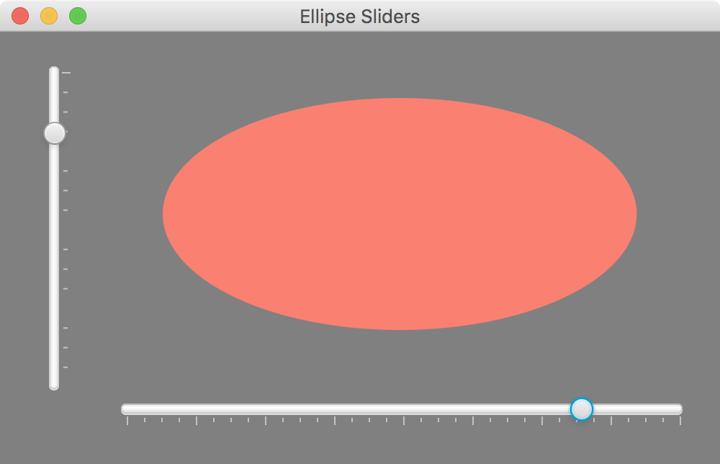
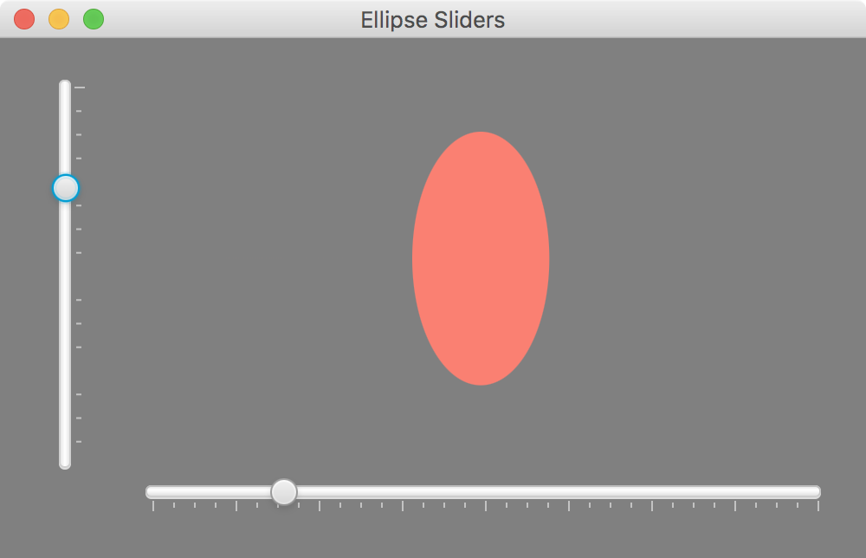
EllipseSliders.java (4)
continue
Scene scene = new Scene(pane, 500, 300);
primaryStage.setTitle("Ellipse Sliders");
primaryStage.setScene(scene);
primaryStage.show();
}
}

Slide 87
Outline
Late Binding
Polymorphism via Inheritance
Polymorphism via Interfaces
Sorting
Searching
Properties
Sliders
Spinners

Slide 88
Spinner
A spinner is a GUI control that allows the user to select a value from a list of predefined values
The current value is shown in a text field with arrow buttons for changing the selection
Only the current value is ever shown, so other GUI elements are never obscured by a drop-down list
Spinner is a generic class – you specify the type of values the spinner presents

Slide 89
Spinner
A SpinnerValueFactory is used to define the spinner options
An integer spinner can be created using an IntegerSpinnerValueFactory
A string spinner is created using an ObservableList
See SpinnerDemo.java

Slide 90
SpinnerDemo.java (1)
import javafx.application.Application;
import javafx.beans.property.SimpleStringProperty;
import javafx.beans.property.StringProperty;
import javafx.collections.FXCollections;
import javafx.collections.ObservableList;
import javafx.geometry.Pos;
import javafx.scene.Scene;
import javafx.scene.control.Spinner;
import javafx.scene.control.SpinnerValueFactory.IntegerSpinnerValueFactory;
import javafx.scene.layout.VBox;
import javafx.scene.text.Font;
import javafx.scene.text.Text;
import javafx.stage.Stage;
//************************************************************************
// SpinnerDemo.java Author: Lewis/Loftus
//
// Demonstrates the use of spinner controls and property binding.
//************************************************************************
public class SpinnerDemo extends Application
{
private Spinner<Integer> intSpinner;
private Spinner<String> stringSpinner;
private Text text;
continue

Slide 91
SpinnerDemo.java (2)
continue
//--------------------------------------------------------------------
// Presents an integer spinner and a string spinner, updating some
// text when either value changes.
//--------------------------------------------------------------------
public void start(Stage primaryStage)
{
IntegerSpinnerValueFactory svf =
new IntegerSpinnerValueFactory(1, 10, 5);
intSpinner = new Spinner<Integer>(svf);
ObservableList<String> list = FXCollections.observableArrayList();
list.addAll("Grumpy", "Happy", "Sneezy", "Sleepy", "Dopey",
"Bashful", "Doc");
stringSpinner = new Spinner<String>(list);
stringSpinner.getStyleClass().add(
Spinner.STYLE_CLASS_SPLIT_ARROWS_VERTICAL);
StringProperty textString = new SimpleStringProperty("");
text = new Text();
text.setFont(new Font("Helvetica", 24));
text.textProperty().bind(textString.concat(
intSpinner.valueProperty()).concat(" and ").concat(
stringSpinner.valueProperty()));
continue

Slide 92
SpinnerDemo.java (3)
continue
VBox pane = new VBox(intSpinner, stringSpinner, text);
pane.setStyle("-fx-background-color: skyblue");
pane.setAlignment(Pos.CENTER);
pane.setSpacing(25);
Scene scene = new Scene(pane, 300, 250);
primaryStage.setTitle("Spinner Demo");
primaryStage.setScene(scene);
primaryStage.show();
}
}

Slide 93
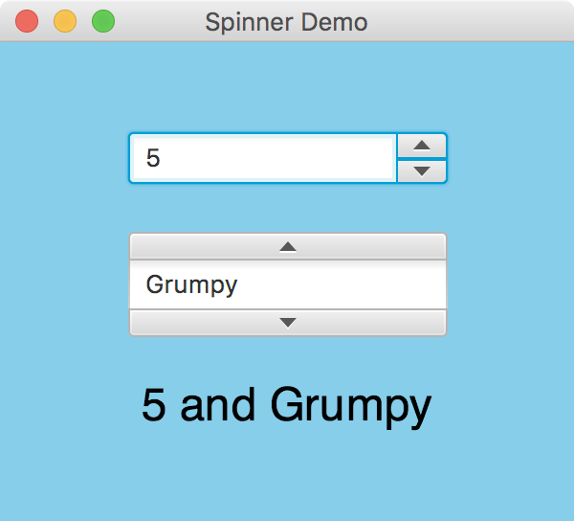
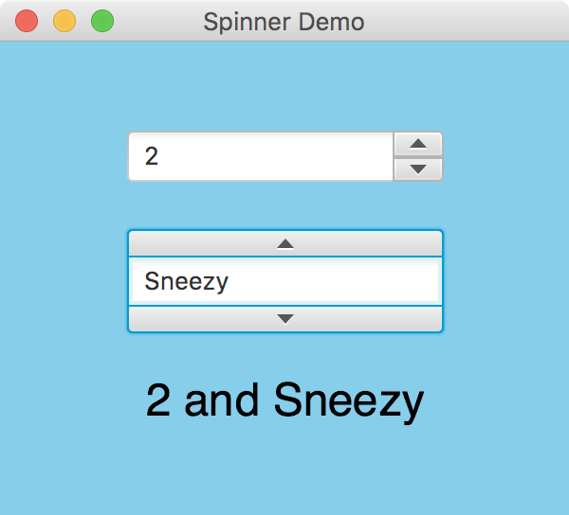
SpinnerDemo.java (4)
continue
VBox pane = new VBox(intSpinner, stringSpinner, text);
pane.setStyle("-fx-background-color: skyblue");
pane.setAlignment(Pos.CENTER);
pane.setSpacing(25);
Scene scene = new Scene(pane, 300, 250);
primaryStage.setTitle("Spinner Demo");
primaryStage.setScene(scene);
primaryStage.show();
}
}

Slide 94
Summary
Chapter 10 has focused on:
defining polymorphism and its benefits
using inheritance to create polymorphic references
using interfaces to create polymorphic references
using polymorphism to implement sorting and searching algorithms
property binding
additional GUI components

