Slide 1
Windows Application & Layout Manager

Slide 2
Jlabel Constructors
JLabel() creates a JLabel instance with no image and an empty string for the title
JLabel(Icon image) creates a JLabel instance with the specified image
JLabel(Icon image, int horizontalAlignment) creates a JLabel instance with the specified image and horizontal alignment
JLabel(String text) creates a JLabel instance with the specified text
JLabel(String text, Icon icon, int horizontalAlignment) creates a JLabel instance with the specified text, image, and horizontal alignment
JLabel(String text, int horizontalAlignment) creates a JLabel instance with the specified text and horizontal alignment

Slide 3
Changing a JLabel’s Font
Font object- Holds typeface and size information
setFont() method requires a Font object argument
To construct a Font object you need 3 arguments
Typeface
Style
Point size

Slide 4
Font Arguments
To construct a Font object you need 3 arguments
Typeface
String representing a font
Common fonts are Arial, Courier, and New Times Roman
Is only a request
Style - applies an attribute to displayed text
Font.PLAIN
Font.BOLD
Font.ITALIC
Point size
Integer that represents 1/72 of an inch
Printed text is usually 10 or 12 points

Slide 5
JTextField Components
JTextField- Component into which a user can type a single line of text data
JTextField Constructors
public JTextField() constructs a new JTextField
public JTextField(int numColumns) constructs a new empty JTextField with a specified number of columns
public JTextField(String text) constructs a new JTextField initialized with the specific text
public JTextField(String text, int columns) constructs a new JTextField with the specified text and columns

Slide 6
JTextField Methods
setText() method- Allows you to change the text in a JTextField that has already been created
getText() method- Allows you to retrieve the string of text in a JTextField

Slide 7
Other JTextField Methods
Keyboard focus - When the user clicks within the JTextField, the JTextField has focus, which means the next entries from the keyboard will be at that location
requestFocus() method - To have the insertion point appear automatically within the TextField without requiring the user to click in it first
setEditable() method - Used to change the editable status of a JTextField
Editable - The capacity for a field to accept keystrokes

Slide 8
JButton Components
JButton - Creates a button
JButton constructors
public JButton() constructs a button with no set text
public JButton(Icon icon) creates a button with an icon of type Icon or ImageIcon
public JButton(String text) creates a button with the specific text

Slide 9
Using Border Layouts
Border layouts
Created by the BorderLayout class
Divide a container into 5 sections
North, South, East, West, and center
Created with the BorderLayout() or BorderLayout(int, int) methods

Slide 10
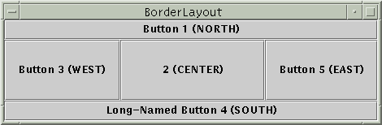
Border Layout

Slide 11
Border Layout
add(component, BorderLayout.CENTER) //preferred
However, you might see code in other programs that specifies the component second. For example, here are alternate ways of writing the preceding code:
add(BorderLayout.CENTER, component) //valid but old fashioned or
add("Center", component) //valid but error prone

Slide 12
Using Flow Layouts
Flow Layouts
Places components in a row, and when a row is filled, it automatically spills components onto the next row
Default positioning of the row of components is centered in the container

Slide 13

Flow Layout

Slide 14
Learning about Event-Driven Programming
Event - Occurs when someone using your applet takes action on a component
Procedural - Programmers dictate the order in which events occur
Event-driven programs - The user can initiate any number of events in any order
Source - Component on which an event is generated
Listener - Object that is interested in an event

Slide 15
Event Handling
Telling Your Swing Applet to Expect Events to Happen and How to Respond to Them
addActionListener() method
To tell the applet to expect ActionEvents
aButton.addActionListener(this);
actionPerformed(ActionEvent e) method
When a JApplet has registered as a listener with a JButton, and a user clicks the JButton the actionPerformed method executes

Slide 16
The setEnabled() Method
setEnabled() method- To make a component unavailable and, in turn, to make it available again
True if you want to enable a component
False if you want to disable a component
If (yLoc==280) pressButton.setEnabled(false);

Slide 17
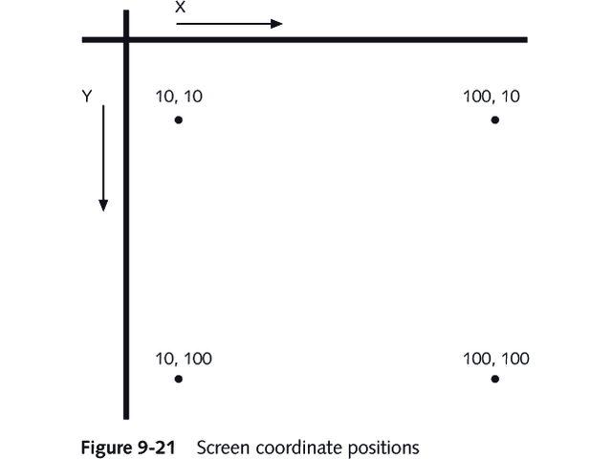
Screen Coordinate Positions

Slide 18
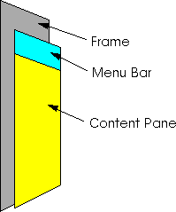
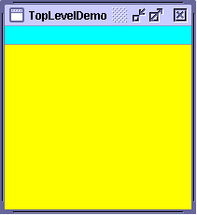
Containers for Windows Apps
A JFrame is the top-level window in an application
A JPanel is a generic lightweight container. JPanel objects are generally created in JFrame and JApplet containers.

Slide 19
JFrame
javax.swing.Jframe
A frame, implemented as an instance of the JFrame class, is a window that typically has decorations such as a border, a title, and buttons for closing and iconifying the window. Applications with a GUI typically use at least one frame. Applets sometimes use frames, as well.

Slide 20
Window Application (JFrame)
import javax.swing.*;
import java.awt.*;
public class myWindowApp
{
public static void main(String args[]) {
JFrame mainFrame = new JFrame("I am a Window Application");
JLabel greeting = new JLabel("Java is Fun!");
JTextField response = new JTextField(4);
JButton pressButton = new JButton("Press");
Container con = mainFrame.getContentPane();
con.setLayout(new FlowLayout());
con.add(greeting);
con.add(response);
con.add(pressButton);
mainFrame.pack();
mainFrame.setLocationRelativeTo(null);
mainFrame.show();
}
}

Slide 21
Example – Cont’d
We can re-write the previous code by extending JFrame and create a constructor

Slide 22
Window Application 2
import javax.swing.*;
import java.awt.*;
public class myWindowAppTwo extends JFrame
{
JLabel greeting = new JLabel("Java is Fun!");
JTextField response = new JTextField(4);
JButton pressButton = new JButton("Press");
public myWindowAppTwo() {
Container con = getContentPane(); // Difference with app 1?
con.setLayout(new FlowLayout());
con.add(greeting);
con.add(response);
con.add(pressButton);
}
public static void main(String args[]) {
myWindowAppTwo mainFrame = new myWindowAppTwo();
mainFrame.setTitle("I am a Window Application!");
// Can I write .. = new myWindowAppTwo(“I am a Window Application”!);
mainFrame.pack();
mainFrame.setLocationRelativeTo(null);
mainFrame.show();
}
}

Slide 23
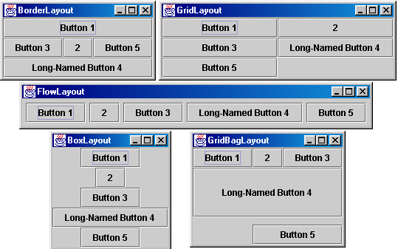
More on Layout Managers
Layout managers align graphical components so they neither crowd or overlap each other. Each layout manager defines methods that arrange components within a container. The five most common layouts are shown below:

Slide 24
BorderLayout
BorderLayout is the default layout manager for every content pane. The content pane is the main container in all frames, applets, and dialogs.
A BorderLayout has five areas available to hold components: north, south, east, west, and center. The compiler determines the exact size of each component based on the components contents
When BorderLayout is used with less than five components, any empty regions disappear
All extra space is placed in the center area

Slide 25
BorderLayout
Container contentPane = getContentPane();
contentPane.setLayout(new BorderLayout());
//comp is a graphic component
contentPane.add(comp,location);

Slide 26
BorderLayout
Five location available
BorderLayout.NORTH
BorderLayout.SOUTH
BorderLayout.EAST
BorderLayout.WEST
BorderLayout.CENTER

Slide 27
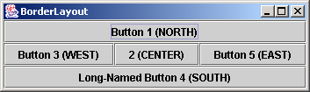
BorderLayout
import java.awt.*;
import javax.swing.*;
public class BorderLayoutDemo extends JFrame {
public BorderLayoutDemo() {
Container contentPane = getContentPane();
// contentPane.setLayout(new BorderLayout()); // necessary?
contentPane.add(new JButton("Button 1 (NORTH)"),BorderLayout.NORTH);
contentPane.add(new JButton("2 (CENTER)"), BorderLayout.CENTER);
contentPane.add(new JButton("Button 3 (WEST)"),BorderLayout.WEST);
contentPane.add(new JButton("Long-Named Button 4 (SOUTH)"), BorderLayout.SOUTH);
// What’s the result if change Button 5 to SOUTH? Resize the window
contentPane.add(new JButton("Button 5 (EAST)"),BorderLayout.EAST);
}
public static void main(String args[]) {
BorderLayoutDemo mainFrame = new BorderLayoutDemo();
mainFrame.setTitle("BorderLayout");
mainFrame.pack();
mainFrame.setLocationRelativeTo(null);
mainFrame.setVisible(true);
}
}

Slide 28
BoxLayout
BoxLayout puts components in a single row or column. This layout manager respects the components' requested maximum sizes and also lets you align components.
Nesting multiple panels with different combinations of horizontal and vertical gives an effect similar to GridBagLayout, without the complexity.
The box layout manager tries to make all the components the same height(row) or width(column) so components do not spill over
Requires two arguments
The first refers to the container to which the layout manager applies
The second is a constant
BoxLayout.X_Axis for a row arrangement
BoxLayout.Y_Axis for a column arrangement

Slide 29
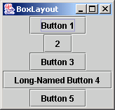
BoxLayout
import java.awt.*;
import javax.swing.*;
public class BoxLayoutDemo extends JFrame {
public BoxLayoutDemo() {
Container contentPane = getContentPane();
contentPane.setLayout(new BoxLayout(contentPane, BoxLayout.Y_AXIS));
addAButton("Button 1", contentPane);
addAButton("2", contentPane);
addAButton("Button 3", contentPane);
addAButton("Long-Named Button 4", contentPane);
addAButton("Button 5", contentPane);
}
private void addAButton(String text, Container container) {
JButton button = new JButton(text);
button.setAlignmentX(Component.CENTER_ALIGNMENT); //default left
container.add(button);
}
public static void main(String args[]) {
BoxLayoutDemo mainFrame = new BoxLayoutDemo();
mainFrame.setTitle("BoxLayout");
mainFrame.pack();
mainFrame.setLocationRelativeTo(null);
mainFrame.setVisible(true);
}
}

Slide 30

FlowLayout
FlowLayout is the default layout manager for every JPanel. This layout manager simply lays out components from left to right, starting new rows, if necessary.
Each component retains its default size
Each component that you add is placed to the right of previously added components

Slide 31
FlowLayout
import java.awt.*;
import javax.swing.*;
public class FlowLayoutDemo extends JFrame {
public FlowLayoutDemo() {
Container contentPane = getContentPane();
contentPane.setLayout(new FlowLayout());
contentPane.add(new JButton("Button 1"));
contentPane.add(new JButton("2"));
contentPane.add(new JButton("Button 3"));
contentPane.add(new JButton("Long-Named Button 4"));
contentPane.add(new JButton("Button 5"));
}
public static void main(String args[]) {
FlowLayoutDemo mainFrame = new FlowLayoutDemo();
mainFrame.setTitle("FlowLayout");
mainFrame.pack();
mainFrame.setLocationRelativeTo(null);
mainFrame.setVisible(true);
}
}

Slide 32
GridLayout
GridLayout simply makes a bunch of components equal in size and displays them in the requested number of rows and columns.
You indicate the numbers of rows and columns you want, and then the container surface is divided into a grid
Specify rows first, columns second
As you add components they are positioned left-to-right across each row in sequence

Slide 33
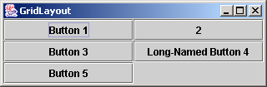
GridLayout
import java.awt.*;
import javax.swing.*;
public class GridLayoutDemo extends JFrame {
public GridLayoutDemo() {
Container contentPane = getContentPane();
// One, but not both, of rows and cols can be zero, means that
// any number of objects can be placed in a row or in a column.
contentPane.setLayout(new GridLayout(0,2));
contentPane.add(new JButton("Button 1"));
contentPane.add(new JButton("2"));
contentPane.add(new JButton("Button 3"));
contentPane.add(new JButton("Long-Named Button 4"));
contentPane.add(new JButton("Button 5"));
}
public static void main(String args[]) {
GridLayoutDemo mainFrame = new GridLayoutDemo();
mainFrame.setTitle("GridLayout");
mainFrame.pack();
mainFrame.setLocationRelativeTo(null);
mainFrame.setVisible(true);
}
}

Slide 34
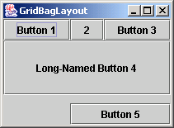
GridBagLayout
GridBagLayout is the most sophisticated, flexible layout manager the Java platform provides. This layout manager aligns components by placing them within a grid of cells, allowing some components to span more than one cell. The rows in the grid aren't necessarily all the same height; similarly, grid columns can have different widths.
This class is difficult to use because you must set the position and size for each component

Slide 35
CardLayout
CardLayout- Generates a stack of containers or components, one on top of another
Each container in the group is referred to as a card
Only one component is visible at a time
A card layout is created from the CardLayout class using one of two constructors
CardLayout() creates a new card layout without a horizontal or vertical gap
CardLayout(int hgap, int vgap) creates a new card layout with the specified horizontal and vertical gaps
Function similar to JTabbedPane

Slide 36
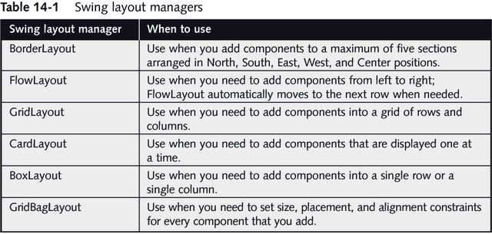
Swing Layout Managers
Table 14-1 Swing layout managers
Swing layout manager | When to use
BorderLayout | Use when you add components to a maximum of five sections arranged in North, South, East, West, and Center positions.
FlowLayout | Use when you need to add components from left to right; FlowLayout automatically moves to the next row when needed.
GridLayout | Use when you need to add components into a grid of rows and columns.
CardLayout | Use when you need to add components that are displayed one at a time.
BoxLayout | Use when you need to add components into a single row or a single column.
GridBagLayout | Use when you need to set size, placement, and alignment constraints for every component that you add.

Slide 37
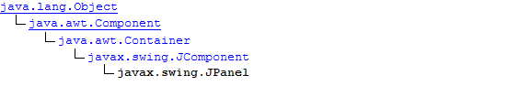
JPanel
javax.swing.JPanel
JPanels are simple UI containers, without borders or captions, used to group other components, such as buttons, check boxes, and text fields. A Panel is embedded within some other UI component, such as Frame or Dialog. JPanels can be nested within other panels.

Slide 38
Using JPanels
JPanels- Increase the number of possible component arrangements by using the JPanel class
A JPanel is similar to a JWindow in that a JPanel is a surface on which you can place components
JPanel is a Container so it can contain other components
By using JPanels within JPanels, you can create an infinite variety of screen layouts

Slide 39
Using JPanels
JPanel object constructors
JPanel() creates a new JPanel with a double buffer and a flow layout
JPanel(LayoutManager layout) creates a new buffered JPanel with the specified layout manager
JPanel con = new JPanel();
con.setLayout(new FlowLayout());

Slide 40
Steps to Create Windows Applications
Import the appropriate Java packages
Create a top-level container such as a JFrame or JApplet.
Create graphical components and put them into containers such as a JPanel.
Create listeners that respond to events generated by the graphical components.

