Slide 1
Absorption and Emission Spectrum: Harmonic Oscillator Model
Speaker: Chih-En Shen
Date: 2023/04/21

Slide 2
Outline
Introduction
Born-Oppenheimer Approximation (B.O. Approximation)
Potential Energy Surface (PES)
Result and Discussion
Displaced Harmonic Oscillator (DHO) Model
Absorption and Emission Spectrum
Conclusion

Slide 3






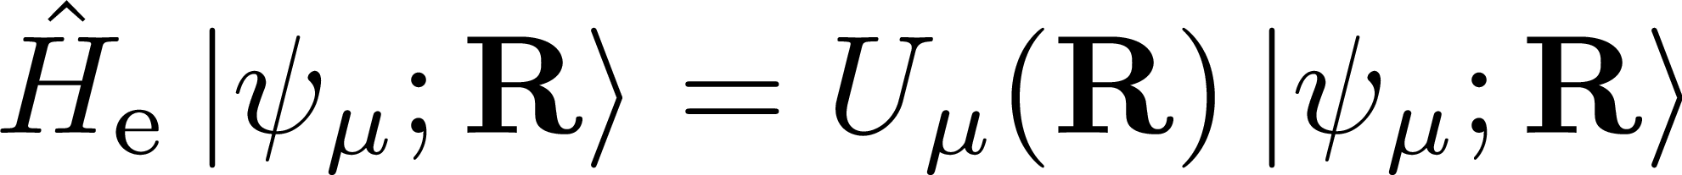
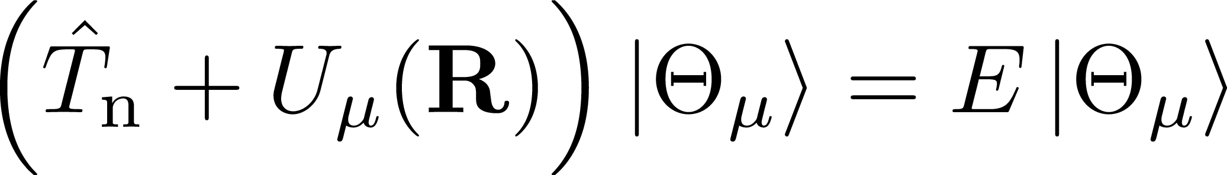
Born-Oppenheimer Approximation
Calculate electronic structure under frozen nuclear
Molecular Hamiltonian
Parameterization:

Slide 4
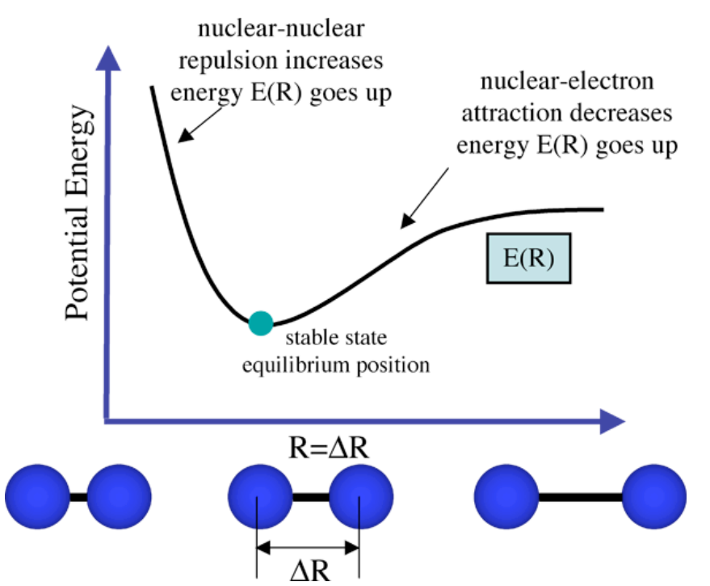
PES of Diatomic Molecule
At each atomic distance, solve the eigenenergy of the electronic Hamiltonian
At each nuclear configuration (geometry), solve the eigenenergy of electronic Hamiltonian

Slide 5

PES of Polyatomic Molecule
Diatomic molecule
N-atom polyatomic molecule
Only one normal mode
One-dimensional PES
$3N−6$ normal modes
$3N−6$ dimensional PES

Slide 6
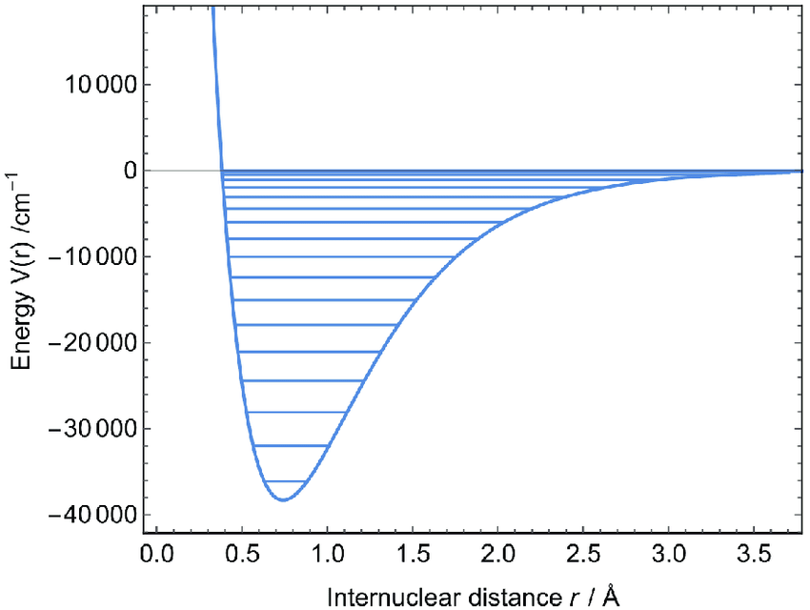
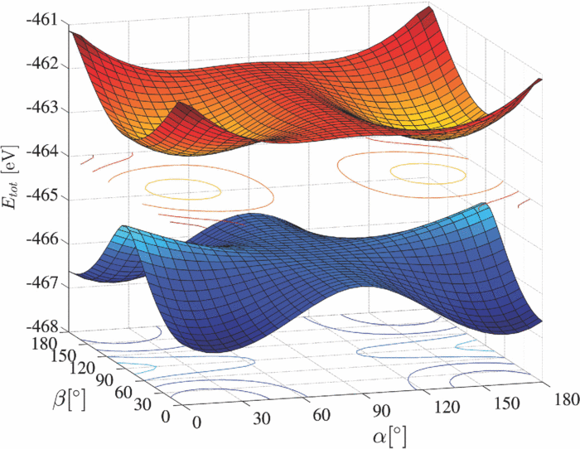
PES of Polyatomic Molecule
Diatomic molecule
N-atom polyatomic molecule
Only one normal mode
One-dimensional PES
$3N−6$ normal modes
$3N−6$ dimensional PES

Slide 7

2D Potential Energy Surface
Molecules always stay at the lowest energy geometry
Second-order expansion around the most stable geometry

Slide 8
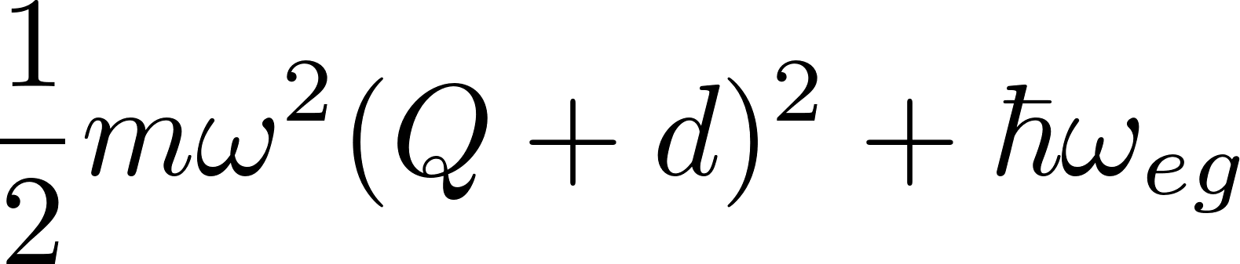


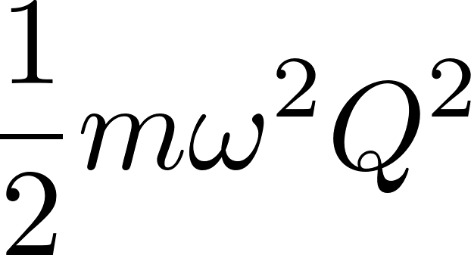


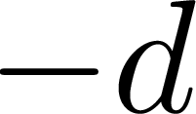
Displaced Harmonic Oscillator (DHO) Model
In atom
In molecule
energy E
0
normal mode coordinate Q

Slide 9
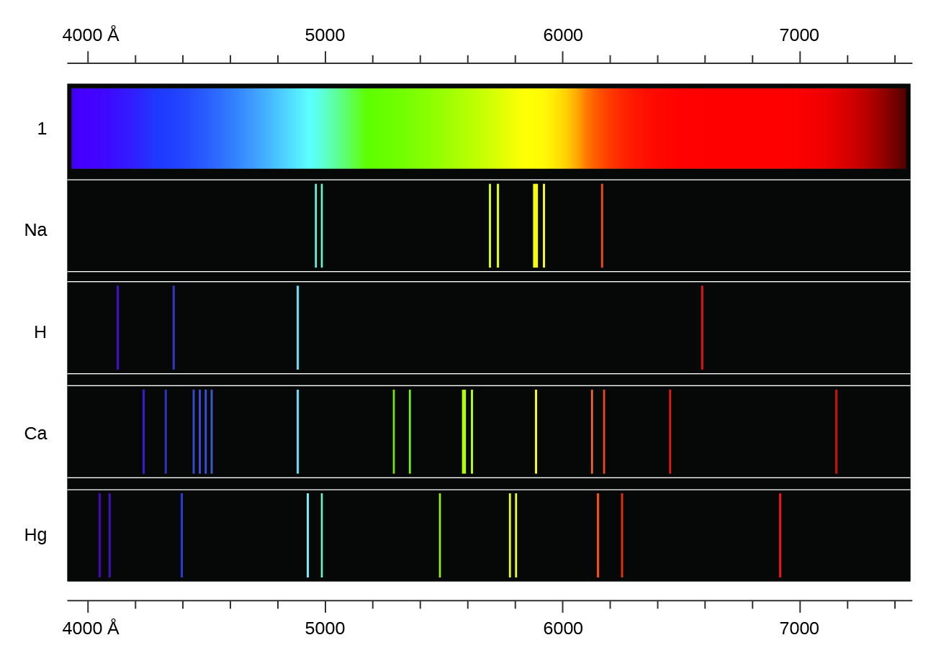
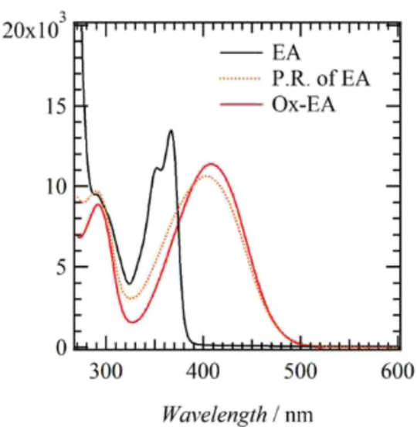
Absorption Spectrum of Atoms and Molecules
Atom
Molecule

Slide 10
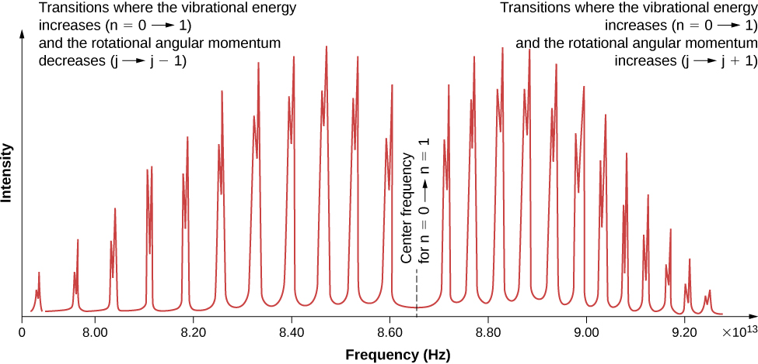
Absorption and Emission Spectrum for Diatomic Molecule
HCl

Slide 11
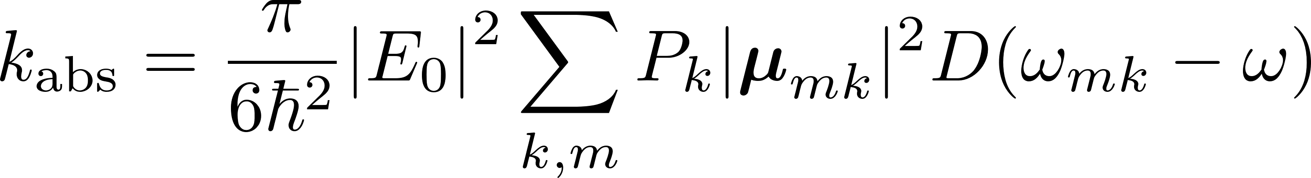
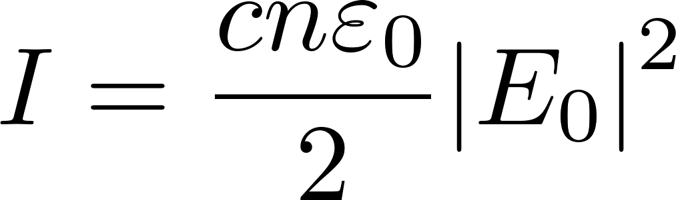
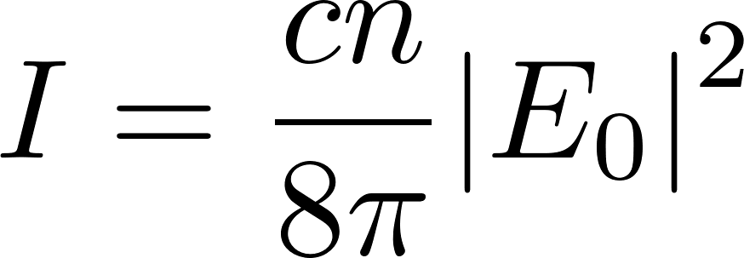
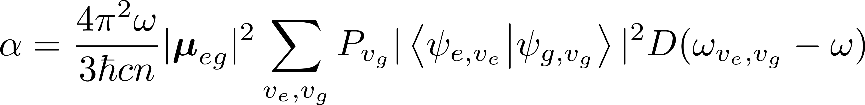
Absorption and Emission Spectrum
On the basis of Fermi’s golden rule, the absorption rate constant is
By Beer’s law, the absorption coefficient could be expressed as
Intensity
Electric field
Population
Transition dipole
Density of state
$k, m$represent the initial and final states, respectively
Refractive index

Slide 12
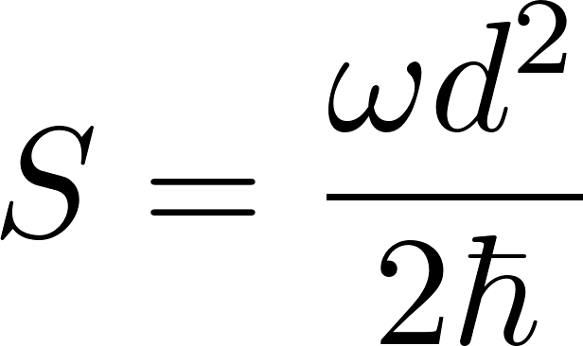
Review of DHO: Huang-Rhys (HR) Factor
Huang-Rhys factor
The dimensionless factor represents the displacement of DHO model.
energy E
normal mode coordinate Q
0

Slide 13
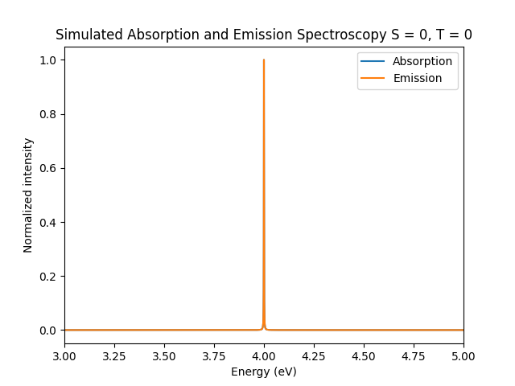
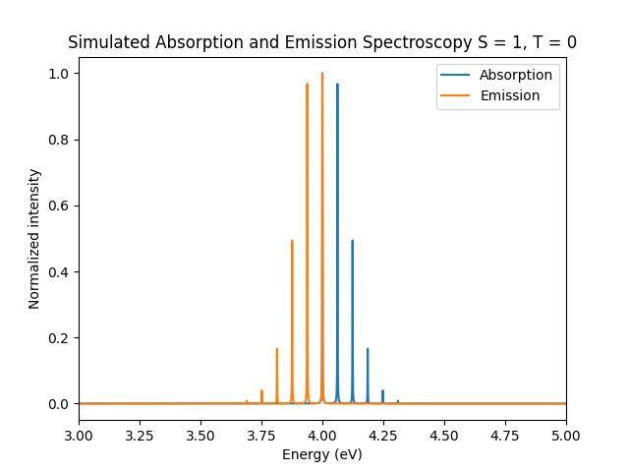
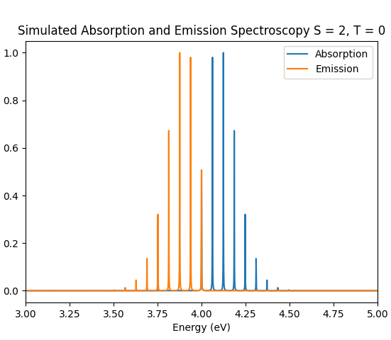



Absorption Spectrum for 1D DHO Model
(T = 0 K)
Huang-Rhys factor dependence
Franck-Condon pattern
$$S=0$$
$$S=1$$
$$S=2$$

Slide 14

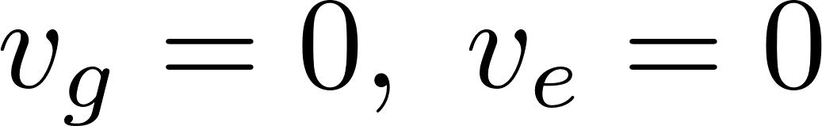
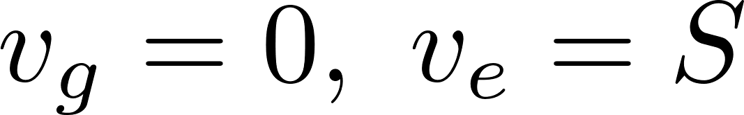



Explanation of HR Factor Dependence
Largest overlap at
Largest overlap at

Slide 15
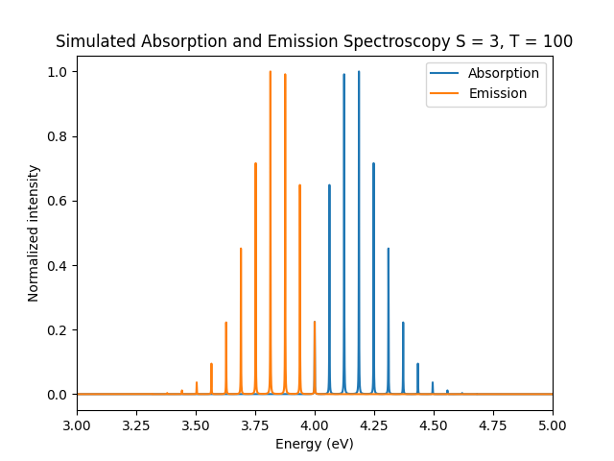
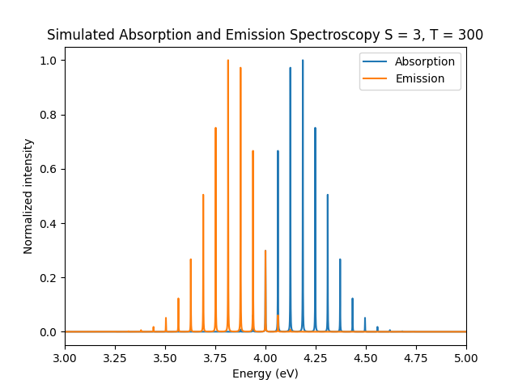
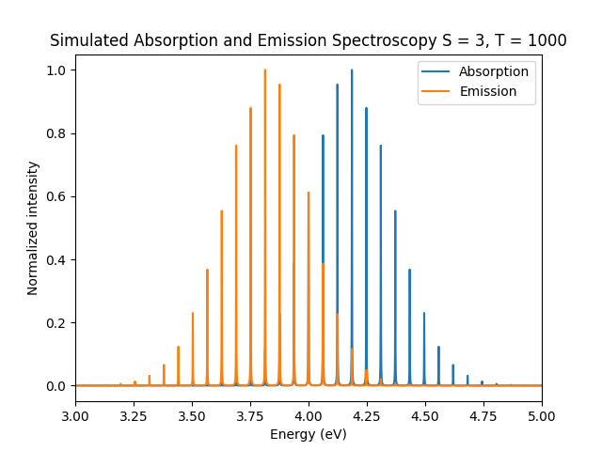

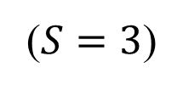

Absorption Spectrum for 1D DHO Model
($S=3$)
Temperature dependence
T = 100 K
$$\text{T} \text{=} \text{3}\text{00} \text{K}$$
$$\text{T} \text{=} \text{10}\text{0}\text{0} \text{K}$$

Slide 16
Explanation of Temperature Dependence
As T increases, the population of high-ladder states increases
T increases

Slide 17
Conclusion
Chemists always use DHO model to describe the molecular vibration
Huang-Rhys factor dependence: larger Huan-Rhys factor gives the more obvious Franck-Condon pattern
Temperature dependence: more population on high-lying states gives the wider energy range

