Slide 1
Design of an Indoor Air Quality Monitoring System using Low-Cost Sensors

Slide 2
Contents
Introduction
Block diagram
MQTT
Node red
Sensors used
Implementation
Results
Future work
References

Slide 3
Introduction
Indoor air quality (IAQ) as referred to by the CPCB is the quality of air inside buildings represented by concentrations of pollutants and thermal (temperature and relative humidity) conditions.
Consequences of poor indoor air quality (IAQ) have been tied to symptoms like headaches, fatigue, trouble concentrating as well as irritation of the eyes, nose, throat and lungs.
The immediate result is decline in performance of students/office employees in addition to affecting the health of the occupants.

Slide 4
Introduction(contd…)
IAQ monitoring units available in the market are expensive.
Smoke sensors without cloud connection cost around 5000-8000
PM sensor cost around 9000-14000
Low cost air quality monitoring stations can be designed using inexpensive sensors to detect the presence and measure the concentration of Particulate matter(PM₁₀, PM_{2.5}) and high levels of harmful gases.
Although usage of low cost sensors will reduce the accuracy, air quality monitoring can be done and relative or indicative data can be published for use in smaller buildings.

Slide 5
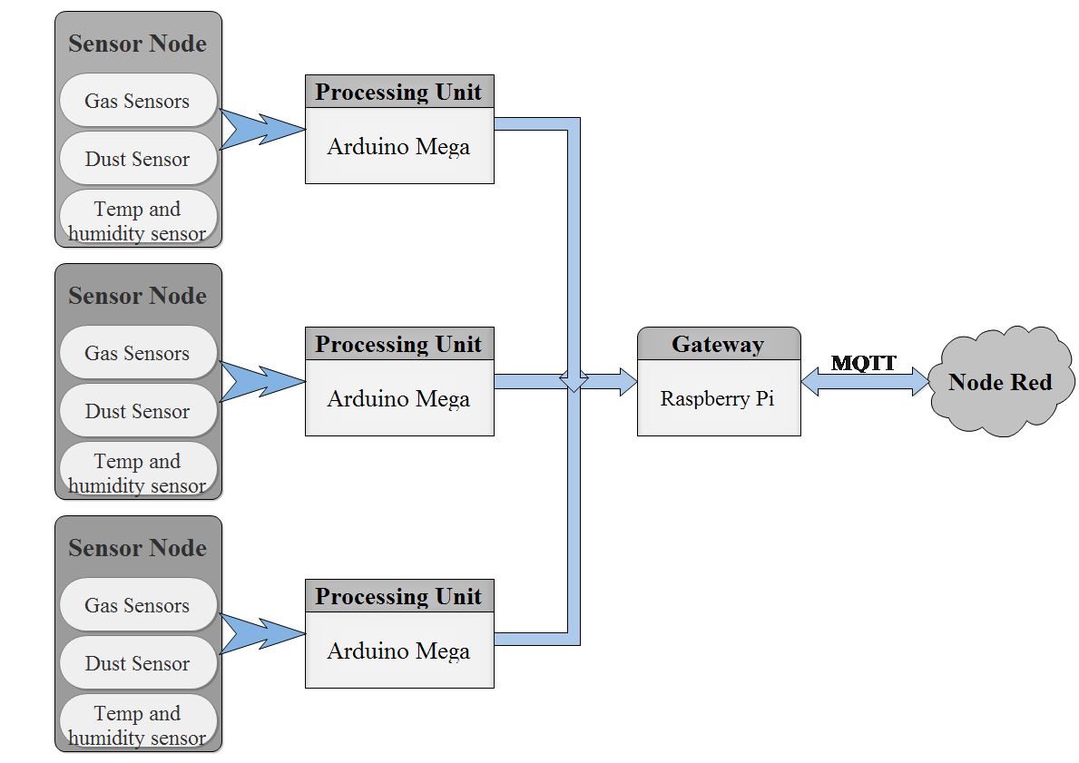
Block Diagram

Slide 6
MQTT
A broker based publish-subscribe lightweight messaging protocol.
Consists of a broker(server) and clients. Both publisher and subscriber are MQTT clients.
MQTT lightweight server called eclipse mosquitto written in c has an executable file size of ~120kb, 3 Mb of ram can handle 1000 clients.
It is useful to establish connection with devices in remote locations where network bandwidth is limited or small code footprint is required.

Slide 7
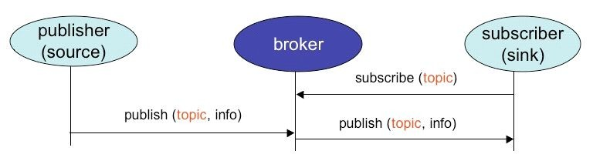
Pub/Sub in MQTT
MQTT decouples publisher from subscriber.
Publisher posts messages to a topic (address).
Subscriber subscribes to a topic to receive the messages. being published.

Slide 8
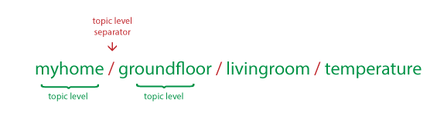
MQTT Topics, Wildcard and QOS
Topic division is the same as file organization in a computer.
Allows Wildcard subscription
Single level ‘+’
Multi level ‘#’
Provides three QOS levels
QOS 0 - at most once
QOS 1 - at least once
QOS 2 - only once

Slide 9
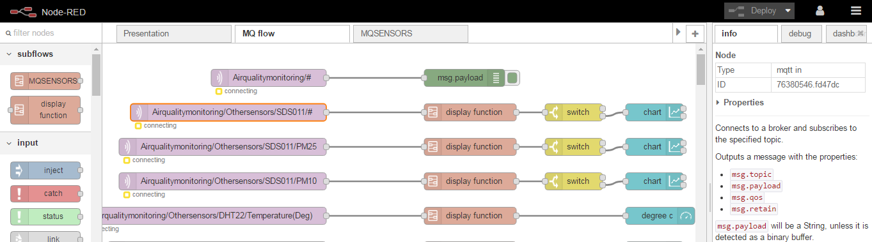
Node-red
Is an Open source visual editor.
Developed by IBM.
Example of flow based programming model.
Provides browser based editor
Provides wide variety of easy to use ‘Nodes’.
Flows/programs are made of wired up nodes.
Flows are stored in JSON format.

Slide 10
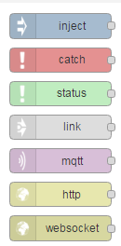
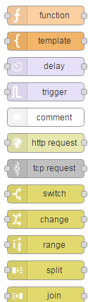
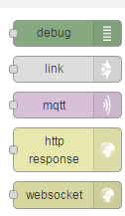
Nodes
Three types:
Input nodes.
Processing nodes.
Output nodes.
Each node has JS file and a HTML file.
Function node for additional functionality.

Slide 11
Dust Sensor
SDS011 dust sensor uses light scattering principle to measure PM.
Can measure PM having thickness in the range of 0.3 µm to 10 µm.
Output range – 0-999.9 µg/m³.

Slide 12
MQ Gas Sensors
Tin dioxide(SnO₂) is used as gas sensing material in MQ gas sensors.
Gases that come close to SnO₂ get ionized and are adsorbed which leads to change in resistance of sensing material.

Slide 13
Implementation Part-1
Steps performed by the sensor node and Processing unit:
Acquires readings from Gas sensors and convert it to PPM values.
Acquires data packet from Dust sensor and extract readings after verification.
Acquires readings from temperature sensor using DHT library written by adafruit industries.
Sends all the sensor readings serially to gateway.

Slide 14
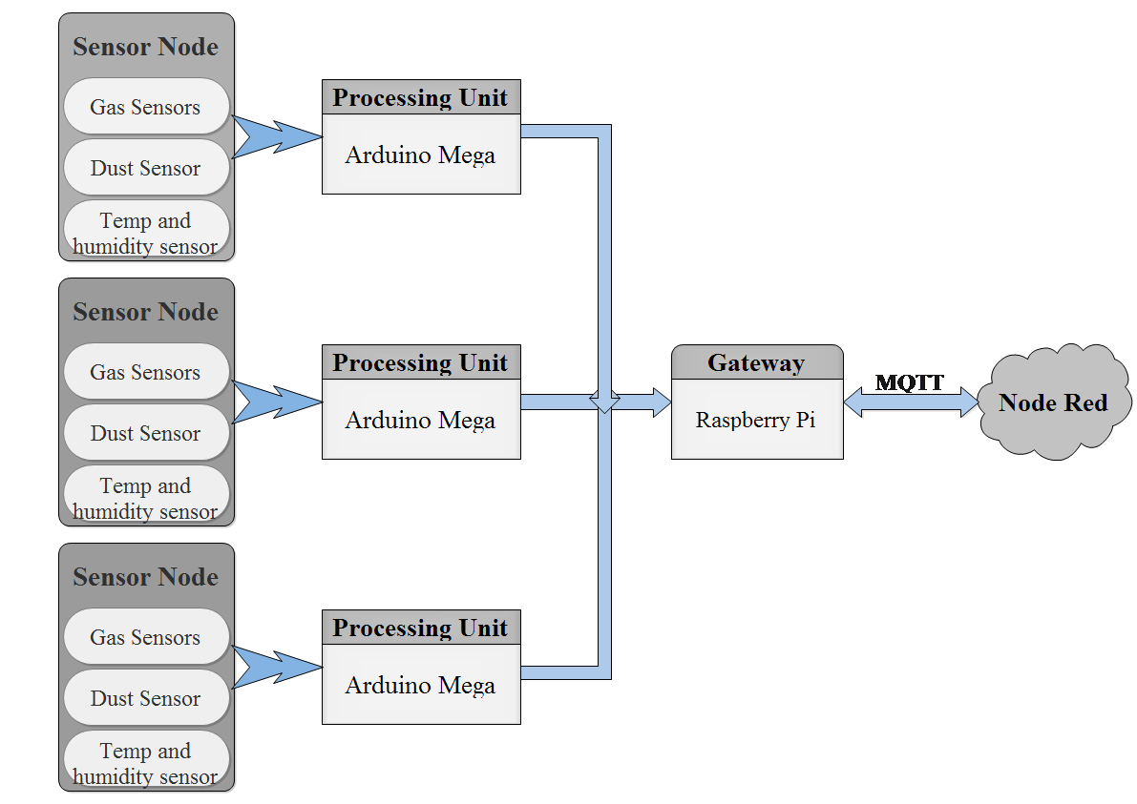

Slide 15
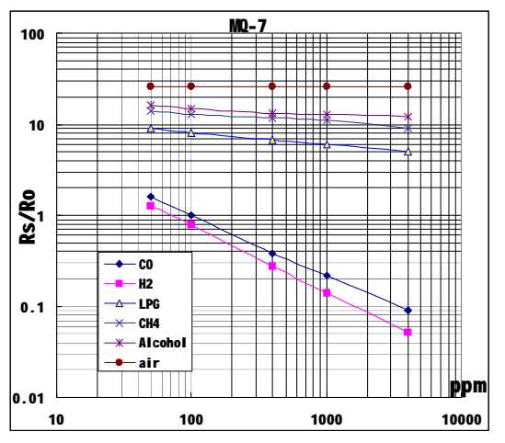
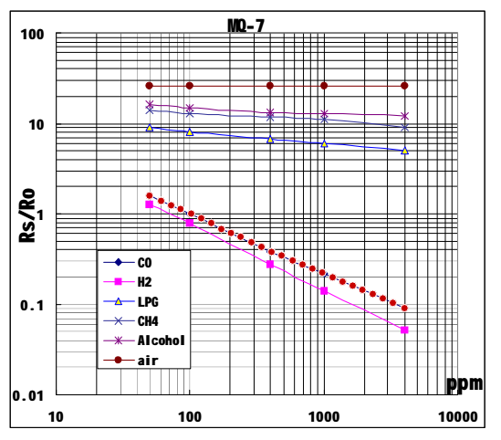
Obtaining PPM Equations

Slide 16
PPM value Calculation
Start
Mqpin, RL, Ratio
Calibration?
No
Sensor Calibration
Yes
End
Calculate Rs
Calculate PPM
Print PPM

Slide 17
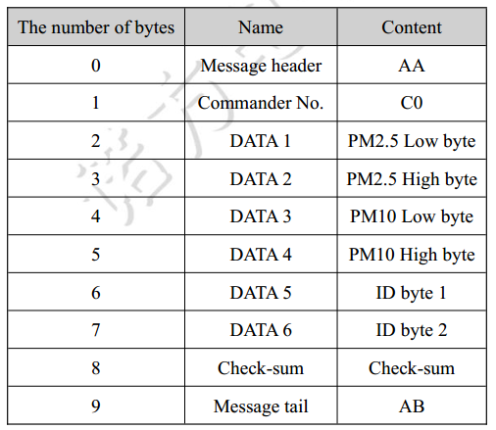
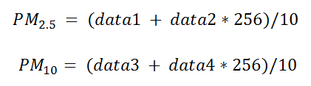
Dust sensor readings

Slide 18
Flowchart
Start
DHT sensor
Mqpin, RL, Ratio
No
Calibration?
No
All Sensors?
Yes
Sensor Calibration
Dust sensor
Yes
Yes
All gases?
Calculate Rs
End
No
Calculate PPM
Print PPM

Slide 20
Implementation Part-2
Steps performed by the gateway:
Establishes and maintains connection with MQTT broker.
Creates individual topics for each sensor and publishes the received readings to their respective topics.
Finally Node-red editor is used to develop a web application that subscribes and displays readings published by the sensors.

Slide 22
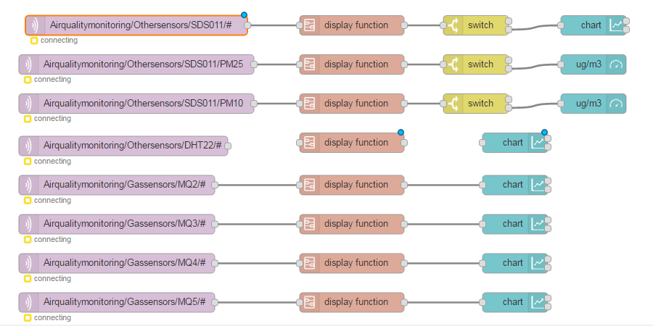
Node-RED application

Slide 23
Complete Working
Sensors send their readings to Arduino.
Arduino calculates PPM values of different gases based on Gas sensor readings, PM concentration values based on dust sensor readings.
Calculated values are serially transmitted to Raspberry pi using USB.
Raspberry pi connects to the MQTT broker and publishes the received values to various topics.
Node-red connects to the MQTT broker and subscribes to interested topics.
Node-red charts the received values using dashboard nodes.

Slide 24

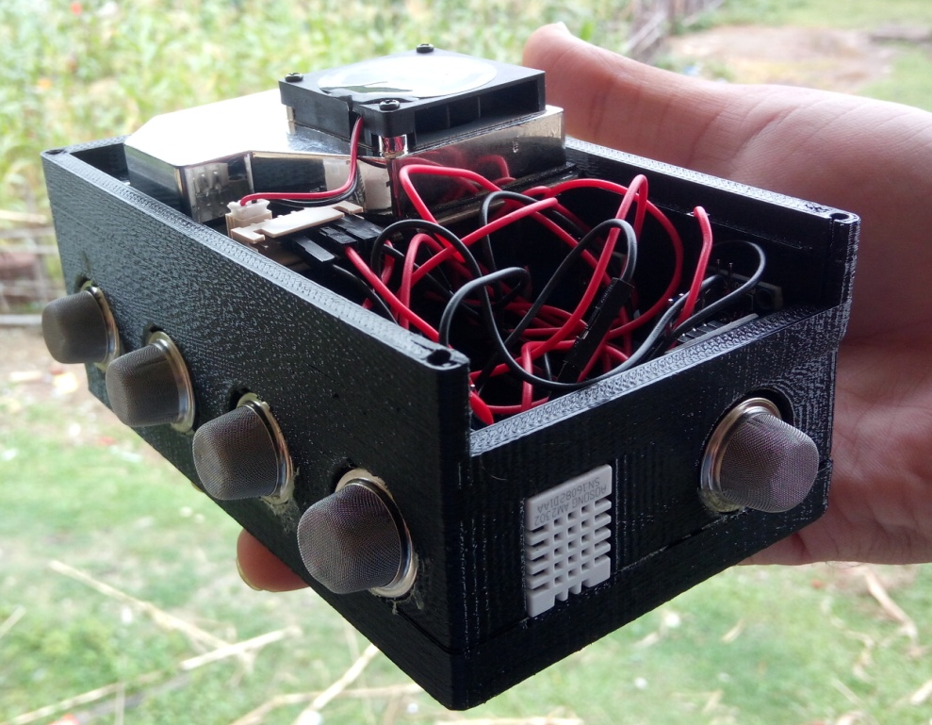
Results
Screenshot of the design file used for 3D printing
3D printed Prototype Sensor node box

Slide 25
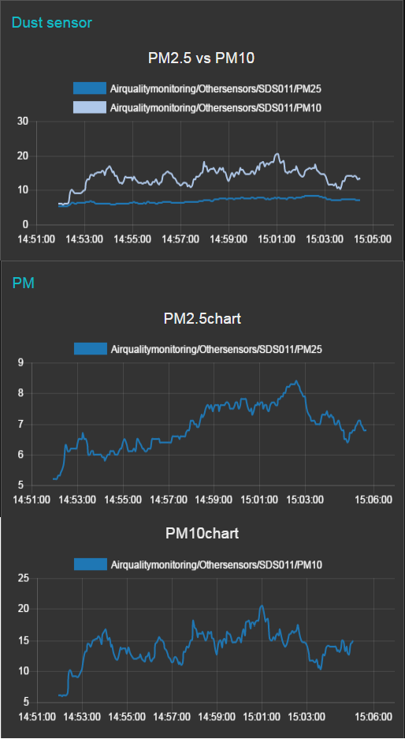
Results (Contd…)
Node-red flow editor: http://172.16.2.201:1880

Slide 26
Future Scope
Cost and size of the sensor node can be further reduced.
A processing device with inbuilt wireless capability can improve the portability.
Power efficiency of the device can be further improved.
Data obtained from a large number of low cost monitoring systems placed at different points in close vicinity could be compared to arrive at a relative or indicative value.
Application can be developed to push notifications.

Slide 27
References
Nick O’Leary and Dave Conway-Jones. (2017, January) Node-RED. [Online]. https://nodered.org/.
National AQI report. Central Pollution Control Board. [Online]. http://cpcb.nic.in/FINAL-REPORT_AQI_.pdf
Kumar, Prashant, et al. "The rise of low-cost sensing for managing air pollution in cities." Environment international 75 (2015): 199-205.
Anuj, and Gerhard P. Hancke. Kumar, "Energy efficient environment monitoring system based on the IEEE 802.15. 4 standard for low cost requirements," IEEE Sensors Journal, vol. 14, no. 8 , pp. 2557-2566, Aug 2014.
Y. C. Kan, and Y. M. Hong H. C. Lin, "The comprehensive gateway model for diverse environmental monitoring upon wireless sensor network ," IEEE Sensors J., vol. 11, no. 5, pp. 1293–1303, May 2011.

