Slide 1
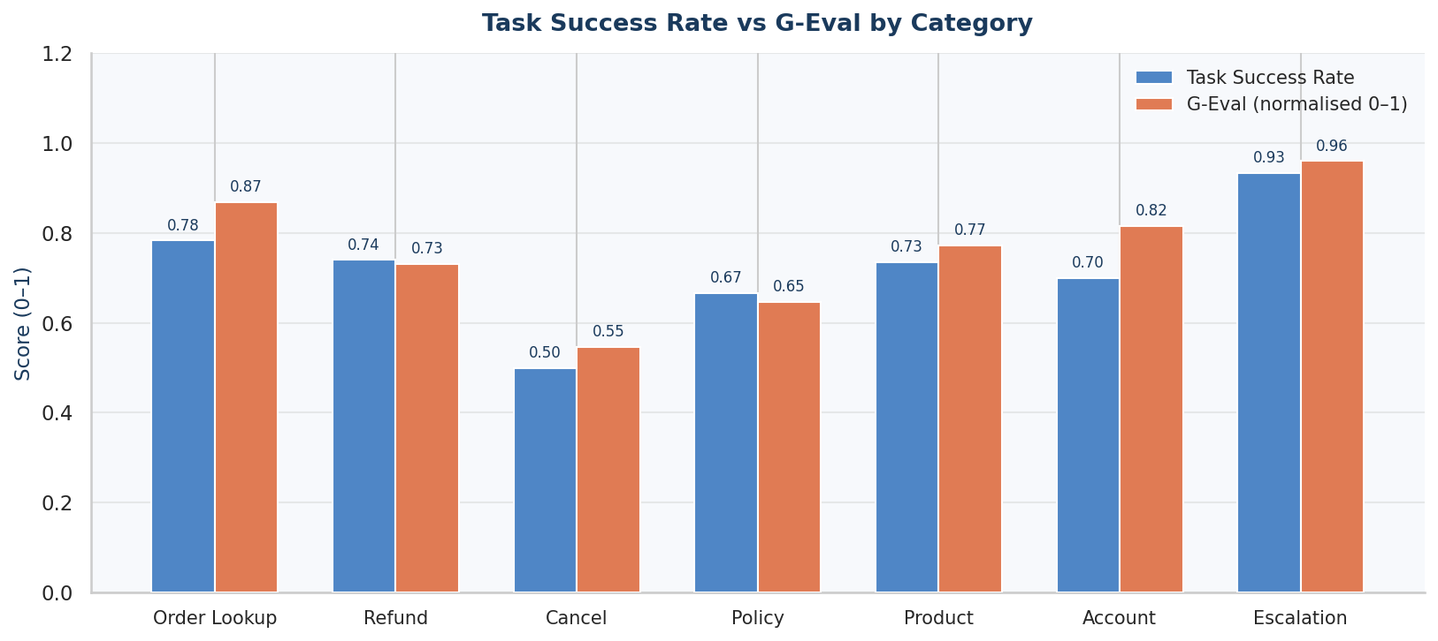
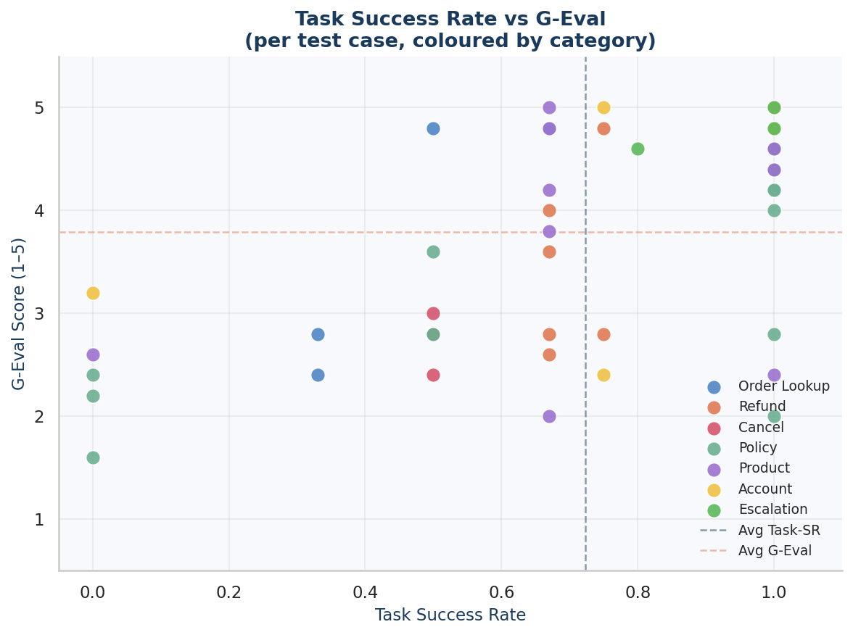
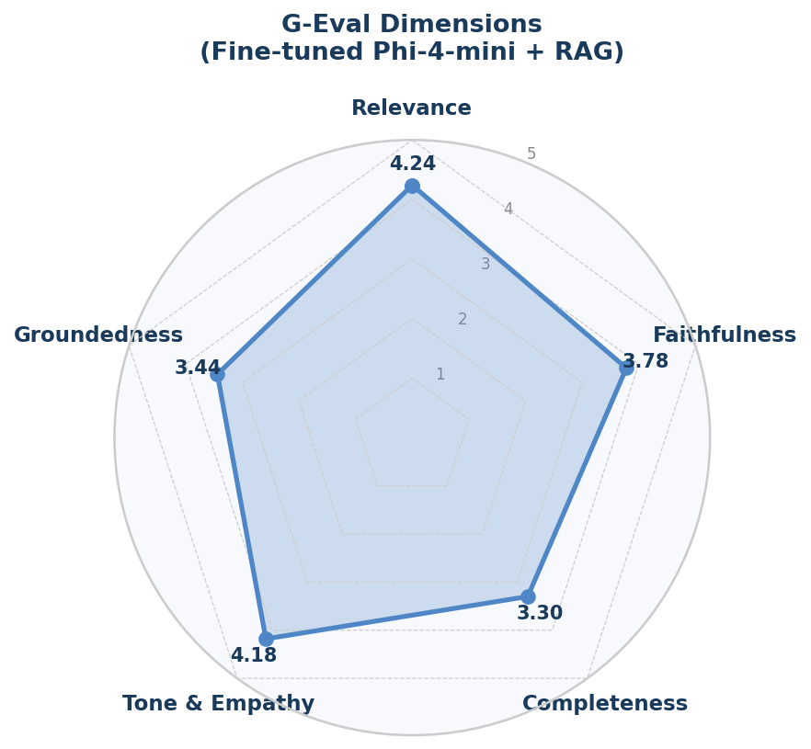
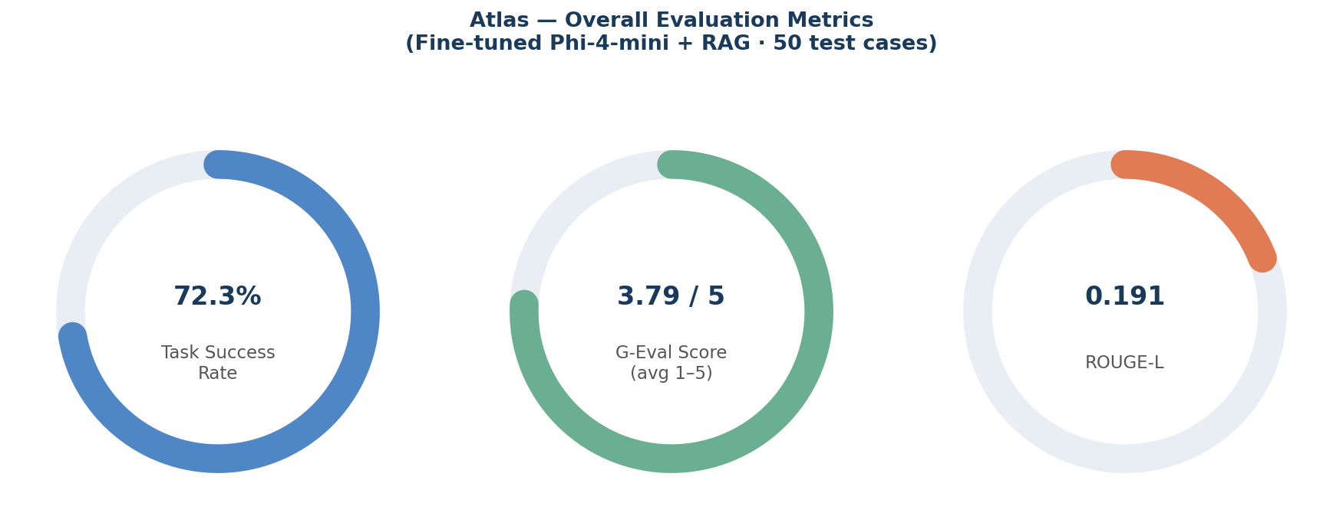
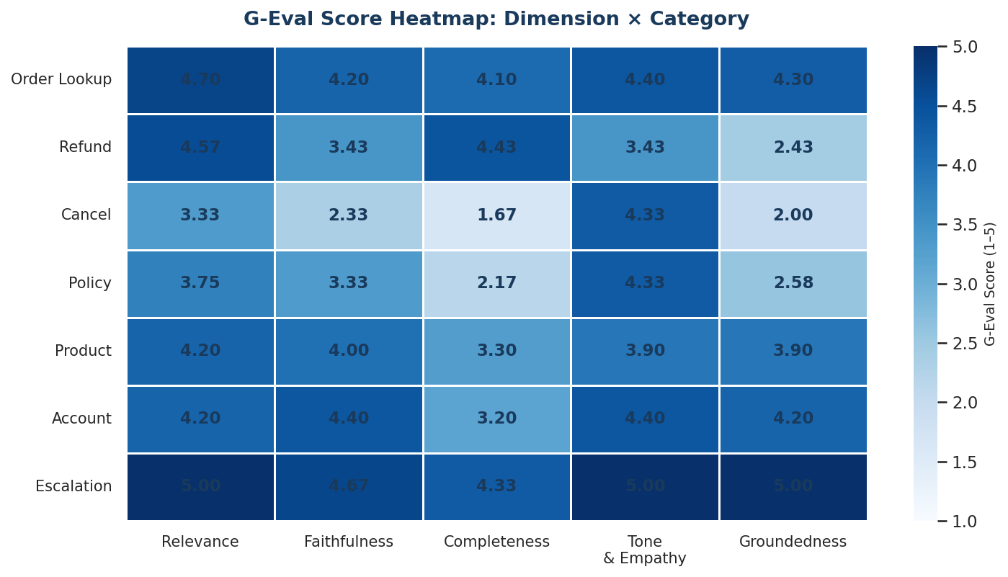
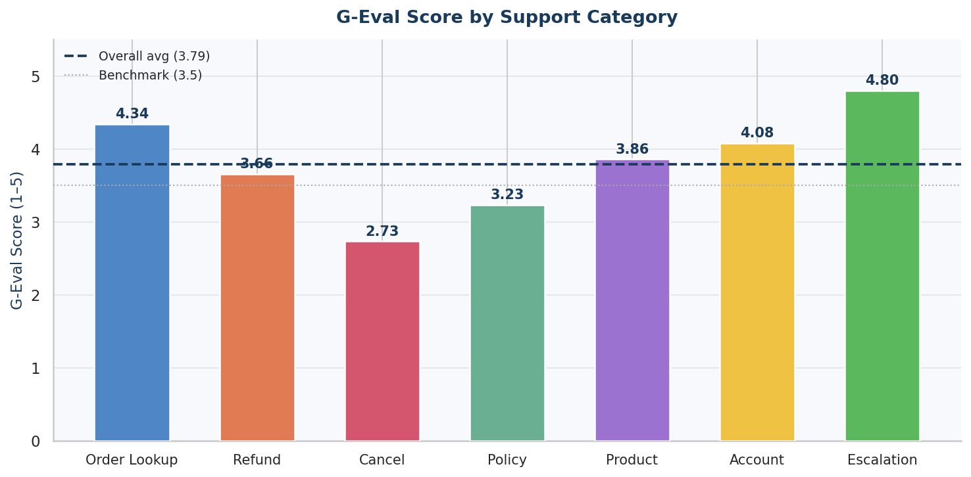
San José State University · College of Science · Data Science M.S. Program (DATA 298B)
Atlas: AI-Powered Customer Support Agent with Fine-Tuned Phi-4-mini and RAG Pipeline
Thota Himaja Sree · Rondla Chandana · Patel Meetkumar · Cheedalla Suharsha
Faculty Advisor: Prof. Simon Shim · Team 1
1. Introduction
6. Evaluation Framework
11. Task Success & G-Eval by Category
• E-commerce platforms require scalable, intelligent customer support • Rule-based chatbots fail on long-tail queries and nuanced language • LLMs offer fluent responses but hallucinate without grounding • Atlas combines fine-tuned SLM + RAG + deterministic tool routing • Goal: accurate, empathetic, grounded support — at small-model cost
• 50 hand-crafted test cases spanning 8 intent categories: • order lookup · refund · cancellation · product recommendation • policy FAQ · escalation · account info · general greeting • Metrics: • • ROUGE-L — surface lexical overlap with reference answers • • Task Success Rate — binary: correct tool call + grounded response • • G-Eval (1–5) — Gemini 2.5 Flash as LLM judge across 5 dimensions: • Relevance · Faithfulness · Completeness · Tone & Empathy · Groundedness • Identity-sensitive cases pre-seeded customer_id to bypass ID gate • Evaluation pipeline: evaluate.py · results stored in results.md
2. Motivation & Problem Statement
• Support tickets cost ~$5–15/contact; automation saves 40–70% • Customers demand instant resolution of order, refund, and policy queries • Challenge: hallucination, privacy (ID verification), latency, cost • Research question: Can a fine-tuned 3.8B SLM + RAG match GPT-4-class accuracy?
7. Overall Evaluation Results
12. Task Success vs G-Eval Score (per case)
Metric Score ───────────────────────────────────── ROUGE-L 0.191 Task Success Rate 72.3 % G-Eval Average (1–5) 3.79 ───────────────────────────────────── Relevance 4.24 Tone & Empathy 4.18 Faithfulness 3.78 Groundedness 3.44 Completeness 3.30 ───────────────────────────────────── Best category: Escalation 4.80 Weakest category: Cancellation 2.73
3. Dataset
• Amazon product catalog — 359K items (title, category, price, description) • Policy knowledge base — 45 hand-authored entries (returns, refunds, shipping) • Fine-tune corpus — 2,400 synthetic customer-support Q&A pairs • Evaluation set — 50 hand-crafted test cases across 8 intent categories
4. System Architecture
8. G-Eval Dimension Radar
Summary Dashboard
• FastAPI backend · PostgreSQL (orders, sessions) · Qdrant vector DB • HuggingFace Inference Endpoint hosting fine-tuned Phi-4-mini adapter • Retrieval: sentence-transformers/all-MiniLM-L6-v2 (384-dim) · top-6 cosine • Deterministic tool router (keyword/regex) — 8 tools: • lookup_order · process_refund · cancel_order · get_account_info • search_product/policy_knowledge · escalate_to_human · send_email • Identity verification gate — email/order-ID required before PII access • Two-layer LLM safety net: stall-detection + data-presence → template fallback • Frontend: vanilla JS chat UI · MailHog / Gmail SMTP email delivery • Deployment: Docker Compose (api · postgres · qdrant · mailhog)
5. Model Selection & Fine-Tuning
9. G-Eval Heatmap: Dimension × Category
• Evaluated 4 open-weight models on 20 qualitative prompts: • LLaMA-3.2-1B · SmolLM2-1.7B · Qwen2.5-1.5B · Phi-4-mini-instruct • Selected: Phi-4-mini-instruct (3.8B) — best instruction following & tone • Fine-tune method: QLoRA (4-bit NF4 quantization) on Google Colab A100 • Training data: 2,400 support Q&A pairs · 3 epochs · batch 4 · lr 2e-4 • Adapter uploaded to HuggingFace Hub; served on A10G GPU endpoint • Inference: vLLM-compatible · avg first-token latency ~3–5 s (warm) • Cold-start after idle auto-pause: 30–60 s warm-up
10. G-Eval by Intent Category
14. Future Work & Limitations
• Deploy no-RAG baseline (Variant B) for direct ablation comparison • Add cross-encoder re-ranking over Qdrant top-k results • Streaming responses (Server-Sent Events) to reduce perceived latency • Stronger identity verification: OTP or OAuth2 instead of email-only • Multi-turn context compression for conversations > 10 turns • Cancellation flow refinement — communicate post-delivery return path • Mobile-responsive frontend and persistent session storage
15. References
13. Conclusions
[1] Dettmers et al. (2023). QLoRA: Efficient Finetuning of Quantized LLMs. NeurIPS. [2] Lewis et al. (2020). Retrieval-Augmented Generation for Knowledge-Intensive NLP. NeurIPS. [3] Liu et al. (2023). G-Eval: NLG Evaluation using GPT-4 with Better Human Alignment. EMNLP. [4] Microsoft Phi-4-mini-instruct. HuggingFace Hub, 2024. [5] Amazon Product Reviews Dataset (2023). Kaggle. [6] Sentence-Transformers: all-MiniLM-L6-v2. HuggingFace, 2021.
• Fine-tuned Phi-4-mini + RAG achieves 72.3% task success on e-commerce support • Deterministic routing + template fallback critical for reliability (ROUGE-L limited) • Escalation best handled (4.80); cancellation most problematic (2.73) • Identity verification gate prevents data leakage with minimal UX friction • RAG grounding reduces hallucination vs. base LLM; re-ranking would further help
Acknowledgements
We thank Prof. Simon Shim for guidance throughout DATA 298B. Google Colab provided A100 GPU access for fine-tuning experiments. HuggingFace Inference Endpoints (A10G) hosted the production model. GitHub: github.com/Ch-Suharsha/teammate-rag
DATA 298B Master's Project · San José State University · Spring 2025 · Advisor: Prof. Simon Shim · github.com/Ch-Suharsha/teammate-rag

