Slide 1
Loan Classification Project
Predicting Loan Approval Status Using Machine Learning

Slide 2
Problem Statement
Financial institutions face challenges in making accurate and timely loan decisions. This project aims to develop a predictive model to classify loan applications as approved or not approved. Factors include age, gender, education, income, employment experience, credit score, and more. The model will help mitigate loan default risks and streamline the approval process.

Slide 3
Data Overview
The dataset includes information on:
- Applicant demographics (age, gender, education)
- Financial details (income, employment experience, credit score)
- Loan-specific data (amount, purpose, interest rate)
- Target variable: Loan status (approved or not)

Slide 4
Methodology
1. Data Preprocessing:
- outlier removal, correlation and feature scaling
- Encoding categorical variables
2. Model Training:
- Algorithms: Logistic Regression, Random Forest, and SVM
3. Evaluation:
- Metrics: Accuracy, Precision, Recall, F1-Score
- Visualization: Confusion Matrix

Slide 5
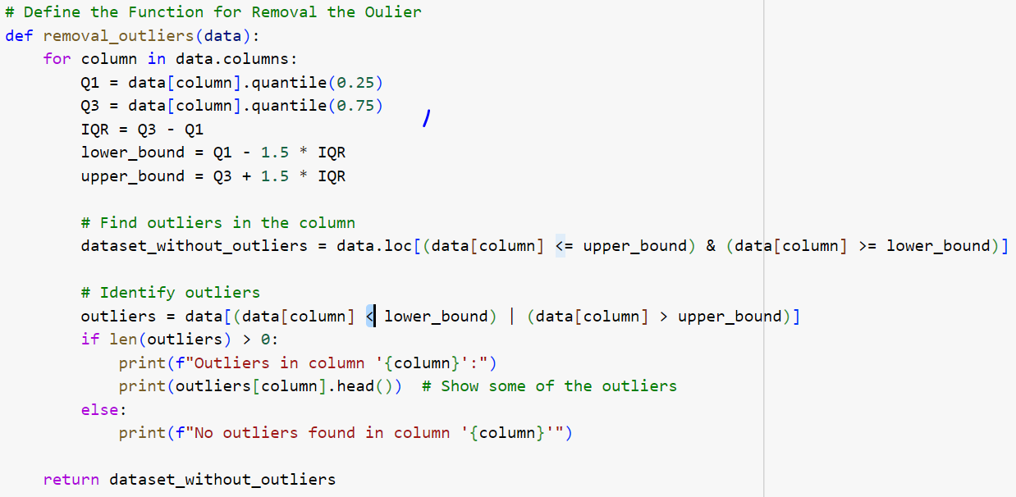
Outliers Detection
Here is the Code for the Outlier Detection:

Slide 6
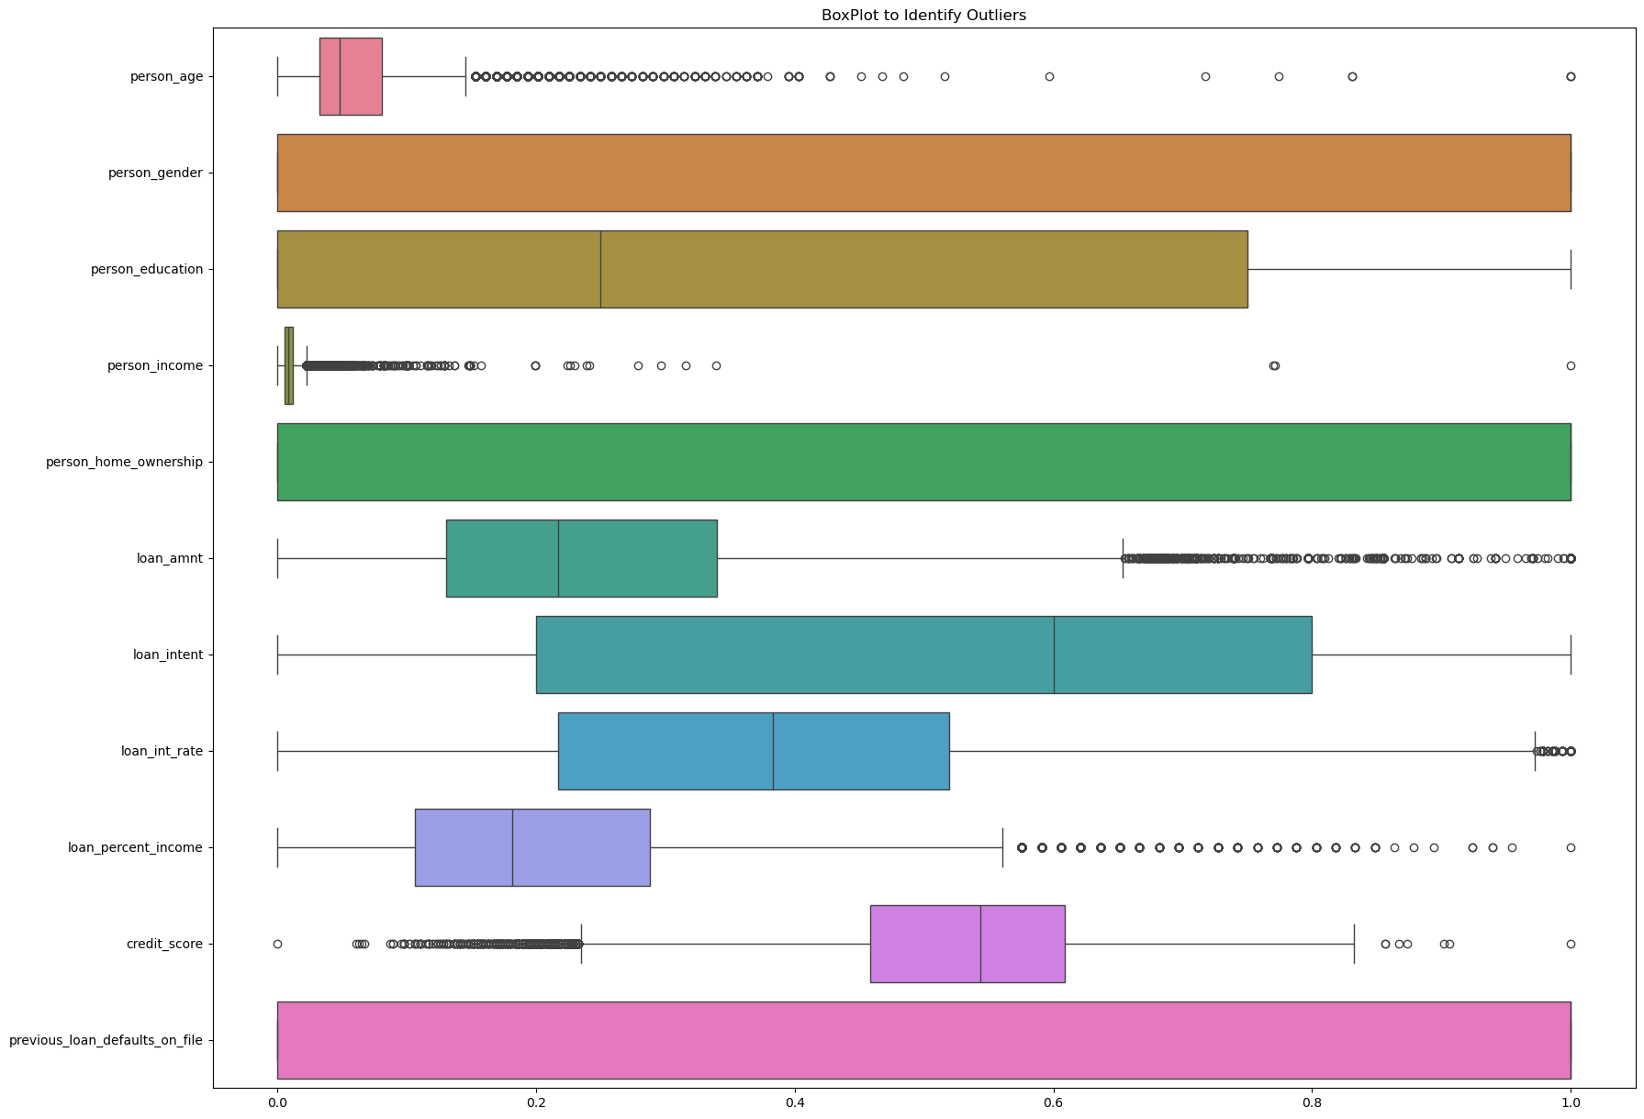
Box Plot For All Columns
This Figure show the Outliers of Each Column:

Slide 7
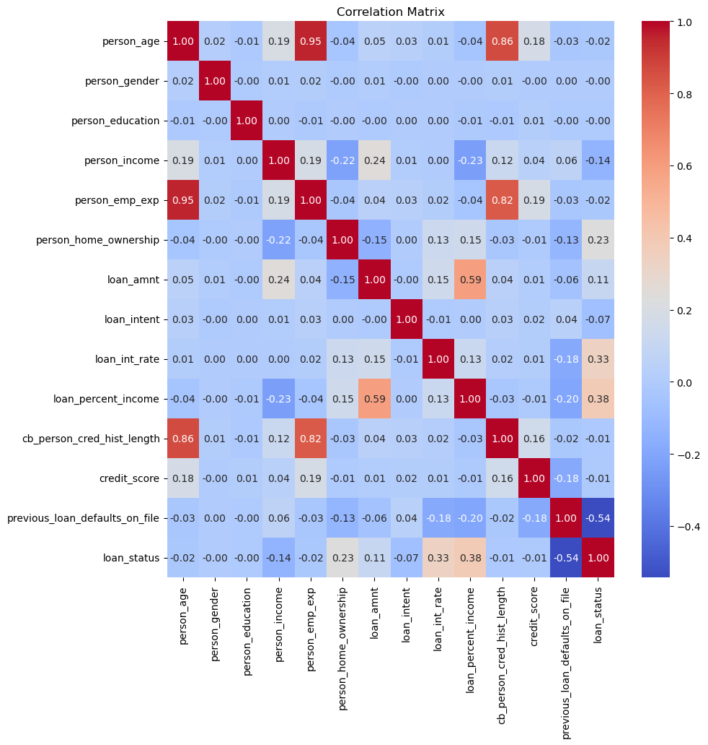
Correlation Table
Here is the Correlation Table: Threshold Value = 0.7

Slide 8
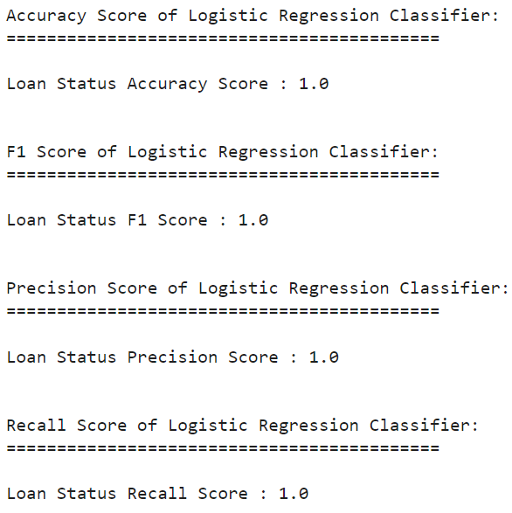
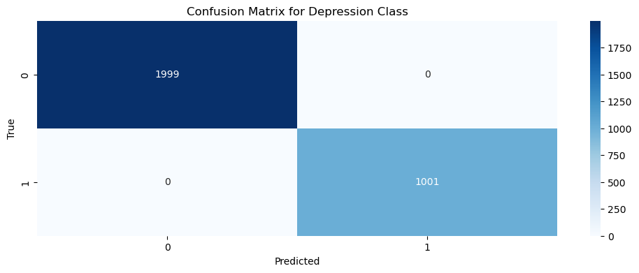
Logistic Regression
Here is the All Results for Logistic Regression:

Slide 9
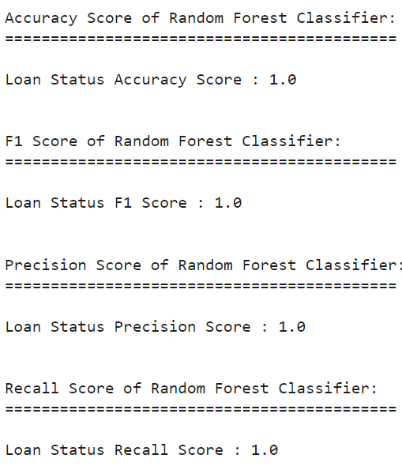
Random Forest
Here is the All Results for Random Forest:

Slide 10
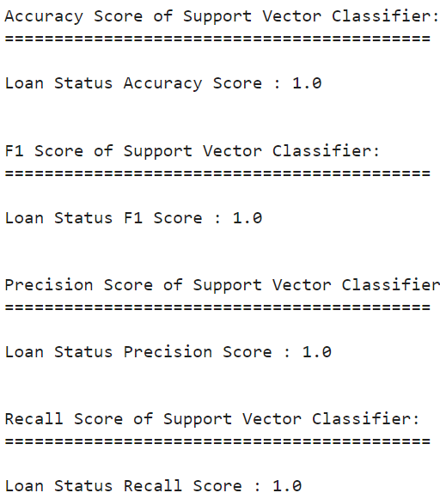
Support Vector Machine
Here is the All Results for Support Vector Machine:

Slide 11
Future Steps
1. Fine-tune models to improve accuracy and robustness.
2. Integrate the model into financial institutions' loan approval systems.
3. Conduct further analysis to identify key factors influencing approvals.
4. Add additional data sources to enhance model performance.

