Slide 1
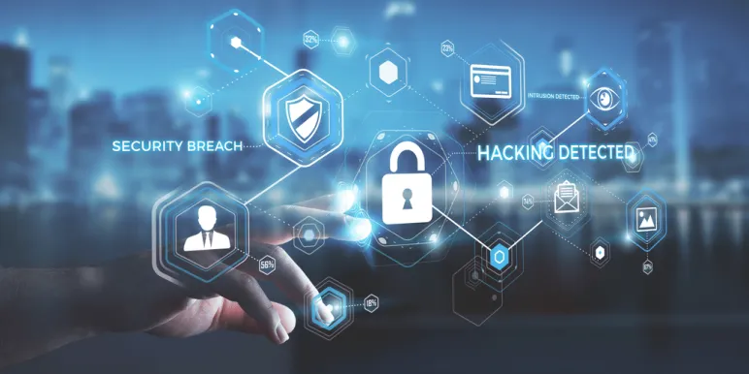
Threats to a Bank’s Cyber Security
Dr Richard Otuka(PhD)

Slide 2
Threat types
Internal Threats
External threats
Physical threats.
Social Engineering
Software driven threats

Slide 3
Threats
1. Unencrypted Data
2. Malware
3. Third Party Services that Aren’t Secure
4. Data That Has Been Manipulated
5. Spoofing

Slide 4
Unencrypted Data
This is a very basic yet crucial part of good cyber security. All data stored on computers within your financial institution and online should be encrypted. Even if your data is stolen by hackers, it cannot be immediately used by them if it’s encrypted – if left unencrypted, hackers can use the data right away, creating serious problems for your financial institution.

Slide 5
Malware
End user devices – such as computers and cell phones – that have been compromised by malware pose a risk to your bank’s cyber security each time they connect with your network. Sensitive data passes through this connection and if the end user device has malware installed on it, without proper security, that malware could attack your bank’s networks

Slide 6
3. Third Party Services that Aren’t Secure
Many banks and financial institutions employ third party services from other vendors in an effort to better serve their customers. However, if those third-party vendors don’t have good cyber security measures in place, your bank could be the one that suffers. It’s important to look into how you can protect from security threats imposed by third parties before you deploy their solutions.

Slide 7
Data That Has Been Manipulated
Sometimes hackers don’t go in to steal data – they simply go in to change it. Unfortunately, this type of attack can be difficult to detect right away and can cause financial institutions to incur millions of dollars in damages, if not more. Because the altered data doesn’t necessarily look any different than unaltered data on the surface, it can be challenging to identify what has and hasn’t been altered if your bank has been attacked in this manner.

Slide 8
Spoofing
A newer type of cyber security threat is spoofing – where hackers will find a way to impersonate a banking website’s URL with a website that looks and functions exactly the same. When a user enters his or her login information, that information is then stolen by hackers to be used later. Even more concerning is that new spoofing techniques do not use a slightly different but similar URL – they are able to target users who visited the correct URL.
HTTPS and Hushpuppy

Slide 9
The effectiveness of techniques used to protect us.
Physical security.
Backup.
Policies and procedures.
Software based protection.
Anti-Virus
Firewall and Intrusion detection systems.
User Authentication.
File/folder access controls.

Slide 10
Impact of IT security threats.
Financial lost.
Loss of service.
Loss of reputation.
Legal impact.
Forensic research.

