Slide 1
Network Forensics

Slide 2
Methodology
OSCAR
O- obtain information
S- Strategize
C-Collect Evidence
A- Analyse
R- Report.

Slide 3
Collecting Information
The Incident
Description of what happened (as is currently known)
Date, time, and method of incident discovery
Persons involved
Systems and data involved
Actions taken since discovery
Summary of internal discussions
Incident manager and process
Legal issues
Time frame for investigation/recovery/resolution
Goals
The Environment
Business model
Legal issues
Network topology (request a network map, etc. if you do not have one)
Available sources of network evidence
Organizational structure (request an organizational chart if you do not have one)
Incident response management process/procedures (forensic investigators are part of the response process and should be at least basically familiar with it)
Communications systems (is there a central incident communication system/evidence repository?)
Resources available (staﬀ, equipment, funding, time)

Slide 4
Strategizing
Source of Evidence Likely Value Effort Volatility Priority
Firewall Logs High Medium Low 2
Web Proxy Cache High Medium Medium 1
ARP Tables Low Low High 3
Here are some tips for developing an investigative strategy:
Understand the goals and time frame of the investigation.
List your resources, including personnel, time, and equipment.
Identify likely sources of evidence.
For each source of evidence, estimate the value and cost of obtaining it.
Prioritize your evidence acquisition.
Plan the initial acquisition/analysis.
Decide upon method and times of regular communication/updates.
Keep in mind that after conducting your initial analysis, you may decide to go back and acquire more evidence. Forensics is an iterative process.

Slide 5
Collect.
Document :Make sure to keep a careful log of all systems accessed and all actions taken during evidence collection. Your notes must be stored securely and may be referenced in court. Even if the investigation does not go to court, your notes will still be very helpful during analysis. Be sure to record the date, time, source, method of acquisition, name of the investigator(s), and chain of custody.
Capture :Capture the evidence itself. This may involve capturing packets and writing them to a hard drive, copying logs to hard drive or CD, or imaging hard drives of web proxies or logging servers.
Store/Transport

Slide 6
Analyze
Correlation :
One of the hallmarks of network forensics is that it involves multiple sources of evidence. Much of this will be timestamped, and so the ﬁrst consideration should be what data can be compiled, from which sources, and how it can be correlated. Correlation may be a manual process, or it may be possible to use tools to do it for you in an automated fashion.
Timeline
Once the multiple data sources have been aggregated and correlated, it’s time to build a timeline of activities. Understanding who did what, when, and how is the basis for any theory of the case. Recognize that you may have to adjust for time skew between sources!
Events of Interest
Certain events will stand out as potentially more relevant than others. You’ll need to try to isolate the events that are of greatest interest, and seek to understand how they transpired.
Corroboration
Due to the relatively low ﬁdelity of data that characterizes many sources of network logs, there is always the problem of “false positives.” The best way to verify events in question is to attempt to corroborate them through multiple sources. This may mean seeking out data that had not previously been compiled, from sources not previously consulted.
Recovery of additional evidence
Often the eﬀorts described above lead to a widening net of evidence acquisition and analysis. Be prepared for this, and be prepared to repeat the process until such time as the events of interest are well understood.
Interpretation
Throughout the analysis process, you may need to develop working theories of the case. These are educated assessments of the meaning of your evidence, designed to help you identify potential additional sources of evidence, and construct a theory of the events that likely transpired. It is of the utmost importance that you separate your interpretation of the evidence from fact. Your interpretation of the evidence is always a hypothesis, which may be proved or disproved.

Slide 7
Orientation
IP (Internet Protocol) is a Network Layer Protocol.
IP’s current version is Version 4 (IPv4). It is specified in RFC 891.

Slide 8
IP: The waist of the hourglass
IP is the waist of the hourglass of the Internet protocol architecture
Multiple higher-layer protocols
Multiple lower-layer protocols
Only one protocol at the network layer.

Slide 9
Application protocol
IP is the highest layer protocol which is implemented at both routers and hosts

Slide 10
IP Datagram Format
20 bytes ≤ Header Size < 2⁴ x 4 bytes = 60 bytes
20 bytes ≤ Total Length < 2¹⁶ bytes = 65536 bytes

Slide 11
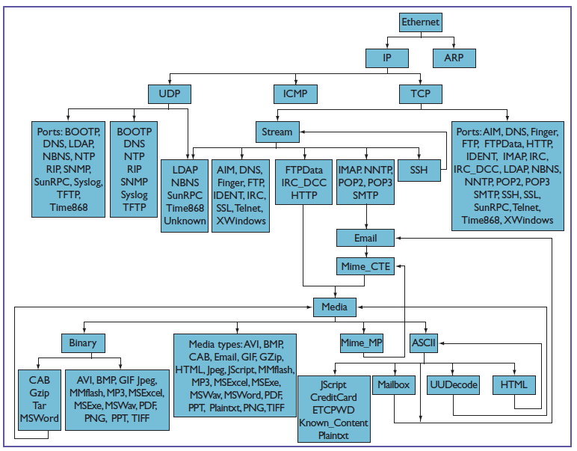

Slide 12
Protocol Parsing
Researchers often follow
Run tcpdump > strings to pull text> grep to find specific words in the recovered string .

Slide 13
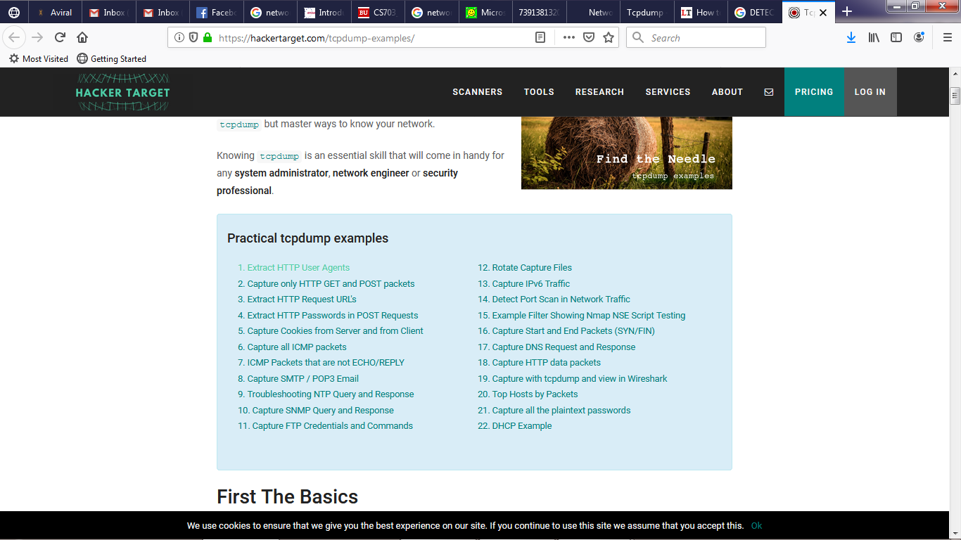
Assignment 1 : How to analyse and capture packet from TCPDUMP
https://www.linuxtechi.com/capture-analyze-packets-tcpdump-command-linux/
Examples of tcpdump
https://hackertarget.com/tcpdump-examples/

Slide 14
