Slide 1
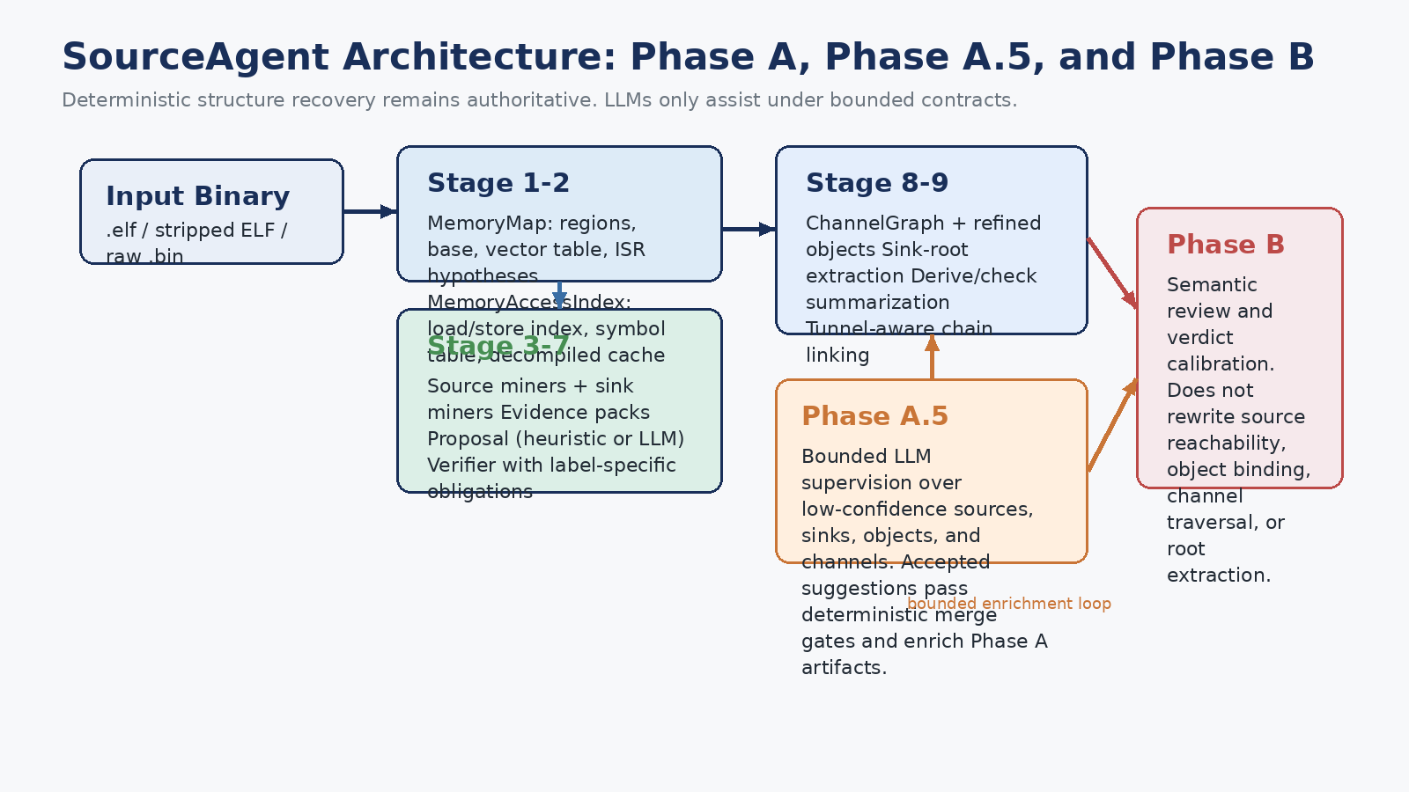
SourceAgent Progress Update
March 12, 2026 | architecture, supervision, benchmark assets, and evidence
Main claim
SourceAgent is not only a source/sink detector. It is becoming a two-phase system for monolithic firmware that recovers source, object, channel, root, and check structure, then calibrates chain risk.
What is already strong
GT-backed structural chain recovery is already very strong.
Chain-level risk GT now exists for curated anchor chains.
Benchmark assets and manifests are mostly in place.

Slide 2
Target Problem and Why Structure Matters
Target binaries are Type-II/III monolithic firmware, not Linux-like multi-process programs.
Inputs enter through MMIO, ISR-filled buffers, DMA-backed buffers, and shared SRAM objects.
A sink hit alone is not enough. We need to explain how attacker-controlled data becomes the dangerous sink parameter.
The core recovery targets are source, sink, object, channel, sink root, and derive/check evidence.
Phase A chain classes: - label verifier verdict: VERIFIED / PARTIAL / REJECTED / UNKNOWN - chain verdict: CONFIRMED / SUSPICIOUS / SAFE_OR_LOW_RISK / DROP - risk side-band: LOW / MEDIUM / HIGH and P0 / P1 / P2
Deterministic means reproducible fact extraction. Fail-closed means missing evidence never upgrades into a stronger claim.

Slide 3
End-to-End Architecture
Stage 1-7 establish label-level facts. Stage 8-9 assemble structure. Phase A.5 enriches low-confidence artifacts. Phase B calibrates semantic verdict and risk.

Slide 4
What Each Early-Phase Artifact Means
MemoryMap
Examples of required obligations: - MMIO_READ: constant base + peripheral range - ISR_MMIO_READ: MMIO obligations + ISR context - COPY_SINK: callsite match + argument extraction - FORMAT_STRING_SINK: printf-like call + non-literal format If required obligations fail, the label does not become authoritative.
Stage 1 output. A binary-specific address-space map: flash, SRAM, MMIO, system regions, base address, entry point, vector table, and ISR hypotheses.
MemoryAccessIndex
Stage 2 output. A structured index of loads/stores with target address, provenance, function context, ISR flag, global symbols, and decompiled cache.
Proposal and verifier
Stage 6 proposes a label for each evidence pack. Stage 7 checks label-specific obligations. The verifier sits before chain linking because it must clean local source/sink facts before they are combined.

Slide 5
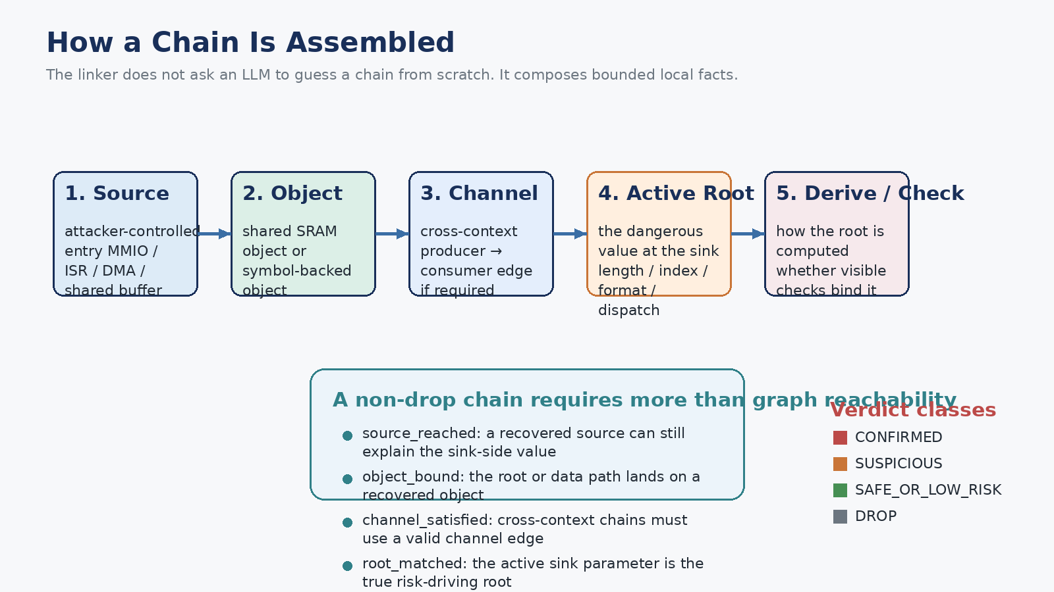
How a Chain Is Assembled

Slide 6
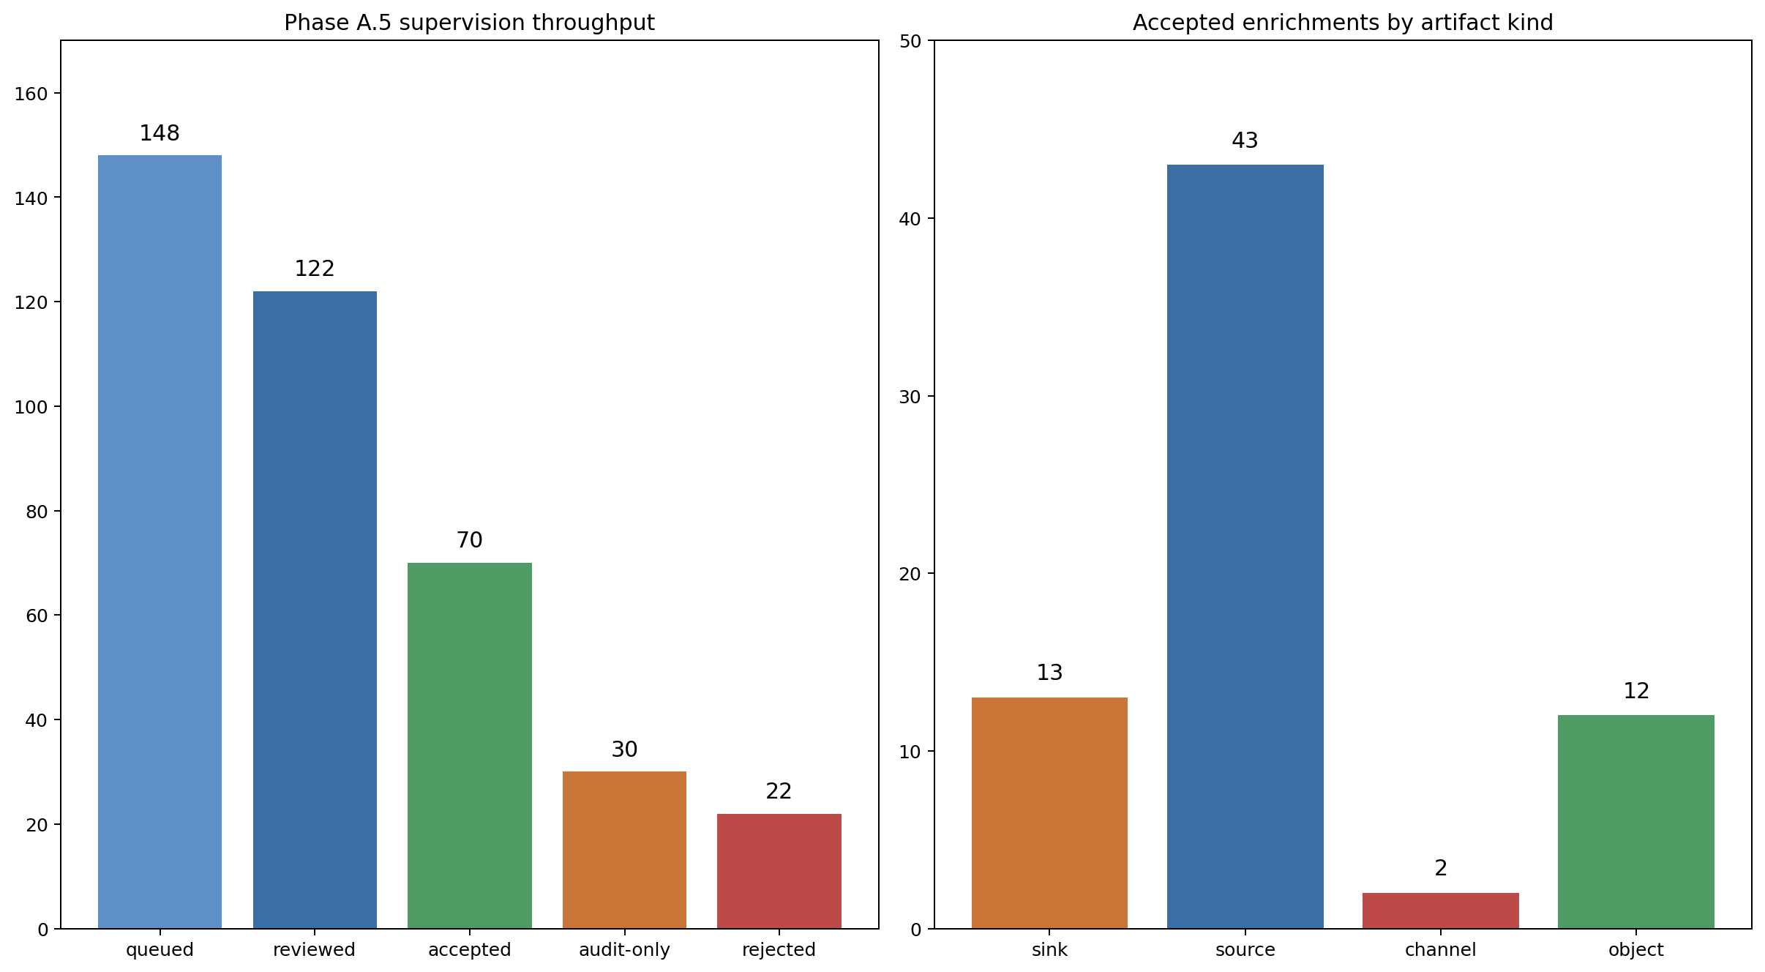
Phase A.5 LLM Supervision
Role: bounded enrichment of low-confidence sources, sinks, objects, and channels before final Phase A artifacts are frozen.
Implementation position: a late Phase A enrichment loop inside stage 10: supervision queue → LLM decisions → deterministic merge gates → rebuilt artifacts.
It is not a second vulnerability reviewer. It does not rewrite source reachability, object binding, channel existence, or root extraction from scratch.
Workflow: build supervision_queue → ask the LLM for structured decisions → pass deterministic merge gates → enrich verified labels / objects / channels only if accepted.
Current aggregate run: 148 queued, 122 reviewed, 70 accepted, 30 audit-only, 22 rejected.
Acceptance is currently strongest for sources and sinks. Object/channel enrichment is wired, but still conservative.

Slide 7
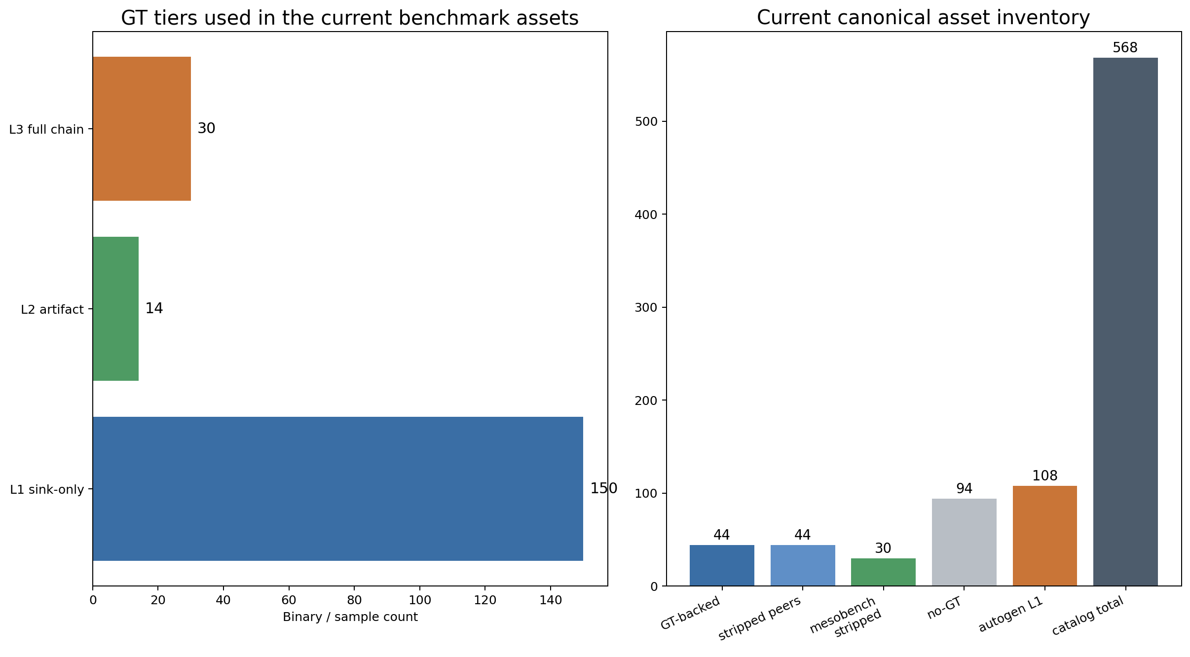
Benchmark Assets and GT Tiers
L1 = sink-only GT for scalable strict metrics. L2 = artifact GT for sources/objects/channels/roots/derive-checks. L3 = full chain GT for publishable end-to-end evaluation.

Slide 8
How GT Is Created
GT construction modes: 1. Microbench - small, controlled CVE reproductions - artifact-complete GT 2. Mesobench / GT-backed - realistic binaries - draft-then-freeze workflow - initial chains may be auto-promoted from live runs, then manually curated 3. Risk GT - only curated anchor chains are labeled first - expected_final_verdict + expected_final_risk_band + expected_review_priority
{ "chain_id": "C1_evt_overflow", "expected_verdict": "CONFIRMED", "expected_final_verdict": "CONFIRMED", "expected_final_risk_band": "HIGH", "expected_review_priority": "P0" }
Example: the HCI-over-SPI microbench sample explicitly records source, objects, sink roots, derive/check facts, full chains, and anchor-level risk GT.

Slide 9
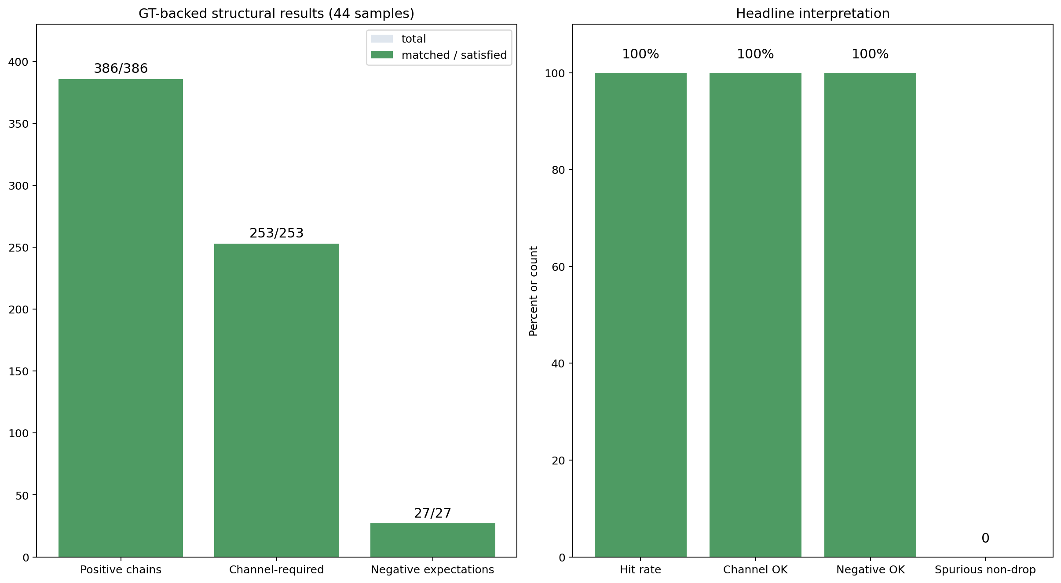
What We Can Already Claim with High Confidence
Interpretation: Phase A structural recovery is no longer the main bottleneck. The main open problem is verdict calibration and robustness on stripped/raw binaries.

Slide 10
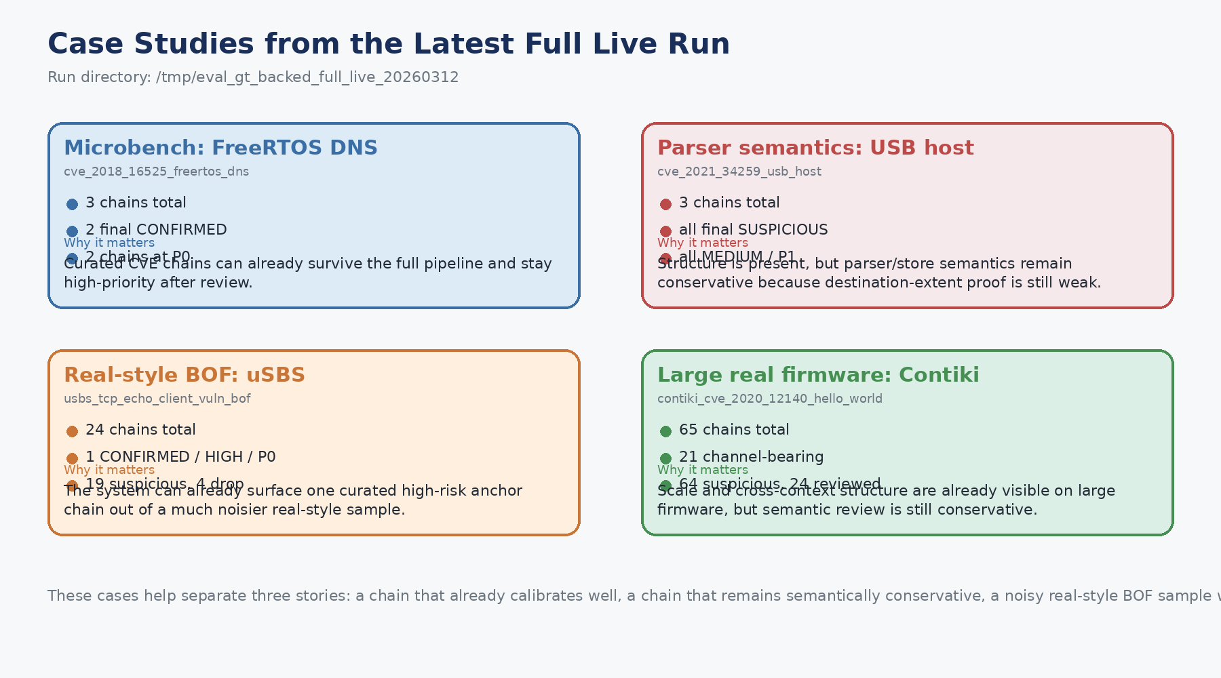
Case Studies from the Latest Full Live Run

Slide 11
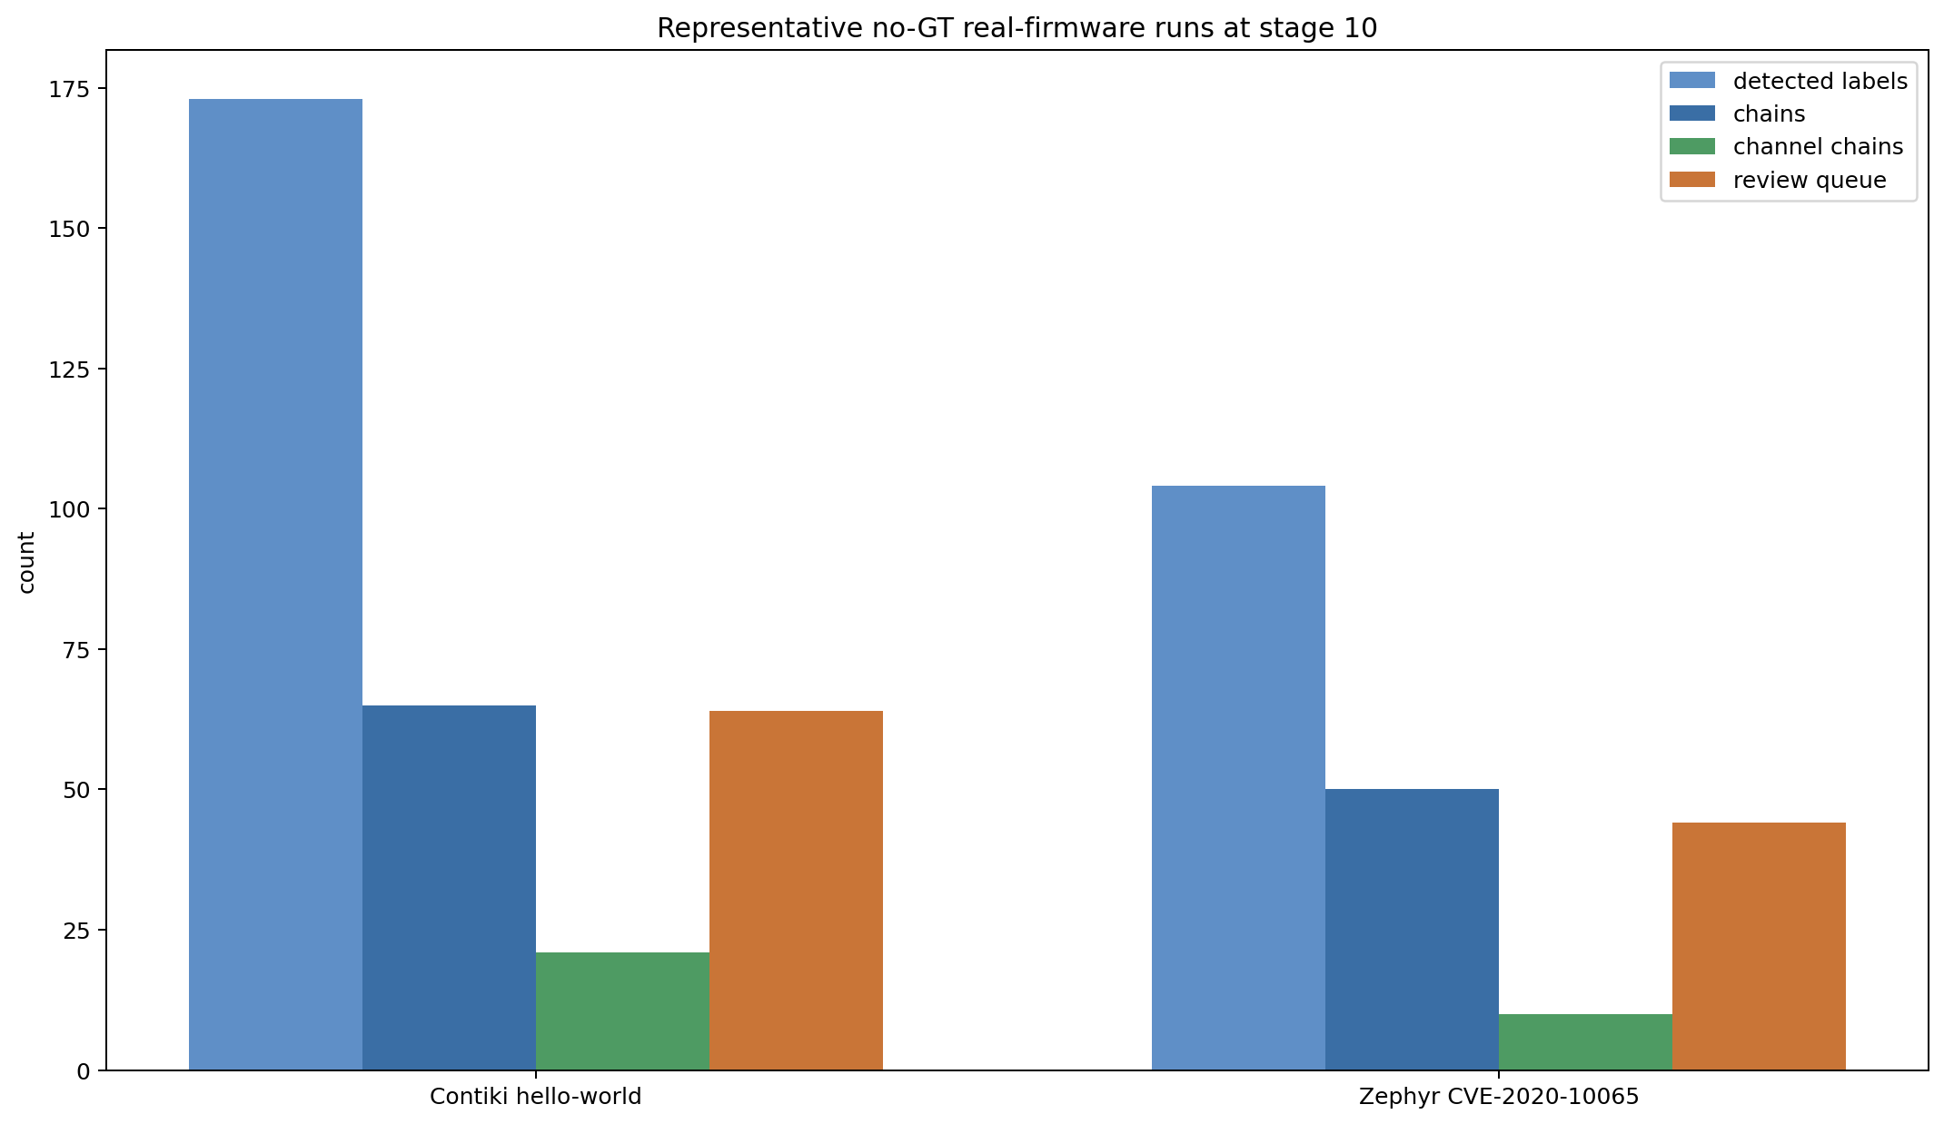
What We Can and Cannot Yet Claim on Real Firmware
Stage-10 runs already scale to real monolithic firmware and produce rich artifacts, chain queues, and review worklists.
Representative no-GT runs on Contiki and Zephyr show dozens of chains and many cross-context paths.
This is evidence of throughput and structural richness, not yet final proof of correctness.
Honest limitation: the benchmark-grade proof on broad real firmware still needs a frozen real-firmware track and more ground truth.
This is the missing claim you wanted to surface explicitly: real-firmware effectiveness is promising, but not yet proven to benchmark standard.

Slide 12
Main Innovations
Targeting Type-II/III monolithic firmware rather than Linux-like software.
Recovering structure beyond source/sink labels: ChannelGraph, root-aware linking, and derive/check evidence.
Using LLMs only in bounded, auditable roles: Phase A.5 supervision and Phase B semantic review cannot replace deterministic fact extraction.
Building a benchmark-ready asset stack instead of a one-off detector demo.
Introducing chain-level risk GT so evaluation can ask not only “was the chain found?” but also “was it calibrated to CONFIRMED / HIGH / P0?”

Slide 13
What Is Still Missing
Benchmark v1 still needs frozen dev/report splits.
Raw .bin known-base and inferred-base tracks are not yet canonical benchmark tracks.
Risk calibration needs a dedicated frozen subset and more patched / negative GT.
Ablations exist conceptually, but are not yet frozen as benchmark presets.
Suite summaries should report by format, size, execution model, and framework.
The strongest remaining external criticism is real-firmware validity: we need more benchmark-grade proof, not just stress-run evidence.

