Slide 1
Q5. Explain the method of Linear Discriminant Analysis (LDA) including assumptions, calculation, and interpretation of the technique. How is this technique used for classification?

Slide 2
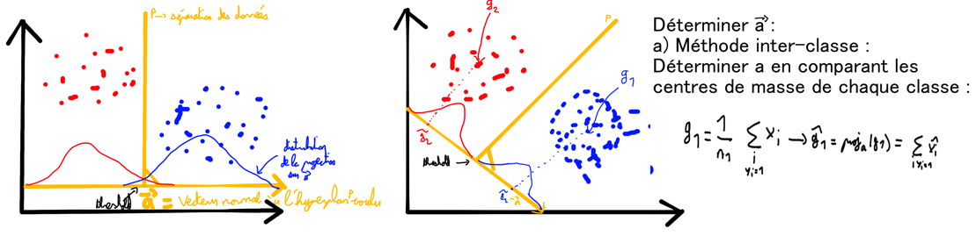

Slide 3

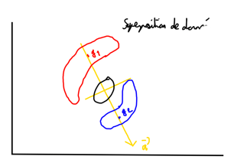



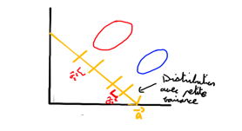



Projection sur de la variance
Variance normalisée

Slide 4

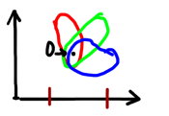


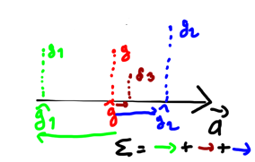

Slide 5




Slide 6


