Slide 1
Q7. What is the EM algorithm and how is it related to the Gaussian Mixture Model? In particular, explain the concept of responsibility.

Slide 2




Slide 3


Slide 4



Slide 5






Slide 6

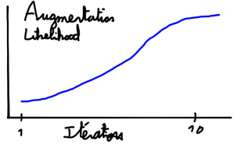

Slide 7

