Slide 1
Q1. Considering multiple random variables, explain the chain rule decomposition for the joint probability. Provide examples of different statistical relationships between random variables. Explain the Markov chain of the first and second orders.

Slide 2

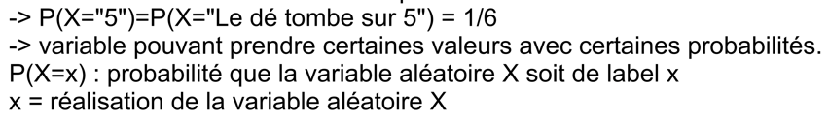

Slide 3

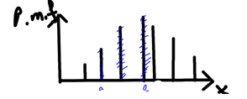

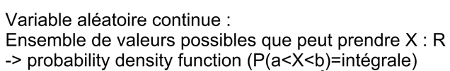
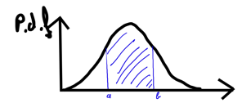


Slide 5
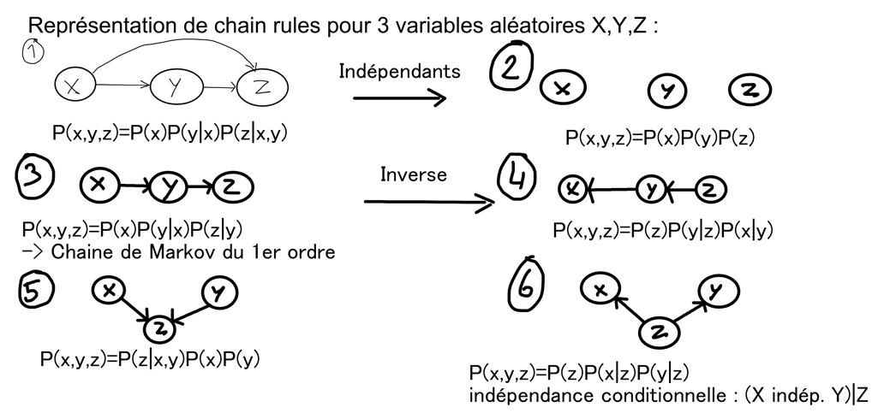

Slide 6


