Slide 1
Q10. Explain the differential entropy for continuous random variables. Explain the properties and differences to the entropy for the discrete random variables.

Slide 2



Slide 3

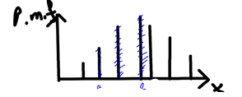


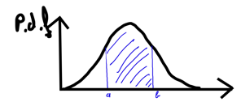


Slide 4



Slide 5




Slide 6




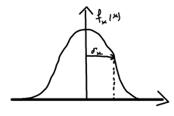


Slide 7




Slide 8
