Slide 1
Q2.Give the definition of entropy for discrete random variables. Explain the main properties of entropy. Explain the entropy of binary random variables.

Slide 2



Slide 3

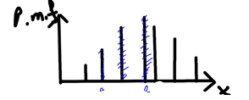


Slide 4



Slide 5


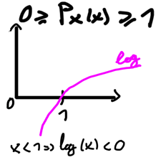


Slide 6
