Slide 1
Q3.Explain the joint and conditional entropy for discrete random variables. Explain the chain rule for entropy.

Slide 2

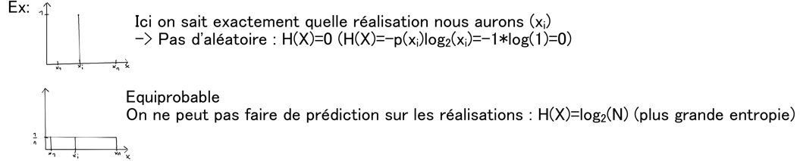

Slide 3


Slide 4
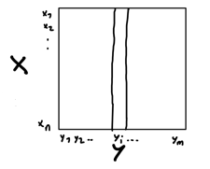
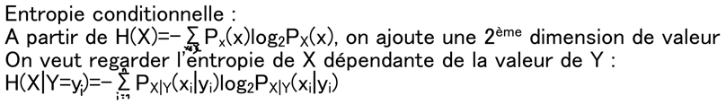

Slide 5


Slide 6



