Slide 1
Q5. Explain the relative entropy, its properties and provide some examples of its usage

Slide 2



Slide 3
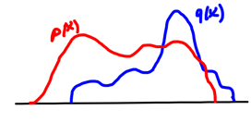


Slide 4




Slide 5


Slide 6

