Slide 1
Q6. Explain the cross-entropy and provide some examples of its usage. Show a link between the cross-entropy and relative entropy.

Slide 2



Slide 3
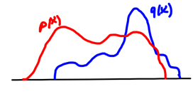


Slide 4




Slide 5



Slide 6


Slide 7


Slide 8

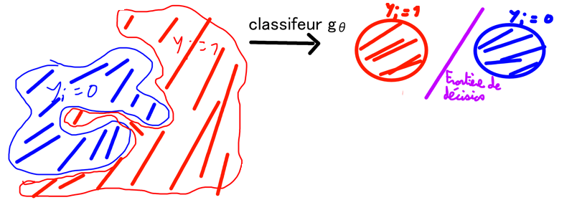

Slide 9
