Slide 1
Q1. Explain how to generate in practice samples from a given distribution. You may also discuss the particular cases of the Uniform and Gaussian distributions.

Slide 2


Slide 3

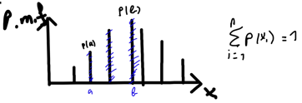

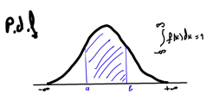

Slide 4


Slide 5
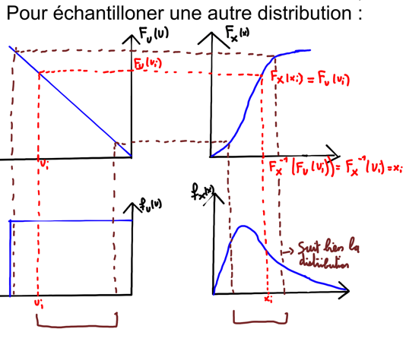

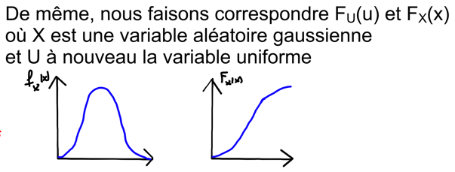

Slide 6



