Slide 1
Q2. Explain in detail the method of Principal Component Analysis (PCA) including assumptions, calculation, and interpretation of the technique.

Slide 2

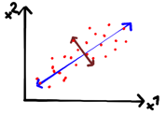


Slide 3


Slide 4


Slide 5




Slide 6


