Slide 1
Q3. . When performing Principal Component Analysis (PCA), how should one choose the number of eigenvectors to keep? Explain why and discuss the implication on the reconstruction.

Slide 3





Slide 4
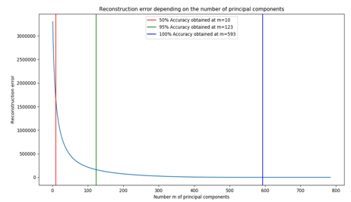


Slide 5

